Slide 1
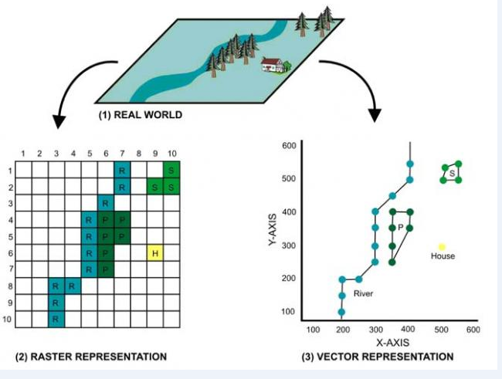
GIS DATA MODELS

