Slide 1

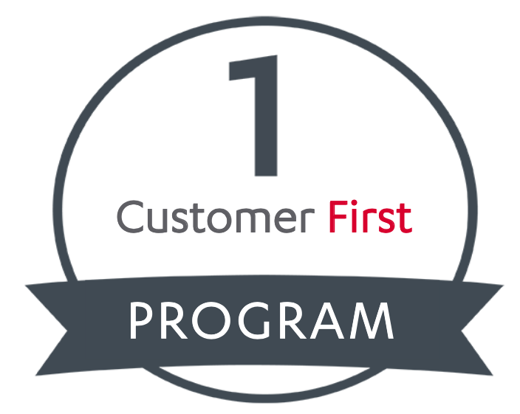
Business case: 3Shape

Slide 2
Agenda
Executive Summary
The current situation in 3Shape
Complication
Question
Business Objective
Alternatives
Alternative 1
Alternative 2
Answer

Slide 3

Our recommendation for 3Shape

Slide 4
Executive Summary
Our recommendation
3Shape should invest in Customer First by centralising Customer Support Centers to only three countries, including USA, Ukraine and China
Benefits of Customer First
Direct interaction with customers
A new revenue stream that bypasses the resellers
Collection of more in-depth post-market surveillance
Benefits of centralising Support Centers in only three countries
Low costs
Customer needs are fully satisfied

Slide 5
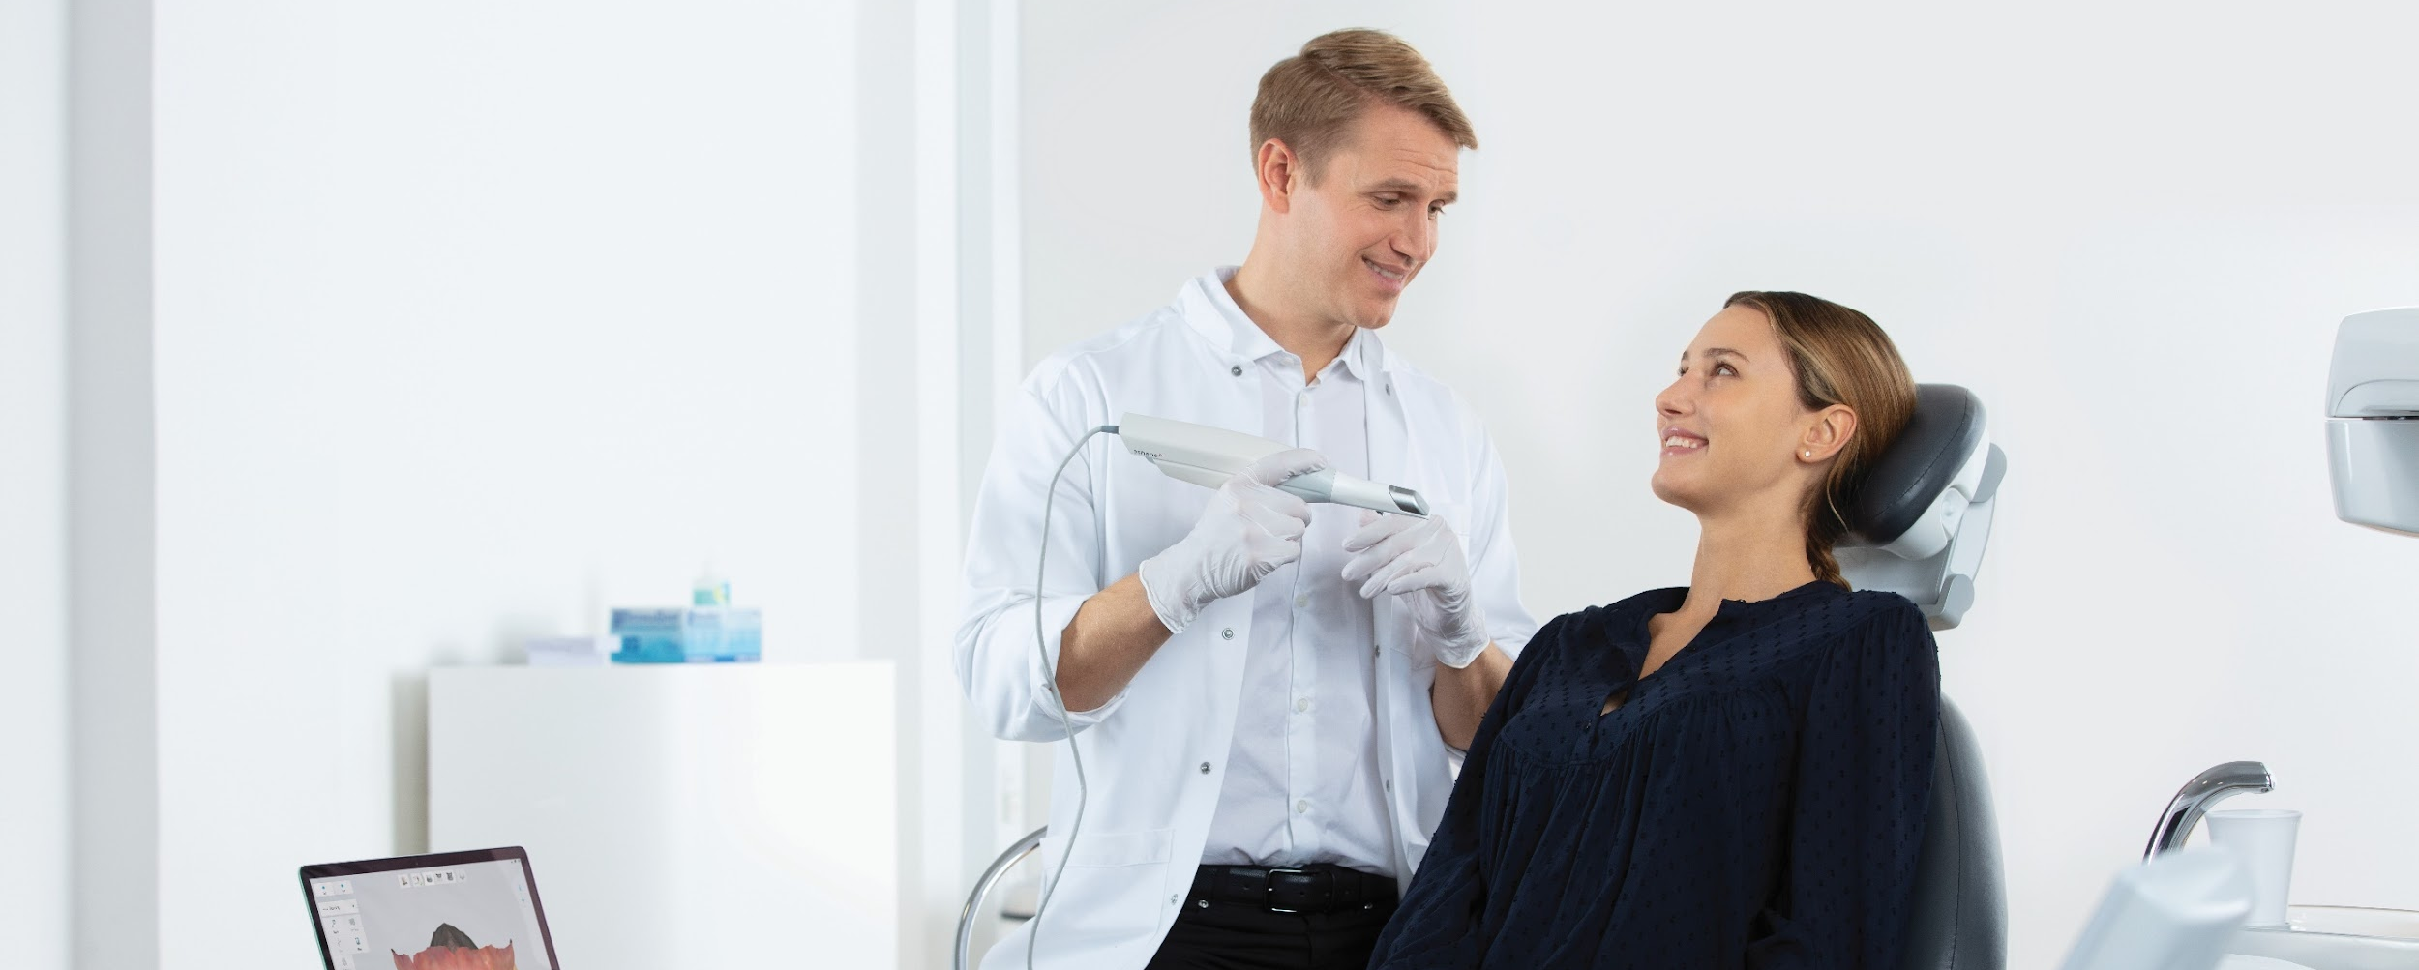
The current situation in 3Shape

Slide 6
The current customer support model in 3Shape
Customer service is handled by resellers
Resellers are trained by 3Shape
Resellers keep 25% of license subscriptions
Resellers own the customer data
3Shape don’t know their end-customers
Not every reseller is prioritizing Customer Support
Customer Centers are not centralized
There are multiple Customer Centers in each region (Americas, Europe and Asia)
3Shape handles the complicated customer cases
Cases too complicated for resellers gets redirected to 3Shape
3Shape only have 2nd and 3rd Line Support

Slide 7
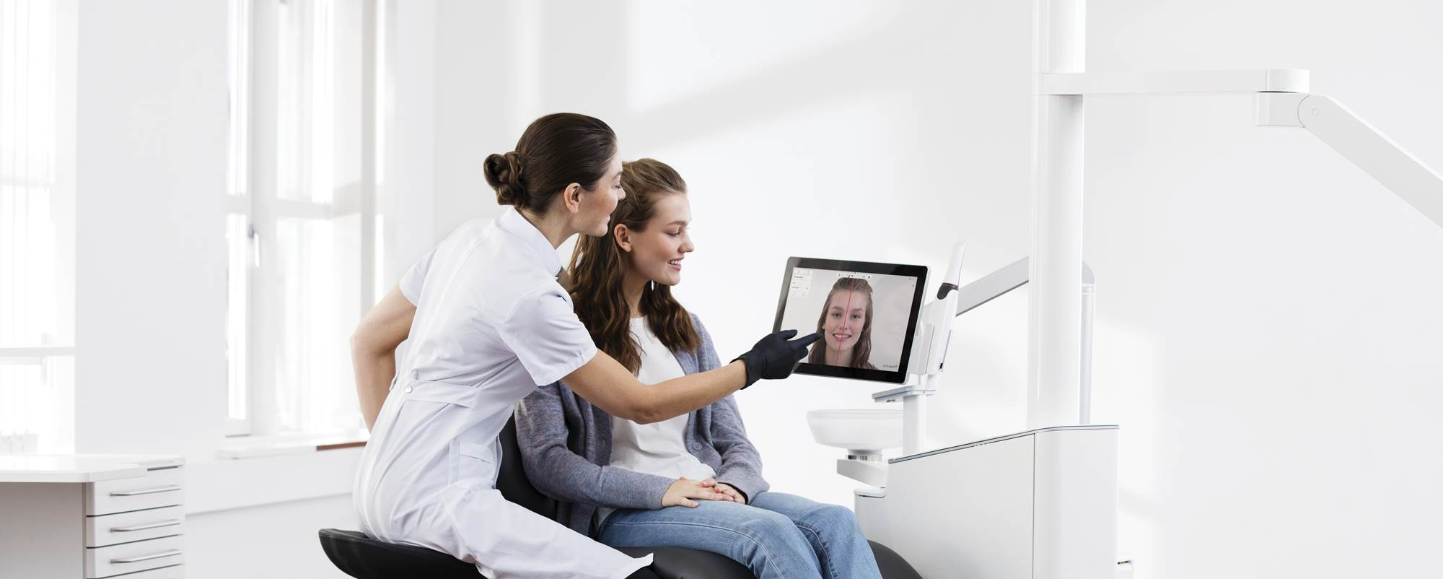
Complications

Slide 8

3Shape has two main complications

Slide 9
Customer survey
70% of respondents in a customer survey ranks 1st line Customer Support from manufacturer as a key consideration for the buying process
Intraoral scanner market
Market growth of 9.3% annually
The growth of 3Shape has been challenged for some years
TRIOS are losing market share to value brands and better branded alternatives
3Shape needs to keep up to either retain market share or grow

Slide 10

The question

Slide 11
What strategic and responsible initiative must 3Shape implement to successfully strengthen the relationship with its customers and gain better control of the customer experience?
Should 3Shape invest in Customer First?

Slide 12
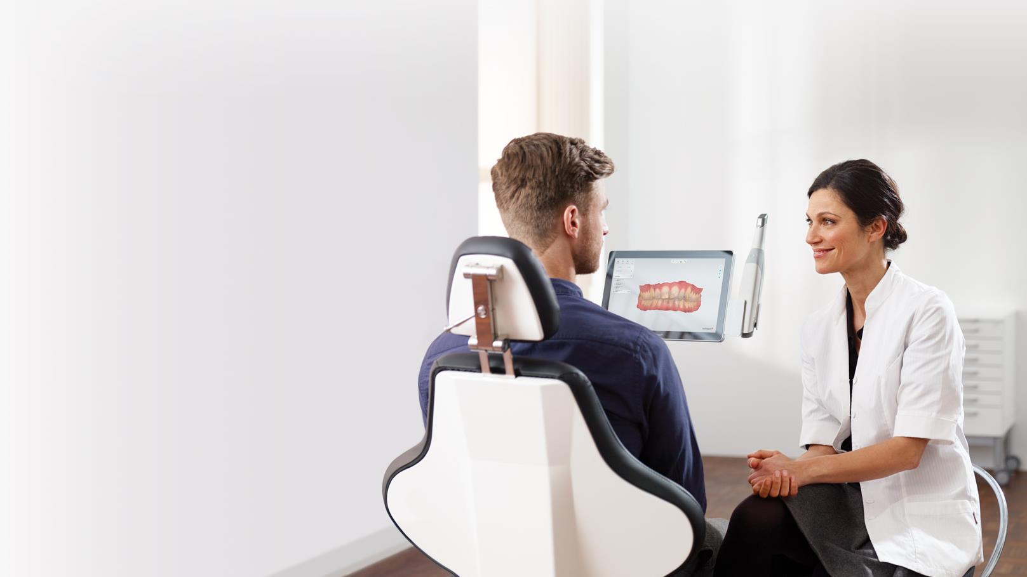
Business Objective
Objective:
3Shape wants to help as many customers as possible with the fewest means needed
How 3Shape should do it?
Centralize customer support in China, USA and Ukraine

Slide 13
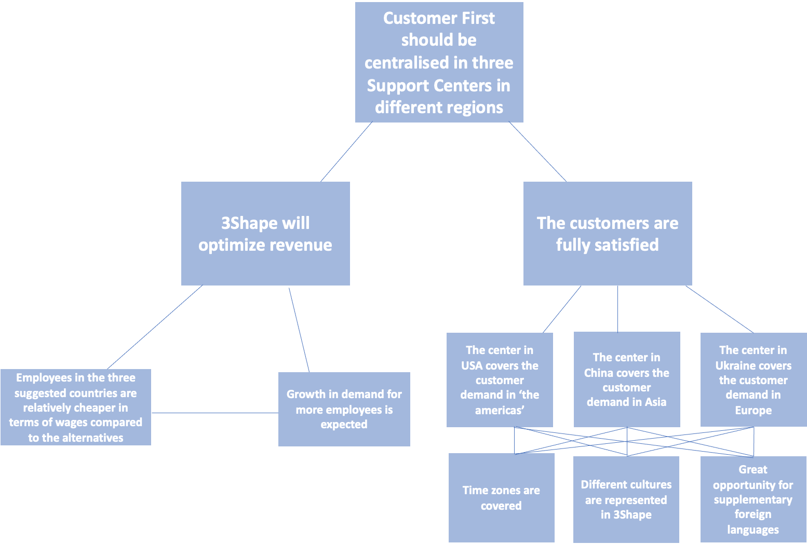

Slide 14

Alternatives to solve the question

Slide 15
Alternative 1
3Shape should locate Support Centers in multiple countries in each region
Alternative 2
3Shape should centralise Support Centers in the regions to only one Support Center per region

Slide 16
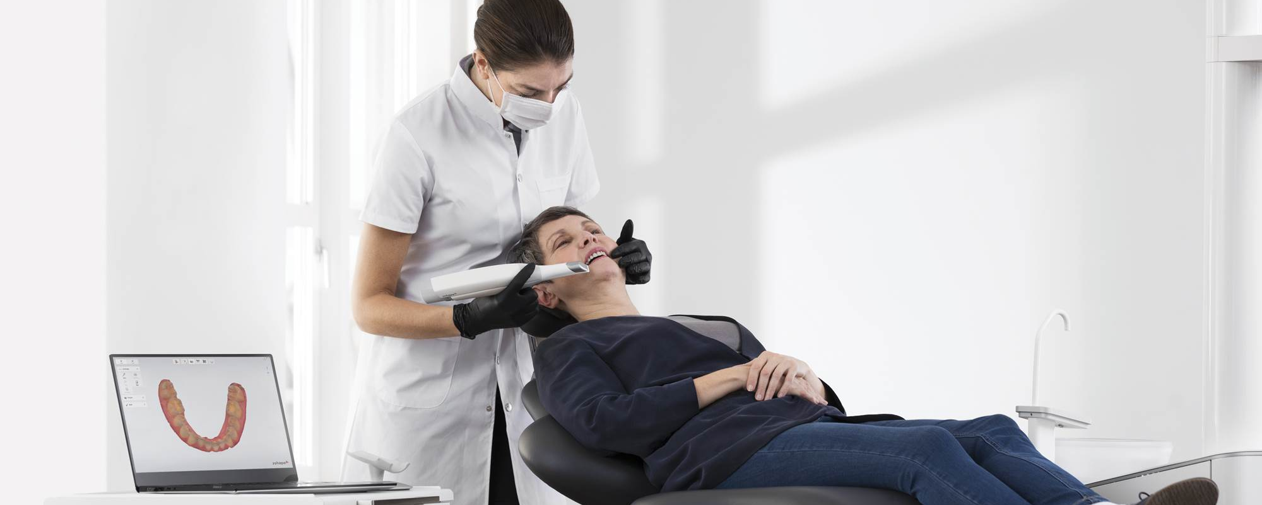
Alternative 1

Slide 17
Alternative 1
Decentralising Support Centers to multiple countries in each region
5 Support Centers in the 3 regions:
Americas: The United States and Colombia
Europe: Denmark and Ukraine
Asia: China

Slide 18

Alternative 1: Effects
More languages would automatically be covered
No problems with time zone-differences

Slide 19
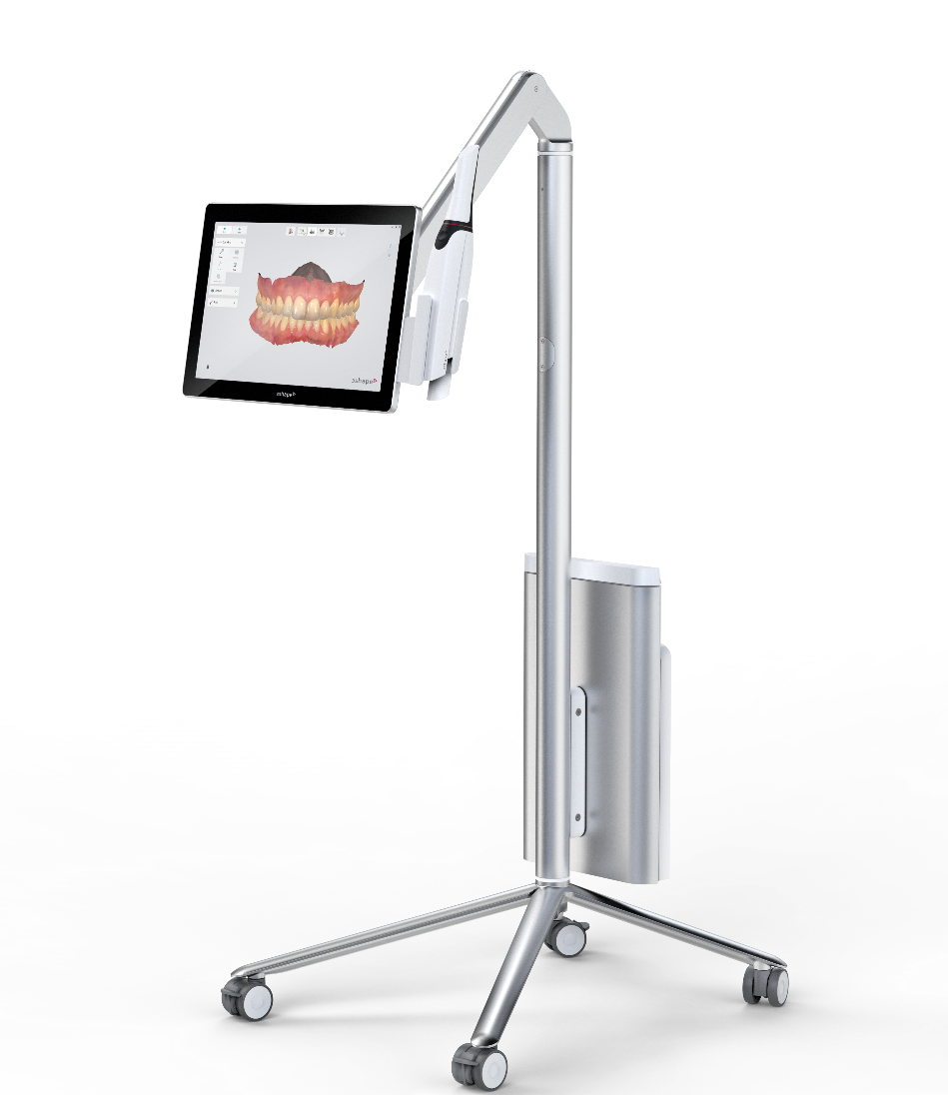
Alternative 1: Costs
The total cost of the 5 Support Centers in the three regions would be too expensive:
United States Colombia Denmark Ukraine China 750,000 2,100,000 2,150,000 650,000 2,500,000
5 Support Centers are also unnecessary as fewer centers can also accommodate time zone differences

Slide 20

Alternative 2

Slide 21
Alternative 2
Centralising Support Centers in the regions
3 Support Centers in the 3 regions:
America: The United States
Europe: Ukraine
Asia: China
= One support center per region

Slide 22
Alternative 2: Positive effects
The project as a whole is geared toward increased 1st Line Support for the customers
→ 1st Line Support will:
Increase engagement with end-users
Create a new revenue stream
Make customer support a source of competitive advantage
Overall, 3Shape will gain more control of the customer support experience

Slide 23

Different time zones 3Shape will be able to help customers in different time zones with minimal cost for the company Few differences in time zone can be accommodated by introducing work shifts at different hours of the day or extending business hours

Slide 24
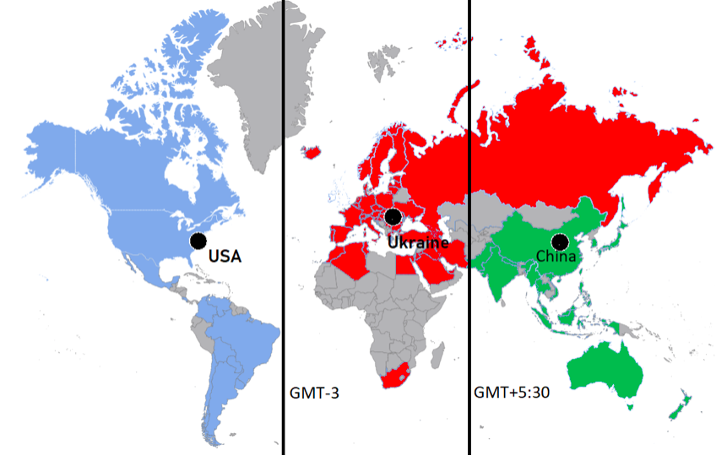
USA (GMT-5): GMT-3 : GMT-9
Ukraine (GMT+2): GMT-2 : GMT+4
China (GMT+8): GMT+5 : GMT+12

Slide 25
Customer licenses in each Support Center
In each location, 3Shape can support:
USA: 9,141 licenses Ukraine: 14,116 licenses China: 6,744 licenses
To support the number of customer licenses, 3Shape will need to hire: 48 employees in USA
73 employees in Ukraine
36 employees in China

Slide 26

A new revenue stream
Billing end-users directly for support service creates a possible new revenue stream → A growth in revenue
Total revenue of each Support Center:
USA: 18,282,000
Ukraine: 28,232,000
China: 13,488,000
Total: 60,002,000

Slide 27
The next three years (3 scenarios)
 | 10% adoption | 50% adoption | 100% adoption
Licenses | 3,993 | 19,966 | 39,931
Employees | 22 | 102 | 202
Revenue | 7,986,000 | 39,932,000 | 79,862,000
Cost | 1,996,626 | 9,257,084 | 18,332,657
Balance | 5,989,374 | 30,674,916 | 61,529,343

Slide 28

Risks of alternative 2

Slide 29
Risks of alternative 2
There are a few risks associated with centralising Support Centers in the three regions
Some customers might feel underrepresented or overlooked by 3Shape
Minimal differences in time zones could lead to unsatisfied customers

Slide 30
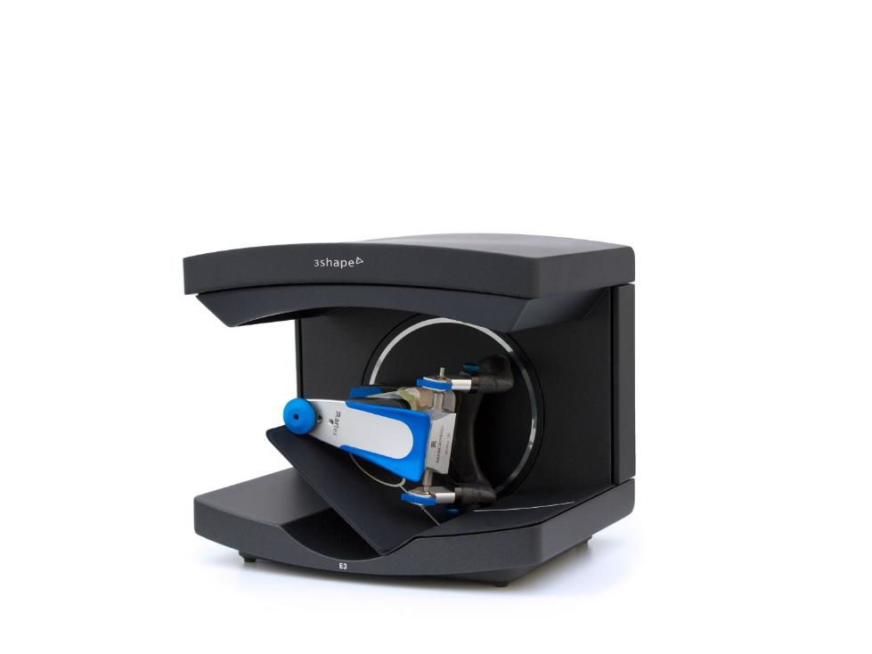
Answer
The best alternative is; Centralising Support Centers in USA, Ukraine and China
Why alternative 2 is the best solution?
It is cost efficient and geared towards the future

Slide 31
Let’s change dentistry together

