Slide 1
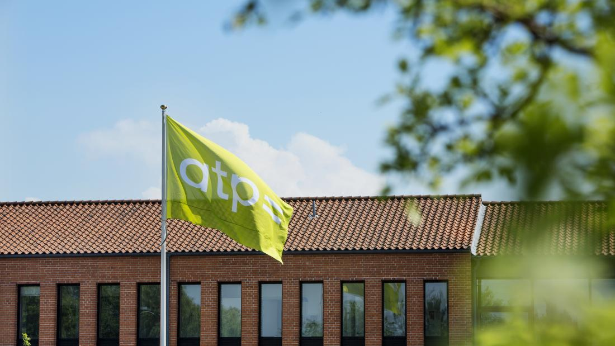
Case: Tidlig Pension
Datadrevet Organisationsanalyse
November 10, 2021

