Slide 1
Extracting electropherogram information and manipulating FASTQ files
PBfB 2019
Marcos Suárez Menéndez (S3684202)
Nadine Rijsdijk (S3813185)
https://github.com/Marcos-SM/Nadine_Marcos-PBFB2019

Slide 2
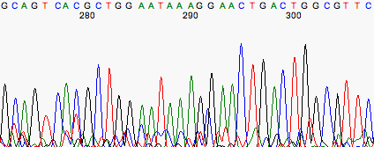
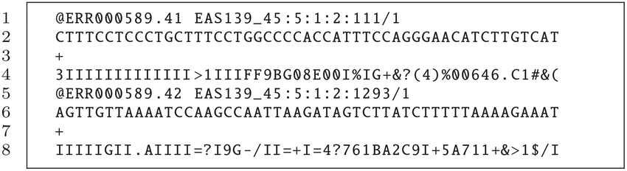
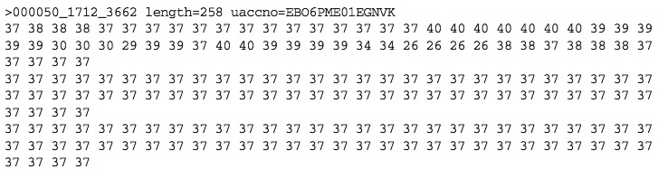
Introduction: Data formats
ab1
FASTQ
QUAL
Notes:
Also explain FASTA file and Phred

Slide 3
Introduction: Goals
Converting ab1 to FASTQ
Creating the final FASTA file
Cutting the FASTQ files
Reversing if cannot find place to cut and cutting reverse
Converting the FASTQ files to QUAL files
Getting the mean Phred score for each sequence
FastQC report
Notes:
Also: Getting best sequence of each sample

Slide 4
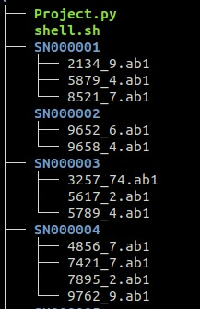
Introduction: programs
Program consists of two scripts: Project.py and shell.sh
Script should be run inside the folder where you have the data
Python v. 2.7.15rc1: To run the main script
Biopython v. 1.73: Most of the tools used are from the Biopython collection; data conversion, cutting sequences, reversing sequences
Shell: To find the best sequence from each sample
FastQC: Getting a report of the sequences
Notes:
FastQC examples: GC content, per sequence quality scores, plot with Phred quality score against nucleotide position

Slide 5
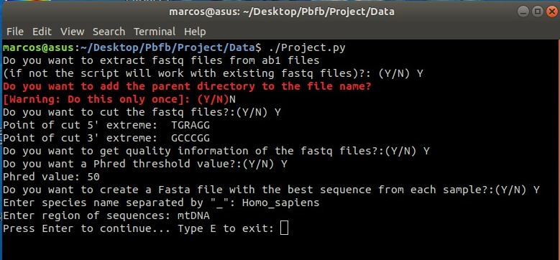
Introduction of the script

Slide 6
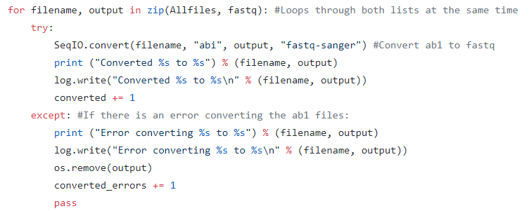
Converting ab1 to FASTQ
Biopython: SeqIO.convert()

Slide 7
Cutting the FASTQ files and reversing
Convert input cutting points (taking into account IUPAC nucleotides)
TGRAGG TG[AG]AGG
If cutting is not possible, check if sequence could be the reverse:
Search for complementary of 5’cutting point; if found reverses file.
ACTGACTTGGAGGATGCATGCTGACTGCCCGGATCGTACG
^^^^^^^^^^^^^^^^^^^^^^^^^^^^^^^^^^^^^^^^^^^^

Slide 8
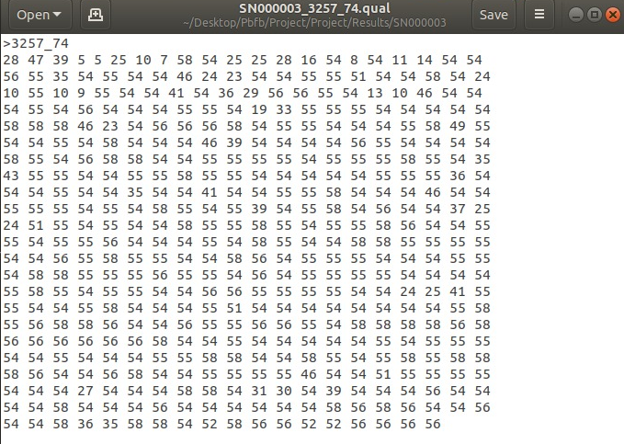
Converting FASTQ files to QUAL files
SeqIO.convert(filename, "fastq", output, "qual")
Notes:
Also talk about mean Phred score

Slide 9
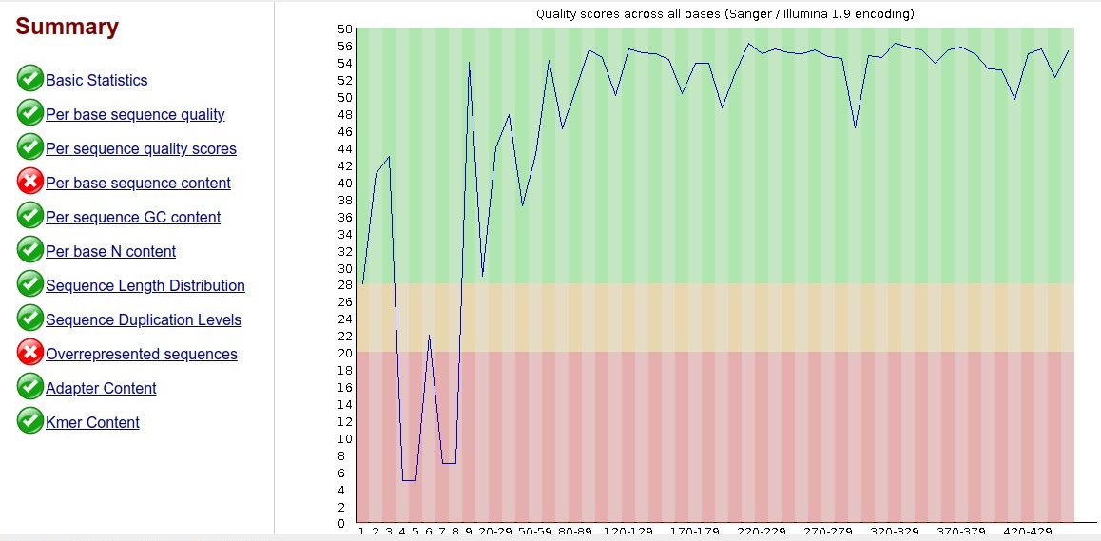
FastQC Report

Slide 10
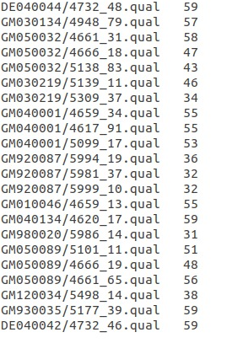
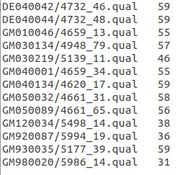
Getting the best sequence for each sample
grep -E "\w+"/*. Quality.txt | sed -e 's/\//\t/g' | sort -t $'\t' -u -k1,1 -k3,3r | uniq -w 8 | sed -E 's/(\w+)\t(\w+\.qual)/\1\/\2/g' > bestqs.txt

Slide 11
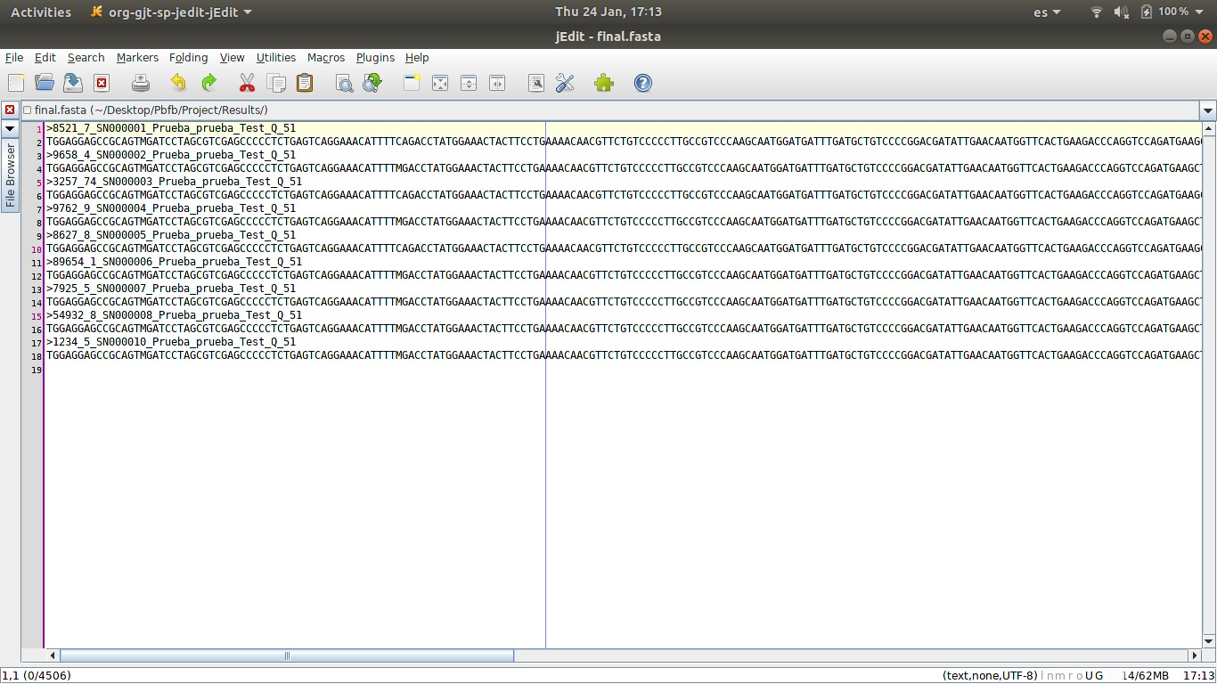
Final FASTA file

Slide 12


Future possibilities
FASTA file with all sequences that pass a quality threshold
Aligning final FASTA file
Making phylogenetic trees
Comparing with database
If you don’t want to cut, you could trim sequences

