Slide 1



Forecasting Wind Power
Group:
Jacob Hægh
Marcos Bauch Mira
Asher Kite
Abbie Langhave
Advanced Time series Analysis - Exam

Slide 2
Table of Contents
1. Project Overview
2. Data Description and Handling
3. Modelling Approach
4. Linear Models
  Persistence and AR(p) models
5. Nonlinear Models
  Sigmoid of Wind Speed, Sine/Cosine of Wind Direction, etc.
6. Model Evaluation
  AIC and BIC, RMSE
7. Conclusion
8. Future Work Suggestions
  SDE Modelling with ctsmTMB, Adaptive GARCH Modelling,

Slide 3




Motivation
Project Overview
Problem
Project Aim
Renewable energy is expanding rapidly, with wind power playing a growing role
Wind variability poses challenges for grid stability and energy markets
Accurate short-term forecasts of wind power are essential
Wind fluctuations complicate operations for power plants and market planning
Develop a model that uses weather data to predict hourly wind power output

Slide 4
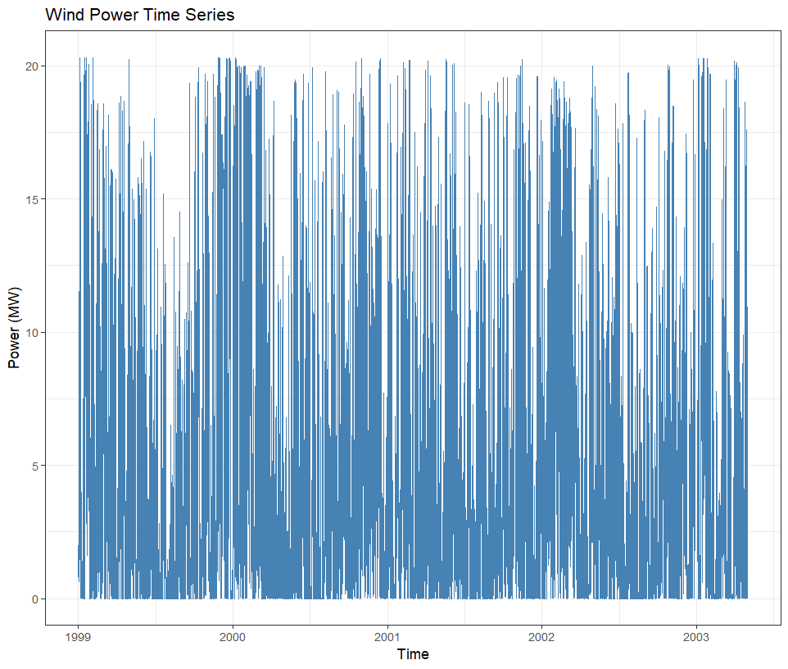
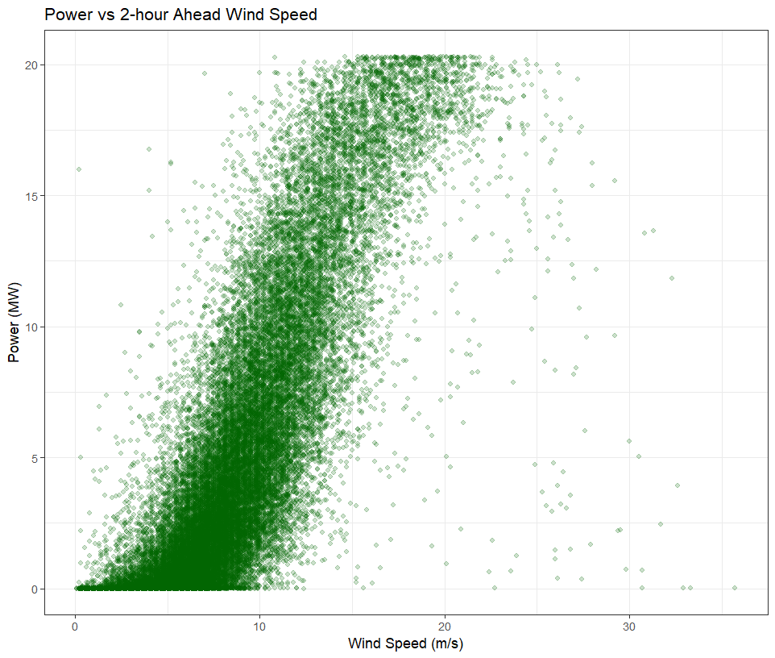
Data Description
Dataset: Hourly observations from a wind farm in Klim, NW Jutland.
Variables: Measured power, 1-,2-and 3-hr forecasted wind speed, wind direction and temperature, timestamps and time-of-year indicator
Power Time Series:
Shows hourly wind power over the observation period
Highlights variability and periods of low/high generation
Power vs. Wind Speed:
Strong nonlinear relationship between wind speed and power
Power rises with wind speed up to the turbine’s rated capacity

Slide 5
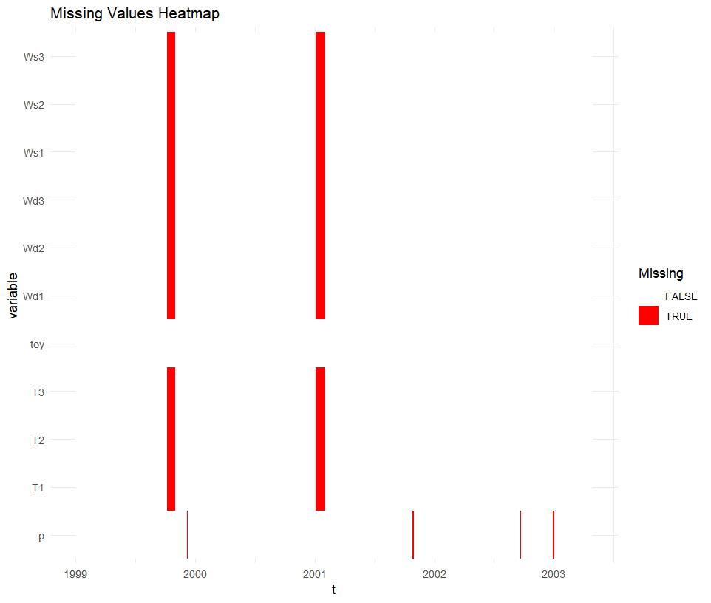
Data Handling
Largest gaps occur in weather forecasts
Power data has smaller missing segments
Three strategies for handling missing values:
  X_p: Fill using persistence
  X_c: Clip large gaps, fill remaining missing values
  X_d: Drop all rows with any missing values

Slide 6
Modelling Approach
Adaptive forecasting using Recursive Least Squares (RLS)
Models updated sequentially as new data becomes available
Forecast horizons: 1-, 2-, and 3-hour ahead wind power
Model complexity increased step by step to improve accuracy

Slide 7
Recursive Least Squares (RLS)
Sequential method for estimating model parameters over time
Updates coefficients at each time step using new observations
Uses a forgetting factor to emphasize recent data
Well suited for non-stationary time series such as wind power

Slide 8
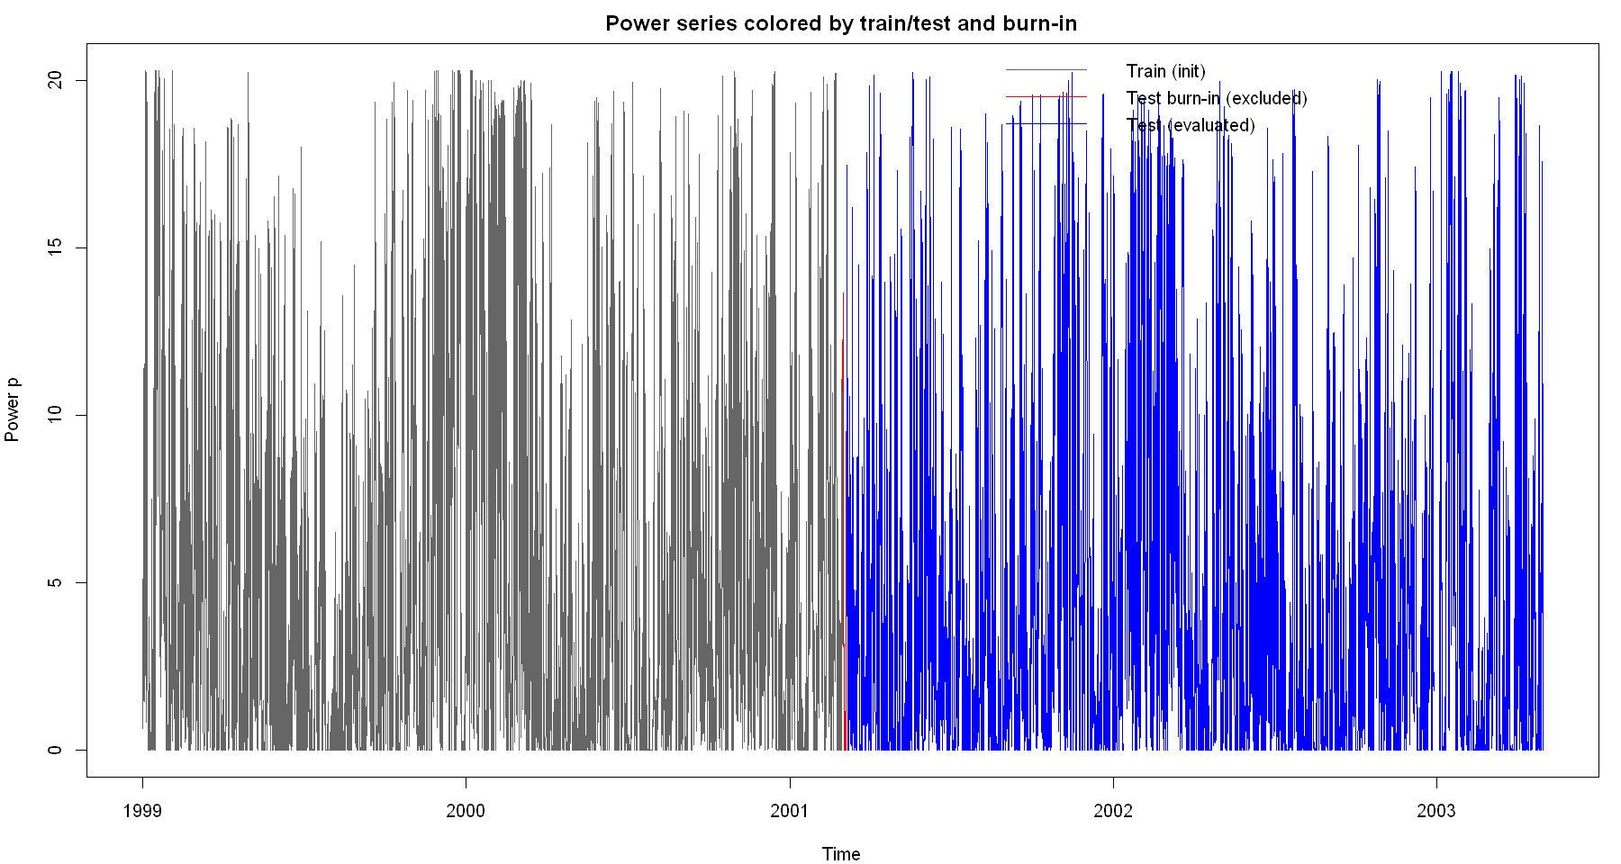
Training and Evaluation Setup
First 50% of the data used to initialize model parameters
Remaining 50% used for testing and evaluation
Burn-in period of 100 time steps excluded from performance metrics
Forecast accuracy evaluated using RMSE

Slide 9
Model Overview
Multiple models tested with increasing complexity
Baseline: Persistence model
Linear models: AR(1) and AR(4)
Nonlinear models: Wind speed, time, direction, and temperature effects
All models estimated using Recursive Least Squares

Slide 10
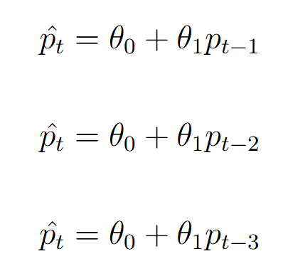
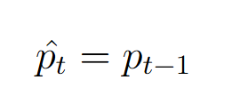
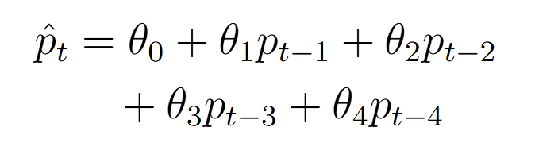
Persistence Model
Baseline and Linear Models
AR(1) Model
AR(4) Model
Forecast equals the most recent observed power value
Linear dependence on the most recent power observation
Uses multiple past power values to capture temporal structure
AR models estimated using Recursive Least Squares

Slide 11
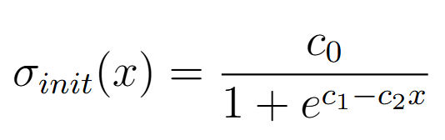
Nonlinear Wind Speed-Power Relationship
Wind power has a nonlinear dependence on wind speed
Linear models cannot capture this behavior effectively
Introduced a sigmoid function to model the power curve

Slide 12
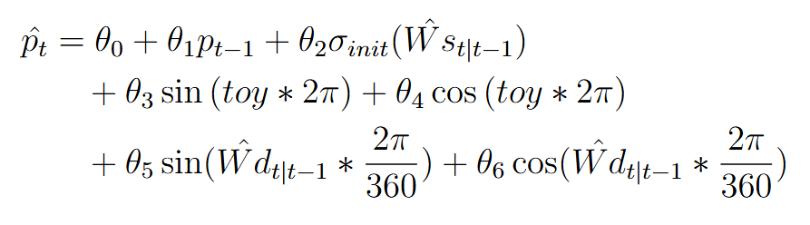
Extended Nonlinear Models
Added time-of-year effects using sine and cosine terms
Included wind direction through circular (sin/cos) features
Improved sigmoid parameters using training data
Applied physical bounds to predicted power values
Final model also incorporates temperature forecasts

Slide 13
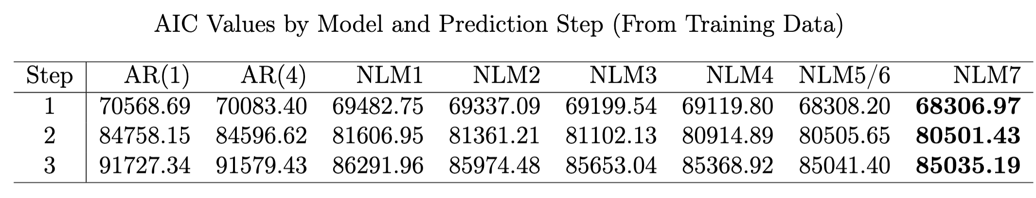
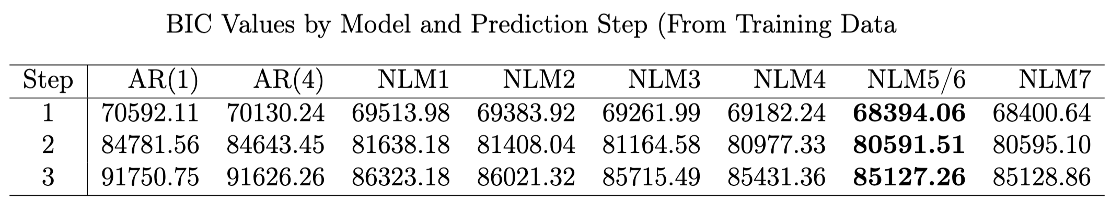
Model Evaluation

Slide 14
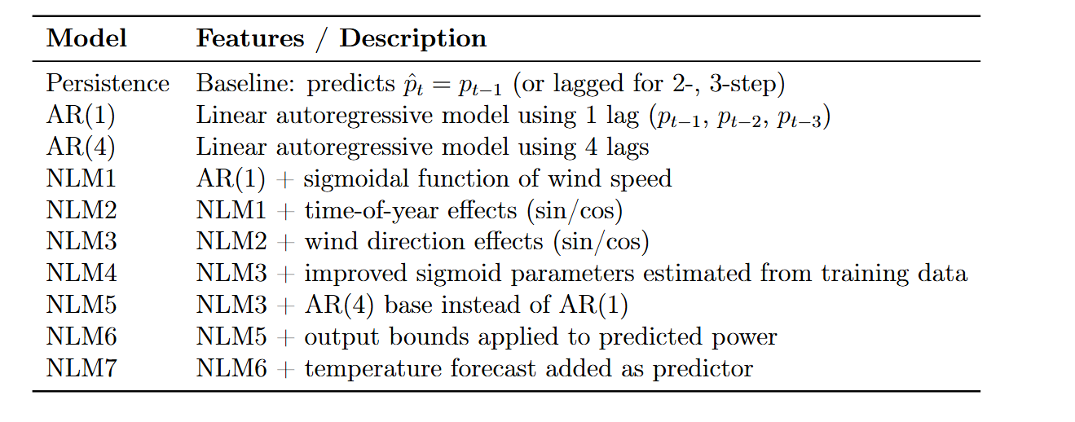
Model Summary

Slide 15

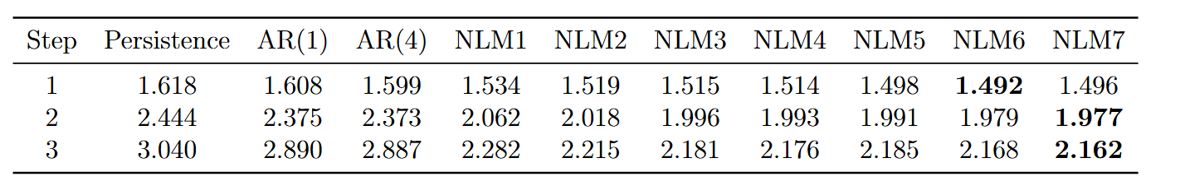
Forecast Accuracy (RMSE)
Models compared using RMSE for 1-, 2-, and 3-hour ahead forecasts
Forecast accuracy generally improves with increased model complexity
Performance gains differ across forecast horizons

Slide 16
Conclusion
Adaptive models improve short-term wind power forecasting
Capturing the nonlinear wind speed–power relationship is critical
Additional nonlinearities provide smaller, horizon-dependent gains
The best-performing model differs slightly by forecast horizon

Slide 17
Thank you!

Slide 18
Future Work – Suggestions
Formulating SDE using the CSTM library
Formulating a GARCH model

Slide 19
References
[1] https://en.wikipedia.org/wiki/Recursive_least_squares_filter

Slide 20
d
Adaptive forecasting using Recursive Least Squares (RLS)
Models updated sequentially as new data becomes available
Forecast horizons: 1-, 2-, and 3-hour ahead wind power
Model complexity increased step by step to improve accuracy

