Slide 1
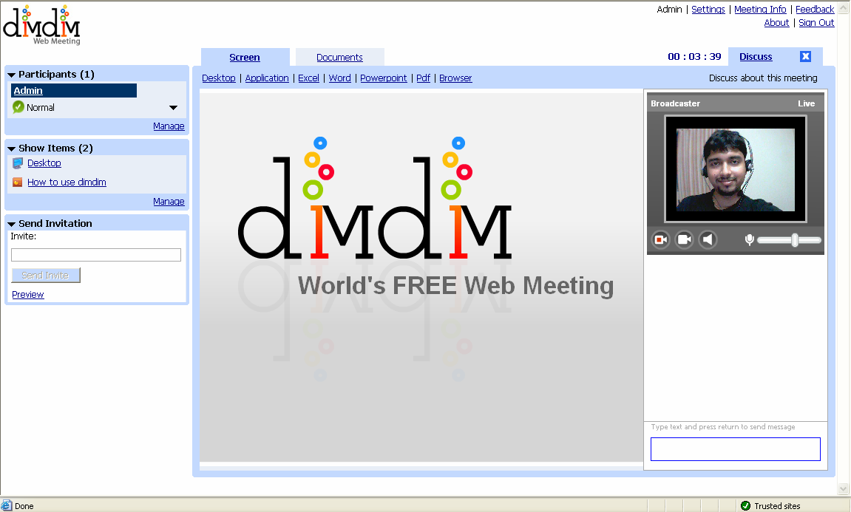
Dimdim Web Meeting
Click to upload & share Powerpoint
Click to share Desktop or Application
Invite Participants

