Slide 1
WiFi network for Real Time apps in a tunnel environment
Sistemas Empotrados Ubicuos
Máster en Ingeniería Informática (2016 – 2017)
Escuela de Ingeniería y Arquitectura, Zaragoza
Marcos Canales Mayo

Slide 2
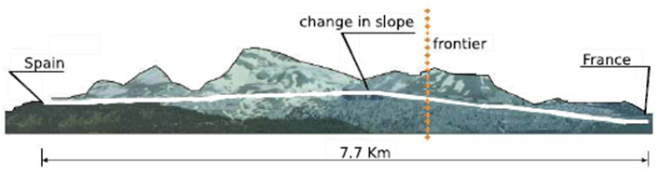
Context
Environment
7.7 Km tunnel
Real-time application in the STA
The STA may move along the tunnel
The APs are placed along the tunnel to provide WiFi coverage
The network must satisfy a packet latency less than 150 ms
Goal
Low WiFi roaming handoff time enough to comply with application requirements
Problems
The STA decides when to start the roaming process
The handoff time depends on the WNIC manufacturer and the software
AP1
AP2

Slide 3
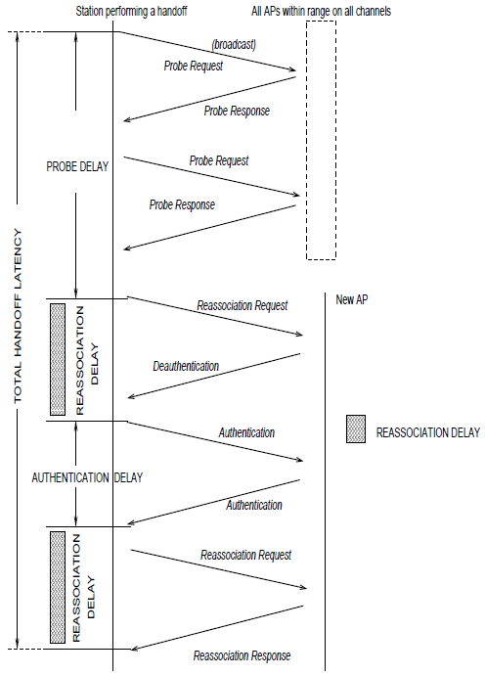
Context
WiFi handoff process
A given policy in the STA (e.g. not receiving L2 acks or losing signal with the current AP) triggers the handoff process
Find potential APs within range on all (or specific) channels
Apply a priority policy to choose an AP among all discovered APs
Reassociate with the chosen AP
A. Mishra, M. Shin, and W. Arbaugh, An Empirical Analysis of the IEEE 802.11 MAC Layer Handoff Process (2002)
Notes:
Reassociation request: The new access point then coordinates the forwarding of data frames that may still be in the buffer of the previous access point waiting for transmission to the radio NIC.
Authentication frame: The NIC begins the process by sending an authentication frame containing its identity to the access point. With open system authentication (the default), the radio NIC sends only one authentication frame, and the access point responds with an authentication frame as a response indicating acceptance (or rejection). OPTIONAL: Shared key authentication

Slide 4
Context
Design of the experiment (University of Maryland)
Network 1: 6 Lucent APs per floor
Network 2: 8 Cisco APs per floor
Used channels: 1, 6 and 11
Different channels in adjacent APs
30min walk for each AP-STA combination, through a fixed way
STA sending periodic ICMP messages
15 - 27 handoffs for each experiment
2 external sniffers close to the STA, WNICs in monitor mode, synchronized with NTP (clk accuracy < 80 us)

Slide 5
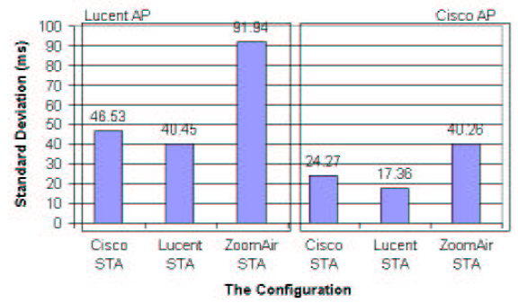
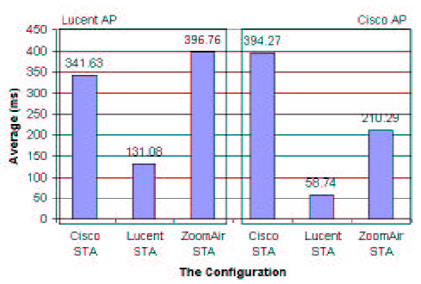
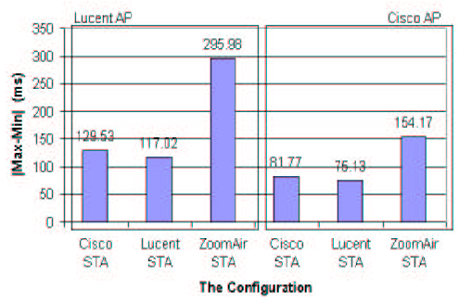
Context
Experiment results
A. Mishra, M. Shin, and W. Arbaugh, An Empirical Analysis of the IEEE 802.11 MAC Layer Handoff Process (2002)
Notes:
Almost 100% reassociation time is because of probing phase

Slide 6
Goal
Reproduce the problem in a controlled environment
Setup the environment so that multiple parameters can be tuned (RSSI threshold, different channels, antenna transmitting power, etc)
Analyze the performance in multiple scenarios:
Wired Distribution System
Wireless Distribution System

Slide 7
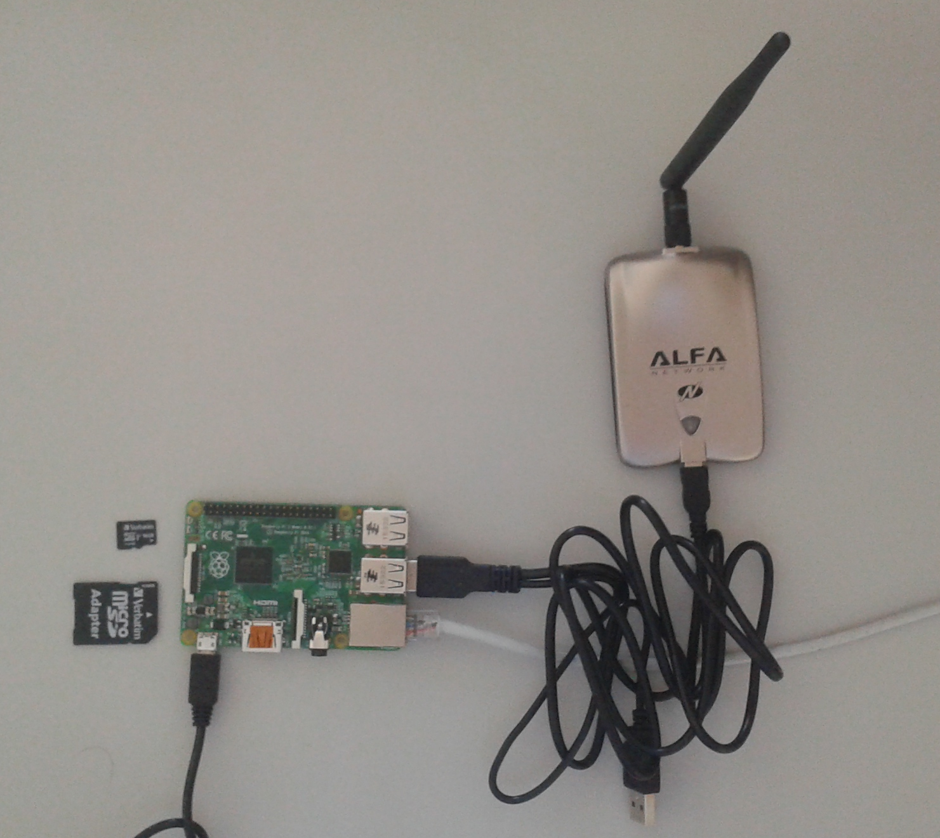
Setup
Raspberry Pi 2 Model B:
900MHz quad-core ARM Cortex-A7 CPU
1GB RAM
Alfa AWUS051NH v2:
802.11 a/b/g/n
OpenWRT 15.05.01:
Lightweight Linux distro, focused on wireless communications in embedded devices
Supports Raspberry Pi 2
Easy to customize wireless parameters, with no restrictions
hostapd (needed to enable WiFi)

Slide 8
Setup
Capture traffic in STA1 and export as CSV
Get statistics and graphs
Clean and save as MATLAB file

Slide 9
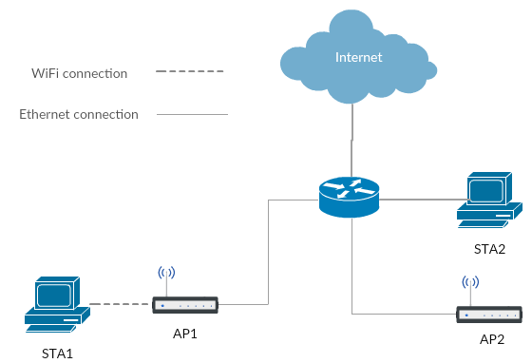
Setup
Normal
Both APs extending the router connectivity through a WiFi network

Slide 10
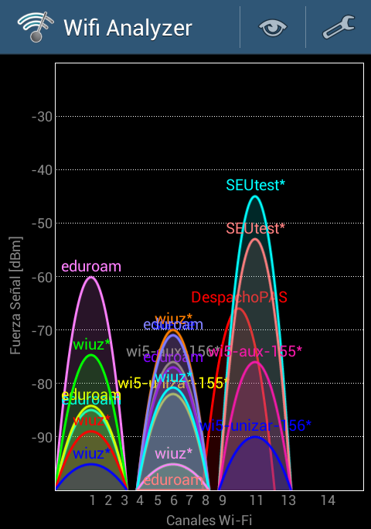
Setup
Setup environment | Real environment
Many other WiFi networks may cause lots of interferences | No other WiFi networks
Many different obstacles between the AP and the STA | No obstacles at all
Short distance between APs | Long distance between APs

Slide 11
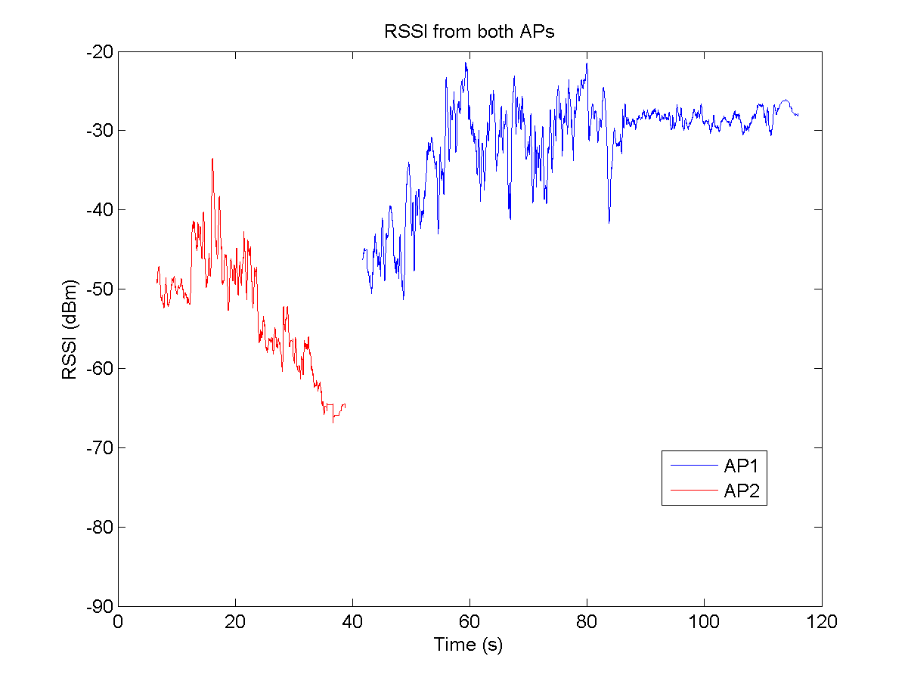
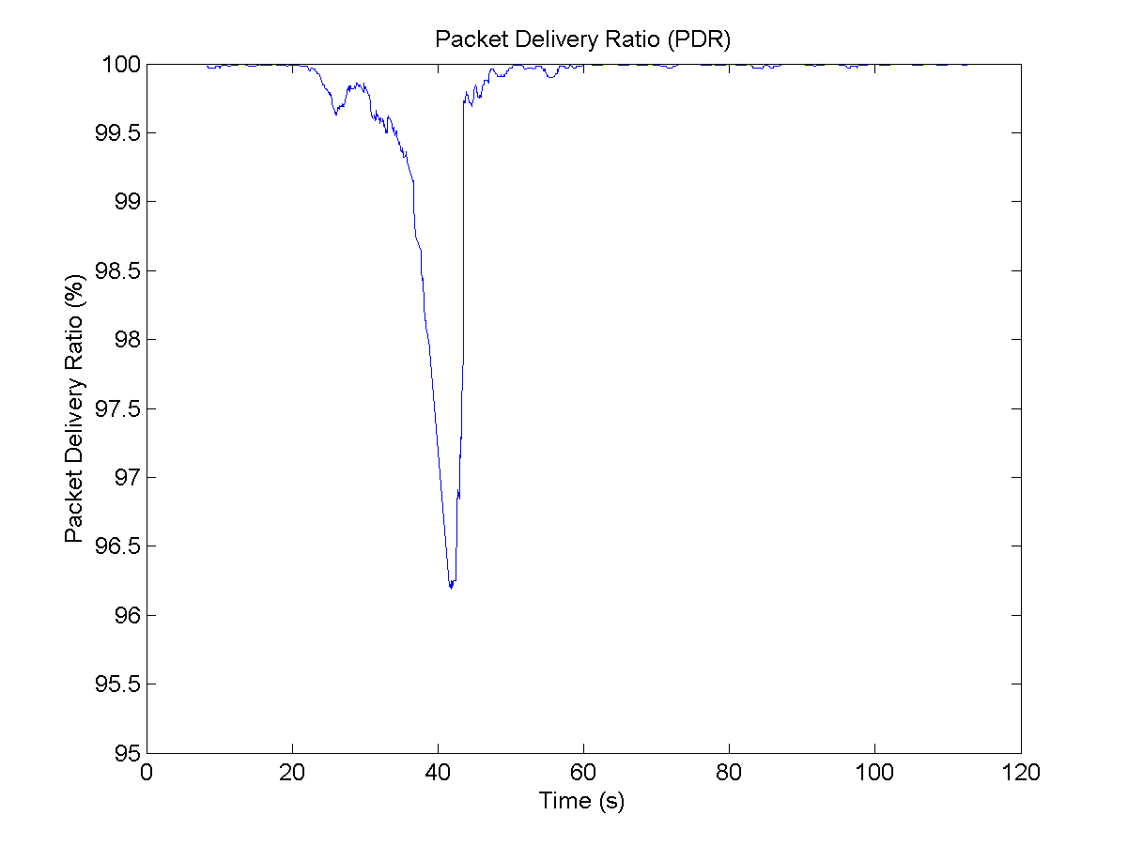
Results
Normal, APs in different channels, STA moving away from both APs
Packets sent: 6772; Packets lost: 675 (9,97%)
AP change reassociation time: 2819,20 ms

Slide 12
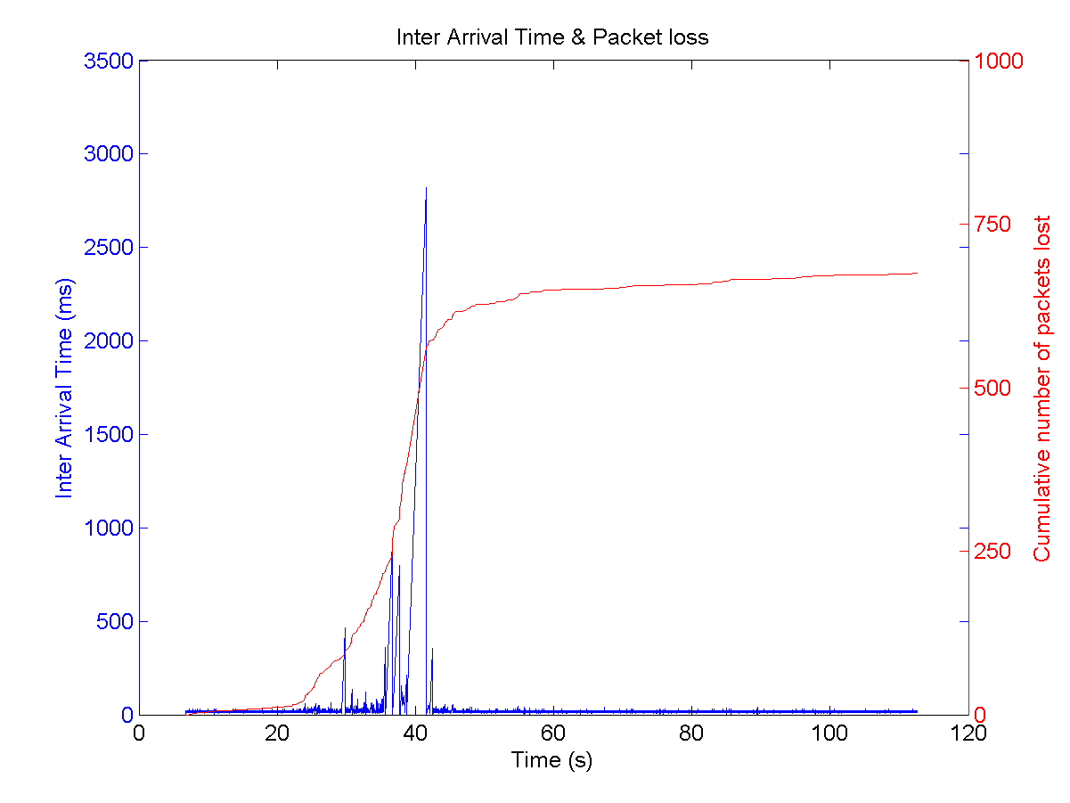
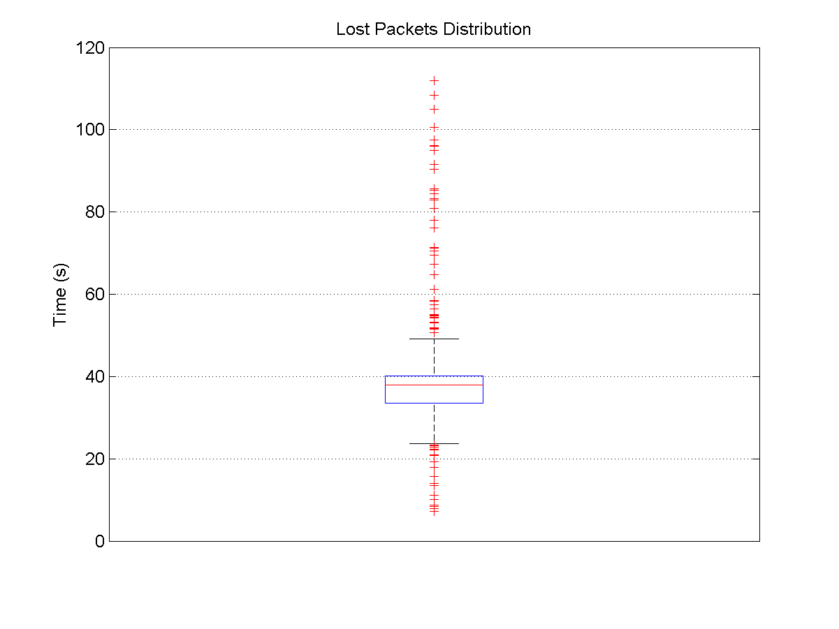
Results
Normal, APs in different channels, STA moving away from both APs
Packets sent: 6772; Packets lost: 675 (9,97%)
AP change reassociation time: 2819,20 ms

Slide 13
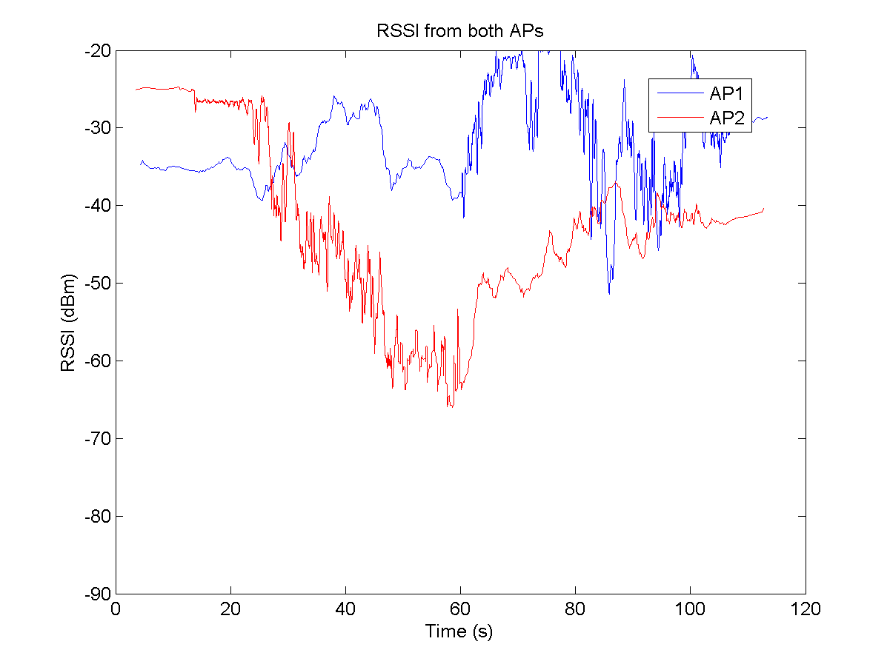
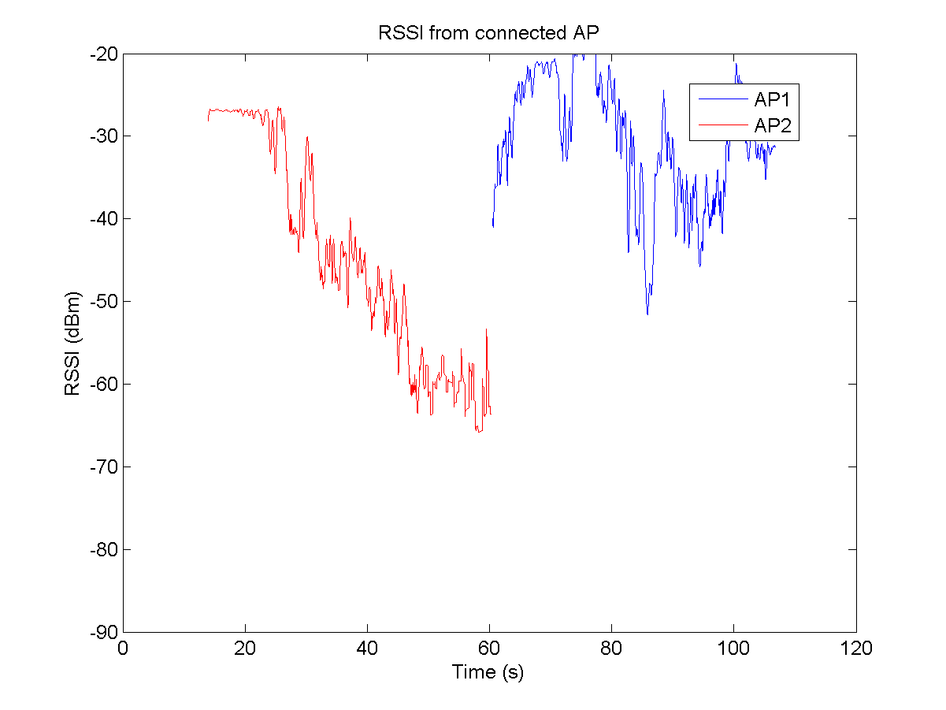
Results
Normal, APs in same channels, STA moving away from AP2 and getting closer to AP1
Packets sent: 5960; Packets lost: 190 (3,19%)
AP change reassociation time: 46,26 ms

Slide 14
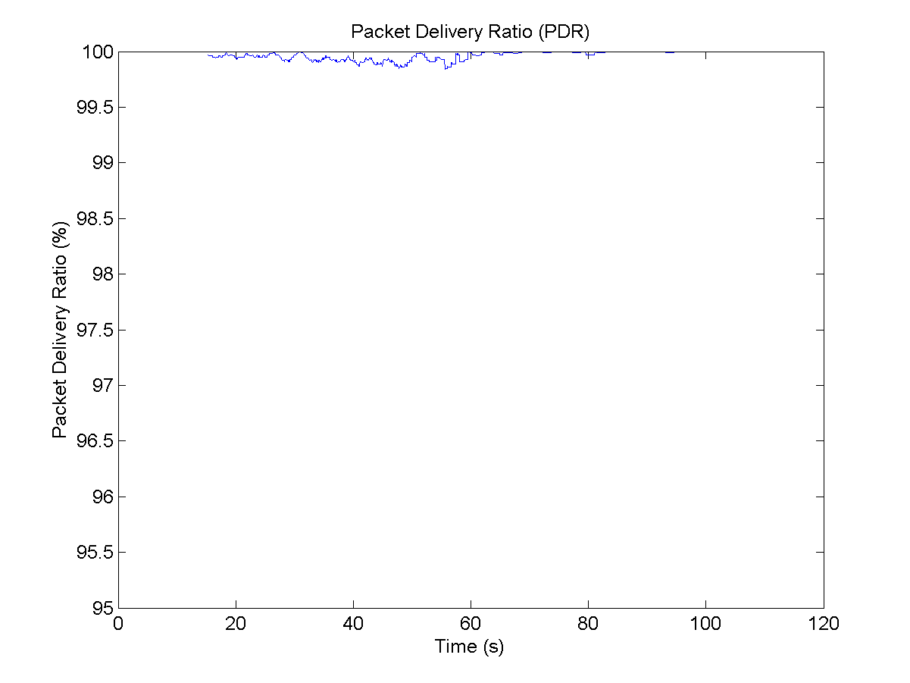
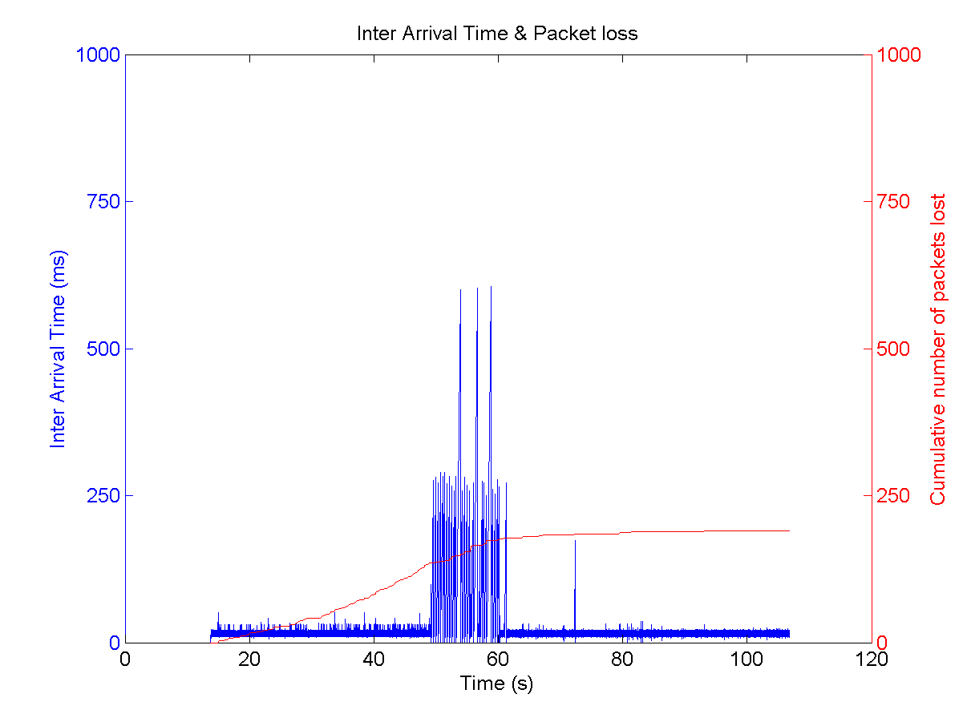
Results
Normal, APs in same channels, STA moving away from AP2 and getting closer to AP1
Packets sent: 5960; Packets lost: 190 (3,19%)
AP change reassociation time: 46,26 ms

Slide 15
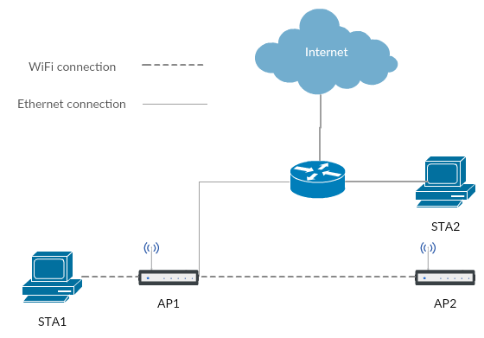
Setup
Wireless Distribution System (WDS)
AP1 as master AP, AP2 as client AP (acting as repeater)
All incoming and outgoing traffic through AP2 must also pass through AP1
WNICs must be the same model from the same manufacturer!
Throughput is halved for every retransmission hop unless dual band is used

Slide 16
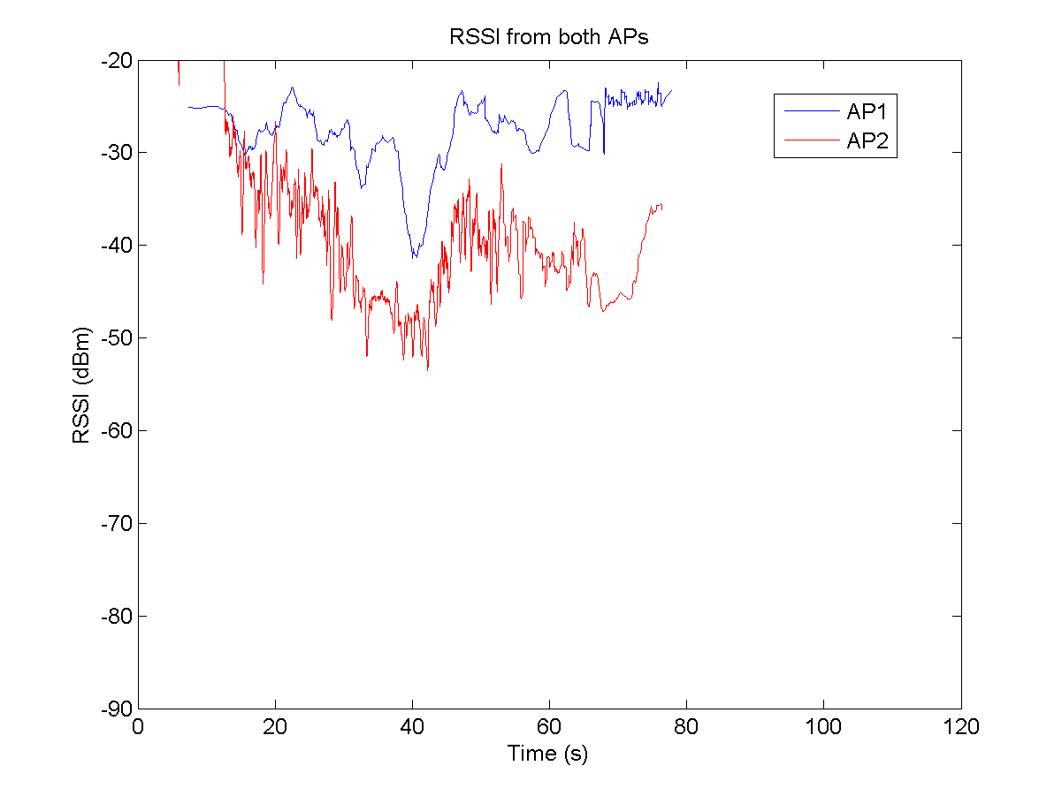
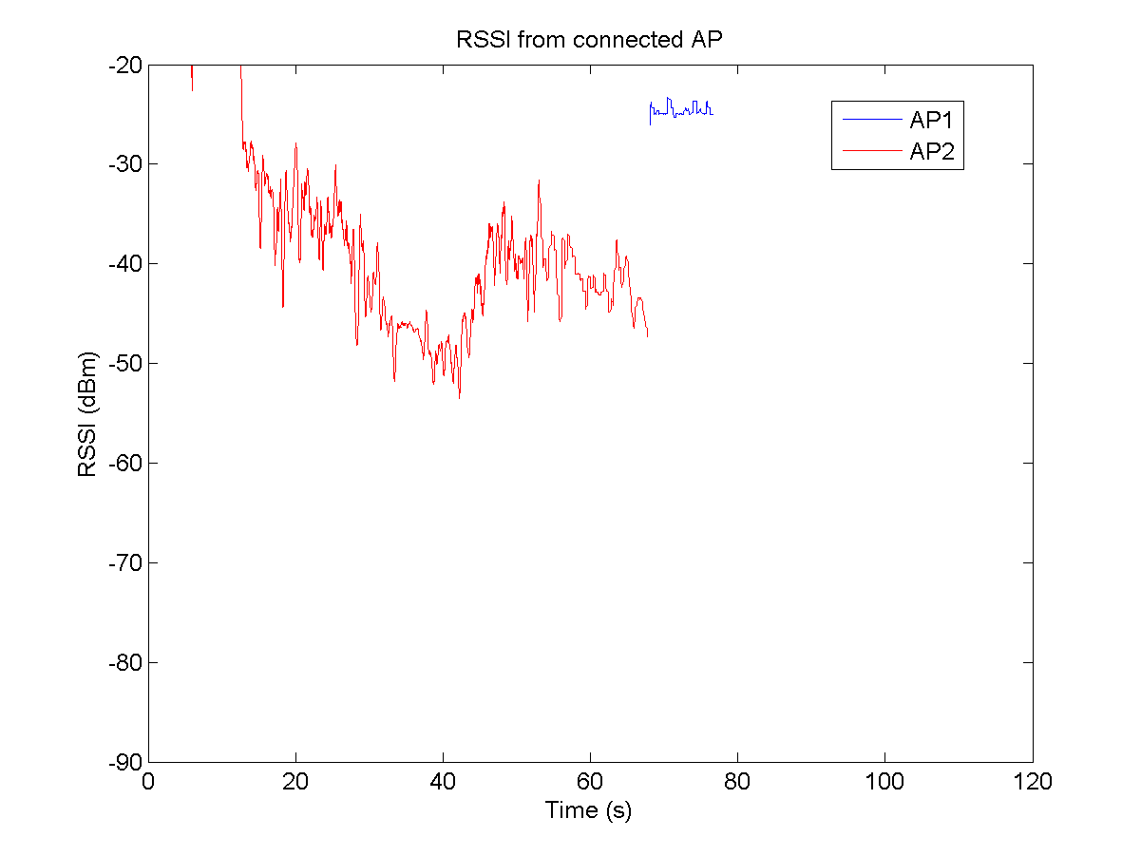
Results
WDS, APs in same channels, STA moving away from AP2 and getting closer to AP1
Packets sent: 4541; Packets lost: 431 (9,49%)
AP change reassociation time: 134,53 ms

Slide 17
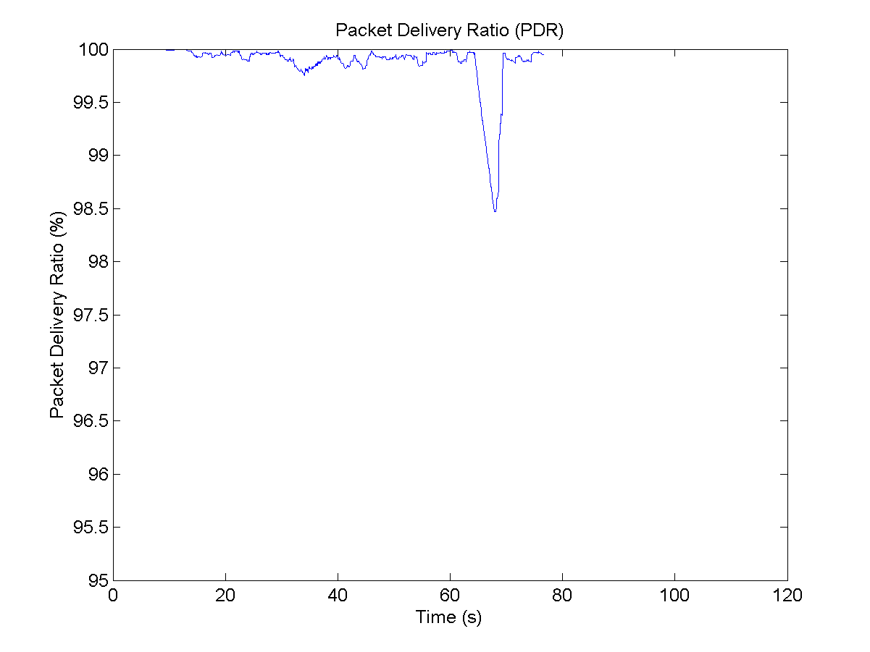
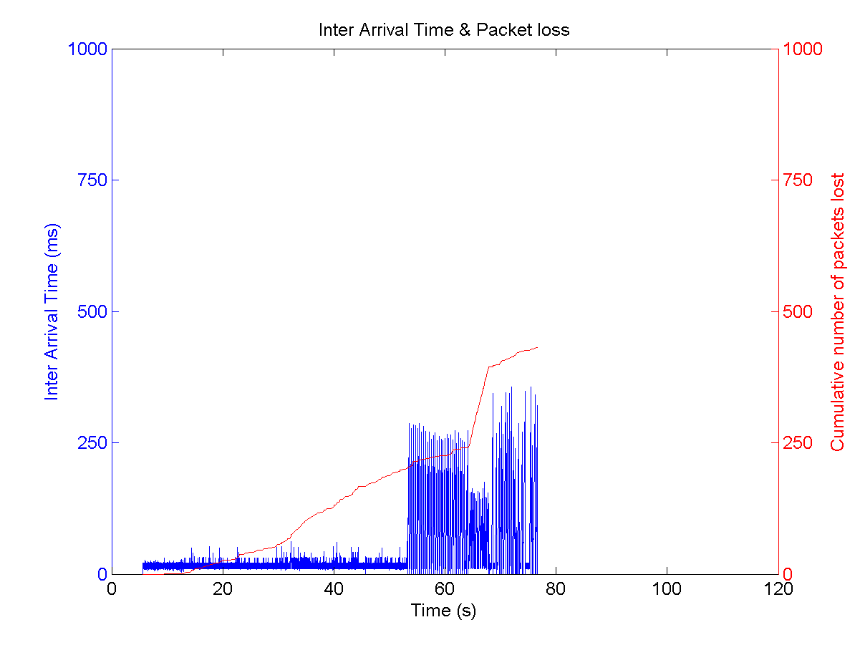
Results
WDS, APs in same channels, STA moving away from AP2 and getting closer to AP1
Packets sent: 4541; Packets lost: 431 (9,49%)
AP change reassociation time: 134,53 ms

Slide 18
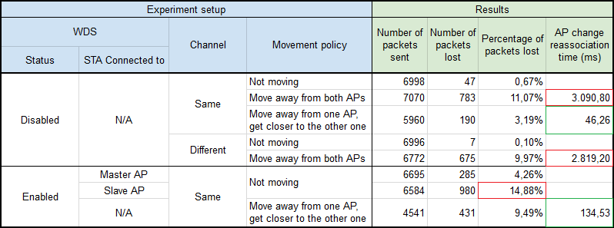
Results

Slide 19
Future work
Try WDS with two WNICs in each AP
WNIC #1 in channel A to AP-to-AP communication
WNIC #2 in channel B to AP-to-STA and STA-to-AP communication
Tune parameters like RSSI threshold, channels to look up while roaming, APs beacon interval...
Test it in a real environment
Try SDN + Virtual AP solution to see if it works better

Slide 20
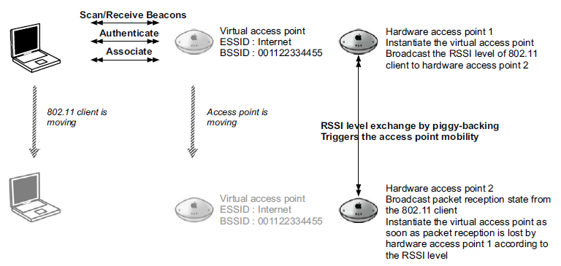
Solution
Virtual APs + SDN
Make the STA think it’s always connected to the same AP
A SDN may be required: a controller monitors the network state and moves the virtual AP from a real AP to another real AP
The SDN can take into account not only the RSSI level, but also traffic level on each AP (and hence balance the load)
Y. Grunenberger and F. Rousseau, Virtual access points for transparent mobility in wireless lans (2010)

Slide 21
Setup
 | APs | STA1 | STA2
Main Hardware | Raspberry PI 2 Model B | PC | PC
WNIC | ALFA AWUS051NH v2 | N/A | ALFA AWUS051NH v2
Operating System | OpenWRT 15.05.01 | Windows 10 | Ubuntu
Software | hostapd | Python 3.5 | netcat & Wireshark

Slide 22
Thanks!
https://github.com/MarcosCM/wifi-traffic-analytics

