Slide 1
Technical Exercise
Travel Audience – Senior Data Analyst Marcos Daniels

Slide 2
Data Quality
Notes:
What are your observations in data quality?

Slide 3
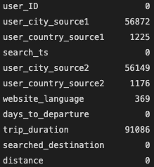
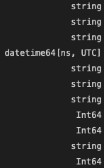
Overview
Raw data: 231,504 rows; 11 columns
138,281 rows containing at least one empty variable
No duplicates (all columns + all columns except ID)
“days_to_departure”:
79 rows containing negative values
“trip_duration”:
0 rows containing negative values
26 rows containing unrealistic values (> 365 days)
“distance”:
0 rows containing unrealistic values (> 40,000 kms)

Slide 4
Description (raw)
 | days_to_departure | trip_duration | distance
Unit | days | days | kilometres
Mean | 35 | 14 | 3681
Std | 67 | 23 | 2033
Min | -99 | 0 | 1007
Max | 649 | 569 | 9760
75% | 41 | 14 | 5249
Total rows: 231,504

Slide 5
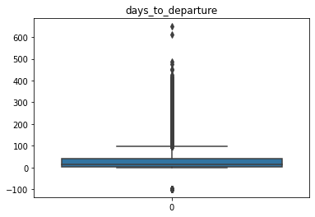
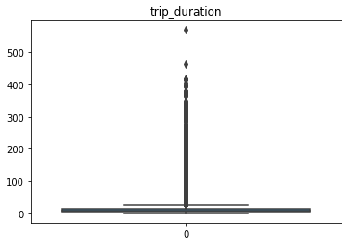
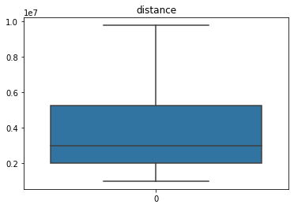
Boxplots (raw)

Slide 6
Description (cleaned)
 | days_to_departure | trip_duration | distance
Unit | days | days | kilometres
Mean | 53 | 14 | 3712
Std | 73 | 22 | 1939
Min | 0 | 0 | 1007
Max | 649 | 365 | 9519
75% | 70 | 14 | 5222
Total rows: 93,129

Slide 7
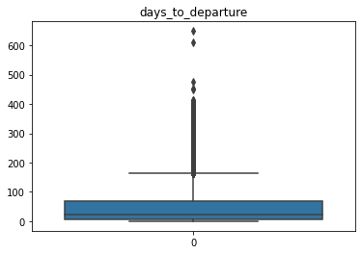
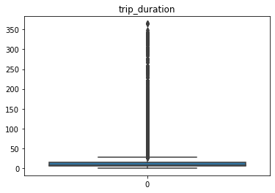
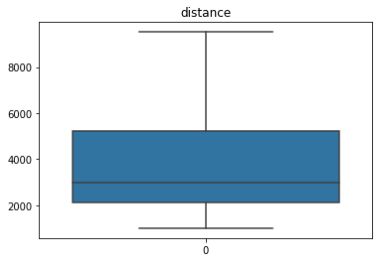
Boxplots (cleaned)

Slide 8
Trends
Notes:
What search trends do we see?

Slide 9
Total
Top 5 Sources
Top 5 Searched Destinations
 | City 1 | Country 1 | City 2 | Country 2
1. | Dubai | Saudia Arabia | Dubai | Saudia Arabia
2. | Riyadh | United Arab Emirates | Riyadh | United Arab Emirates
3. | Jeddah | Germany | Jeddah | Germany
4. | Dammam | United Kingdom | Dammam | United Kingdom
5. | Abu Dhabi | France | Abu Dhabi | France
1. Istanbul
2. Cairo
3. Abu Dhabi
4. Antalya
5. Hurghada

Slide 10
Top Sources and Destinations By Month
 | City 1 | Country 1 | City 2 | Country 2 | Searched Destination
July | Dubai | Saudi Arabia | Dubai | Saudi Arabia | Cairo
August | Dubai | Saudi Arabia | Dubai | Saudi Arabia | Istanbul
September | Riyadh | Saudi Arabia | Riyadh | Saudi Arabia | Cairo

Slide 11
Top Sources and Destinations By Month Phase
 | City 1 | Country 1 | City 2 | Country 2 | Searched Destination
Beginning | Riyadh | Saudi Arabia | Dubai | Saudi Arabia | Cairo
Mid | Dubai | Saudi Arabia | Dubai | Saudi Arabia | Istanbul
End | Dubai | Saudi Arabia | Dubai | Saudi Arabia | Istanbul

Slide 12
Top Sources and Destinations By Weekday
 | City 1 | Country 1 | City 2 | Country 2 | Searched Destination
Monday | Dubai | Saudi Arabia | Dubai | Saudi Arabia | Istanbul
Tuesday | Riyadh | Saudi Arabia | Riyadh | Saudi Arabia | Istanbul
Wednesday | Dubai | Saudi Arabia | Dubai | Saudi Arabia | Istanbul
Thursday | Dubai | Saudi Arabia | Dubai | Saudi Arabia | Cairo
Friday | Riyadh | Saudi Arabia | Dubai | Saudi Arabia | Istanbul
Saturday | Dubai | Saudi Arabia | Dubai | Saudi Arabia | Cairo
Sunday | Dubai | Saudi Arabia | Dubai | Saudi Arabia | Istanbul

Slide 13
Numeric Metrics By Month (Average)

Slide 14
Numeric Metrics By Month phase (Average)

Slide 15
Numeric Metrics By Weekday (Average)

Slide 16
Correlations
Notes:
Is there a correlation between user city and search destination or between any other data points?

Slide 17
Overview
Independent Variables
Dependent Variables
City 1
Country 1
City 2
Country 2
Website language
Month
Day
Day (month phase)
Weekday
Days to departure
Trip duration
Searched destination
Distance

Slide 18
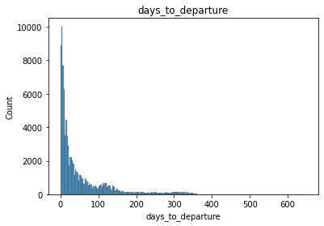
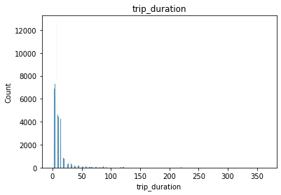
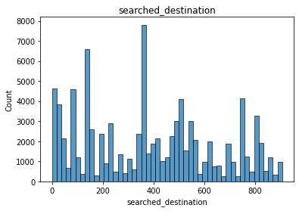
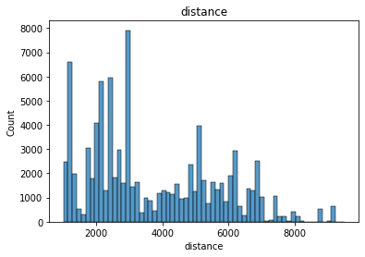
Normally Distributed?

Slide 19
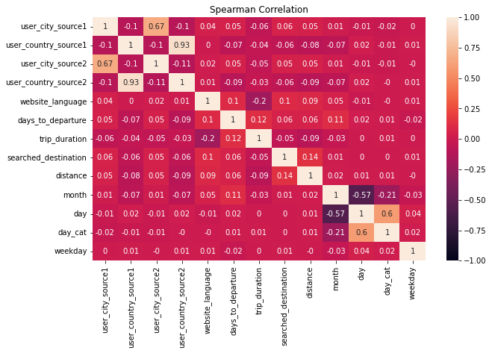

Spearman Correlation

Slide 20
Further ideas
Fill NA gaps by creating profiles for each user
Think of an approach to detect anomalies with the help of standard deviation
Look for other anomalies like multiple changes in city/country/language for the same user within a short time period
Look for trends by time (hourly / times of day)
Look for trends by specific cities/countries/languages
Internalize differences between short-term and long-term trends as well as seasonal adjustments and cycles
Use other correlation methods like linear regression that also allows for predicting future outcomes

Slide 21
Questions
Only data for three months?
Multiple sources?
So many NAs?
No correlations?

