Slide 1

Who We Are
Our Values, Mission & Vision
What We Do
Gallery
Contact us
Asian Petroleum Technology and Commercial Service

Slide 2
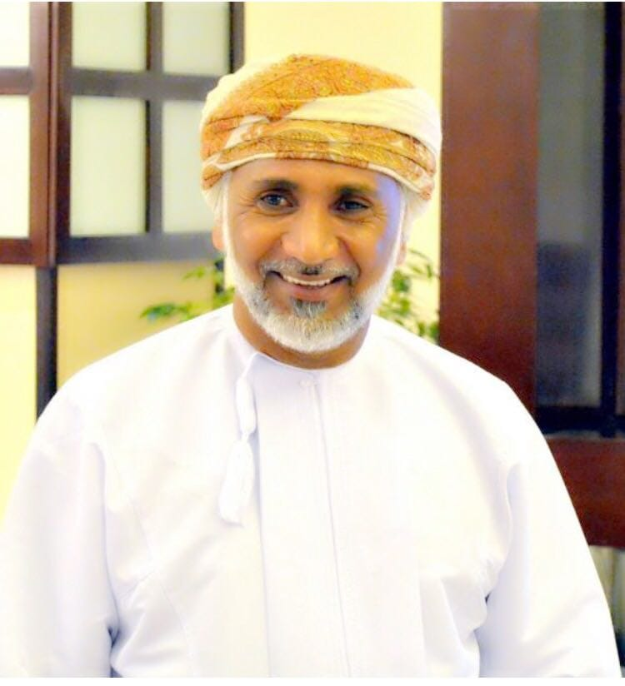
Home Our Values, Mission &Vision What We do Gallery Contact us
Who We Are
APTCS is a Local Community Contractor Company headquartered in Muscat, Sultanate of Oman. Our core business is in Oil & Gas Services, Civil & Mechanical construction, Logistic & Cargo haulage Services, Cleaning & Sanitation Services and supply of technical manpower for Oil & Gas Projects including supply of equipment, manpower without endanger HSE.
I would like to begin by thanking
His Majesty Sultan Qaboos bin Said for his
benevolence, continuous support and encouragement
towards the development of the citizens operating in
the oil field concession areas should also be made
of His Excellency Minister of Oil & Gas.
Asian Petroleum Technology & Commercial Services
was founded 2006 in the Sultanate of Oman establishment under
the laws and regulations of the Oman Government.
The company is 100% owned by an Oman national.
We have aimed to provide the best possible services in Sultanate of Oman industries in a transparency manner by providing the best competitive prices with the best quality and new technology. We also envisioned our business relationship with our prospects by working as a partner and not treating them as clients, by meeting their requirements and supporting them.
Also, the management is committed and fully supports our employees by providing the best and comfortable workplace atmosphere, in order to achieve effective and efficient productivity within the organization. We believe the success and growth of our business can be attributed to consistency in terms of standards and policies and to the efforts of our supportive local and international partners.
Finally, I would like to extend my deep appreciation to our clients for their trust, and employees of Asian Petroleum for their continuing efforts and loyal dedication to our company. Rabia Talib Hamed Al Junaibi, Managing Director

Slide 3
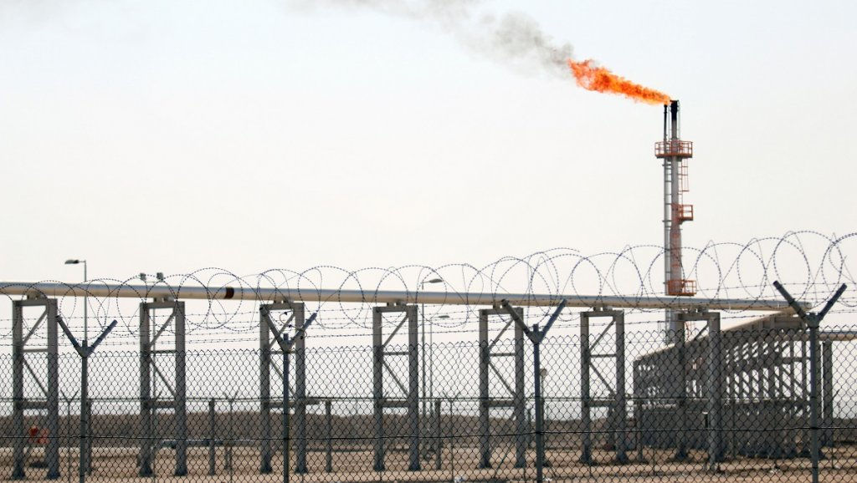
Home Who We Are What we do Gallery Contact us
Our Values
Respect
Safety
Team work
Our Vision
Asian Petroleum Technical Trading aims to be a National Pioneer service provider in the Oil and Gas industry. The Company plans to employee qualified Nationals to comply with the Governmental direction towards Nationalization. Additionally, to cooperate with local Communities to enhance the economy and welfare of the Country.
Our Mission
Comply with the rules and Procedures Concentrate on the missions and target Communicate and share

Slide 4

Home Who We Are Our Values, Mission &Vision What We Do Contact us
What We Do
APTCS Provides services for the main clients like Petroleum Development Oman LLC., Oman LNG, Daleel Petroleum LLC, Occidental Oman LLC, Oman Gas Company, Government Ministries and various organizations in the Oil & Gas sectors.
What We Do
APTCS Provides services for the main clients like Petroleum Development Oman LLC., Oman LNG, Daleel Petroleum LLC, Occidental Oman LLC, Oman Gas Company, Government Ministries and various organizations in the Oil & Gas sectors.
Oil & Gas sector:
Oil & Gas Consultancy Services
Pipe Cleaning Services
Supplying industrial Materials and Chemicals.
Oil and Gas Machines Maintenance
Supply of Machinery, Manpower & Equipment
EPC, Oilfield Services, Pipeline, Civil Works, Waste Management, Maintenance, Electro Mechanical, Fabrication.
Construction Sector:
Industry Contracting
Building Construction Contract (Residential and Non-Residential)
Construction of Industrial Sites
Mechanical Electrical and Plumbing (MEP) Contracting
Electro-Mechanical Contracting, Steel Fabrication

Slide 5
Home Who We Are Our Values, Mission &Vision Gallery Contact us

Slide 6
Home Who We Are Our Values, Mission &Vision What We Do Gallery
Head Office
Location
Contact
Email: info@asiantechnocommercial.com
Operation’s Coordinator: Khalfan@asianpterocommercial.com

