Slide 1
Healt Care Analysis
IBM Professioal Certificate

Slide 2
Health Care Analysis for habits improvement
Compare Life Expectancy with Health Care Expenses and Cost of Life.
Link the result to the most common venues of each country.
Cluster each country among groups to showrelations between members of the same group.

Slide 3
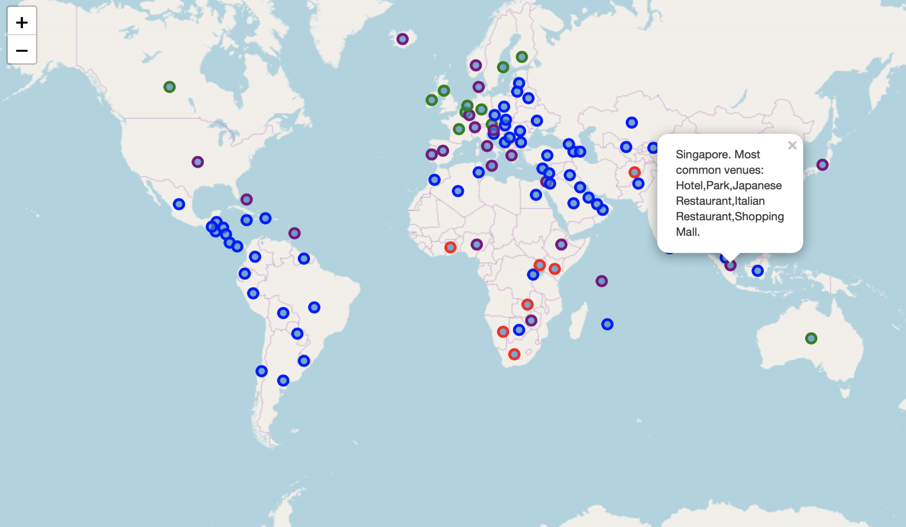
DBSCAN Clustering

Slide 4
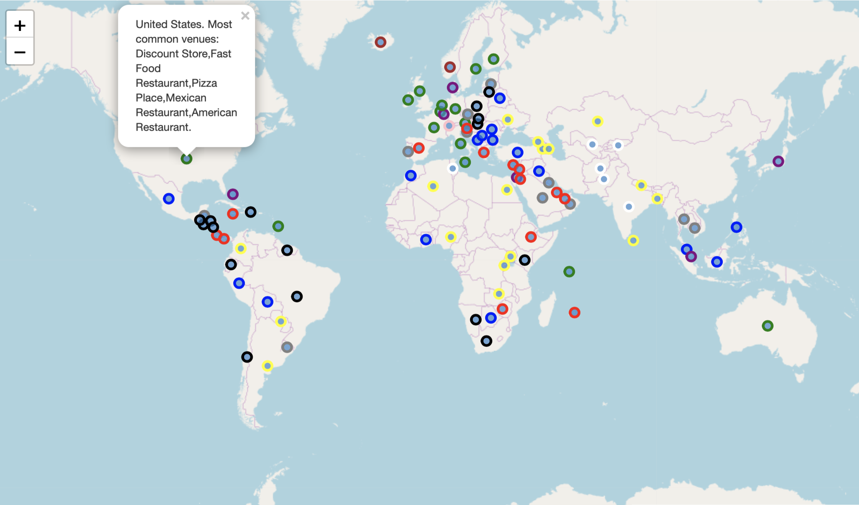
K-Means Clustering
Total Results

Slide 5
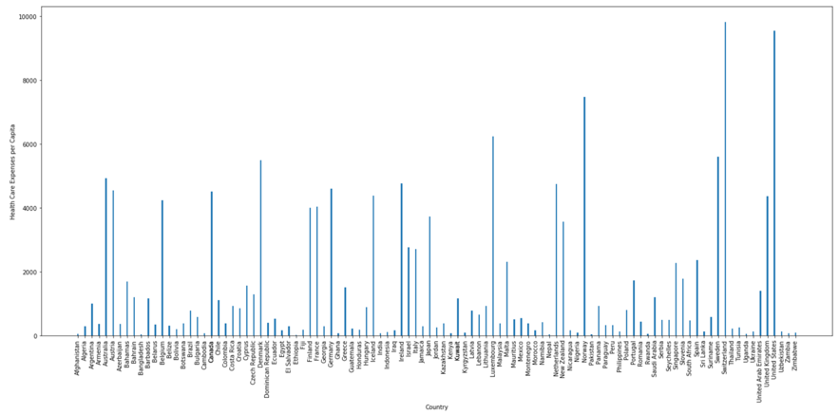
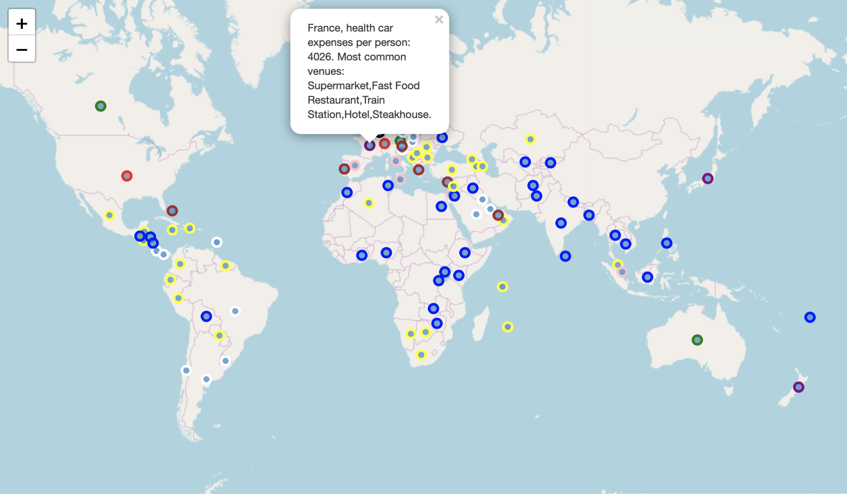
K-Means Clustering
Health Care Expenses Results

Slide 6
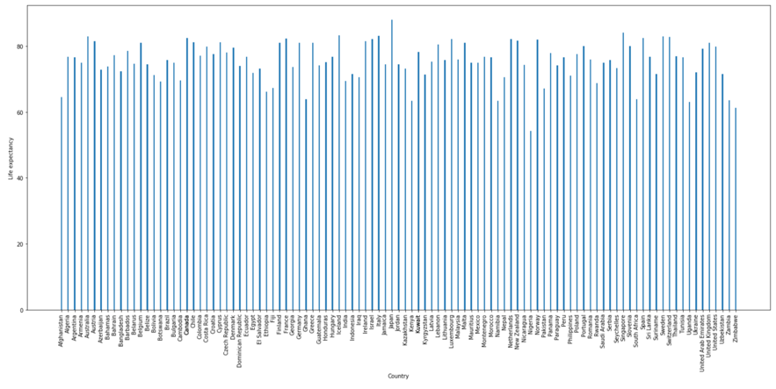
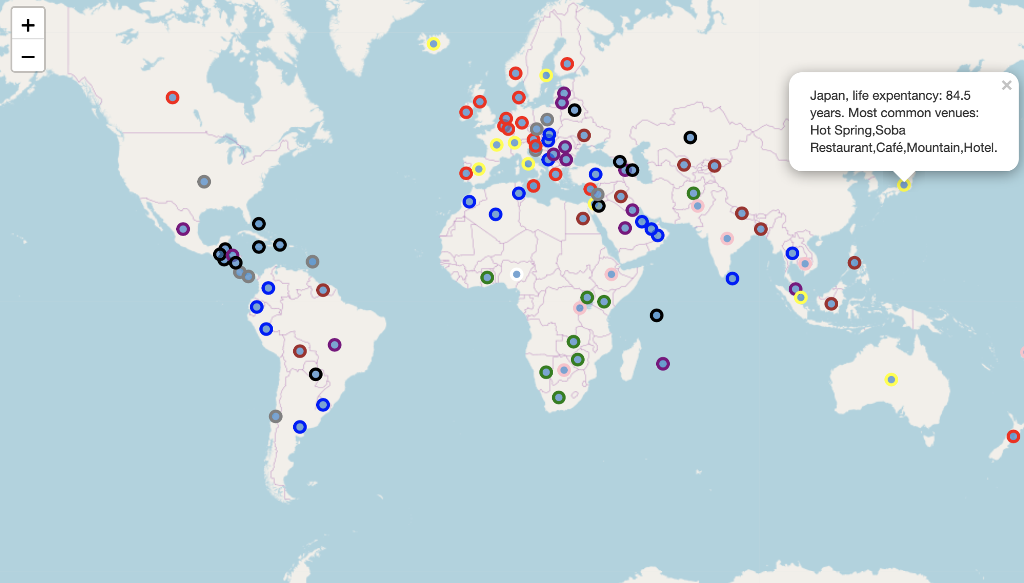
K-Means Clustering
Life Expectancy Results

Slide 7
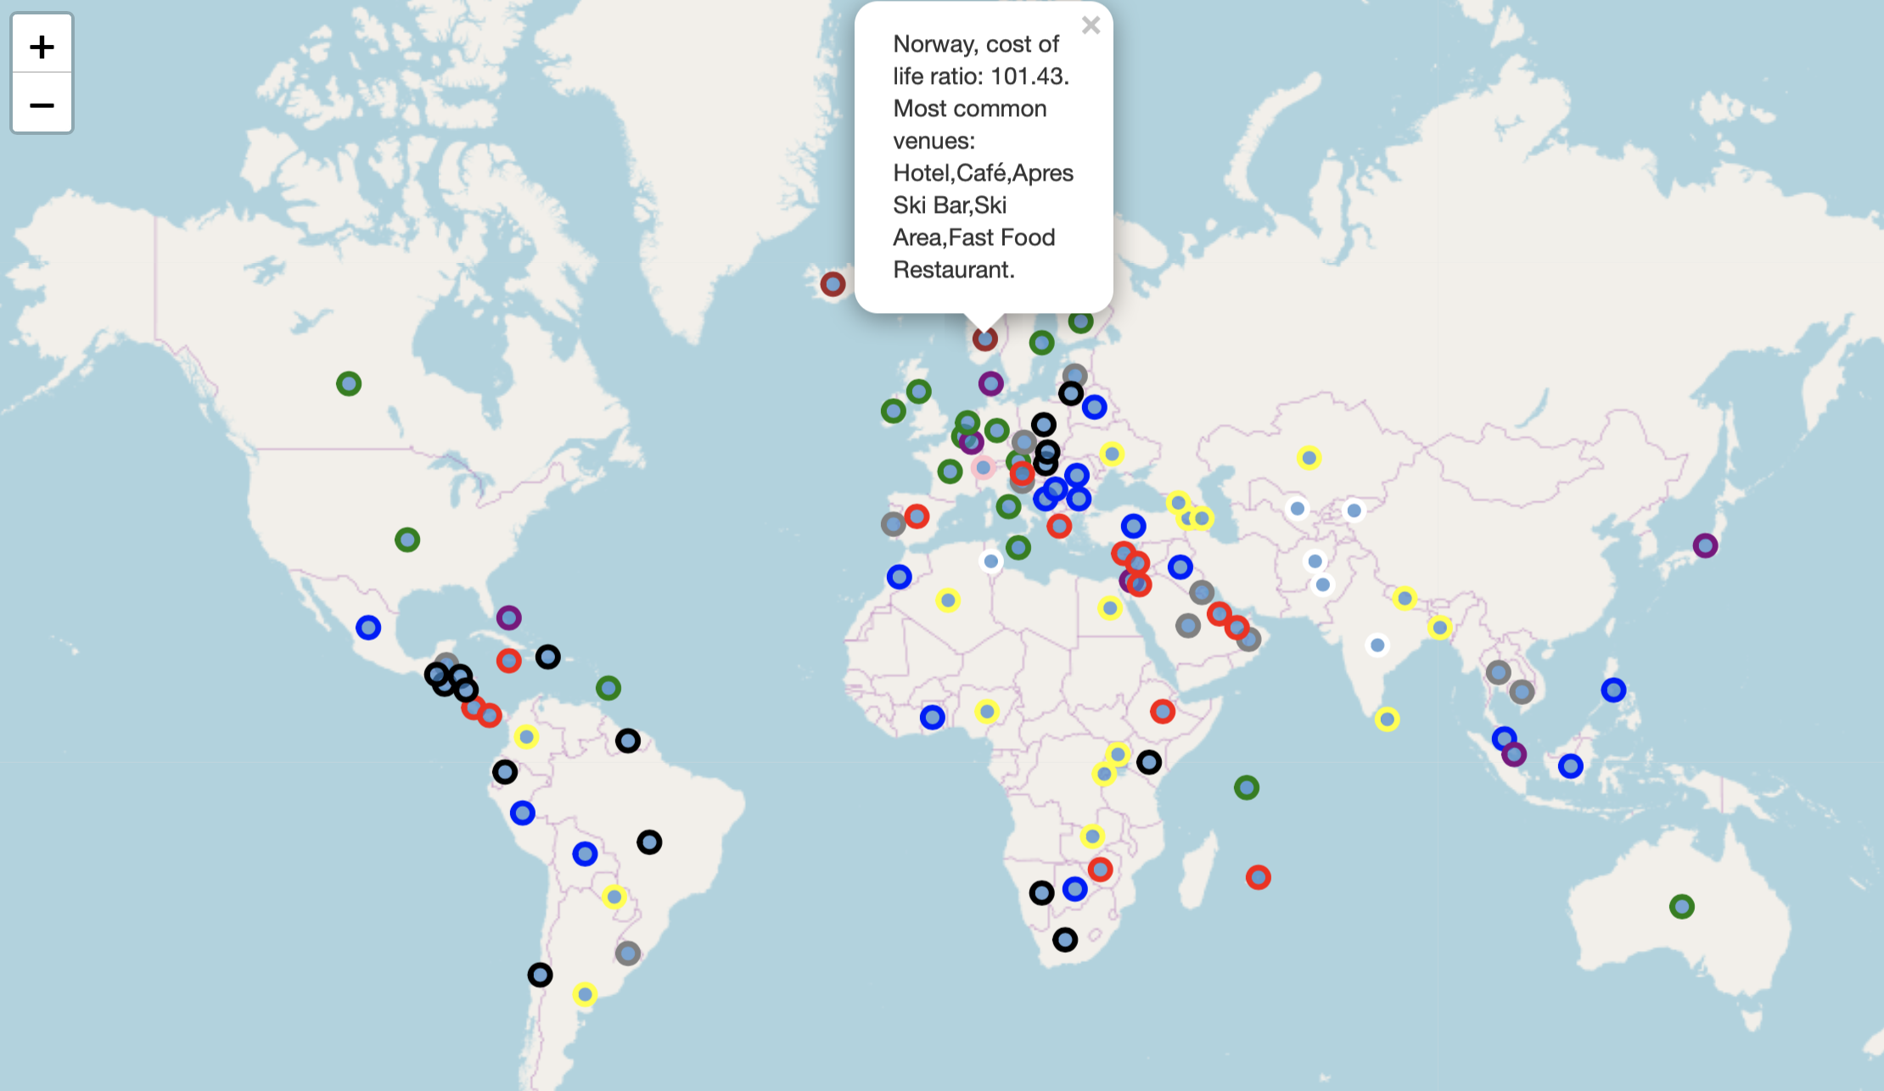
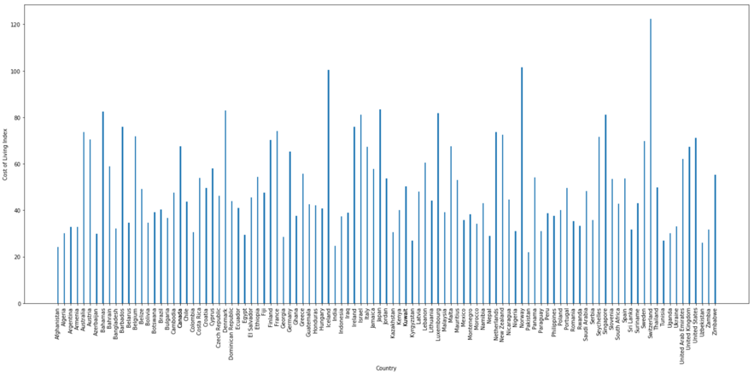
K-Means Clustering
Cost of Life Results

Slide 8
Conclusions
As expected, developped countries with fast food as one as the common vinues has shorter life expectancy compare to countries such as Japan or Spain.
Having high health expenses is not directly connected to have a longer life expectancy. Nevethless, it is closely linked to a higher cost of life.
Countries with one or more sport places in their common venues have a higher life expectancy.

