Slide 1

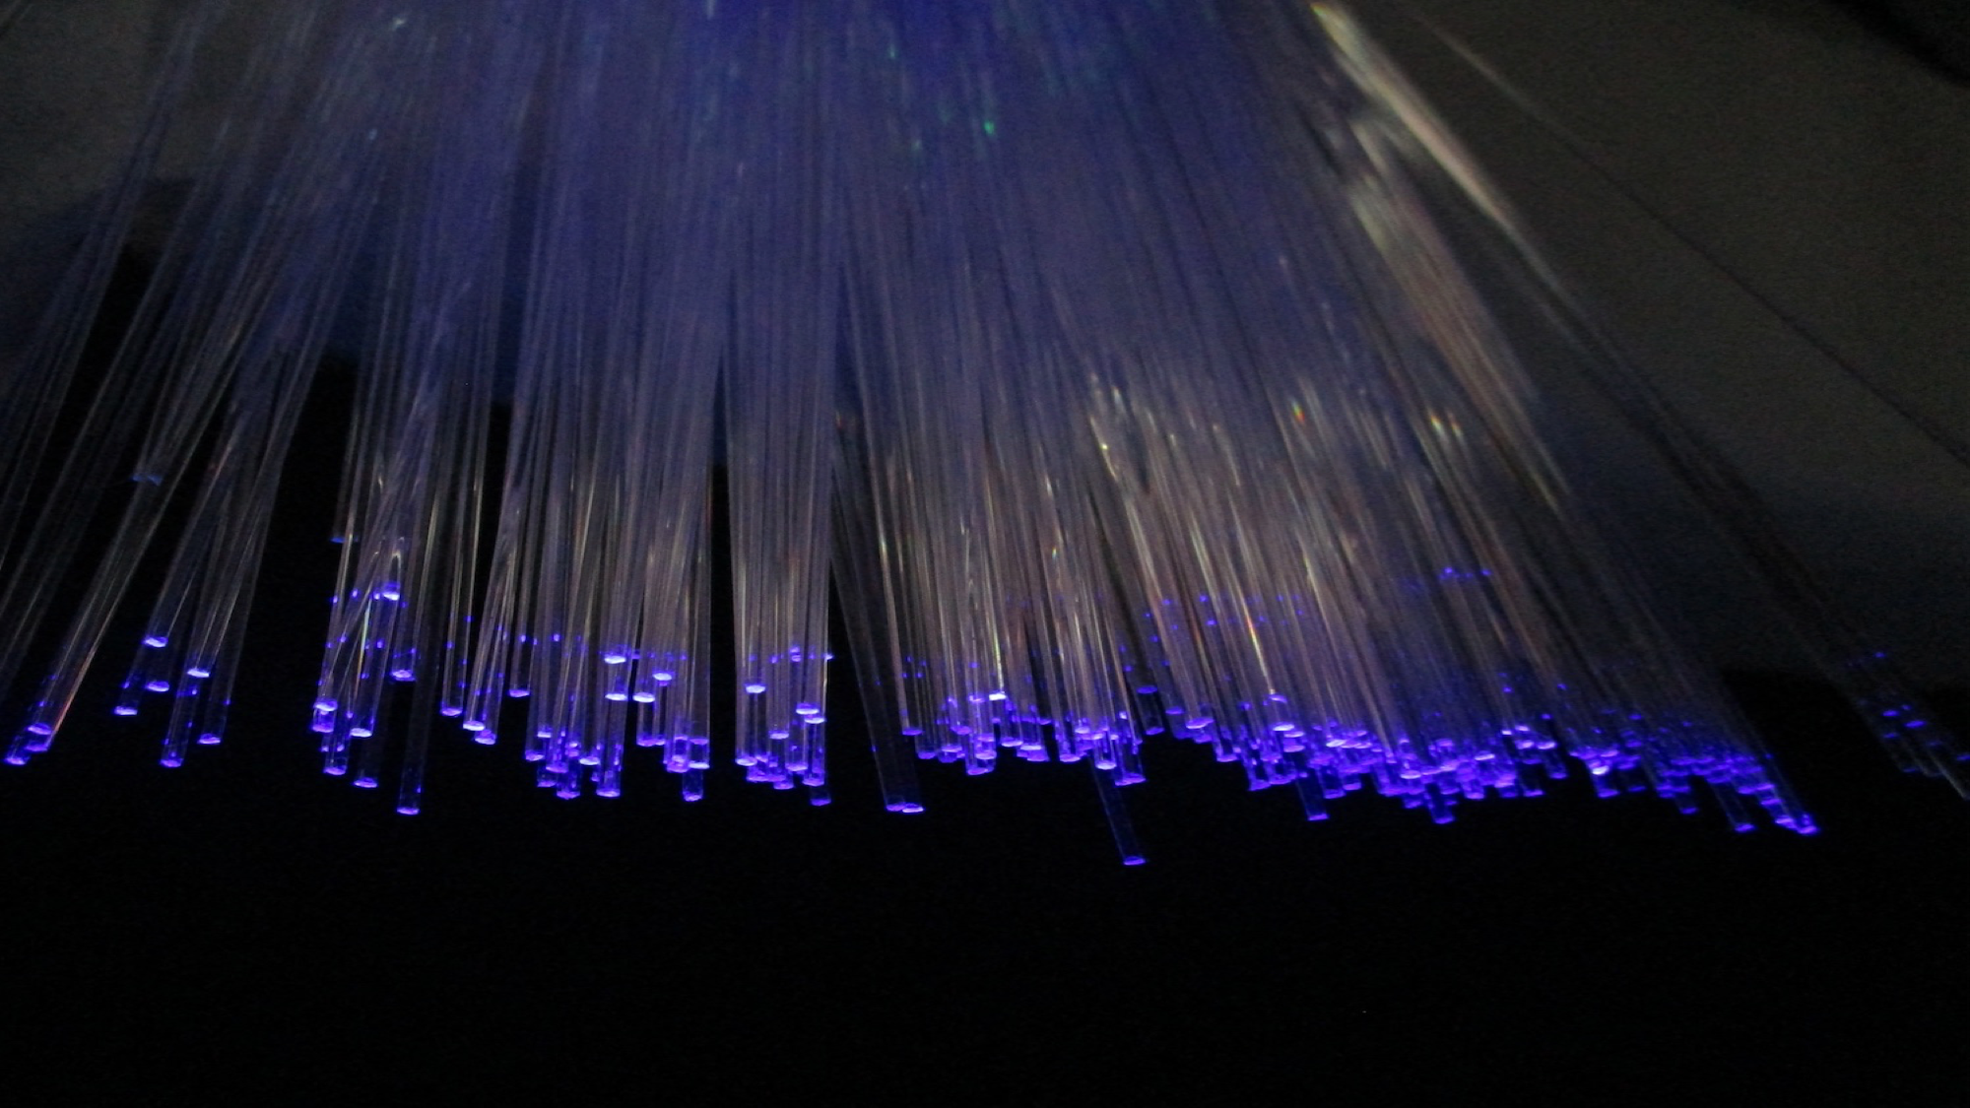
TRITIUM: Design, Construction and Commissioning of an In-Water Tritium Detector
Departament de Física Atòmica, Molecular i Nuclear
TRITIUM: Design, Construction and Commissioning of an
In-Water Tritium Detector
Marcos Martínez Roig
Ph D. Dissertation
26th July 2022
Marcos Martínez Roig
Supervisors
José Díaz Medina
Nadia Yahlali Haddou
2022
Notes:
<número>

