Slide 1


Cloud Computing
Historical Spotify data

Slide 2
Table of Contens
App description
Our app is going to have the following AWS services:
Cognito
CloudFormation
Instances
Security Groups
Load Balancer
Auto Scaling Group
DataBase
Disaster Recovery Plan

Slide 3
App Description.
The main goal of this project is to implement and deploy a web application offering visualization of users’ historical Spotify data. Spotify is an online streaming service offering its clients access to the history of listening.
But this function is not automatic, where you can see information about what, when and how long has been played on the account. Through amazon web services we create an app that is able to visualize the history.

Slide 4
App Description
The app will be available to both anonymous and registered users. All users will be able to view and analyze their history, but only registered users will be able to store and manage their files.
The al app system will offer high availability thanks to the use of AWS managed products. The module in charge of verifying and managing the different user accounts will be implemented on the basis of Amazon Cognito.
The application can be accessed through the following link: https://pawel99k.shinyapps.io/SpotiData/

Slide 5
FunCtional REQUIREMENTS
Our app has implemented the following functional requirements:
Public users are allowed to register an account.
Public users are able to sign into the account.
Logged in users can upload and store their historical JSON files on the service.
Users will be able to select a JSON file in order to visualize its content.
Logged in users can delete their file from the system.
Logged in users can change the password of their accounts.

Slide 6
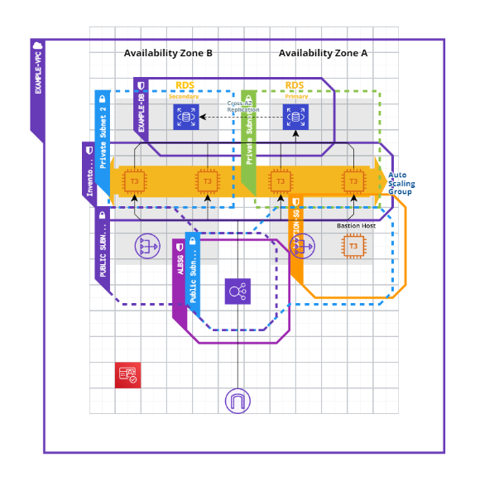
System Architecture
The application is implemented through the following architecture of AWS services:

Slide 7
disaster recovery plan
For the database we have implemented, all kinds of disasters can occur, so there must exist a plan to recover.
To make a disaster plan from AWS services, RTO and RPO must be defined.
Recovery Time Objective : Is the maximum acceptable amount of delay between service interruption and service restoration. This is the window of acceptable time when service is unavailable.
Recovery Point Objective: Is the maximum acceptable amount of time since the last point where data recovery has occurred.
In AWS we have four different strategies. The one that most closely resembles our needs is Backup and restore. Where we will have an RTO of 24h and an RPO of 24h. Data and applications are backed up in the DR zone to recover from the disaster and data is recovered as needed. It is the cheapest option.

