Slide 1
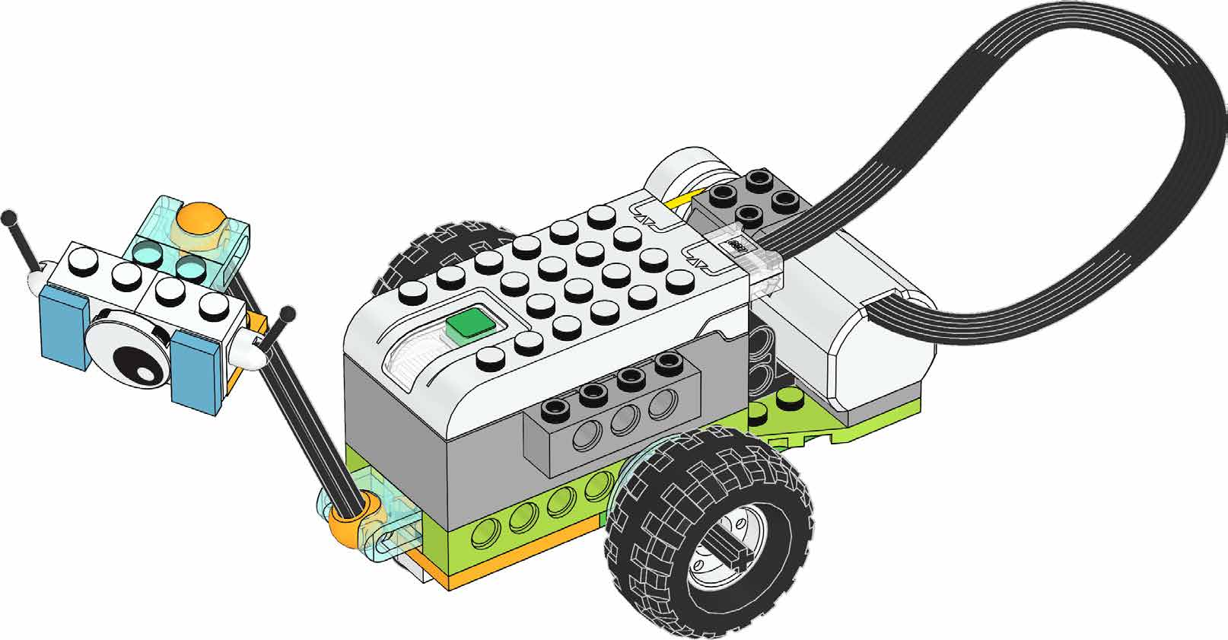
3D tutorial to assembling a lego robot figure

Slide 2
Goals:
1. Teach to child to relate objects through lego game
2. Teach to child how to build a robot with Legos
3. Teach to child how to give instruction in low level
Roles, activities:
David Casnanzuela: tester
Marcos Quichimbo: UX-UI, QA
Materials, technologies
Lego robot
Potential examples:
Lego robot car
Target:
2 – 4 years old
Institution:
Edison Mendoza
Julian Galindo: Product Owner
3D printer
Flash cards

