Slide 1
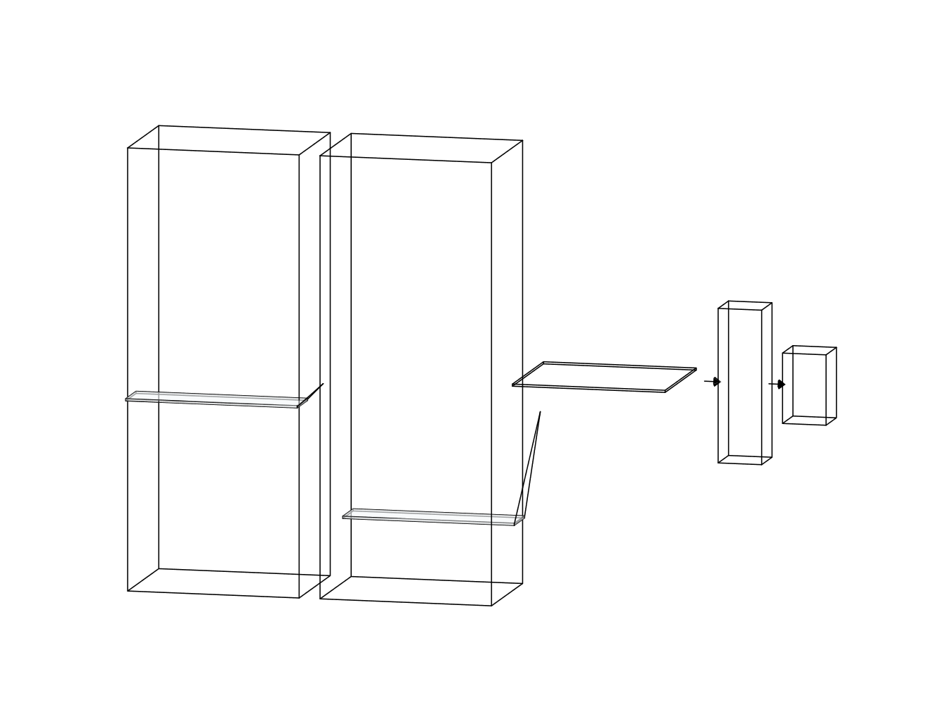
Output Distribution layer:
Output size:
(1, 1, 8)
Time-Distributed Dense layer:
Input size:
(1, 96, 8)
Output layer:
Output size:
(1, 96, 8)
LSTM layer:
168 neurons
Input size:
(1076, 168, 8)
LSTM layer:
168 neurons
Input size:
(1076, 168, 8)

