Slide 1
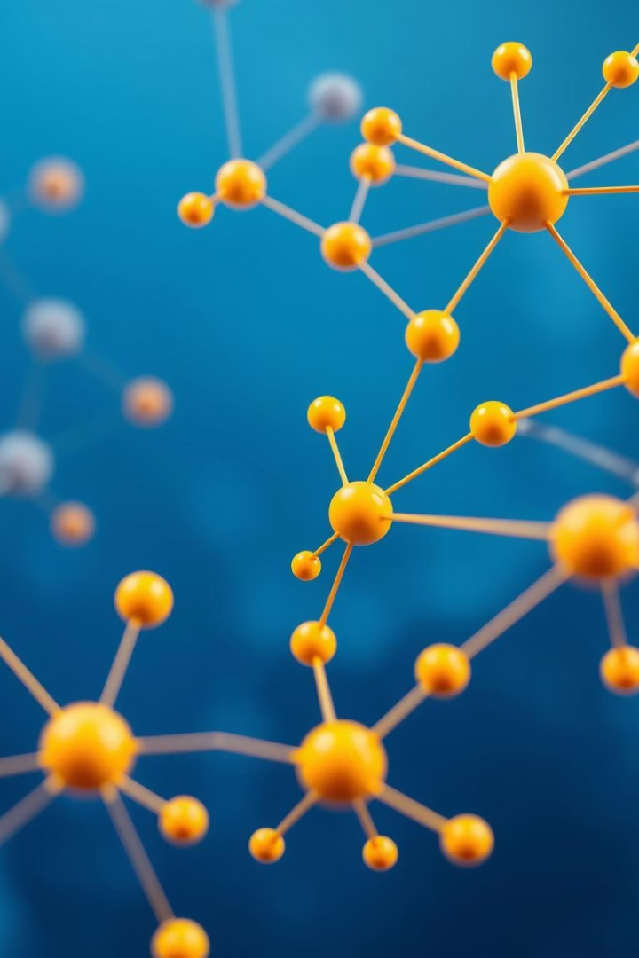
Benchmarking KANG on Molecular Graph Learning Tasks
Sahar Khanlari - 2107563
Marco Natale - 1929854
Data Mining
A.A. 2024/2025

Slide 2
Introduction
Objective: Evaluate the performance of the KANG model across classification and regression tasks using MoleculeNet datasets.
Molecular property prediction is crucial for drug discovery.
Only 2D molecular structures

Slide 3
Overview of Datasets
Classification:
HIV
ToxCast
(subset of 5 tasks from 617)
Regression:
QM8
(12 tasks, quantum mechanical)
QM9
(12 tasks, quantum chemical)

Slide 4
Experimental Setup
SMILES to graph conversion with RDKit
Graph generation: atoms → nodes, bonds → edges
Hyperparameter tuning with Optuna
Best val score saved and evaluated on test set

Slide 5
Data Representation
Node features:
Atomic number
Degree
Formal charge
Aromaticity
Total hydrogens
Edge features:
Bond type
Conjugation
Ring membership
Stereochemistry

Slide 6
Graph Classification - HIV
Metric: ROC-AUC
State-of-the-Art model: CIN++ (0.8063)
KANG result: 0.6997

Slide 7
Graph Classification - ToxCast
5 selected binary tasks from 617
Tasks include: AhR, Aromatase, AutoFluor, p53 (2 types)
State-of-the-Art model: DumplingGNN (0.782)
KANG average result: 0.7896

Slide 8
Graph Regression - QM8
12 quantum mechanical tasks
Metric: MAE
SoTA: D-MPNN (0.0190)
KANG average result: 0.0221

Slide 9
Graph Regression - QM9
12 quantum chemical tasks
Metric: MAE
SoTA: D-MPNN (0.00814)
KANG average result: 7.1407

Slide 10
Performance Summary Table
Dataset | Metric | SoTA Model | SoTA Value | KANG Value
QM8 | MAE | D-MPNN | 0.0190 | 0.0221
QM9 | MAE | D-MPNN | 0.00814 | 7.1407
HIV | ROC-AUC | CIN++ | 0.8063 | 0.6997
ToxCast | ROC-AUC | DumplingGNN | 0.782 | 0.7896

Slide 11
Conclusions
Significant underperformance in QM9
Comparable QM8 performance
ToxCast comparable performance, but only 5 out of the total tasks were evaluated
Slightly worse performance for HIV
Further Improvements:
3D Structure
Multi-Task Learning

Slide 12
Thank You
Sahar Khanlari - 2107563
Marco Natale - 1929854
A.A. 2024/2025

