Slide 1
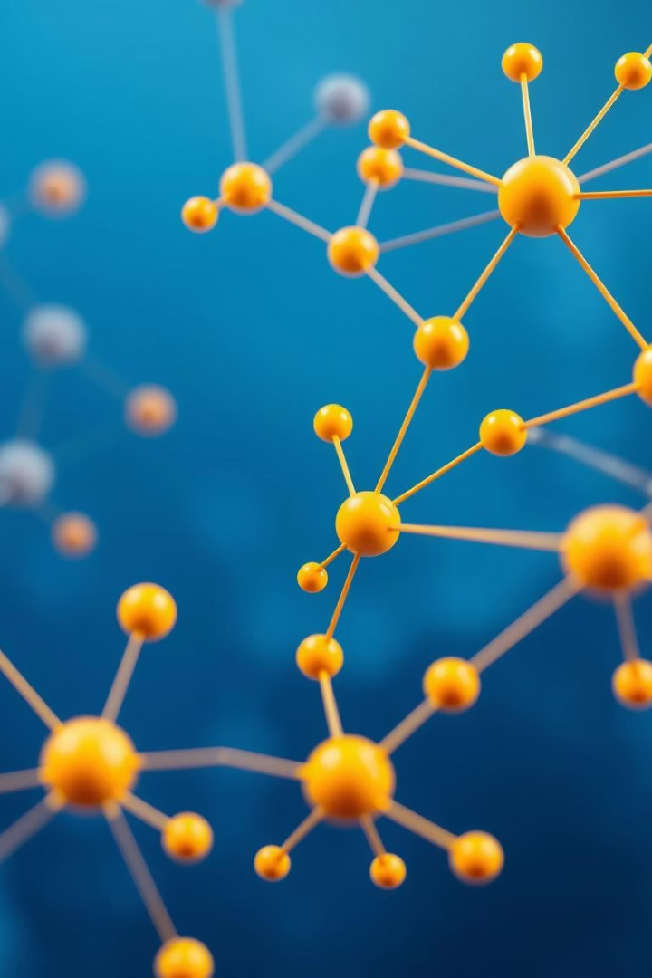
Benchmarking KANG on Molecular Graph Learning Tasks
Sahar Khanlari - 2107563
Marco Natale - 1929854
Data Mining
A.A. 2024/2025

Slide 2
Introduction
Objective: Evaluate the performance of the KANG model across classification and regression tasks using MoleculeNet datasets.
Molecular property prediction is crucial for drug discovery.
Only 2D molecular structures

Slide 3
Overview of Datasets
Classification:
HIV
ToxCast
(subset of 5 tasks from 617)
Regression:
QM8
(12 tasks, quantum mechanical)
QM9
(12 tasks, quantum chemical)

Slide 4
Experimental Setup
SMILES to graph conversion with RDKit
Graph generation: atoms → nodes, bonds → edges
Hyperparameter tuning with Optuna
Best val score saved and evaluated on test set

Slide 5
Data Representation
Node features:
Atomic number
Degree
Formal charge
Aromaticity
Total hydrogens
Edge features:
Bond type
Conjugation
Ring membership
Stereochemistry
Atomic mass
Chirality
Hybridization

Slide 6
Improvements
Improve performance of the KANG model on regression and classification molecular datasets.
Address limitations in feature representation, training configuration, and loss function design.

Slide 7
Methodology Updates
Feature Engineering
Added three new atom features.
Normalized two numeric atom features (others were one-hot already).
Training Configuration
Expanded hyperparameters search grid.
Compressed grid values to [-1.1, 1.1].
Extended epochs and early stopping patience.
New Classification Loss
Implemented Focal Loss for graph classification tasks.
Helps tackle class imbalance by focusing learning on hard samples.
we introduced FocalLoss to improve robustness on imbalanced data.

Slide 8
Breakdown of HIV Dataset
HIV dataset is extremely imbalanced, with only ~3.5% positives.
That makes the use of Focal Loss and ROC-AUC evaluation justified.
Class | Count | Proportion
Negative (0) | 39,684 | 96.49%
Positive (1) | 1,443 | 3.51%
Total | 41,127 | 100%

Slide 9
Graph Classification - HIV
Metric: ROC-AUC
State-of-the-Art model: CIN++ (0.8063)
KANG result: 0.8104

Slide 10
Graph Classification - ToxCast
5 selected binary tasks from 617
Tasks include: AhR, Aromatase, AutoFluor, p53 (2 types)
State-of-the-Art model: DumplingGNN (0.782)
KANG average result: 0.7922

Slide 11
Graph Regression - QM8
12 quantum mechanical tasks
Metric: MAE
SoTA: D-MPNN (0.0190)
KANG average result: 0.0164

Slide 12
Graph Regression - QM9
12 quantum chemical tasks
Metric: MAE
SoTA: D-MPNN (0.00814)
KANG average result: 8.5740

Slide 13
Performance Summary Table
Dataset | Metric | SoTA Model | SoTA Value | Previous KANG Value | Updated KANG Value
QM8 | MAE | D-MPNN | 0.0163 | 0.0221 | 0.0164
QM9 | MAE | D-MPNN | 2.694 | 7.1407 | 8.5740
HIV | ROC-AUC | CIN++ | 0.8063 | 0.6997 | 0.8104
ToxCast | ROC-AUC | DumplingGNN | 0.782 | 0.7896 | 0.7922
Improvements on QM8, HIV, ToxCast
QM9 still underperforms despite retraining with best hyperparameters.

Slide 14
Conclusions
Significant underperformance in QM9
Comparable QM8 performance
ToxCast better performance, but only 5 out of the total tasks were evaluated
Better performance for HIV
Further Improvements:
3D Structure
Multi-Task Learning

Slide 15
Thank You
Sahar Khanlari - 2107563
Marco Natale - 1929854
A.A. 2024/2025

