Slide 1
Spotify Data Analysis Project
Final Project Presentation

Slide 2
Project Overview
This project analyzes Spotify track data using APIs, visualizations, and statistical methods to explore trends, artist dynamics, and music success factors.

Slide 3
Project Objectives
- Fetch and enrich Spotify track data.
- Perform statistical analyses and visualizations.
- Compare track features and trends.
- Use APIs for external data (e.g., news and events).
- Provide insights into popularity, genres, and artist dynamics.

Slide 4
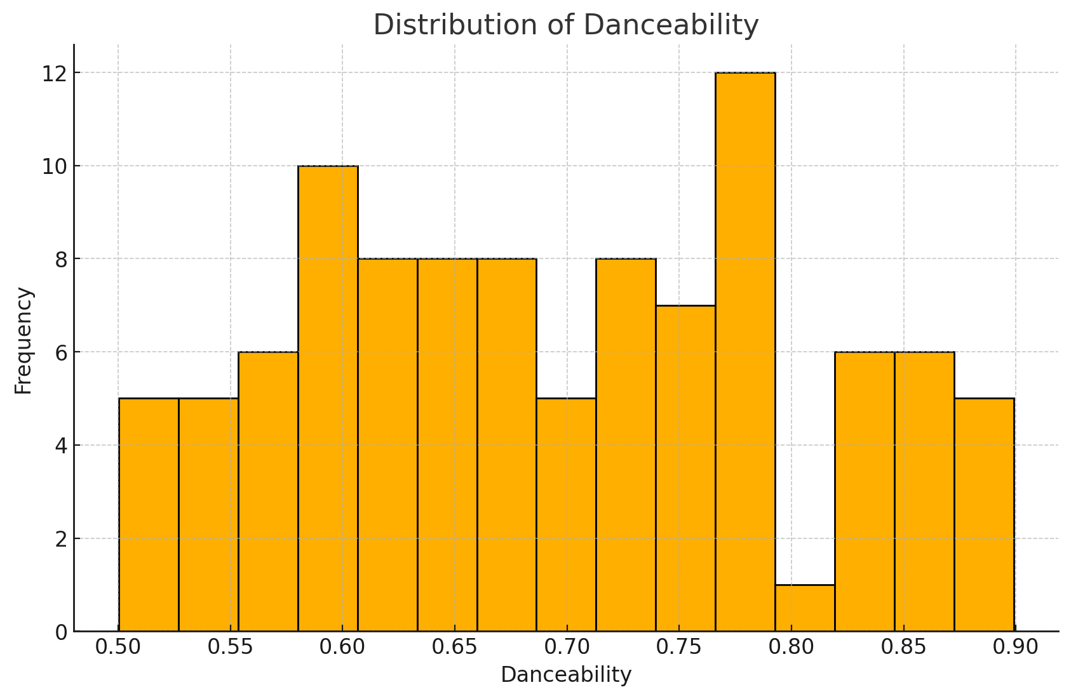
Visualization 1

Slide 5
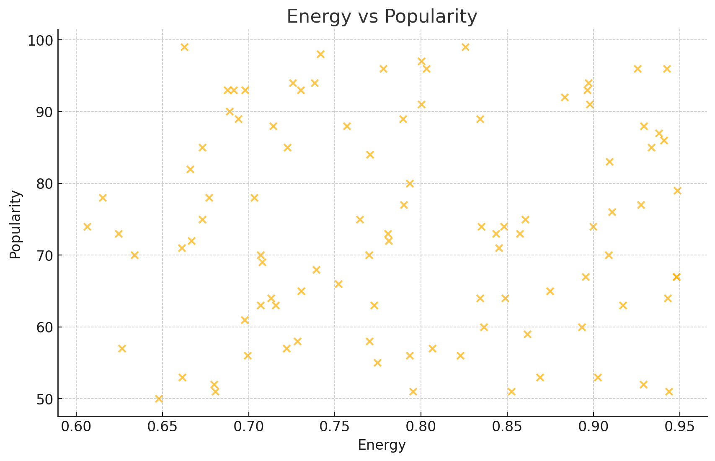
Visualization 2

Slide 6
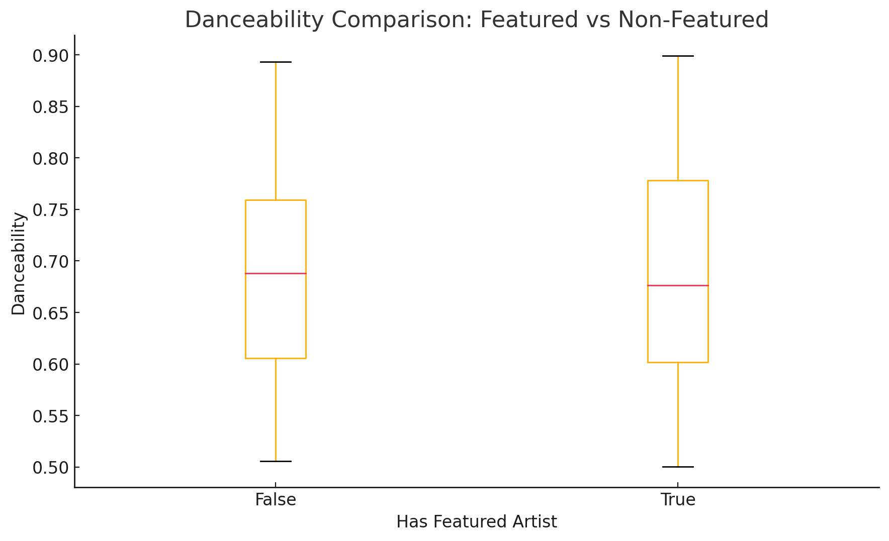
Visualization 3

Slide 7
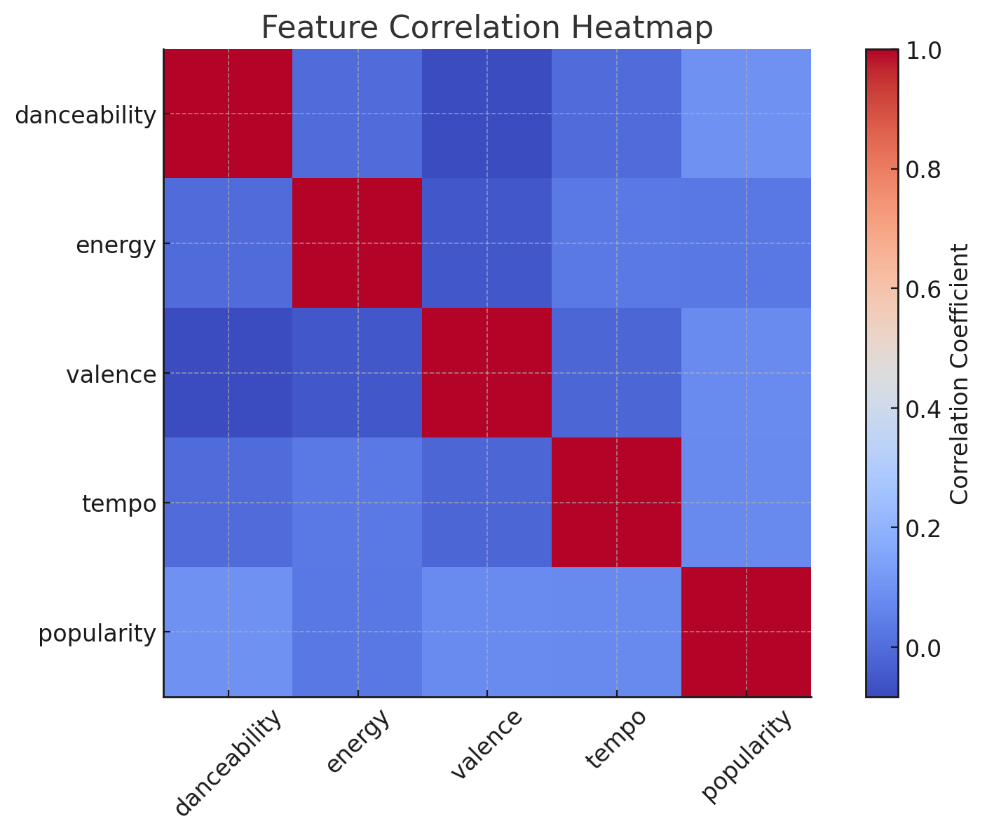
Visualization 4

Slide 8
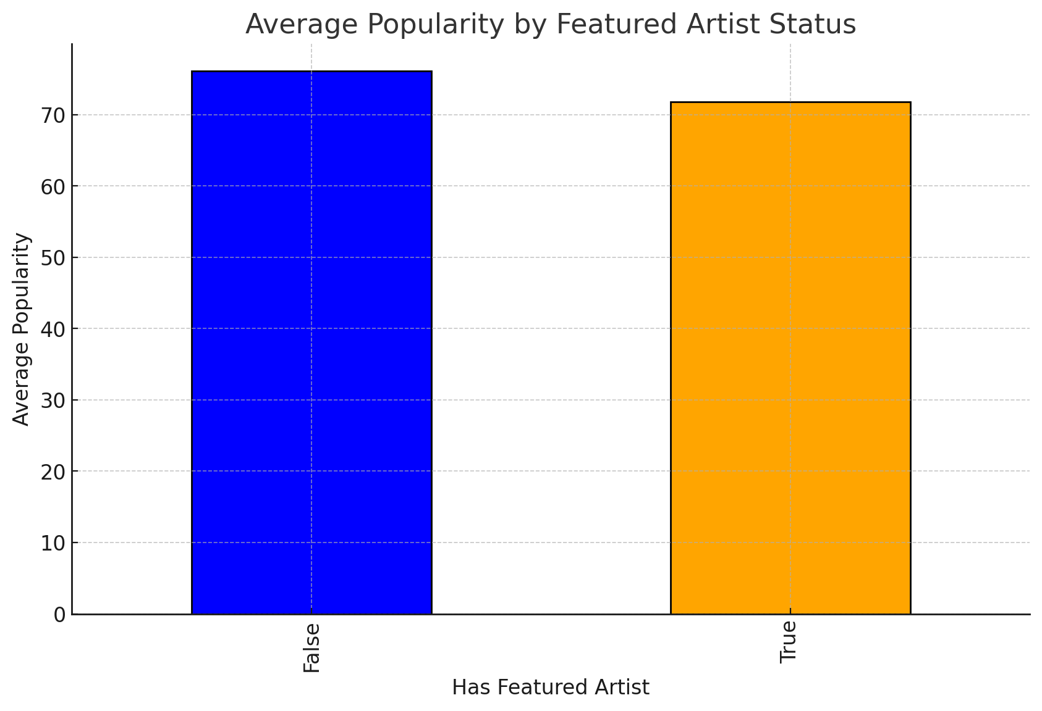
Visualization 5

Slide 9
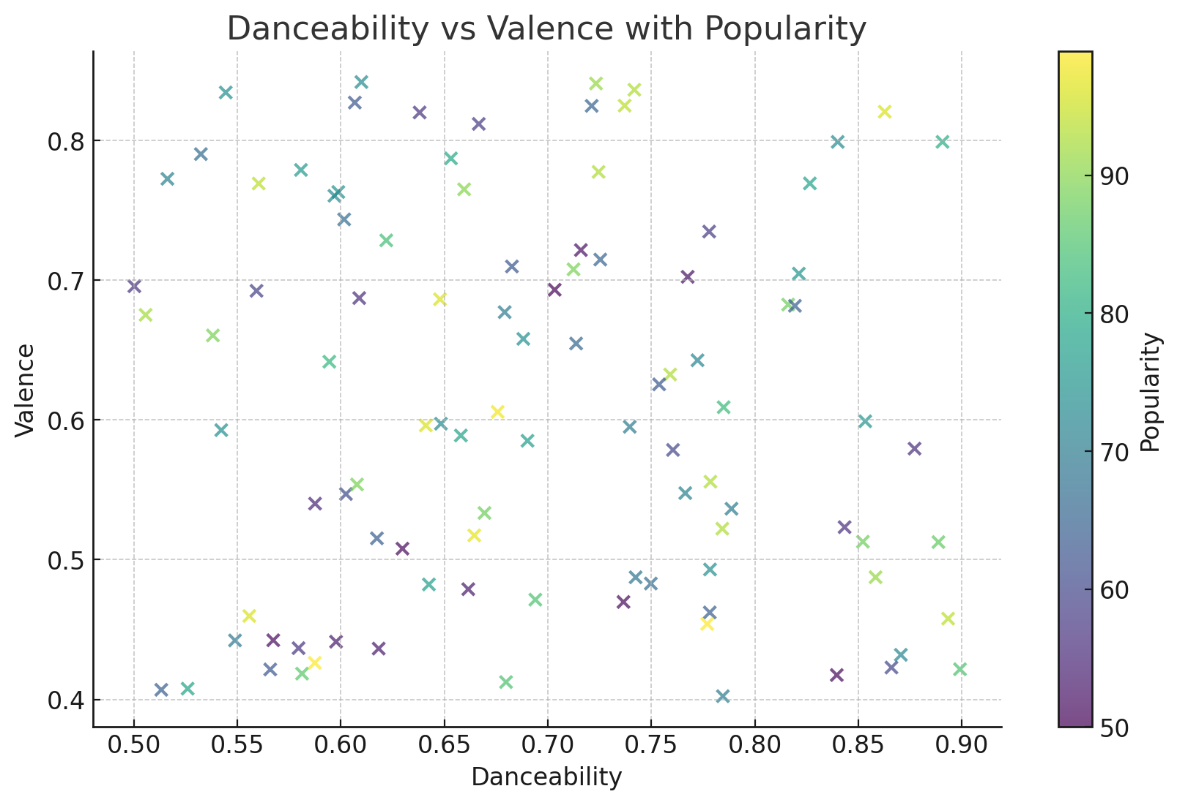
Visualization 6

Slide 10
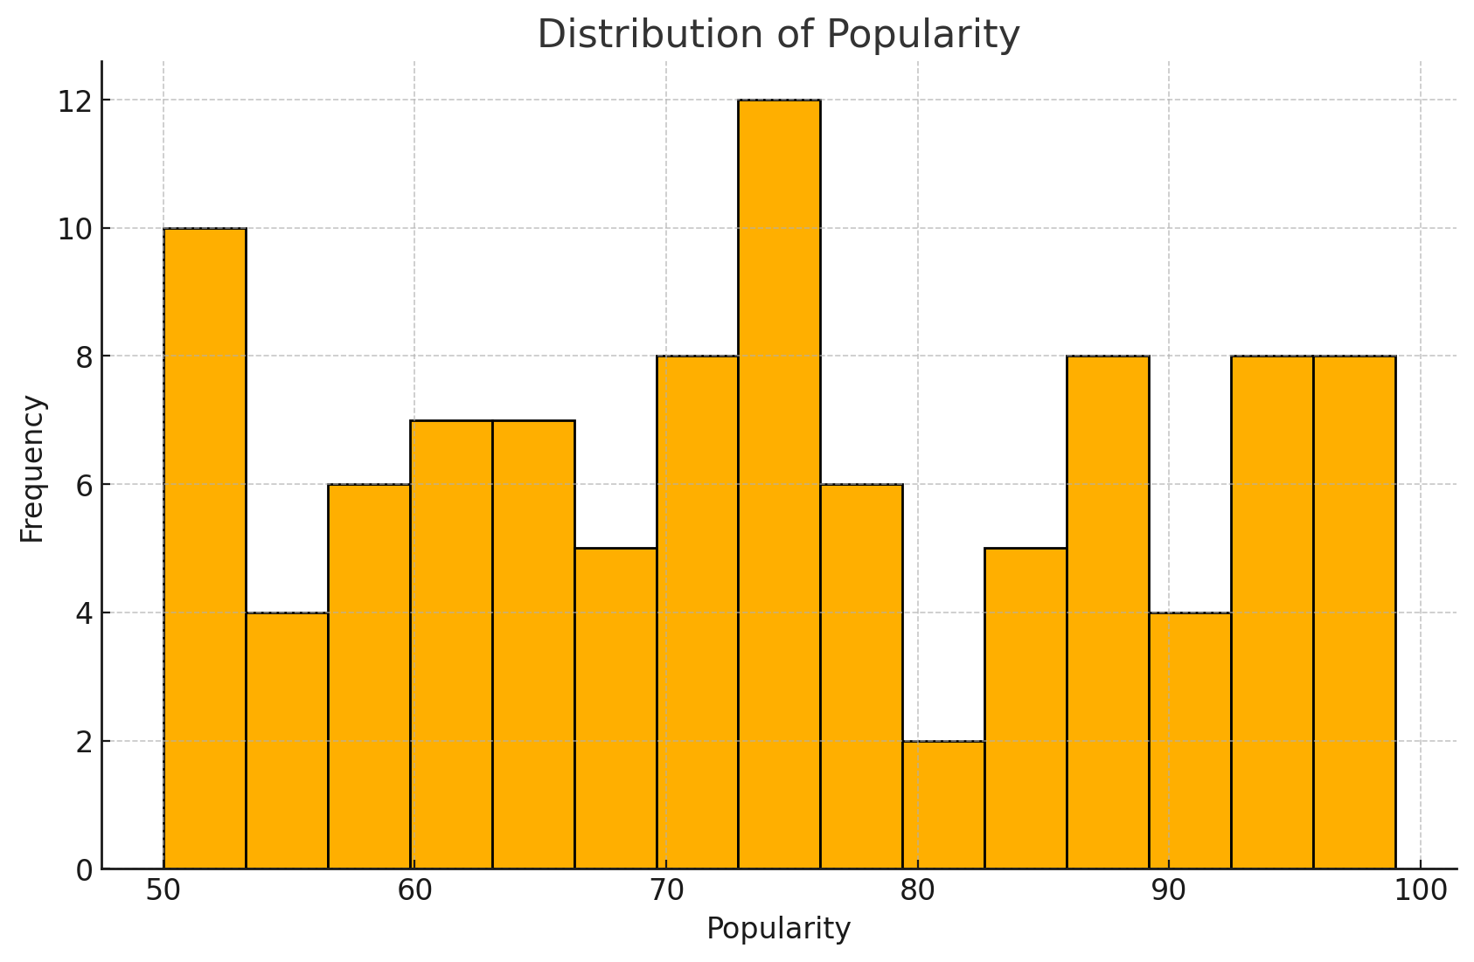
Visualization 7

Slide 11
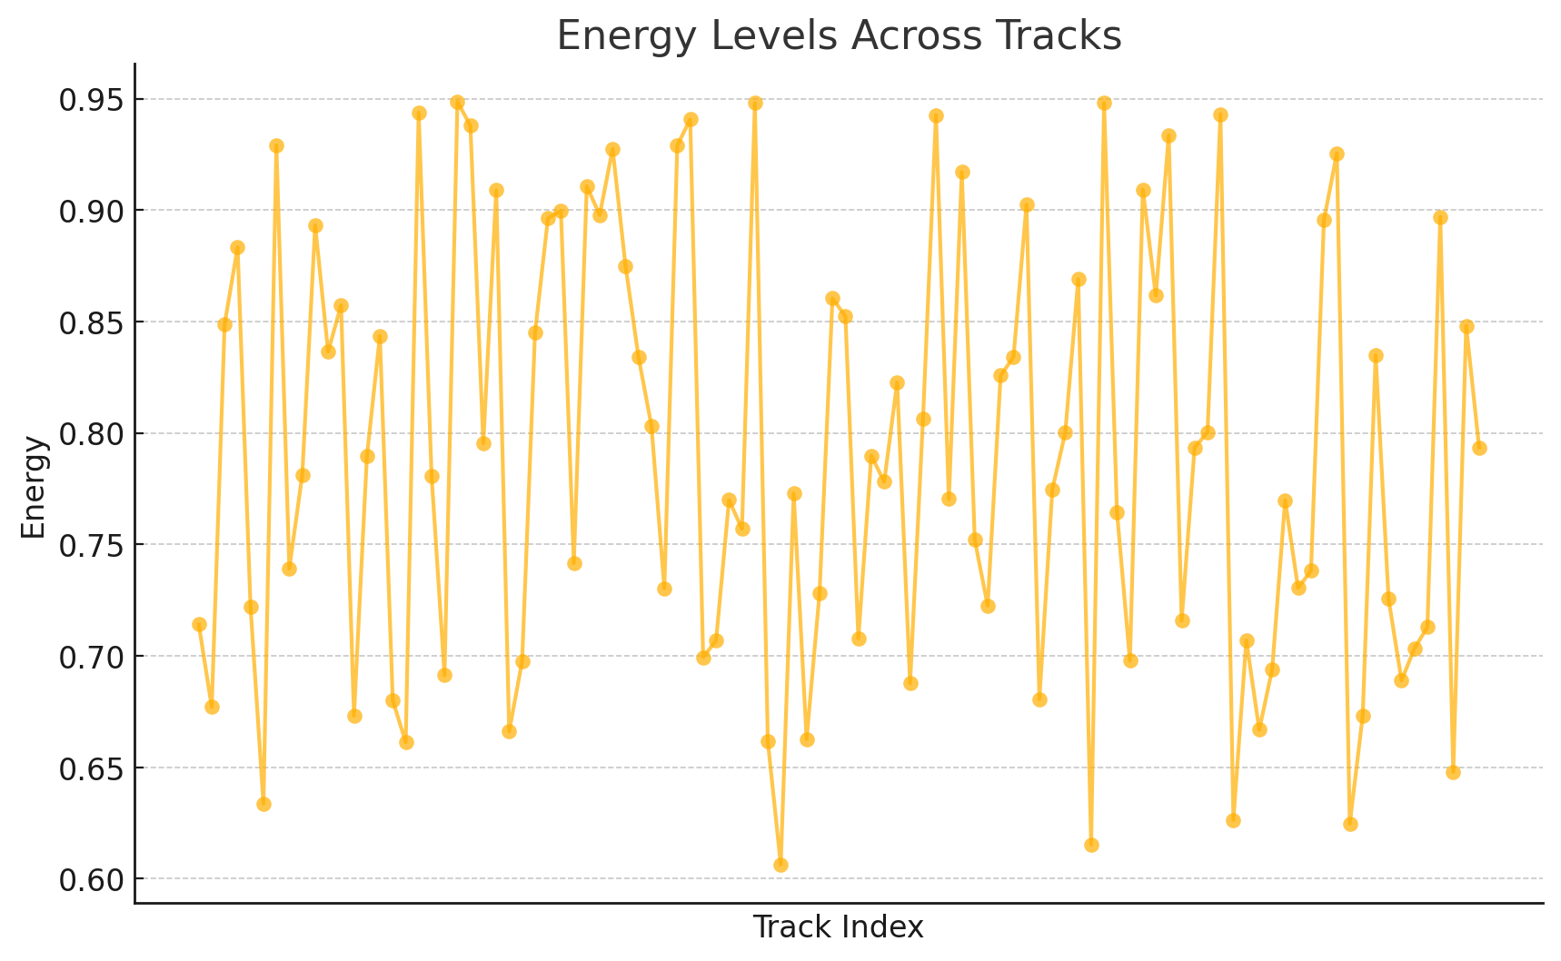
Visualization 8

Slide 12
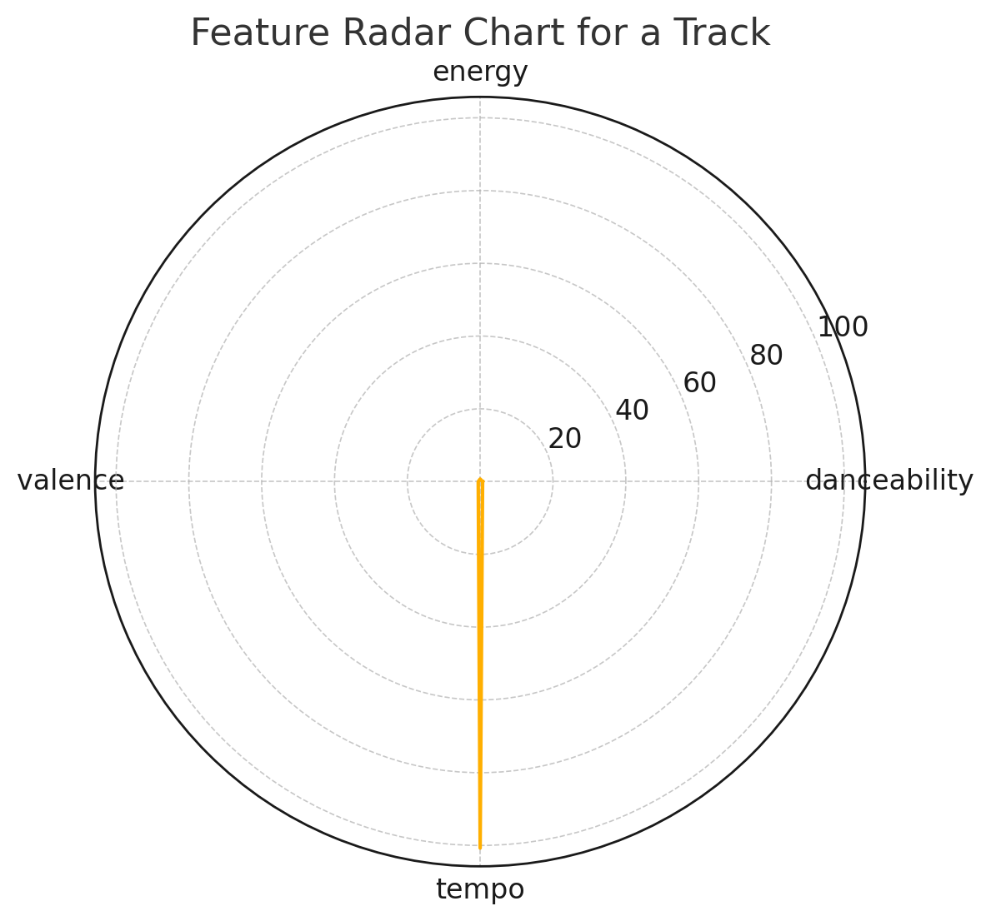
Visualization 9

Slide 13
Key Insights
- Popular songs have high danceability and energy.
- Collaborations impact track features and broaden audience reach.
- Pop and hip-hop dominate global trends.
- External APIs enrich insights with news and event data.

Slide 14
Practical Applications
- Music Production: Optimize features for higher success.
- Recommendation Systems: Improve playlist curation.
- Marketing Strategies: Use insights to target audiences effectively.
- Event Planning: Identify demand and schedule tours.

