Slide 1

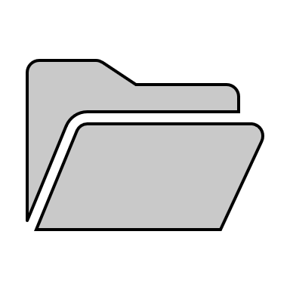

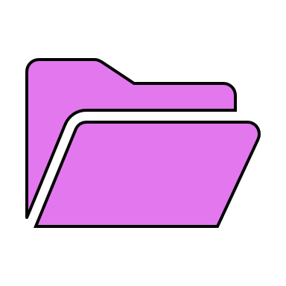


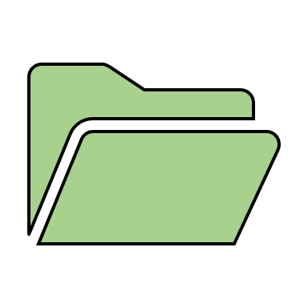
FOLDER STRUCTURE (possible options)
.extension - folder with your extension name to end with .extension. Folder to contain .tab folder and optionally lib and hooks folders.
lib - is to store your library (functions, etc.)
hooks - to store hook scripts which get executed when certain events occur.
.extension folder to be stored in C:\Program Files\pyRevit-Master\extensions
.extension
lib
hooks
.tab - folder with your Tab name to end with .tab. If more than one .Panel folder, then .tab folder to contain bundle.yaml file to indicate layout of panels.
.tab
* more than one Tab can be created
.Panel - folder with your panel name to end with .Panel. If .Panel folder contains more than one folder, then bundle.yaml file is required to indicate the layout.
* more than one Panel can be created. This example shows 2 panels with 2 stack options
.Panel
.Panel
* stack to have at least 2 pushbuttons and maximum of 3 pushbuttons
.pushbutton - folder with your pushbutton name to end with .pushbutton. Folder to contain icon.png (96x96) file and .py file with your script name that ends with script.py.
.pushbutton
.pulldown
.stack
.pushbutton
.pulldown
.stack
.pulldown - folder to end with .pulldown and to contain .pushbutton folder and icon.png (96x96) file for the .pulldown folder. If more than one .pushbutton folder, then bundle.yaml file is needed to indicate the layout.
.pushbutton
.pushbutton
.pushbutton
.pushbutton
* pulldown button to have at least one pushbutton
.stack – folder to end with .stack. Can contain .pushbutton and .pulldown folders. If more than one folder inside .stack folder, bundle.yaml file is required to indicate the layout.
.pushbutton
.pushbutton
.pushbutton
.pulldown
.pushbutton
.pushbutton
.pushbutton

