Slide 1

Does Defense Win Championships? A look at the NBA from 2009 – 2019
Doug Marcum
Bellevue University DSC 530
February 29, 2020

Slide 2

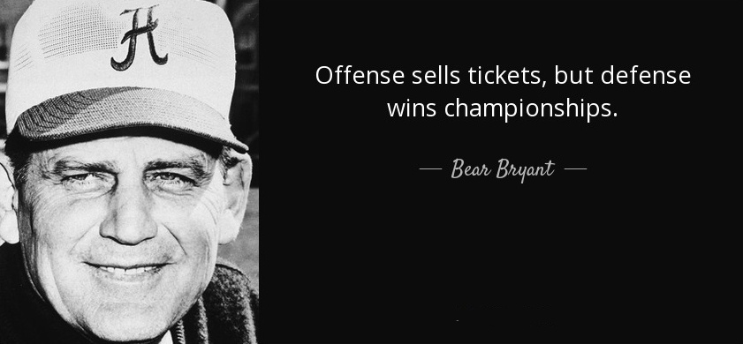
While Bear Bryant did not coach basketball, his statement has resonated across all sports since he uttered those words. The purpose of this project is to see if this still rings true in today’s National Basketball Association (NBA). This will be done through an evaluation of the past decade of performance (2010 – 2019).

Slide 3
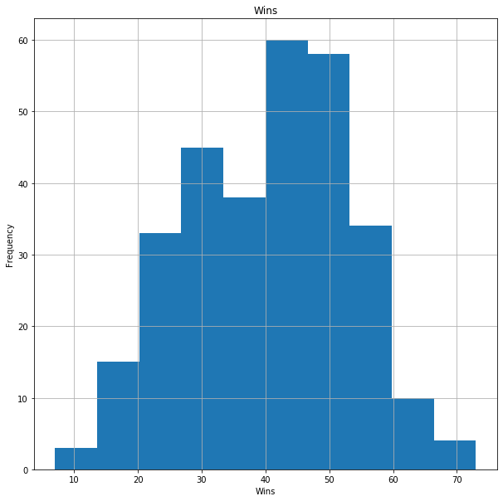
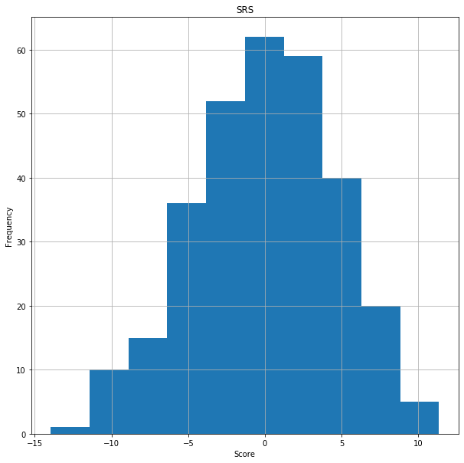
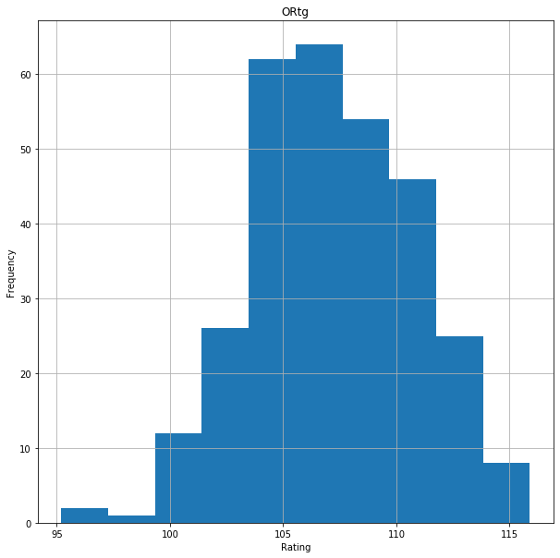
Data - Variables
Wins - The number of wins a team had in each season.
SRS - Simple Rating System
A rating that considers average point differential and strength of schedule.
The rating is denominated in points above/below average, where zero is average.
ORtg - Offensive Rating
For teams it is points scored per 100 possessions (higher rating is better).

Slide 4
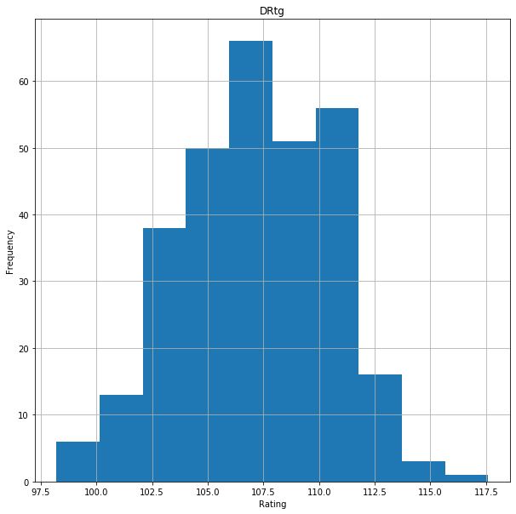
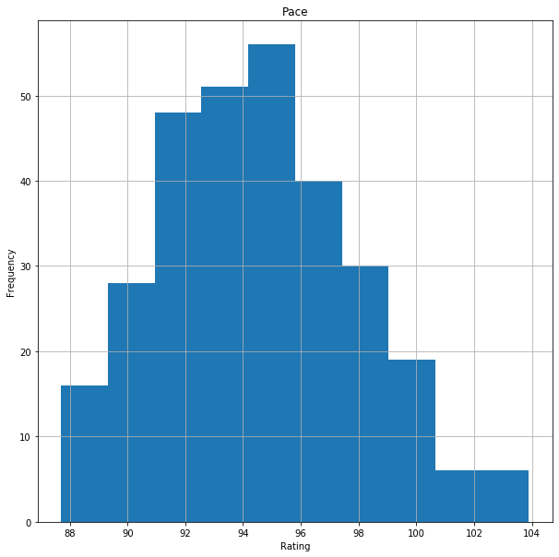
Data - Variables
Additional Variables
Season - The season/year the team played in.
Team - Identifier for the team by City / Name.
Champion - An integer code for the outcome of the winner of the season. The code 1 indicates the winner.
Playoffs - An integer code for teams in the playoffs each season. The code 1 indicates a playoff participant.
DRtg - Defensive Rating
For teams it is points allowed per 100 possessions (lower rating is better).
Pace - Pace Factor
The formula is 48 * ((Tm Poss + Opp Poss) / (2 * (Tm MP / 5))).
Pace factor is an estimate of the number of possessions per 48 minutes by a team.

Slide 5
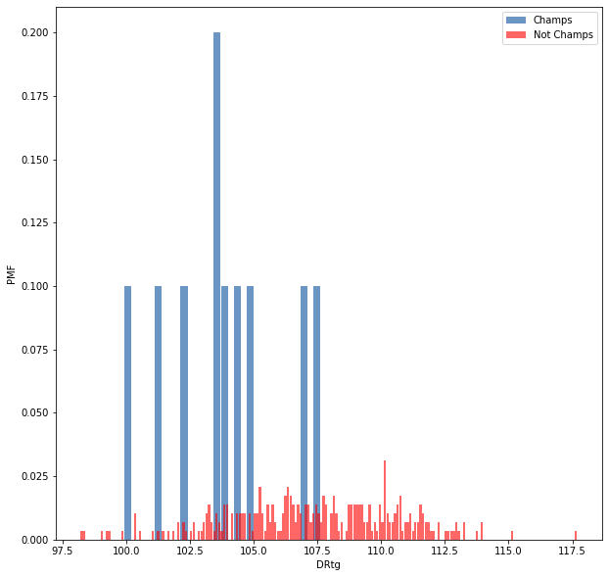
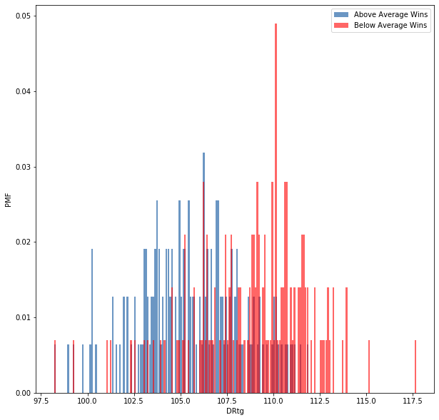
Probability Mass Function (PMF)

Slide 6
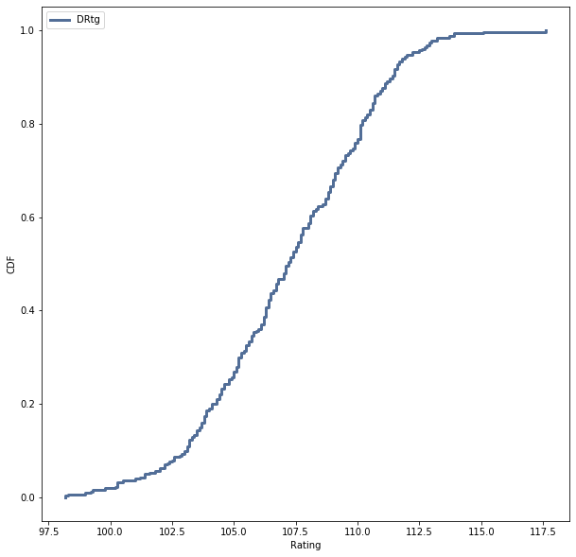
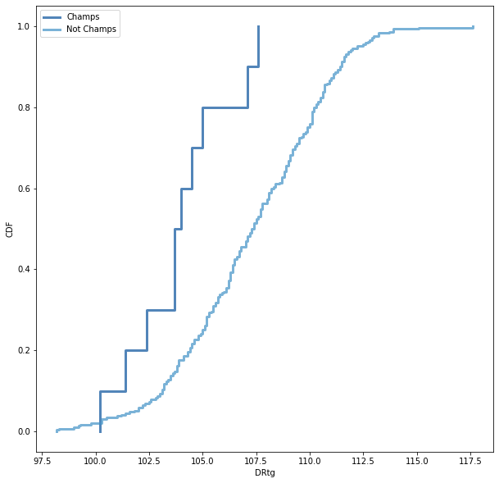
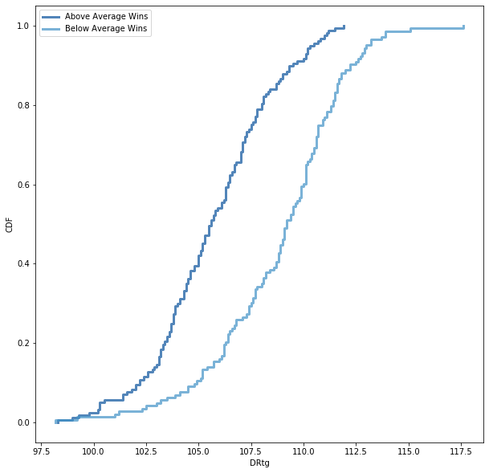
Cumulative Distribution Function (CDF)

Slide 7
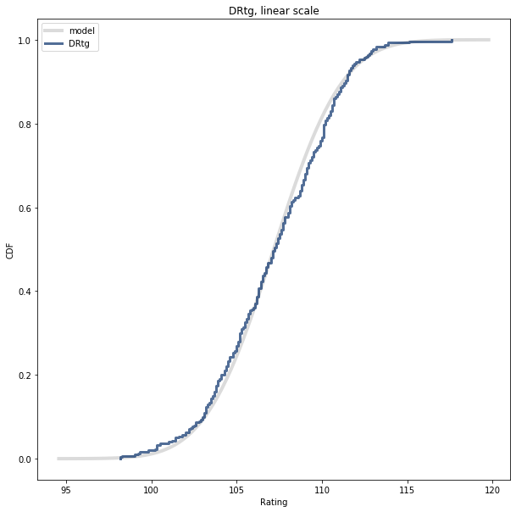
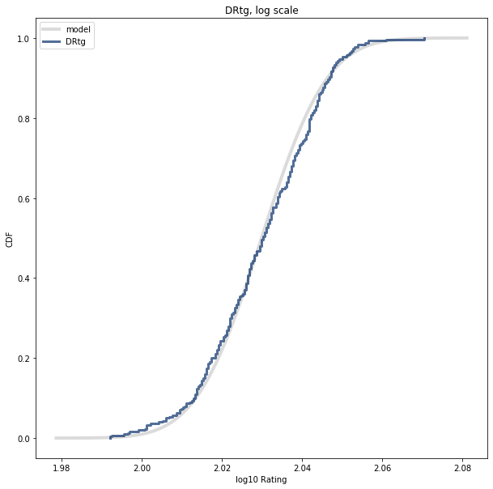
Analytical Distribution

Slide 8
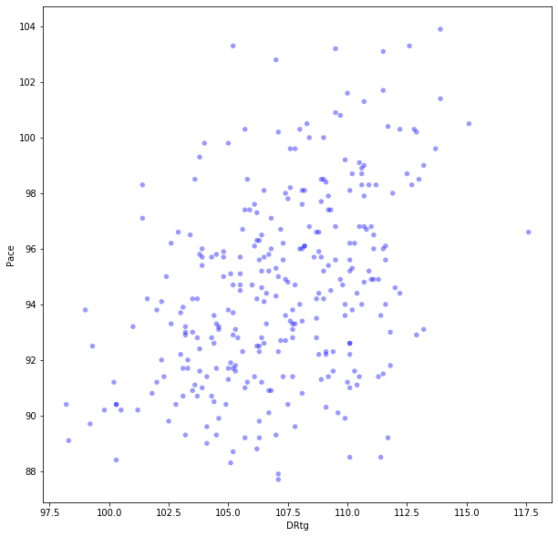
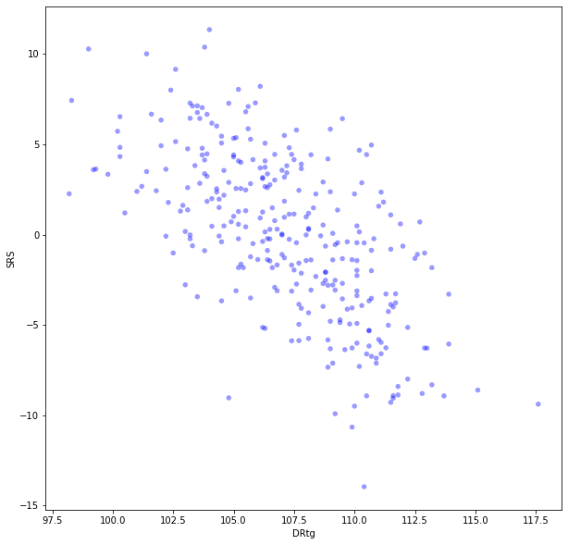
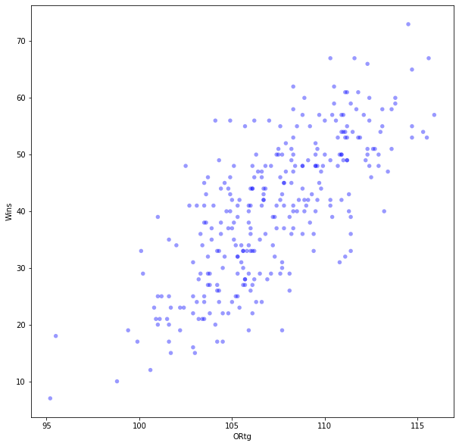
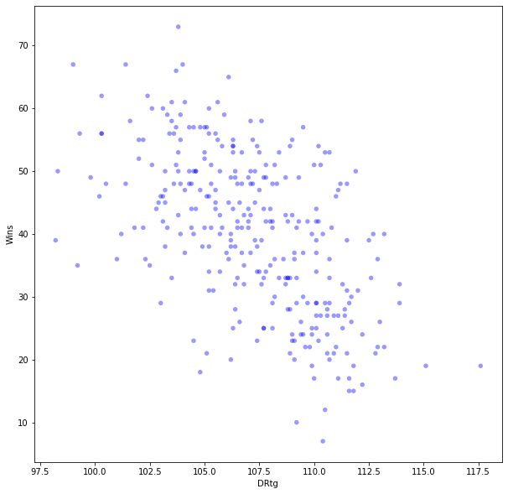
Scatter Plots

Slide 9
Hypothesis Testing
For hypothesis testing, two tests were executed on the data. The first, a permutation test on Champs_DRtg and Not_Champs_DRtg was ran. The results show p < .001 and can be concluded that the difference in DRtg is statistically significant.
For the second test, a correlation test between Wins and DRtg was executed. The computed p-value < 0.001 and after multiple iterations the actual correlation is approximately 0.573. The observed correlation is larger and statistically highly significant.

Slide 10
Regression Analysis
Multiple logistic regression models were built and executed based on different dependent variables. The first model had Champion as the dependent variable with multiple explanatory variables (DRtg, SRS, Pace). For comparison, a second model had Champion as the dependent variable with multiple explanatory variables (ORtg, SRS, Pace). The results from these models delivered extremely high accuracy (DRtg - 96.7%, ORtg - 96.3%), so a second set of models were built with Playoffs as the dependent variable. Here the results returned (DRtg - 75.7%, ORtg - 73.3%).
To attempt to answer the question of defense equally championships, new predictions were made based off the following:
Defense = (Champs.DRtg.min(), Champs.SRS.max(), Champs.Pace.min())
Offense = (Champs.DRtg.max(), Champs.SRS.max(), Champs.Pace.max())
This would hypothetically create the best defensive metrics team from the Champion over the past ten (10) seasons, as well as the best offensive metrics team. The results show that these scenarios, while not head to head, predict the max defensive team to win the championship an estimated 70.21% and the max offensive team an estimated 68.10%.

Slide 11
Data Sources and References
Basketball-Reference.Com (BRC)
https://www.basketball-reference.com
https://www.basketball-reference.com/leagues/
Downey, Allen B. Think Stats: Exploratory Data Analysis. O'Reilly Media.

