Slide 1
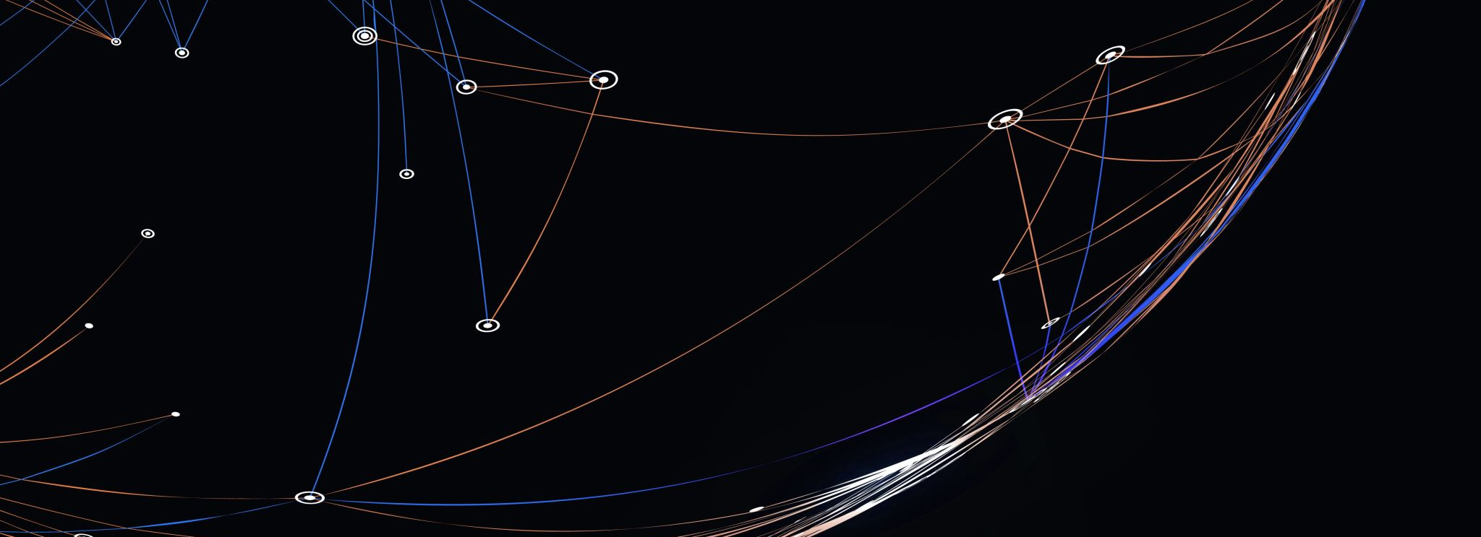
Flappy bird AI
Szigethy Virág
Szigeti Mark

Slide 2
Framework and goals
Pygame for GUI
Neat for AI
Github for version control
Anaconda for environment managment
Goal: Beat Mark with the AI (Live demo ☺)

Slide 3
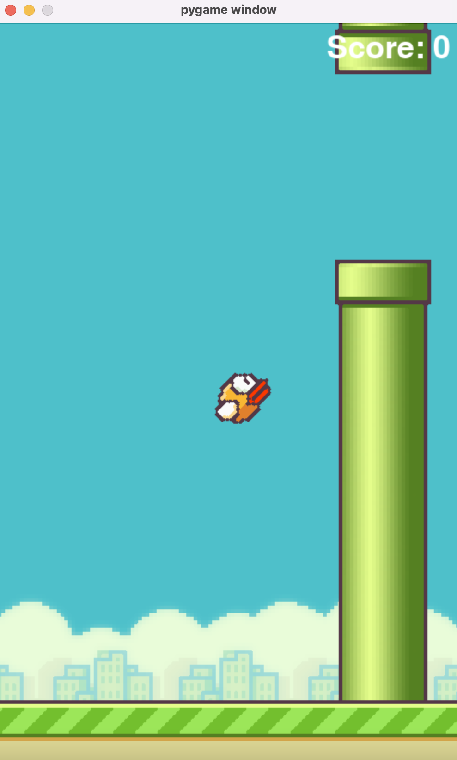
Recreating the game
„Borrowing” the textures from the internet
Animating the bird
Ground movement
Infinity pipe generation

Slide 4
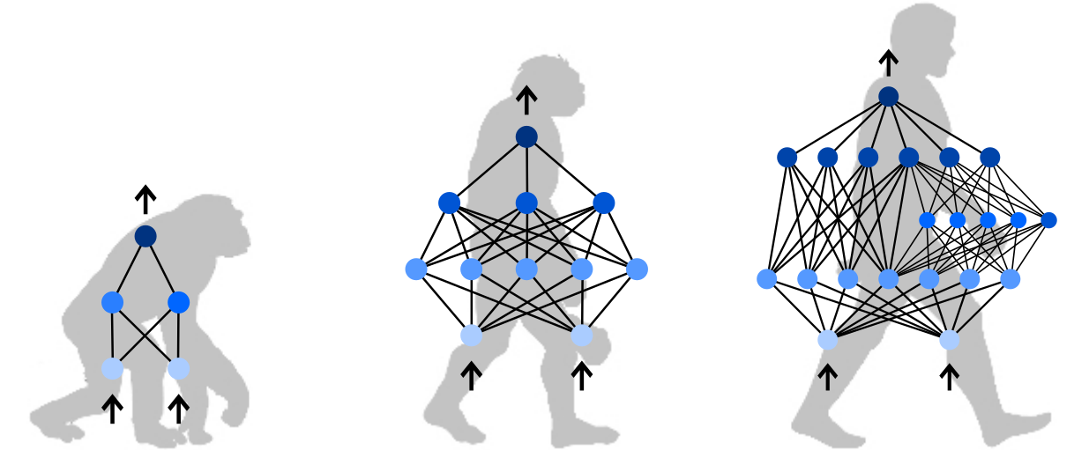
The NEAT algorithm
NeurEvolution Augmenting Topologies
Python library
Each bird has a network
Feed forward neural networks
Populations
Config file

Slide 5
LIVE DEMO TIME ☺

Slide 6
Thank you for your attention!

