Slide 2
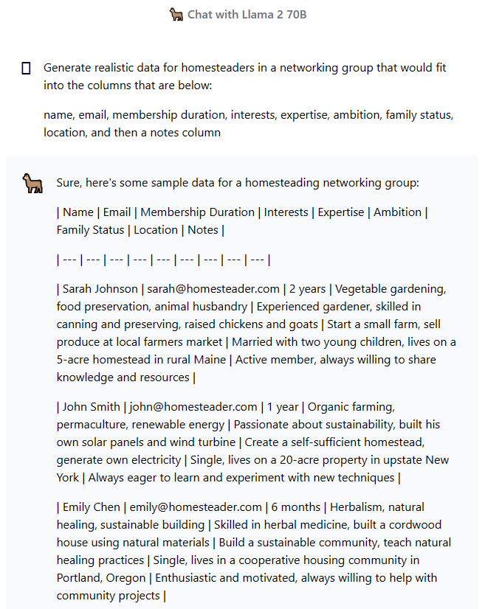
Fake Profile Creation
Used Llama 2 chatbot to create fake profiles of potential Exit members that fit into a variety of interest/expertise categories
Converted to a CSV file for use in various test projects

