Slide 1
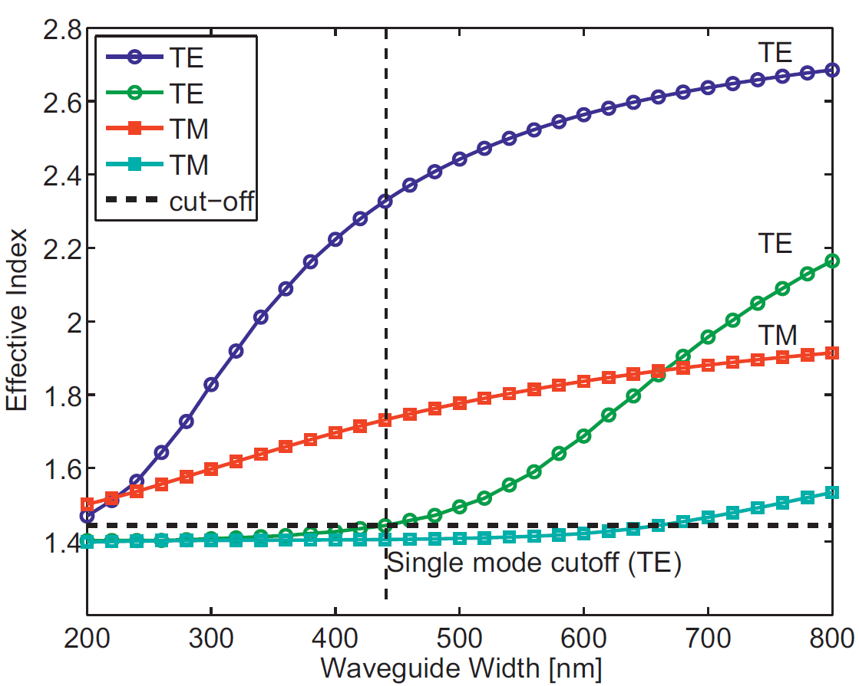
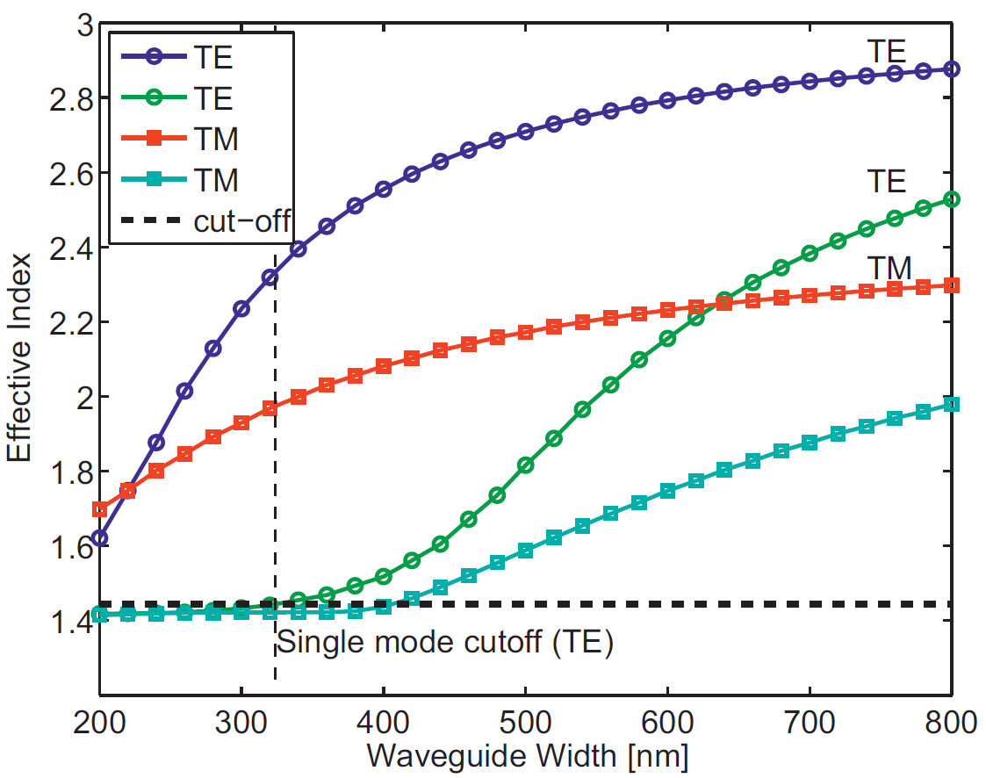
Notes:
Silicon Photonic Design Pg. 64

Slide 2
nSi = 3.477
nSiO2 = 1.444
Wl = 1550 nm
W = 500 nm
THK = 220 nm
nSi = 3.503
nSiO2 = 1.447
Wl = 1310 nm
W = 500 nm
THK = 220 nm
Mon1 = Effective index
Mon2 = Field 1/e width
Mon3 = Effective area
Mon4 = Partial power (Confinement factor)

Slide 3
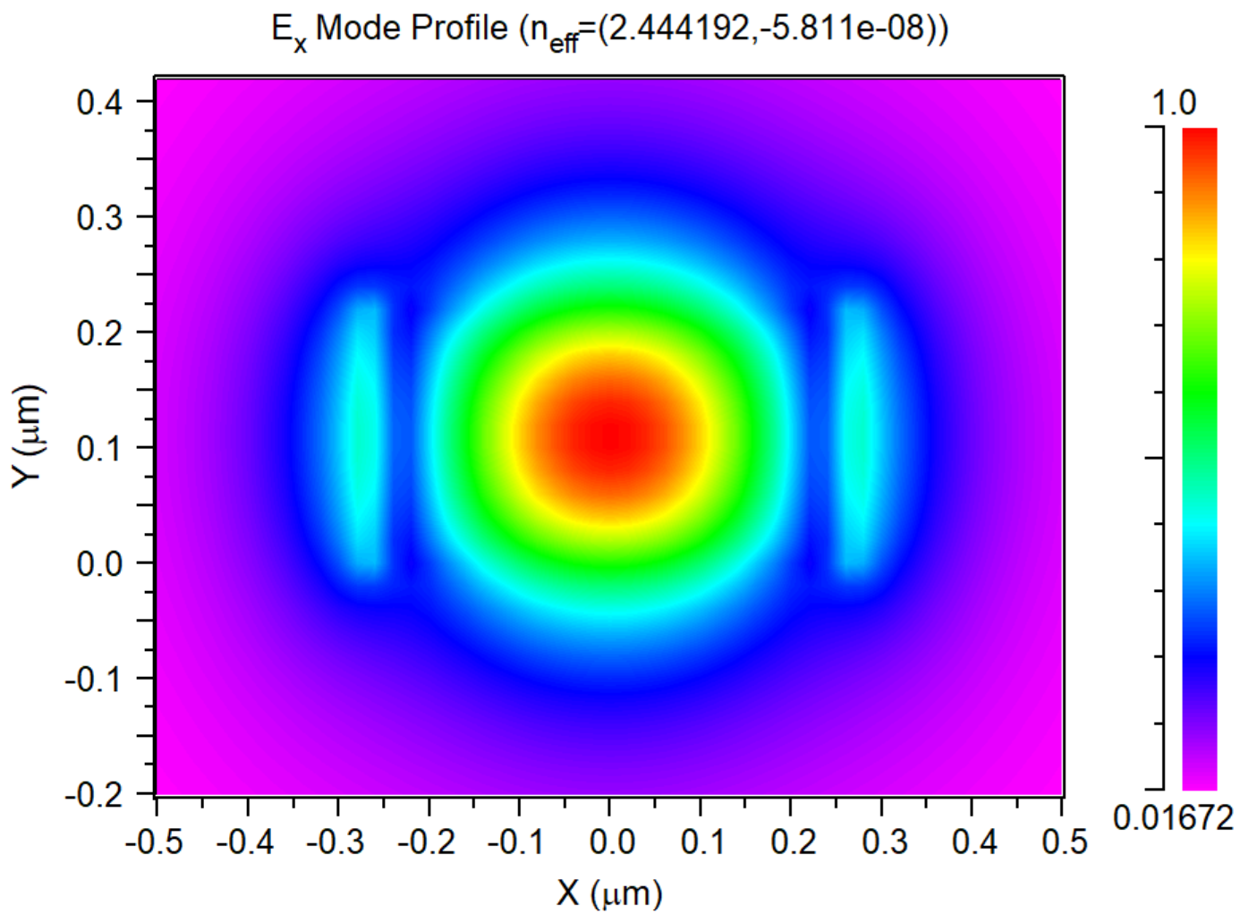
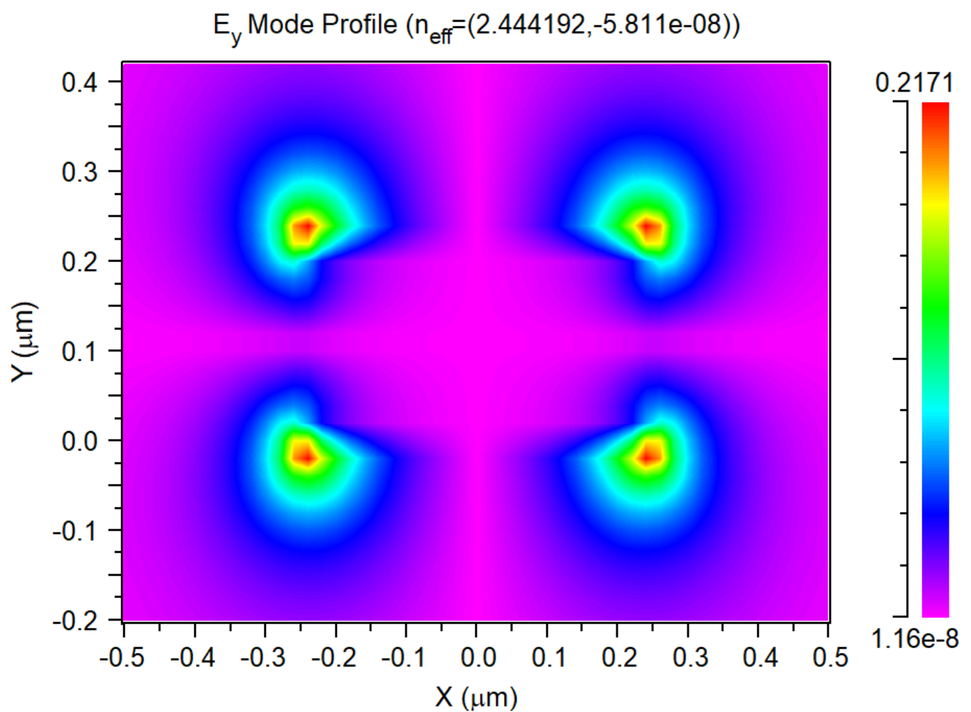
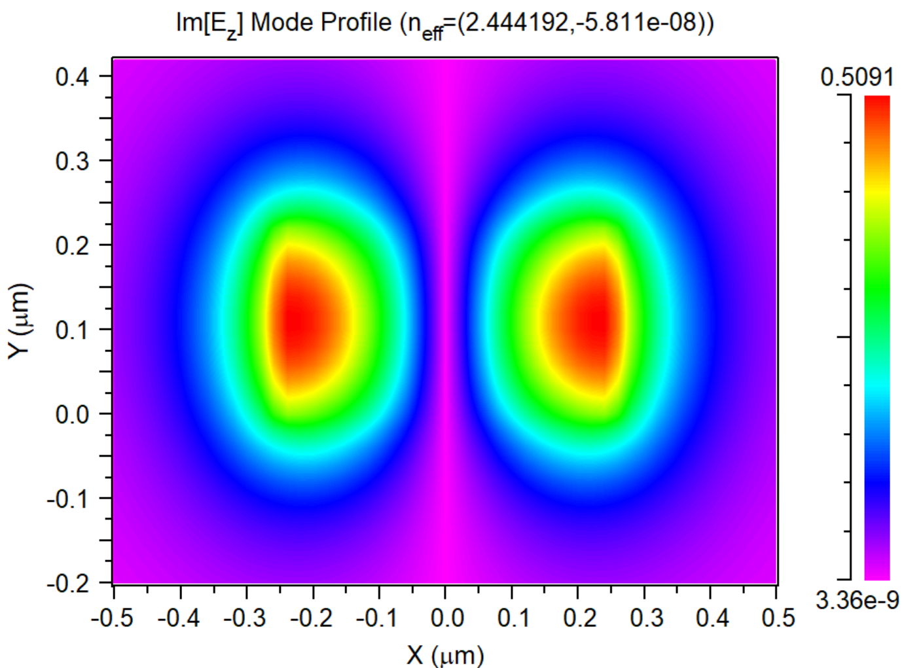
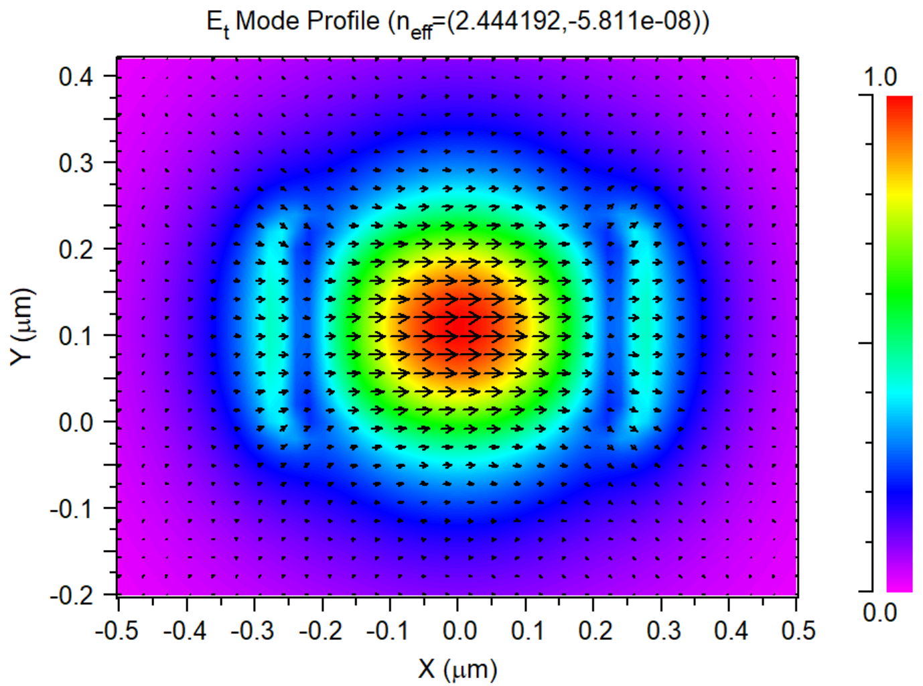
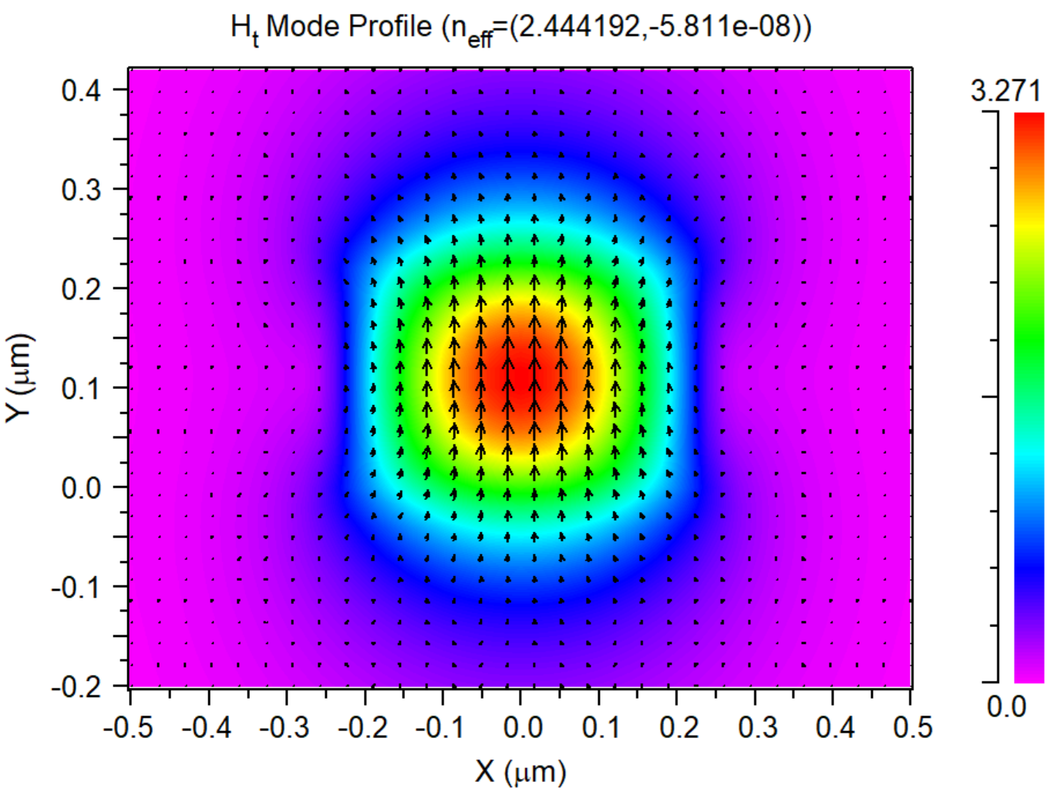
Ey
Ez
Ex
Notes:
1550 TE0

Slide 4
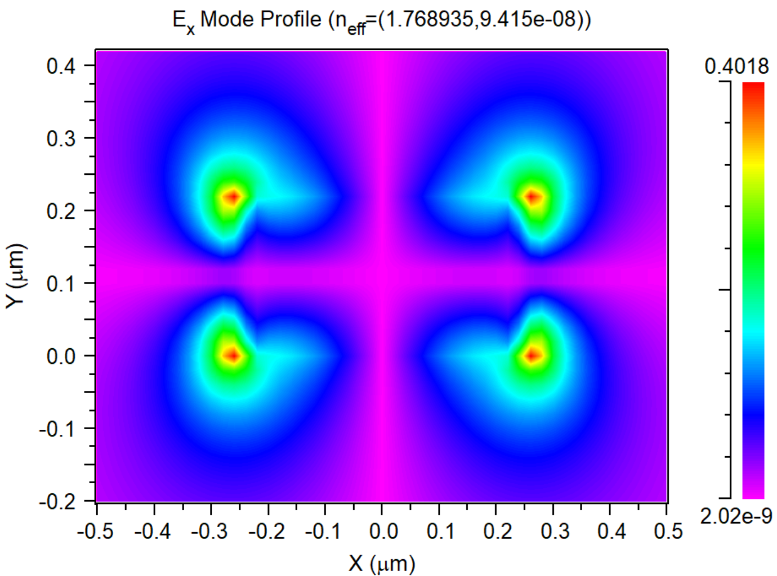
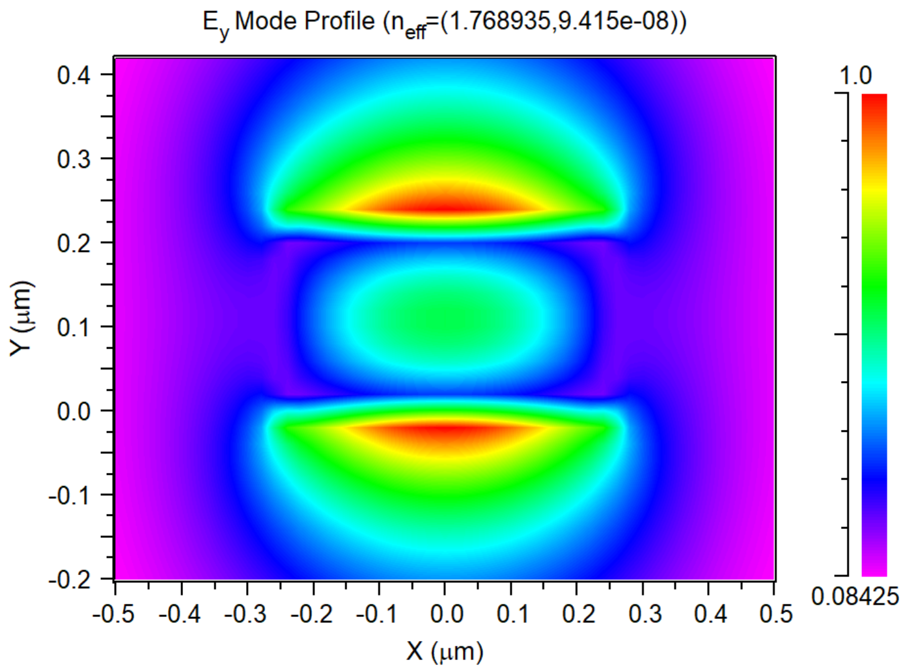
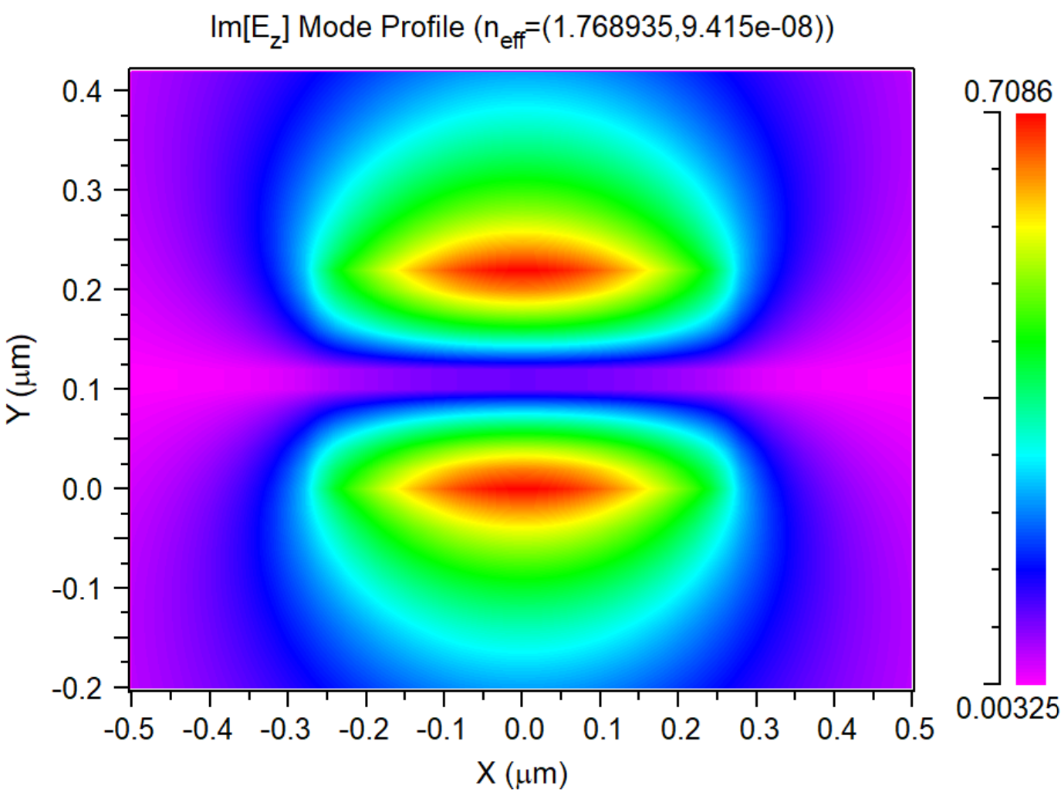
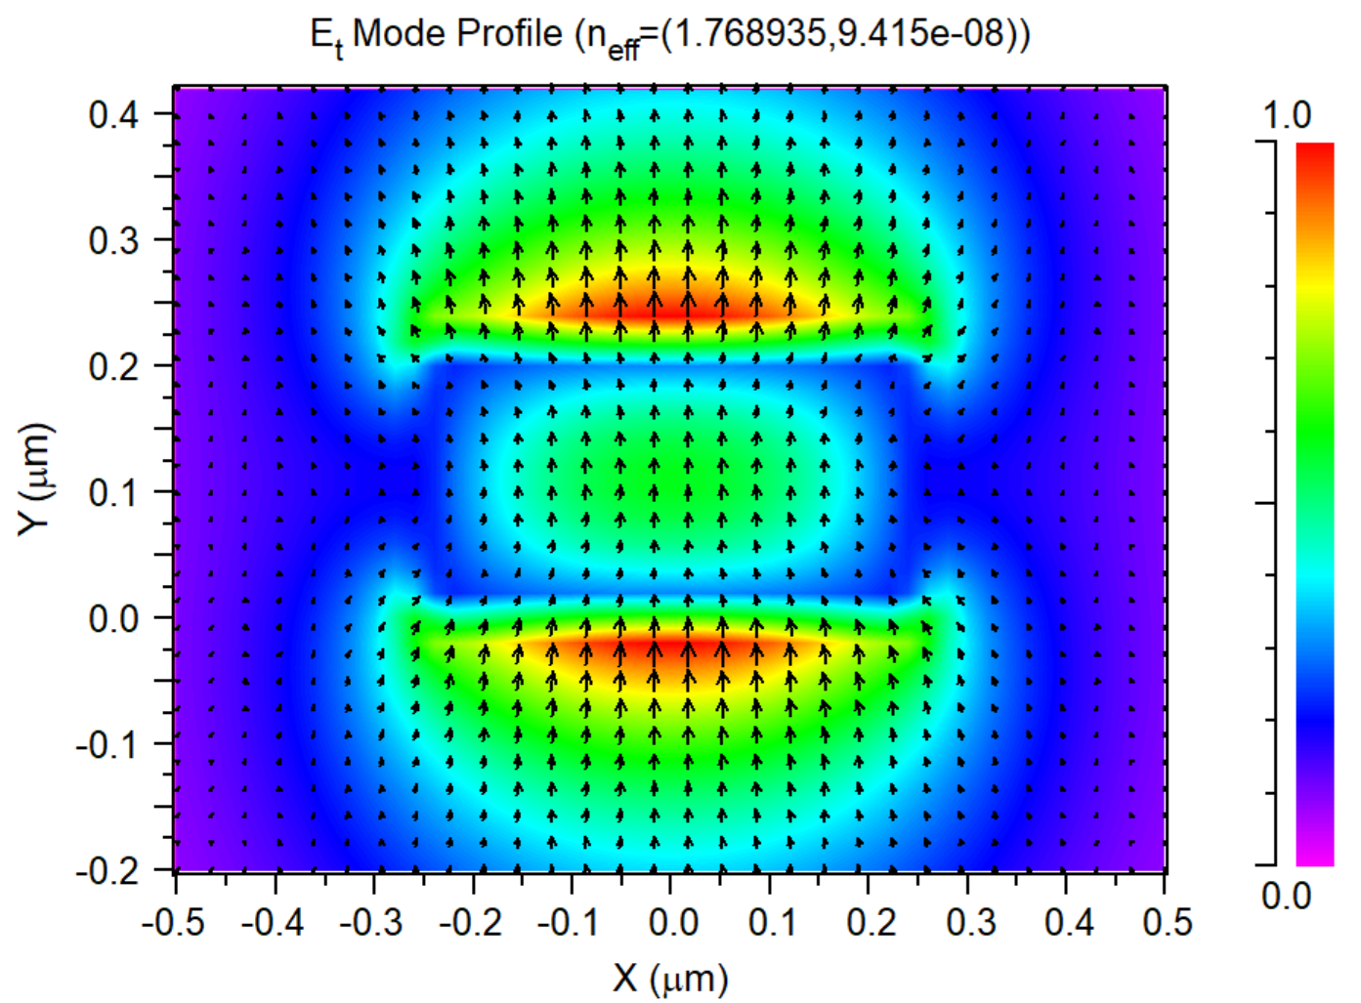
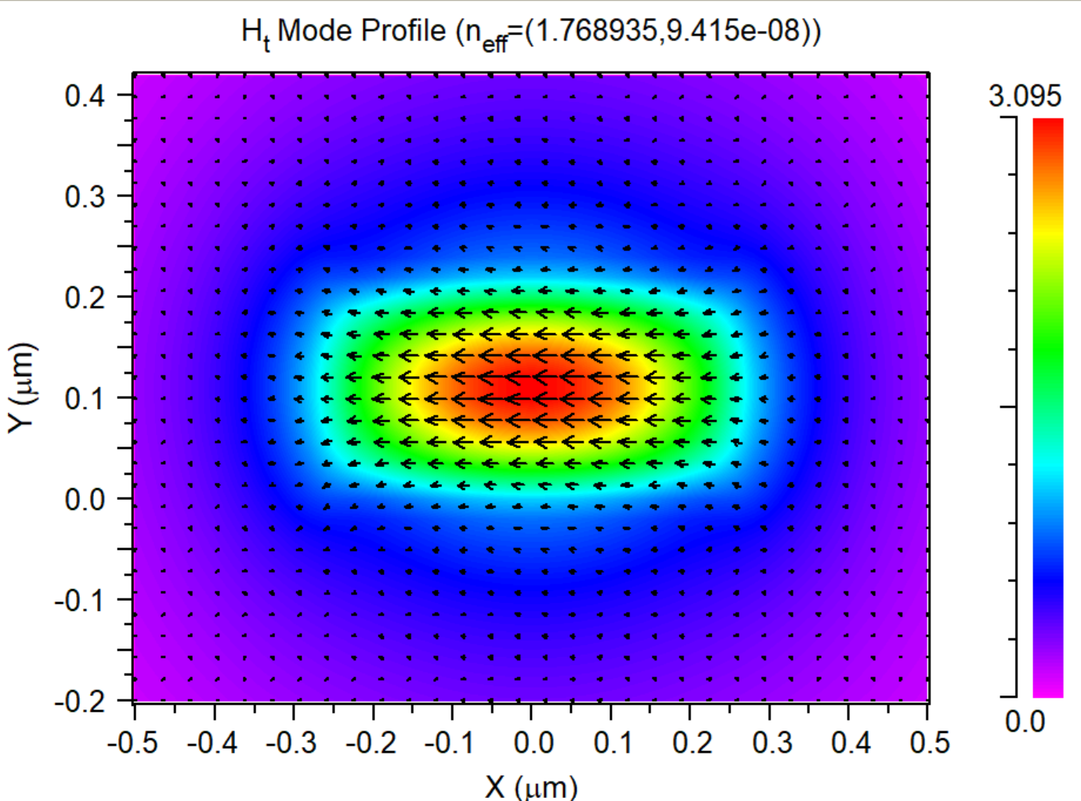
Ex
Ey
Ez
Notes:
1550 TM0

Slide 5
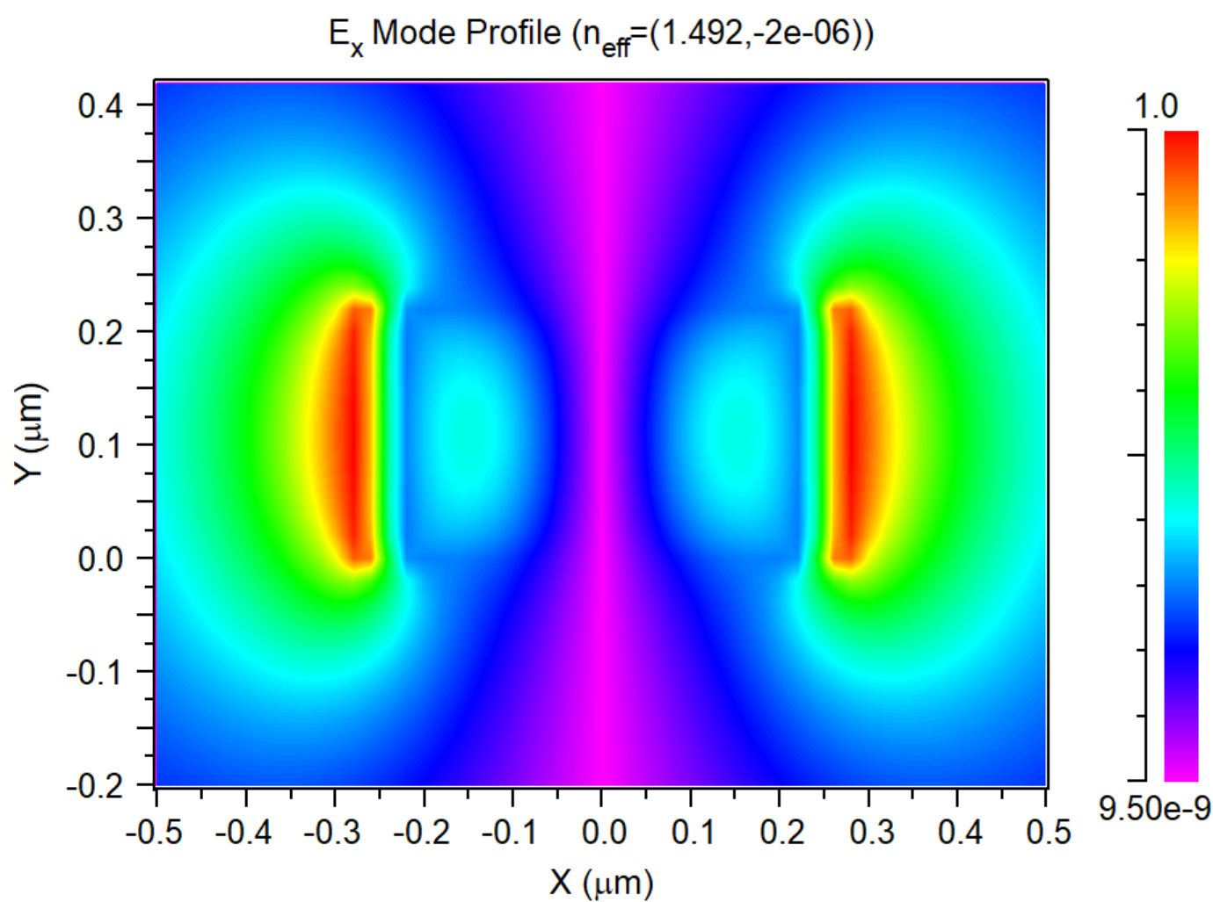
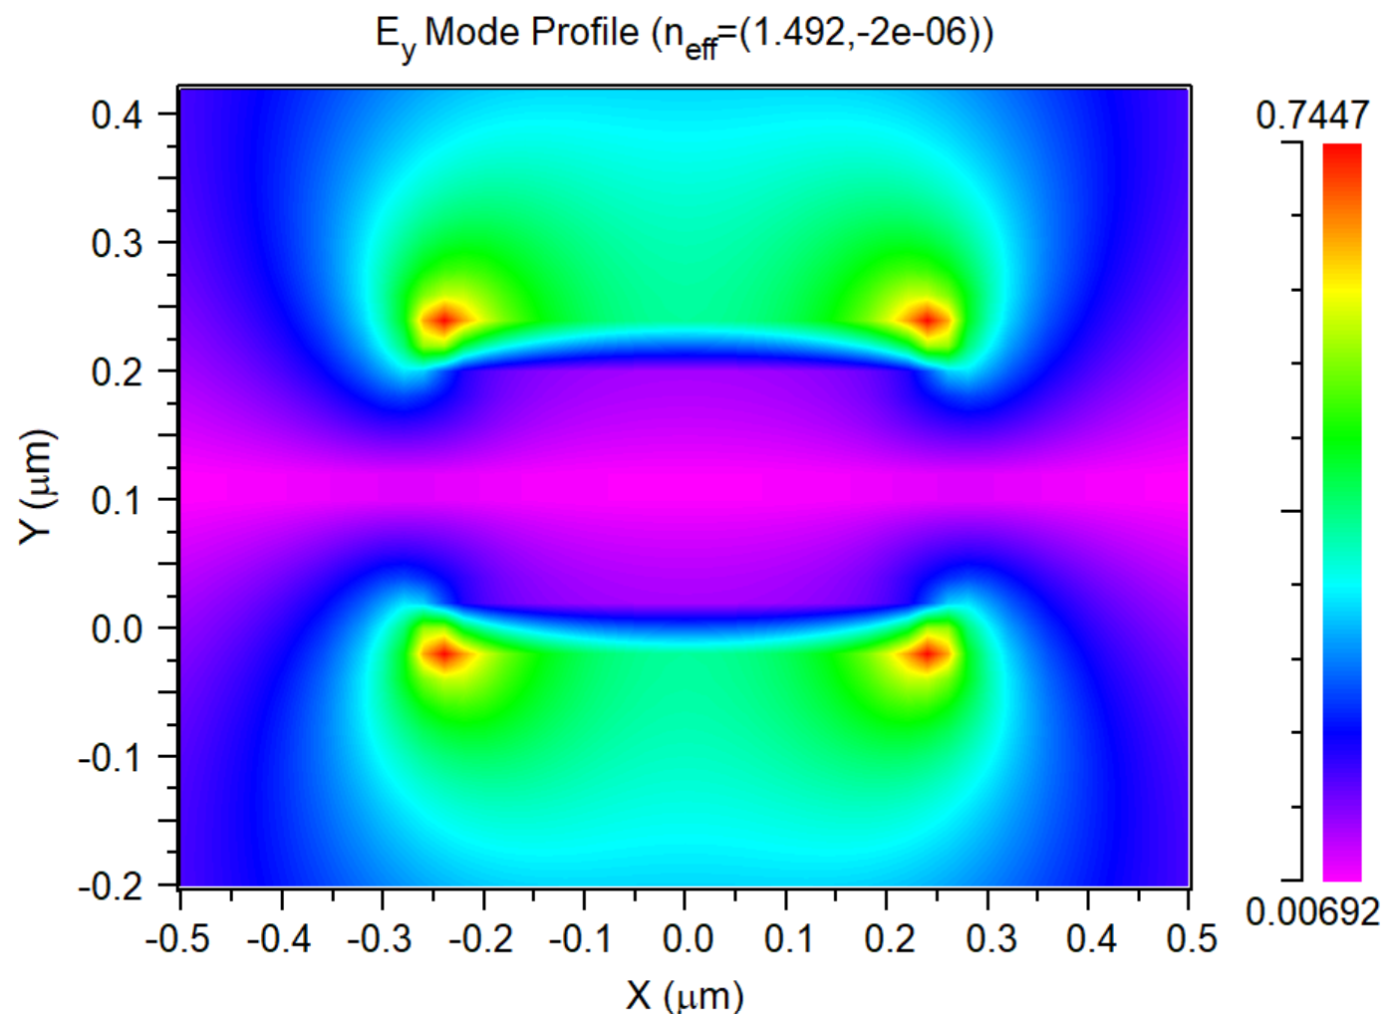
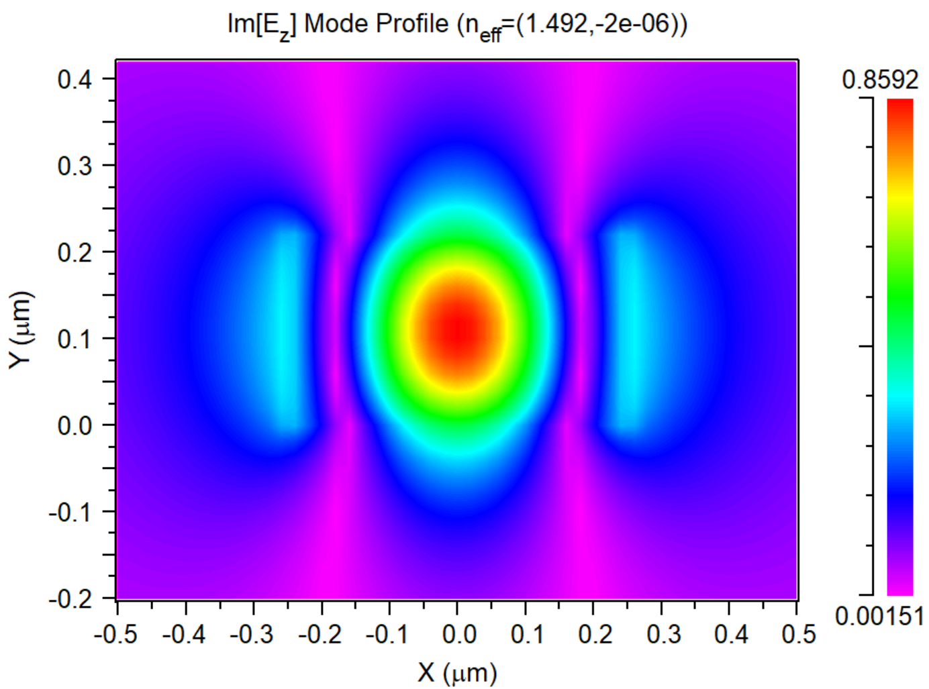
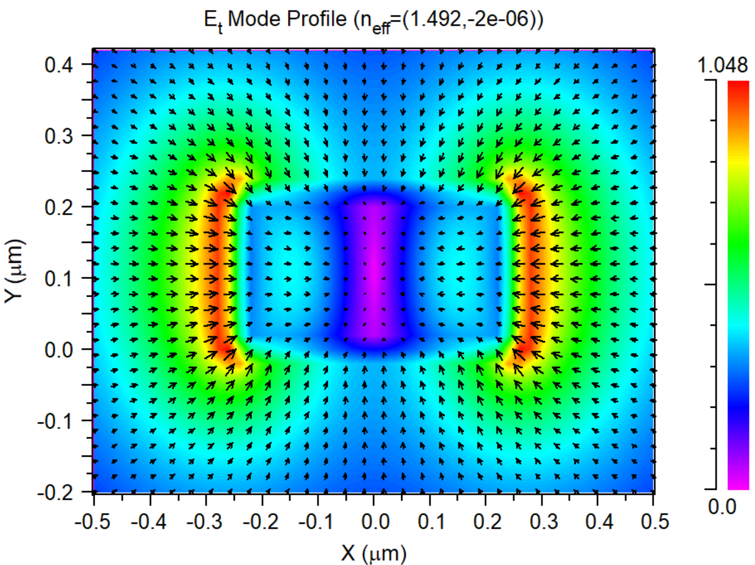
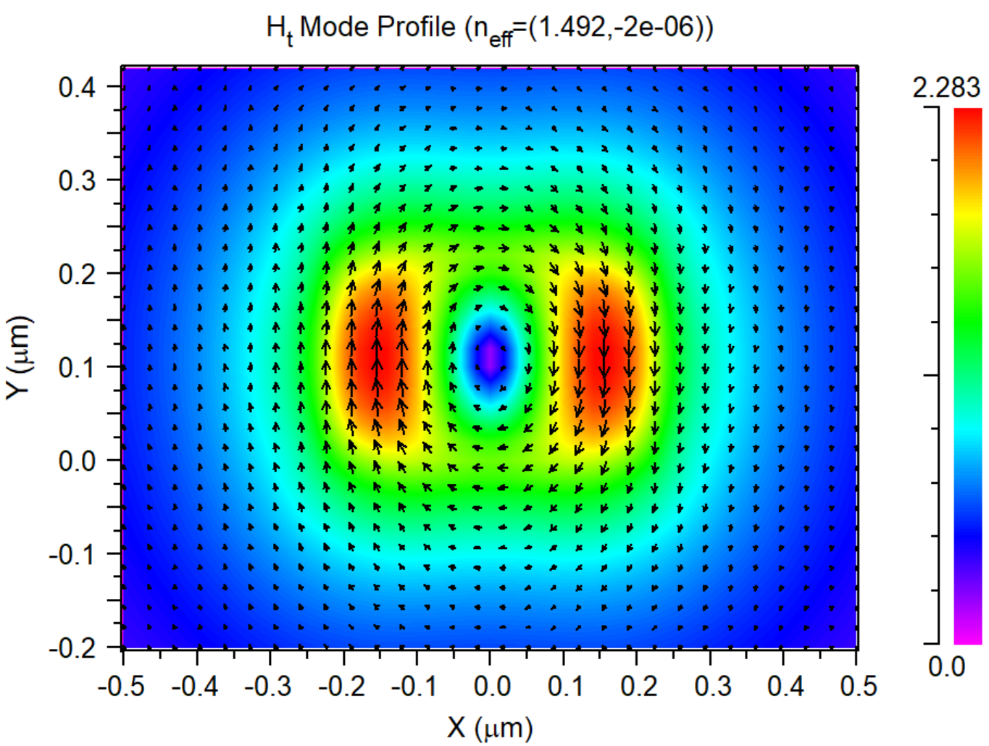
Ex
Ey
Ez
Notes:
1550 TE1

Slide 6
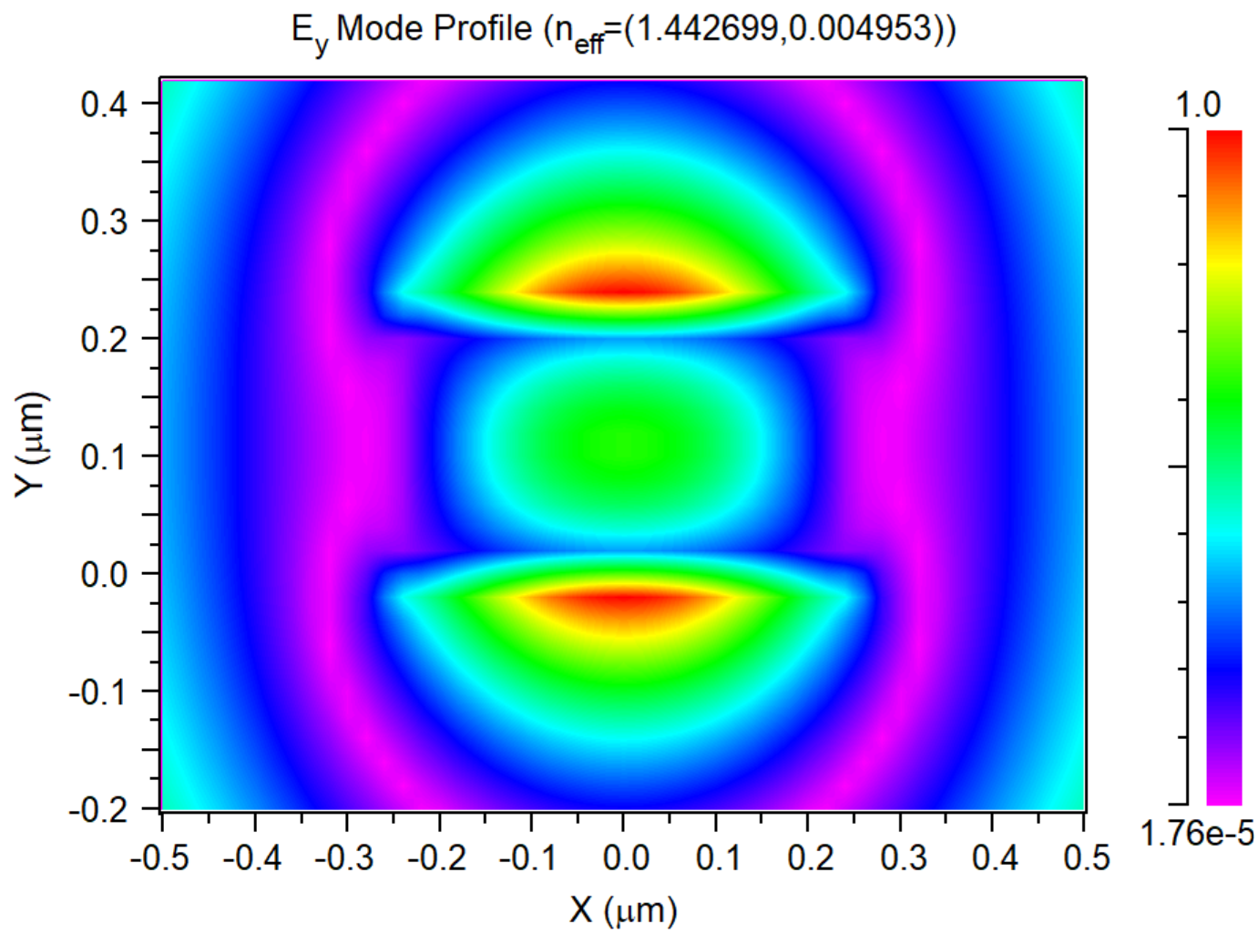
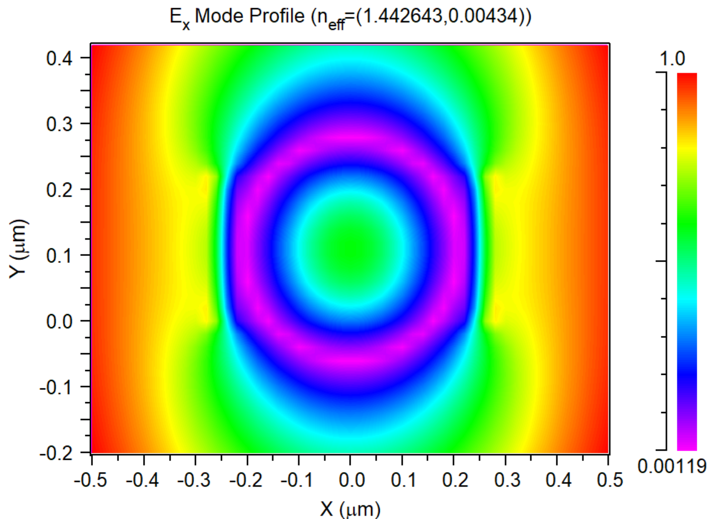
Notes:
TM1 and TE2

Slide 7
Neff[0]=(2.444192,-5.811117e-08) TE PolMeasure=0.983685
Neff[1]=(1.768935,9.414631e-08) TM PolMeasure=0.0492922
Neff[2]=(1.492,-1.99953e-06) TE PolMeasure=0.719835
Neff[3]=(1.442699,0.004953322) TM PolMeasure=0.0888244
Neff[4]=(1.442643,0.004339945) TE PolMeasure=0.973903
Mode# Mon#1 Mon#2 Mon#3 Mon#4
0 2.44419 0.61736 0.147106 0.785254
1 1.76893 0.660624 0.275839 0.492213
2 1.492 1 0.365638 0.233765
3 1.4427 1 0.247158 0.660977
4 1.44264 1 0.393324 0.117816
Notes:
1550

Slide 8
Neff[0]=(2.712281,-1.051095e-08) TE PolMeasure=0.992888
Neff[1]=(2.163342,3.748277e-08) TM PolMeasure=0.0400735
Neff[2]=(1.810994,-1.044668e-07) TE PolMeasure=0.876603
Neff[3]=(1.579416,-5.693446e-08) TM PolMeasure=0.281126
Neff[4]=(1.4453,0.002777592) TE PolMeasure=0.938753
Mode# Mon#1 Mon#2 Mon#3 Mon#4
0 2.71228 0.407539 0.108373 0.850202
1 2.16334 0.532129 0.210047 0.759053
2 1.81099 0.863456 0.257162 0.61014
3 1.57942 0.912313 0.348685 0.468028
4 1.4453 1 0.390573 0.0858218
Notes:
1310

Slide 9
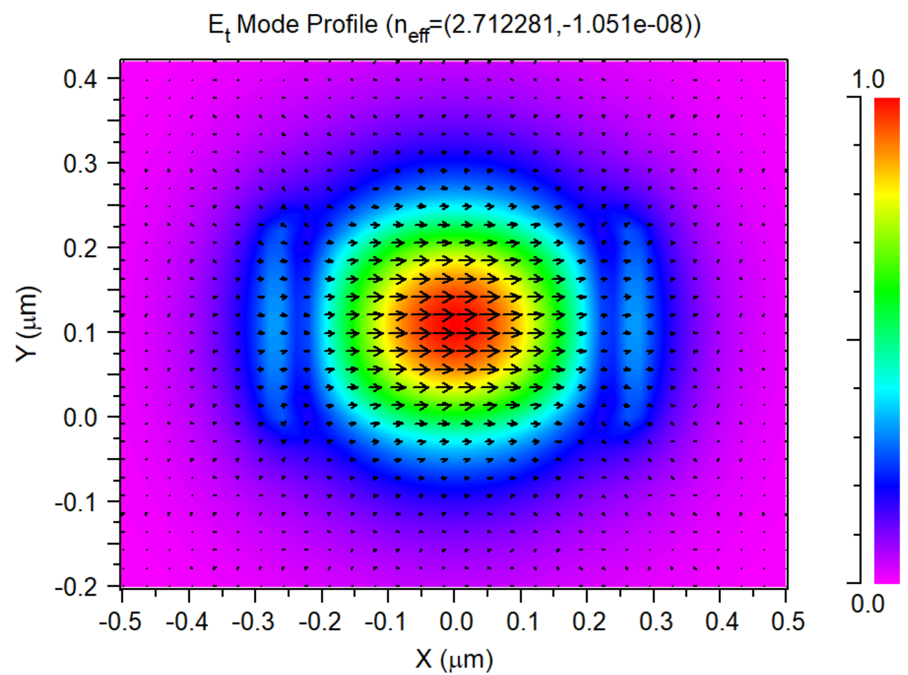
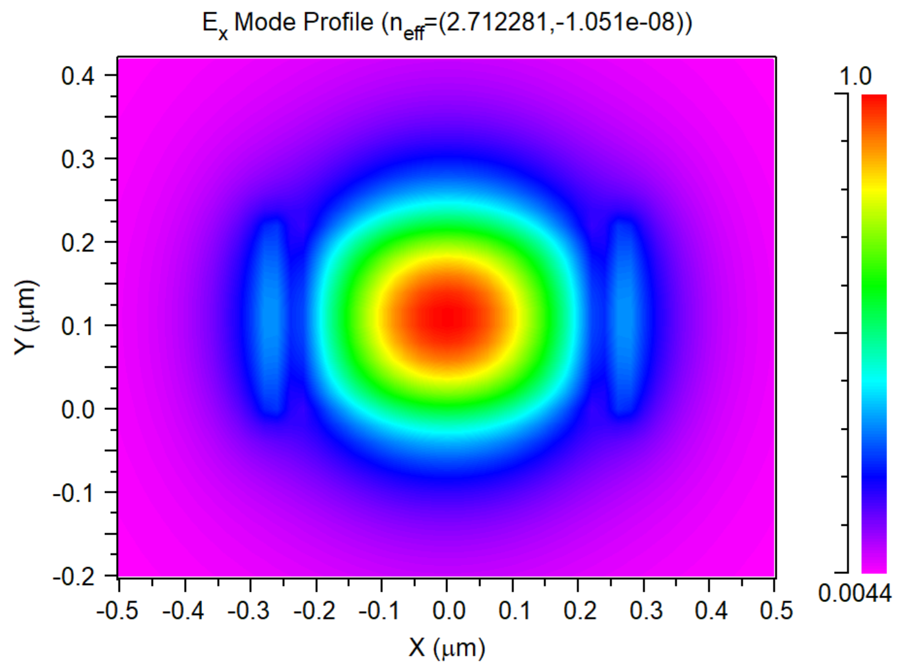
Notes:
TE0

Slide 10
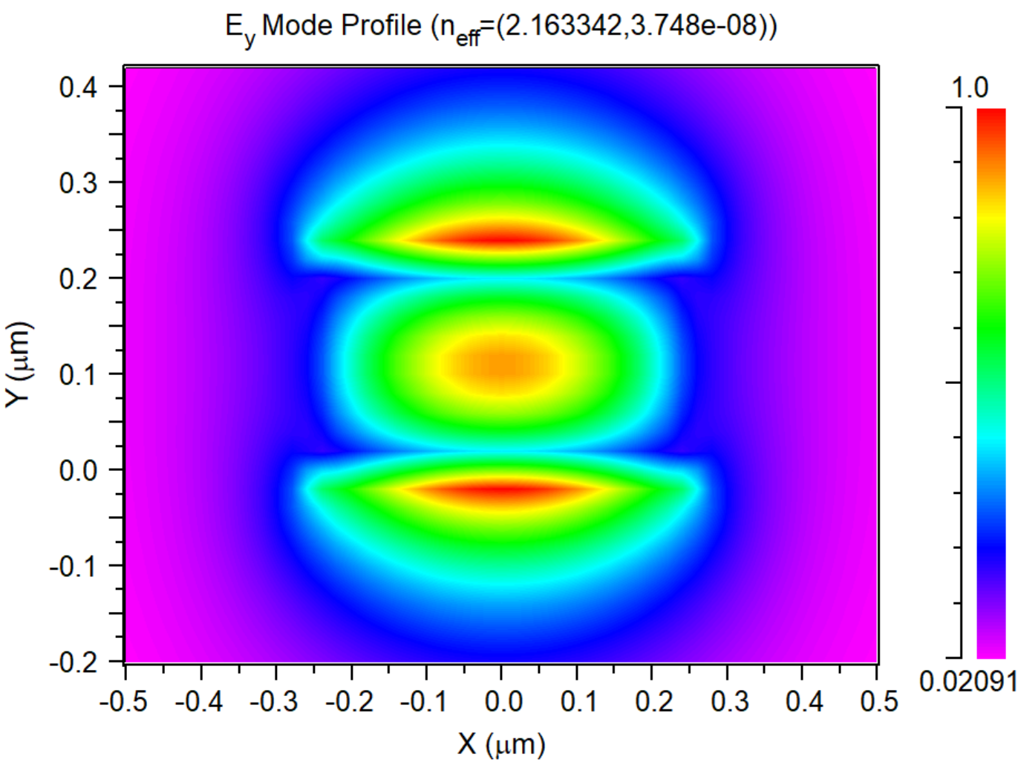
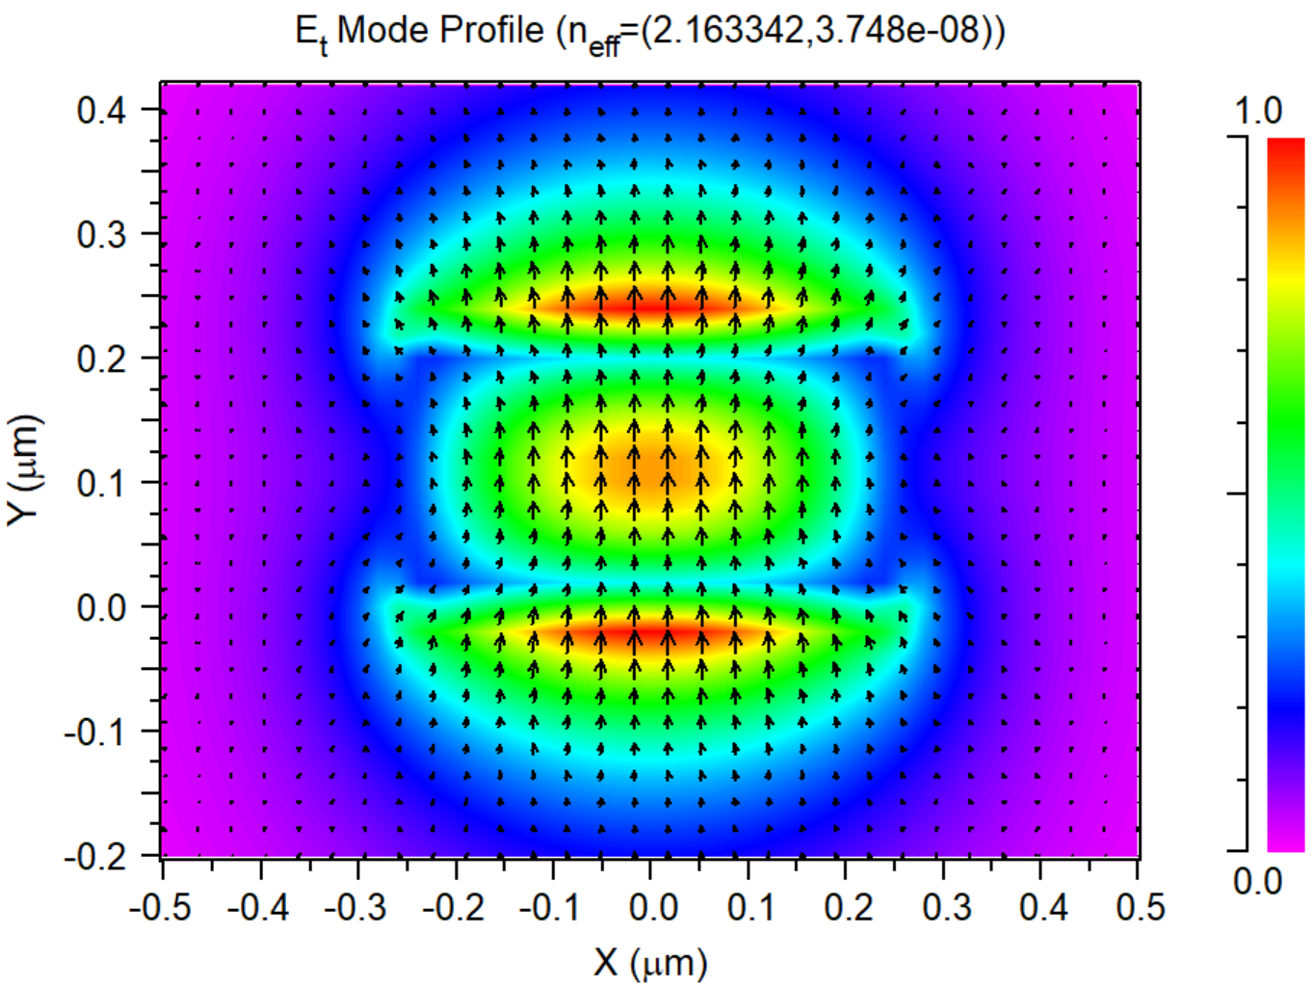
Notes:
TM0

Slide 11
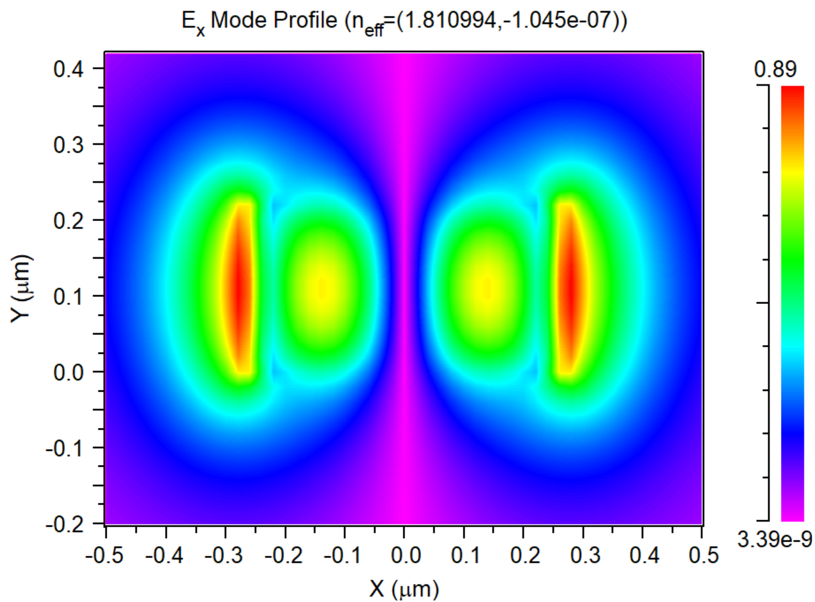
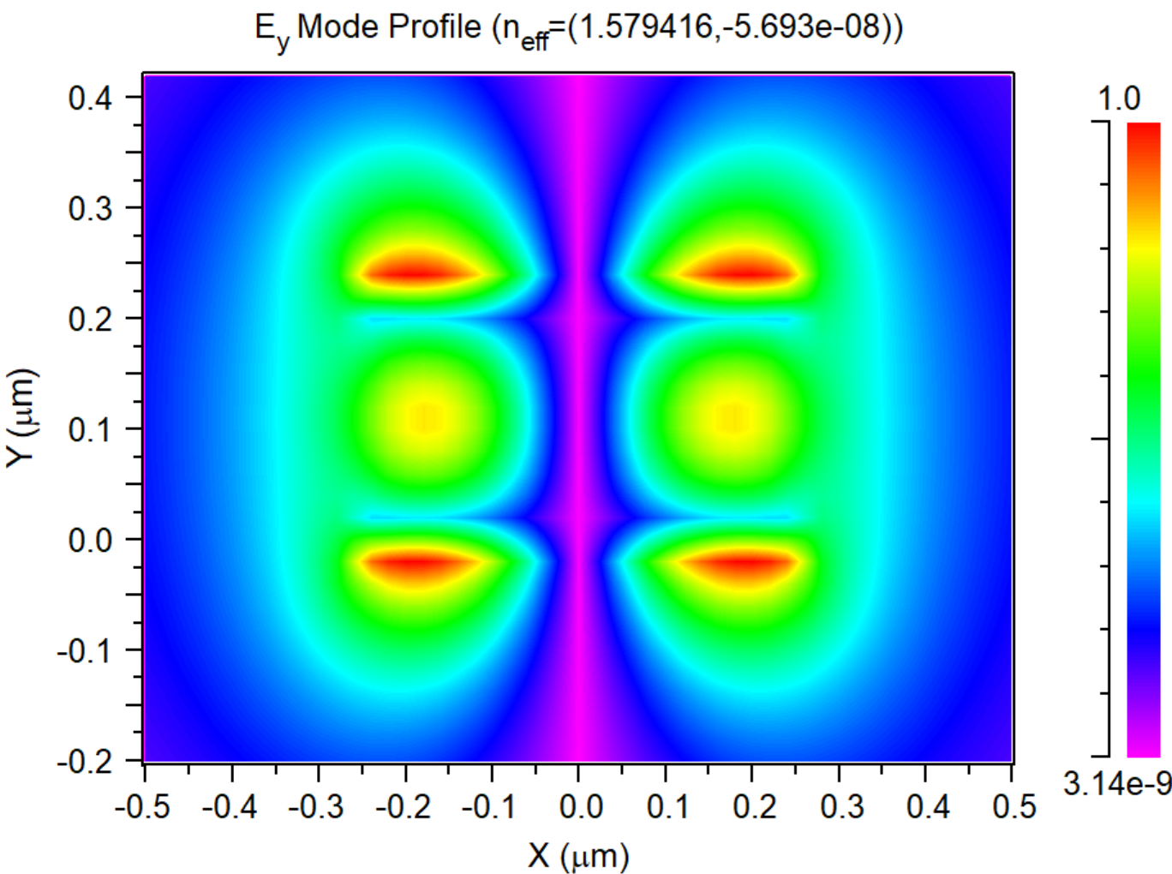
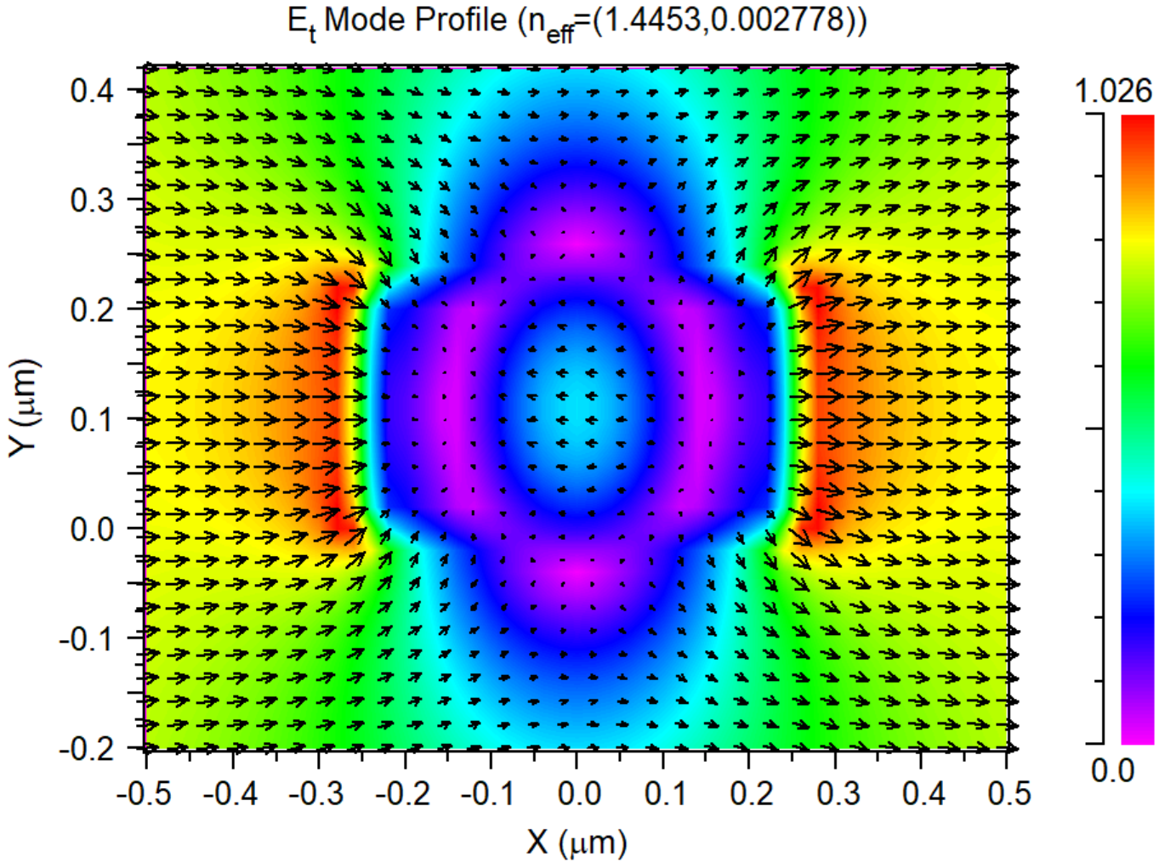
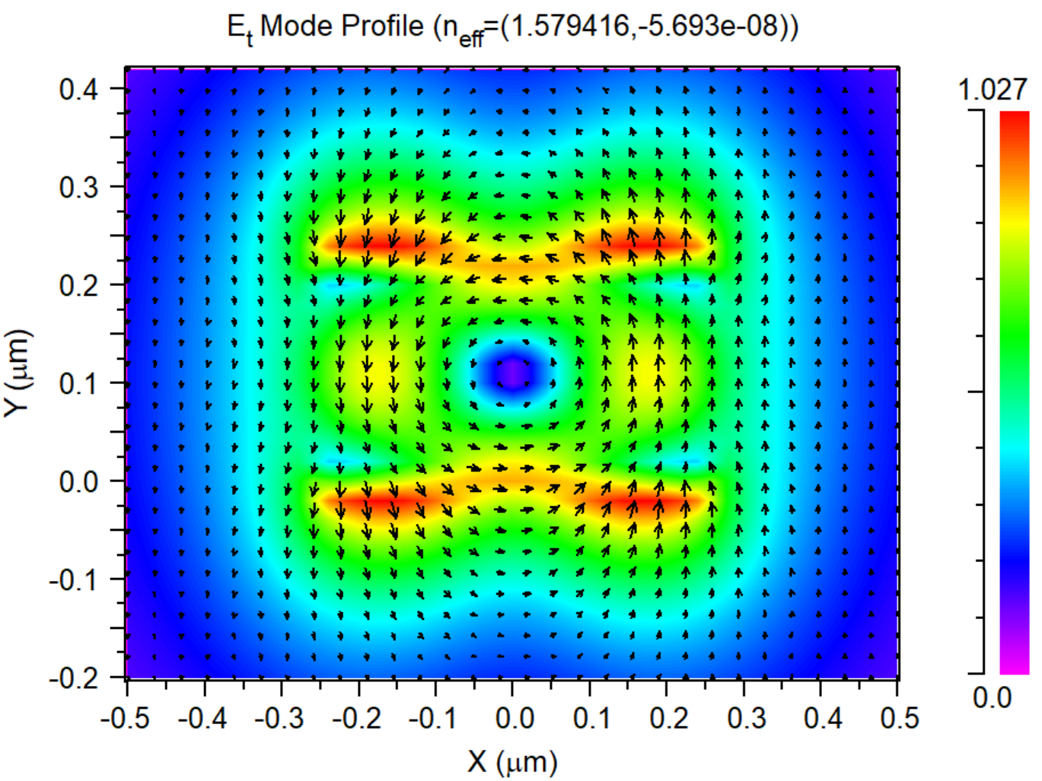
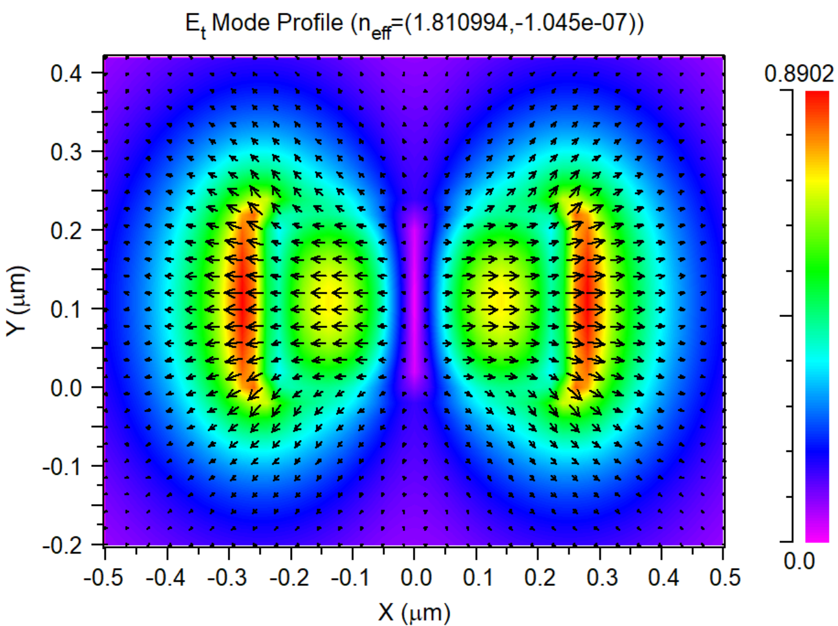

Slide 12
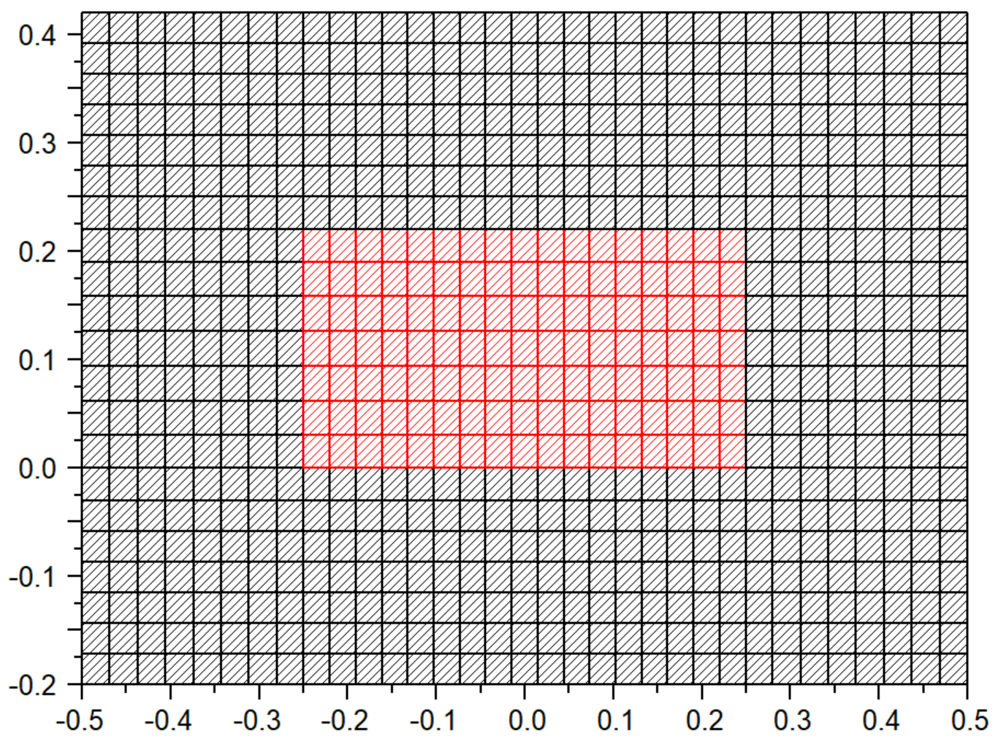
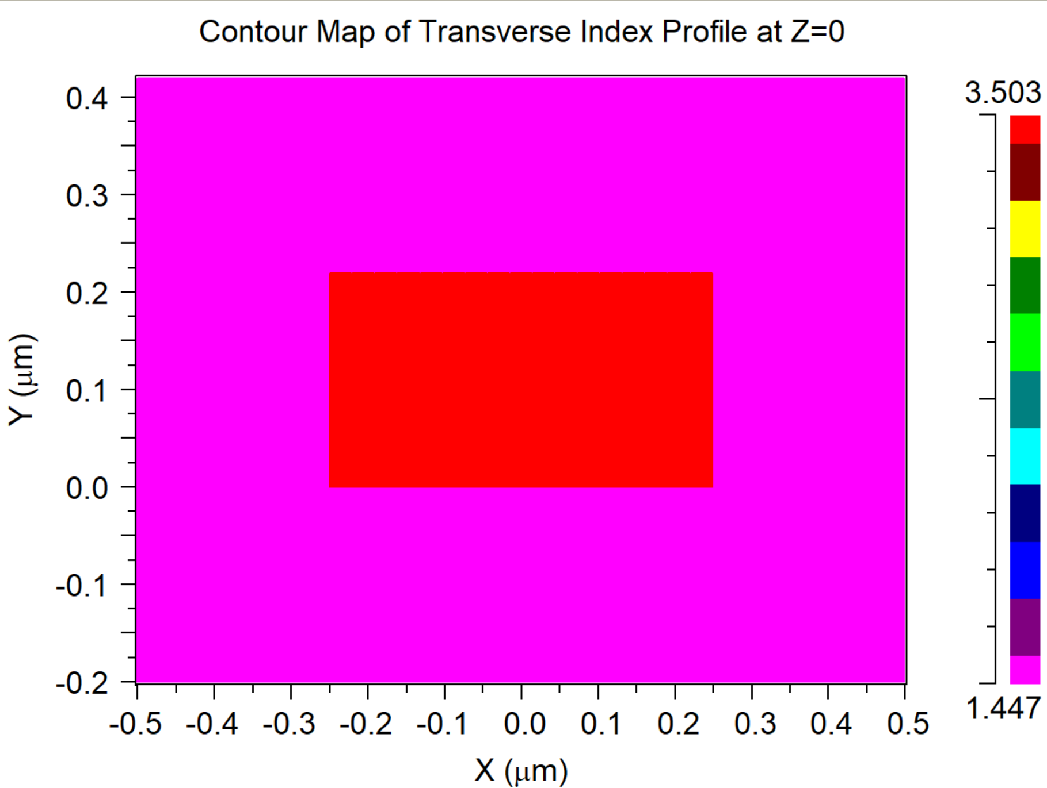

Slide 13
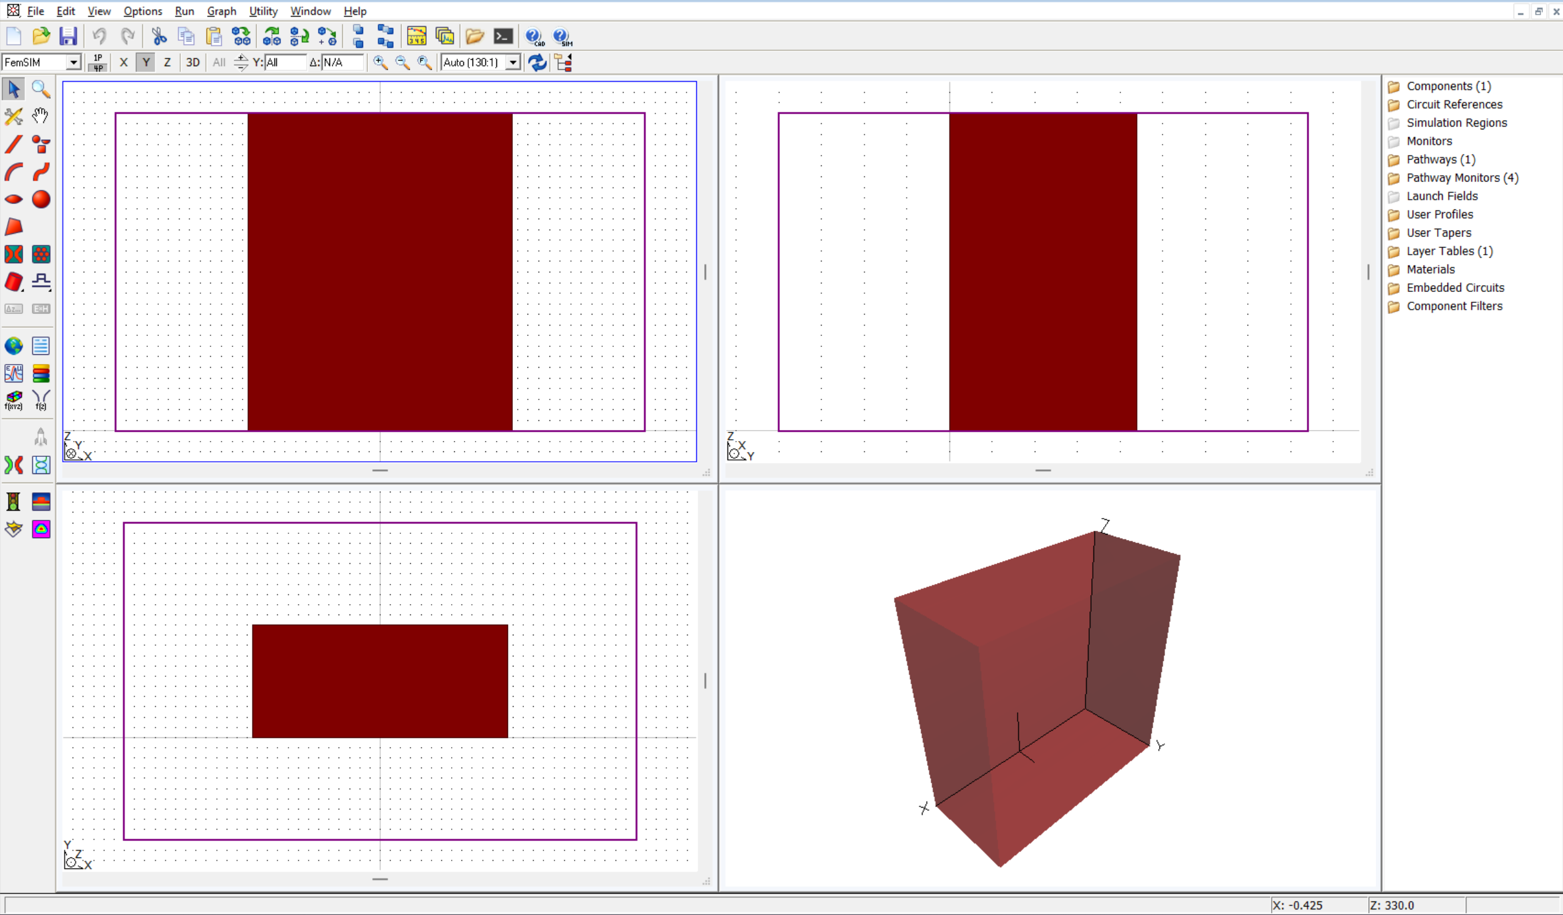

Slide 14
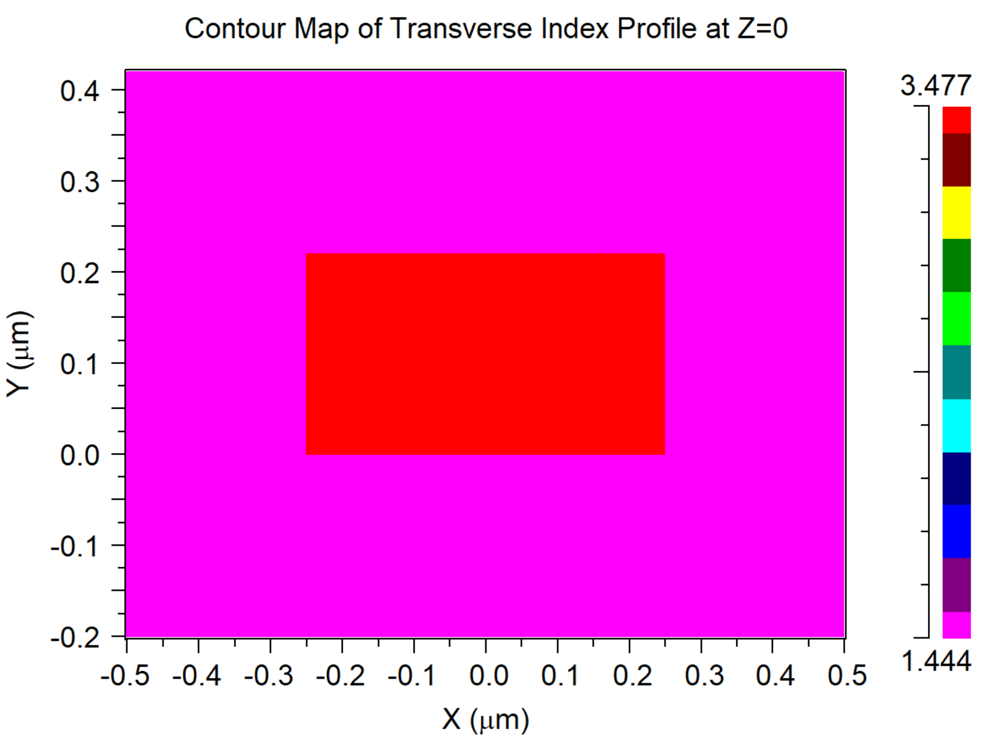
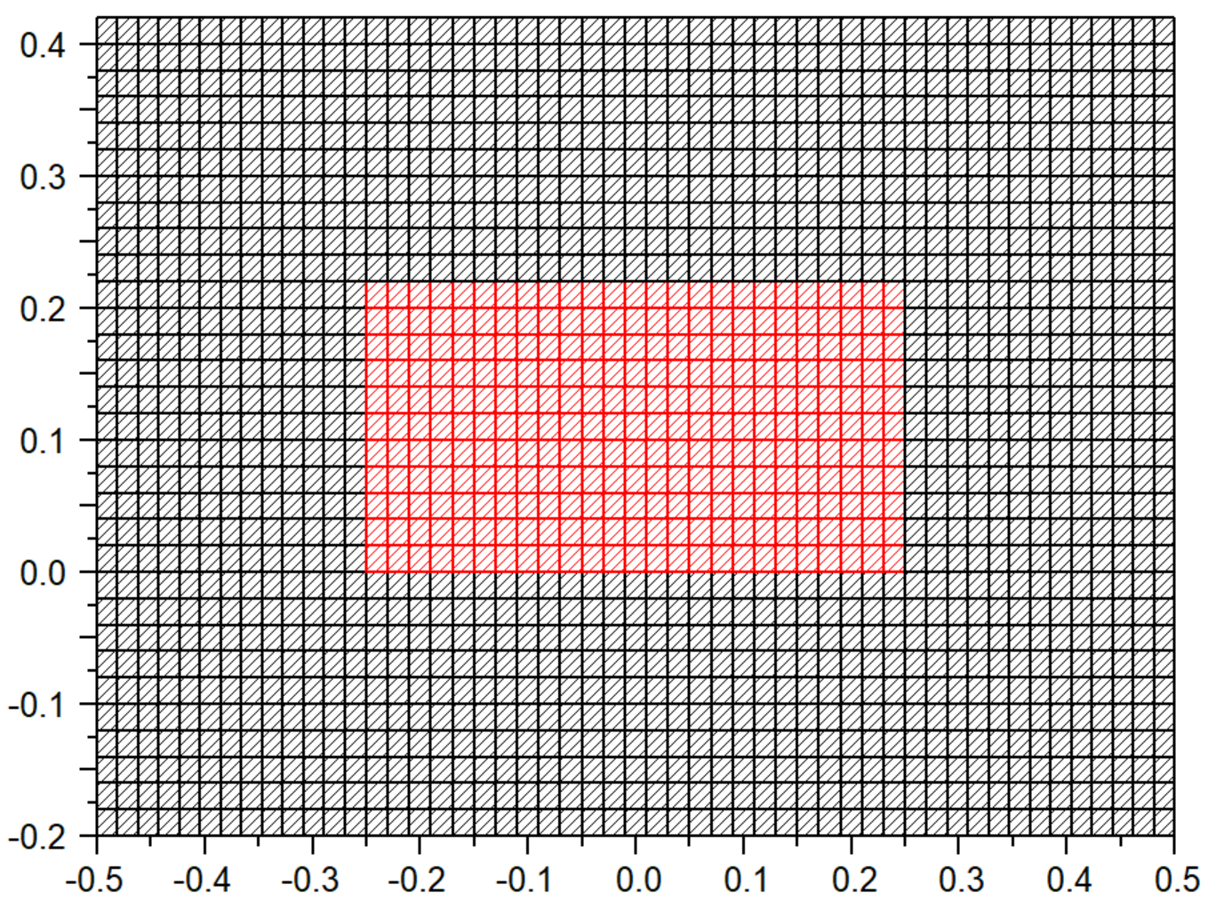

Slide 15
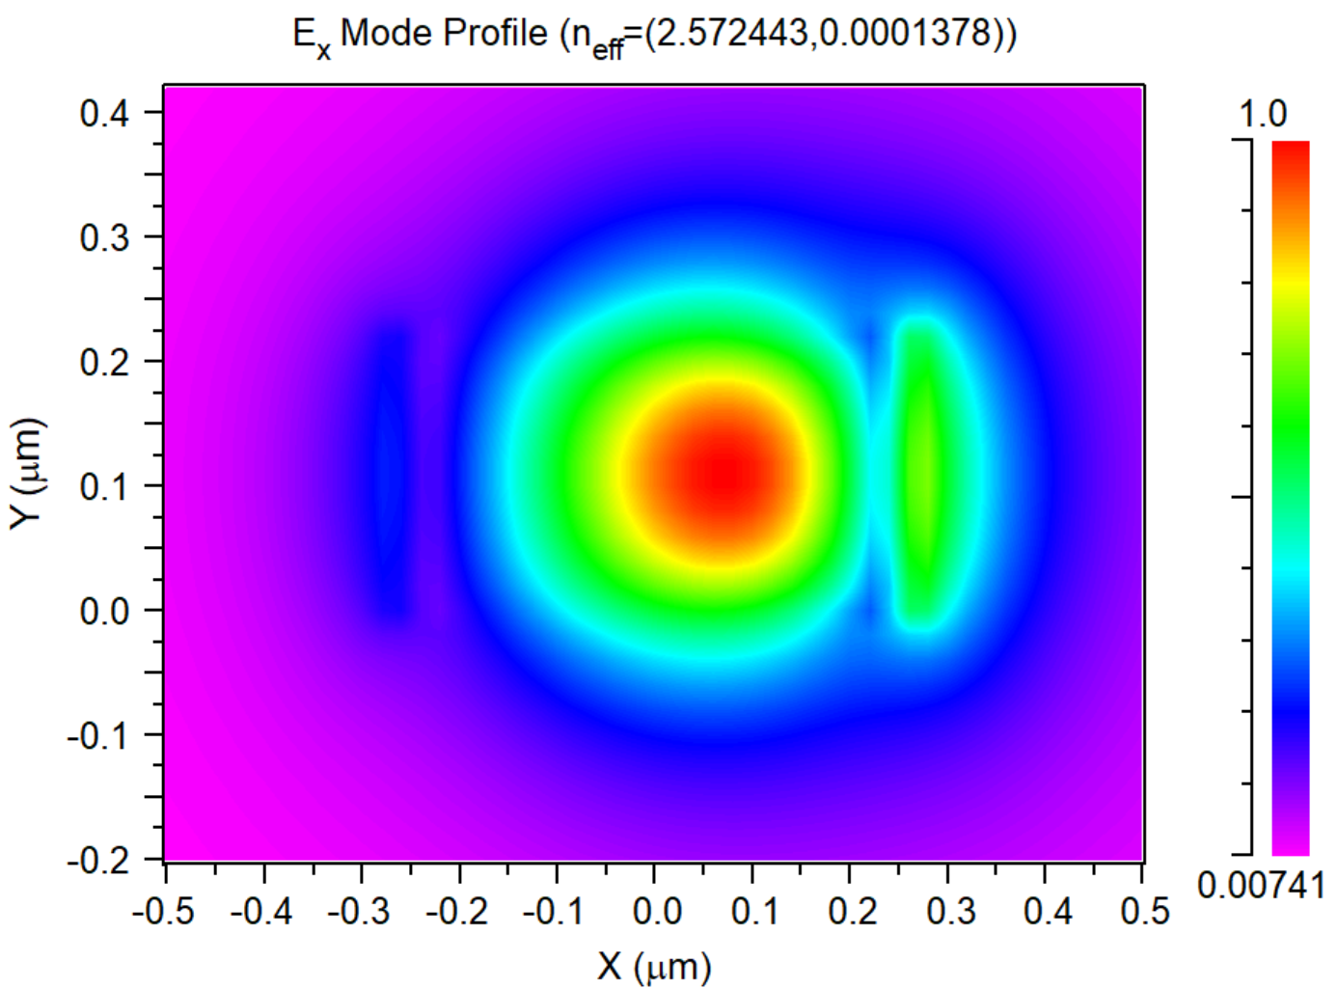
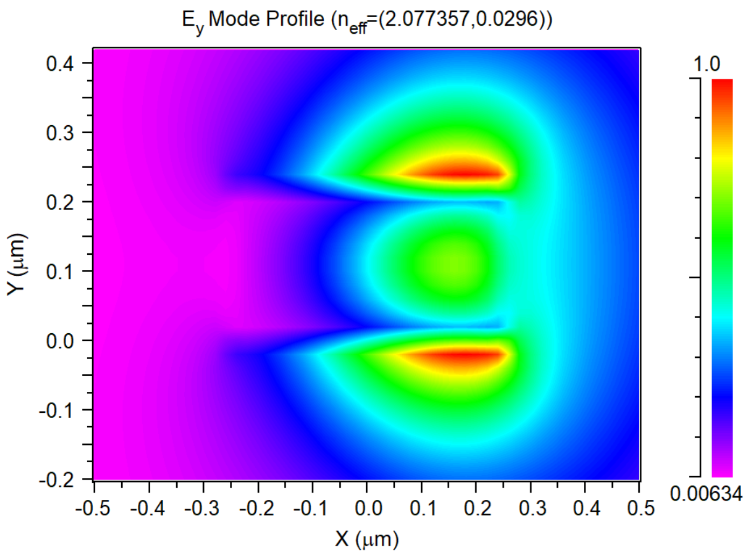
Neff[0]=(2.572443,0.0001378095) TE PolMeasure=0.980461
Neff[1]=(2.077357,0.02959678) TM PolMeasure=0.0530053
Mode# Mon#1 Mon#2 Mon#3 Mon#4
0 2.57244 0.344322 0.143849 0.770432
1 2.07736 0.612686 0.227871 0.480229
Notes:
1550 nm, bend radius = 1 um,

Slide 16
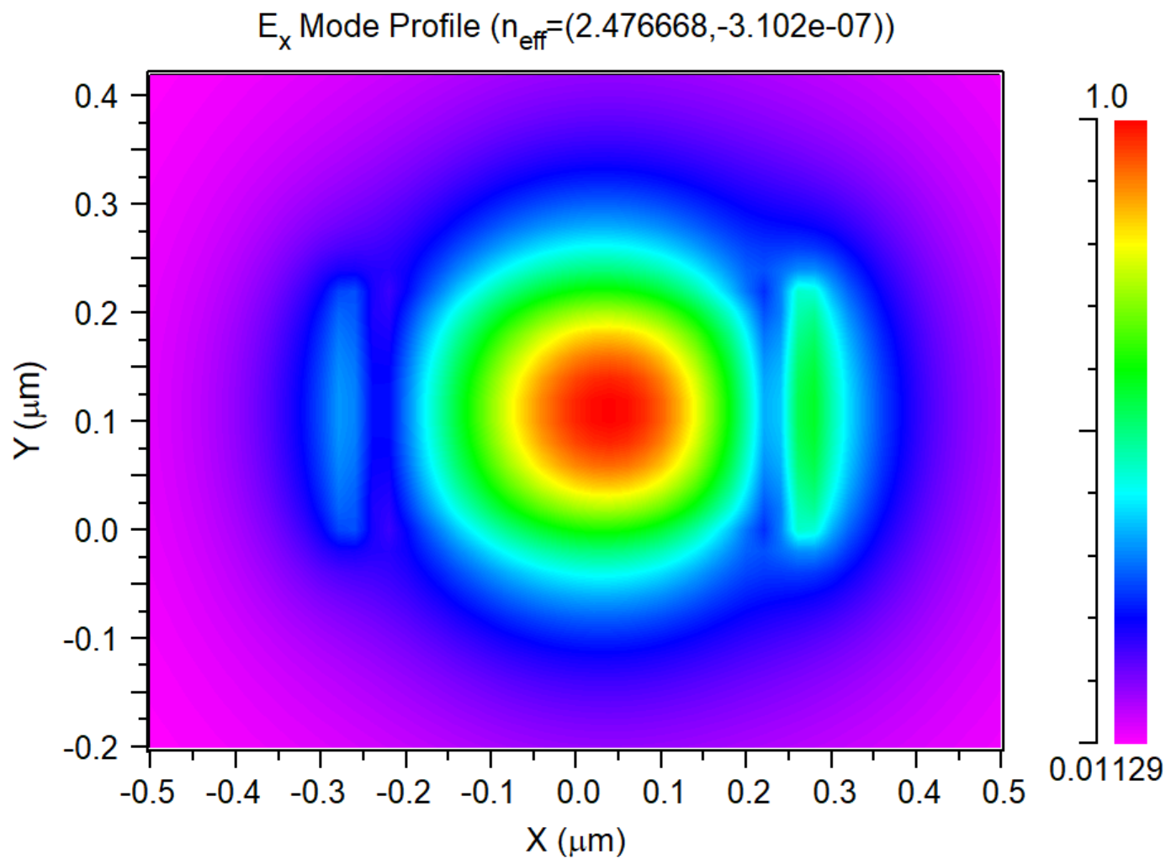
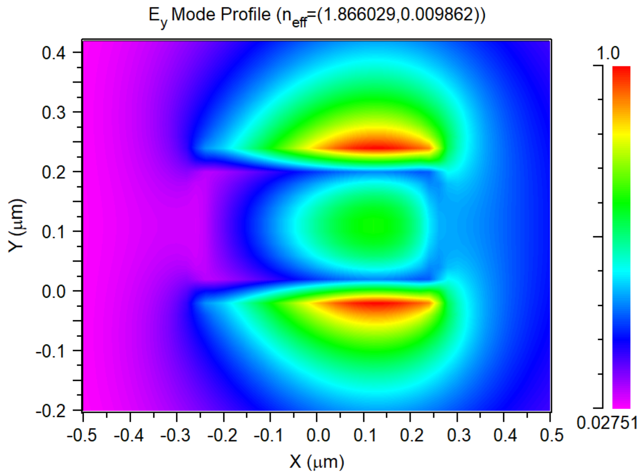
Neff[0]=(2.476668,-3.10213e-07) TE PolMeasure=0.982712
Neff[1]=(1.866029,0.009862064) TM PolMeasure=0.0505736
Mode# Mon#1 Mon#2 Mon#3 Mon#4
0 2.47667 0.349618 0.146422 0.781631
1 1.86603 0.62 0.259536 0.472122
Notes:
Bending radius = 2um,

Slide 17
