Slide 1
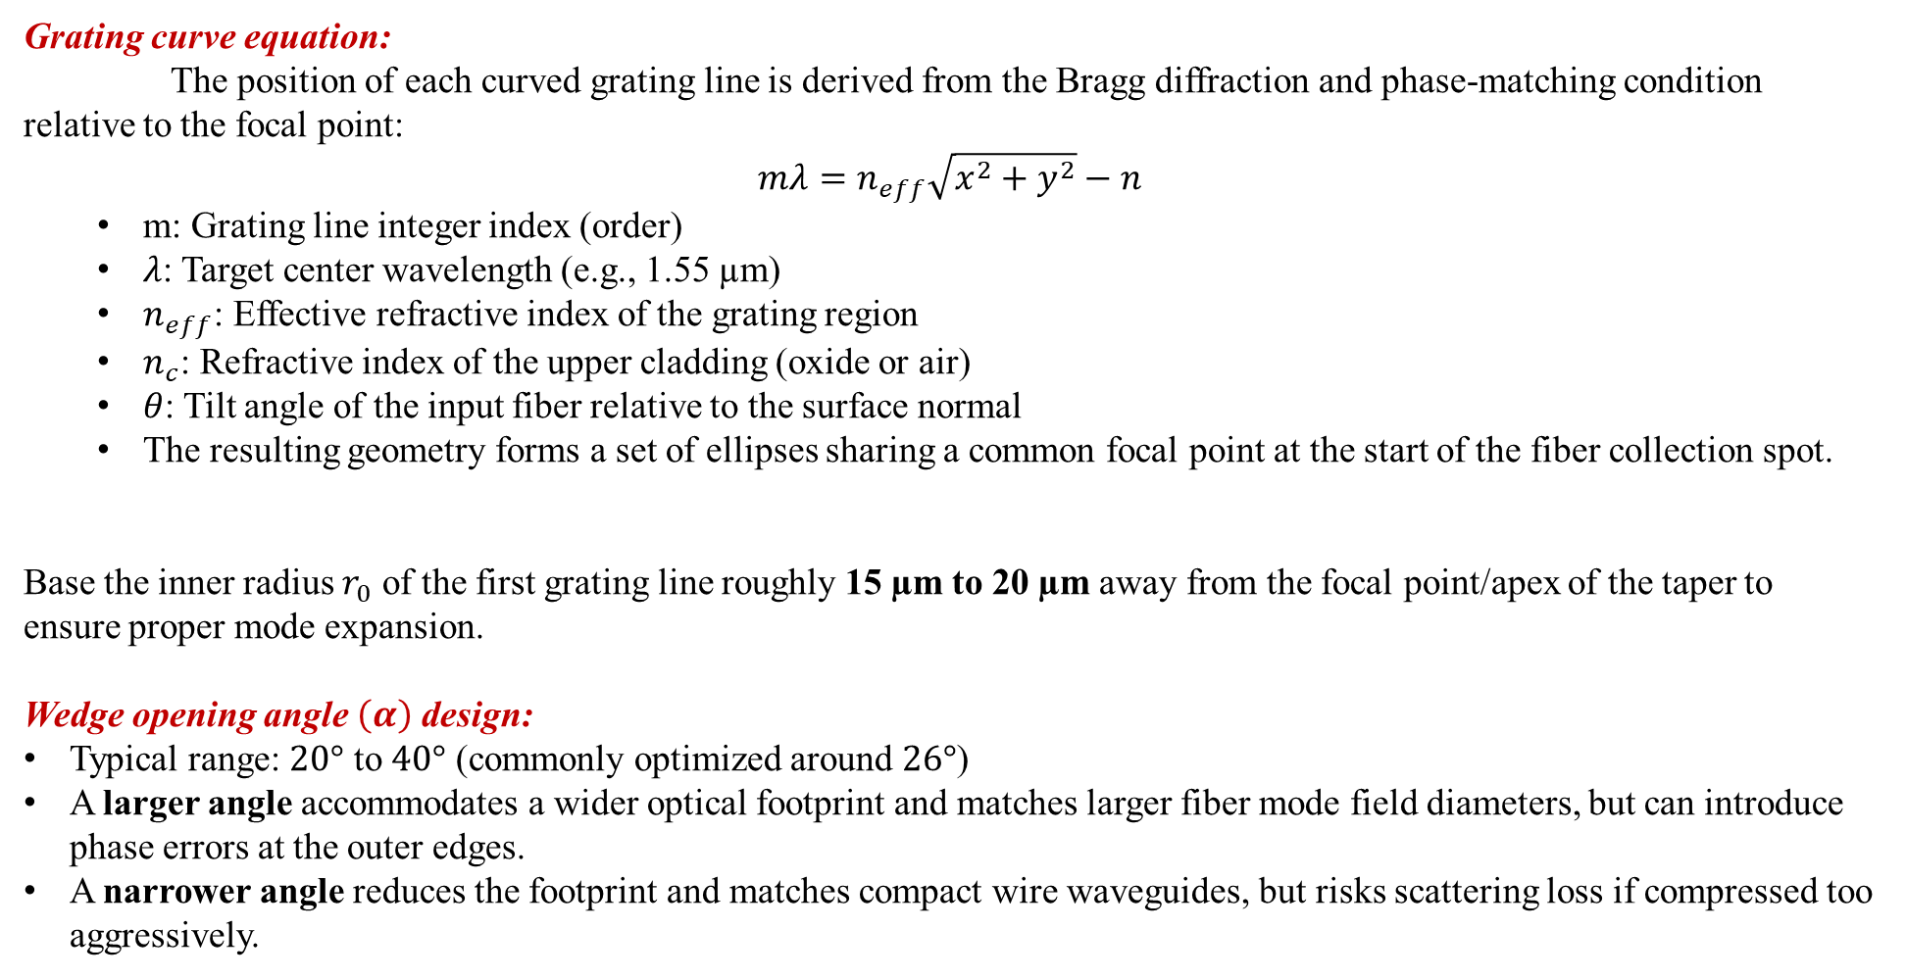
Grating curve equation:
The position of each curved grating line is derived from the Bragg diffraction and phase-matching condition relative to the focal point:
$$mλ=n_{eff}\sqrt{x^{2}+y^{2}}−n$$
m: Grating line integer index (order)
$λ$: Target center wavelength (e.g., 1.55 µm)
$n_{eff}$: Effective refractive index of the grating region
$n_{c}$: Refractive index of the upper cladding (oxide or air)
$θ$: Tilt angle of the input fiber relative to the surface normal
The resulting geometry forms a set of ellipses sharing a common focal point at the start of the fiber collection spot.
Base the inner radius $r_{0}$ of the first grating line roughly 15 µm to 20 µm away from the focal point/apex of the taper to ensure proper mode expansion.
Wedge opening angle $\left(α\right)$ design:
Typical range: $20°$ to $40°$ (commonly optimized around $26°$)
A larger angle accommodates a wider optical footprint and matches larger fiber mode field diameters, but can introduce phase errors at the outer edges.
A narrower angle reduces the footprint and matches compact wire waveguides, but risks scattering loss if compressed too aggressively.

