Slide 1
Team Snapchat
Marcus Blaisdell, Carly Ott, Joseph Crissey, Tim Rice, Brendan Lauck
Notes:
Brendan

Slide 2
Introduction
Motivation
Fun and simple
Sharing moments and staying connected with friends quick
Software Domain
Smartphones: iOS and Android
User Population
People with smartphones
2.53 Billion smartphones globally
158 million current Snapchat users
Similar Software
Instagram stories and Facebook stories
Notes:
Brendan
-Core Tasks: sending/editing snaps, messaging, using stories, accessing SnapMap, accessing the support page
-I’ll also explain a scenario

Slide 3
Early Data Gathering
Design of Study
Thought about which Snapchat tasks we liked and used the most
Came up with usability questions for those core tasks
Participants
Heavy, medium, and light users.
College students with different technical backgrounds and majors
Findings
Users generally can send “snaps” and messages quickly
Users are unaware of the Snapchat support page within the app
Most users were unaware of the SnapMap until they were told about it
Notes:
Marcus and Tim

Slide 4
Functional Requirements
Functional Requirement | Associated Usability Target(s) | Empirical Source/Rationale
* Users must be able to take and edit photos and videos. | Users must be able to take a photo or video, edit it, and send it to their distribution list within 5 seconds. | The ability to quickly capture a moment, customize it, and share it is the nature of the app.
* Users must be able to communicate with friends via a chat function that allows them to also send photos, videos, and messages. | Users must be able to access the chat function from the snap page as well as access photos/videos from the chat page. | The chat feature gives users another option for sending and receiving messages.
Users must be able to send photos and videos to friends. | Users must be able to send photos and videos to people within 4 seconds. | The ability to quickly send photos and videos to contacts is one of the primary functionalities of Snapchat.
* Users must be able to sort stories by multiple criteria. | Users must be able to choose how they want to sort stories (alphabetically, most recent, most popular, etc). | Users appreciate having the ability to personalize their experiences while using Snapchat.
Users must be able to send photos and videos to their story. | Users must be able to send photos and videos to their story within 3 seconds. | The story feature of Snapchat is essential as it brings its community of users closer.

Slide 5
Functional Requirements Cont.
Users must be able to receive relevant tips on how to use functions. | User should not ever have to go to an outside source to learn how to do things. User should be able to learn a desired function within 30 seconds. | Two out of three users go to Google for questions on how to use the app.
Users must be able to replay their friends stories as many times as they want within the story’s time period. | Users must be able to replay their friends stories as many times as they want within 5 seconds. | Being able to replay friends’ stories is a convenient feature.
* Users must be able to access the map by pinching in the screen. | Users must be able to access the map within 3 seconds. | The SnapMap is a fun additional feature that allows the community of users to connect.
User must be able to voice activate support, e.g. “Hey SnapChat, how do I view the map?” | Users must be able to receive a reply to the query within 3 seconds. | This would provide a very accessible interface to discover and learn features. It would also provide data to SnapChat on what people do not know how to use.

Slide 6
User Experience Requirements
User Experience Requirement | Empirical Source/Rationale
Users must rate the app at least 4 out of 5 on a scale of 1 - 5 for ease of use. | 2 of 3 users rated it 3, 1 user rated it 4
Users must rate the app at least 4 out of 5 on a scale of 1 - 5 for overall experience | 2 of 3 users rated it a 4, 1 user rated it 5
Users must rate the app at least 4 out of 5 on a scale of 1 - 5 for finding map | Users rated it a 1 or a 5
Users must rate the app at least 4 out of 5 on a scale of 1 - 5 for finding help | All users rated this a 3

Slide 7
Usability Requirements
Usability Requirement | Empirical Source/Rationale
User must be able to get to their messages from the 'snap' function. | All participants agree that this is essential; messages should be located in a spot that is easy to find and access.
User must be able to see who has sent them snaps. | All participants agree that this is essential.
User must be able to see who has seen their snaps. | Participant 3 mentioned that this feature was one of her favorites.
User must be able to determine how many times a snap can be viewed before disappearing. | Participant 3 does not think this feature is necessary however, participant 1 thinks this feature could be valuable.
User must be able to navigate to sort the stories in the desired order within 1 second. | This was mentioned as a common, desired feature.
User must be able to ask SnapChat how to use any feature. | This avoids cluttering the interface while enhancing discoverability and learnability of new features.

Slide 8
Interface Demo
*Live demo on camera
Notes:
Joseph

Slide 9
Usability Study: Issue Documentation
Usability Problems
Finding Snapchat Support Page
Finding SnapMap
Finding Stories
Notes:
Marcus

Slide 10
Usability Study - Video Clips
Highlights

Slide 11
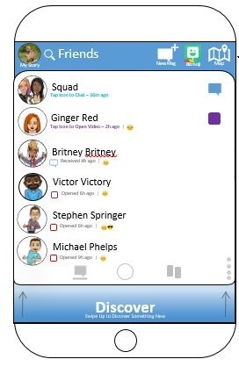
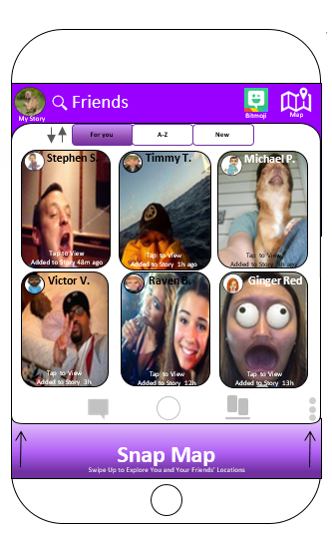
Usability Study: Proposed Design Changes
Made SnapMap easier to find (icon, swipe up from Stories Page)
Added BitMoji icon
Added dual encoding signifiers (using graphics and text)
My Story, New Message, Map, BitMoji
Better Signifier for where to click for viewing/opening messages
Moved Discover Page
Moved stories to their own screen (not on the same screen with messages)
Added Sorting stories function
Notes:
Carly

Slide 12
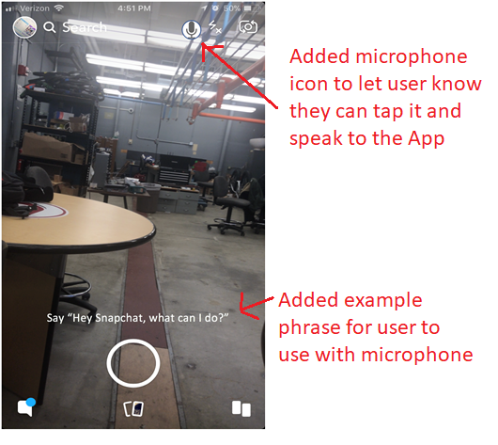
Usability Study: Proposed Design Changes cont...
Added voice support (microphone icon on camera screen, example phrase appears on camera screen)

Slide 13
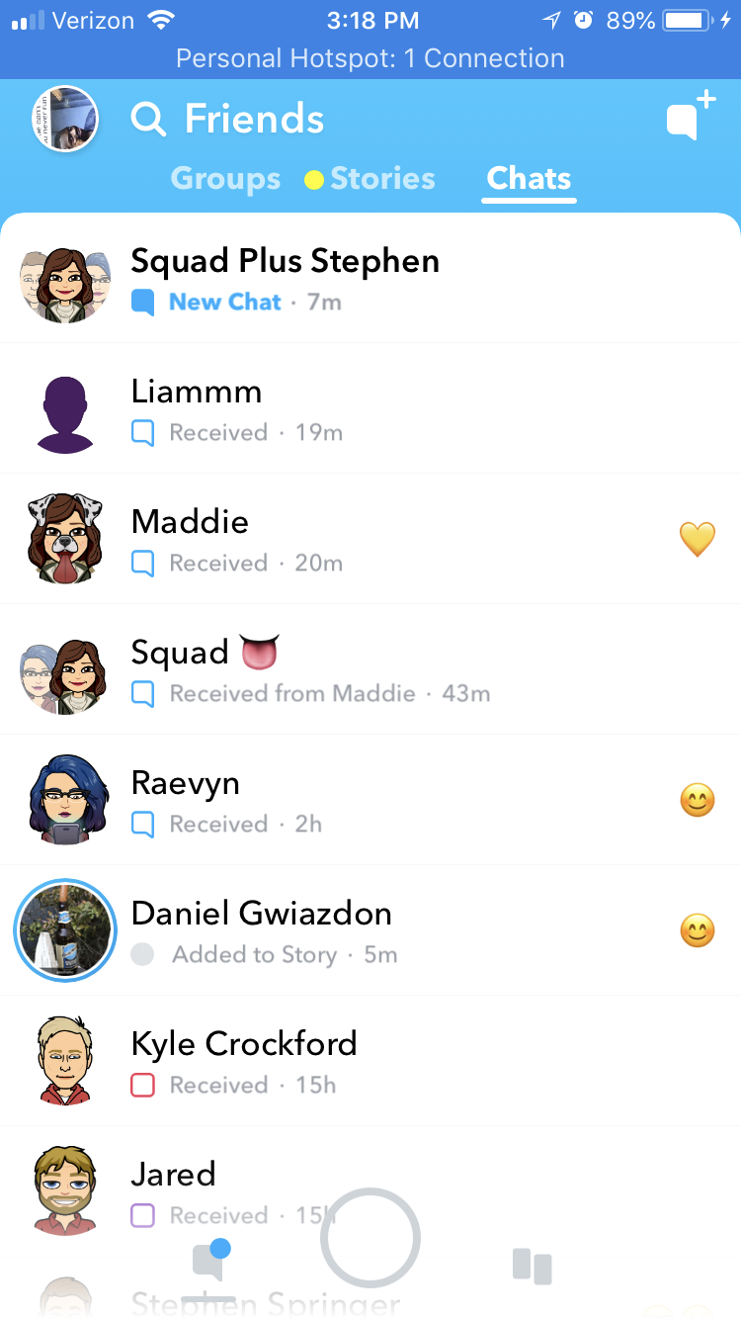

Slide 14
Questions?
Notes:
Carly

