Slide 1
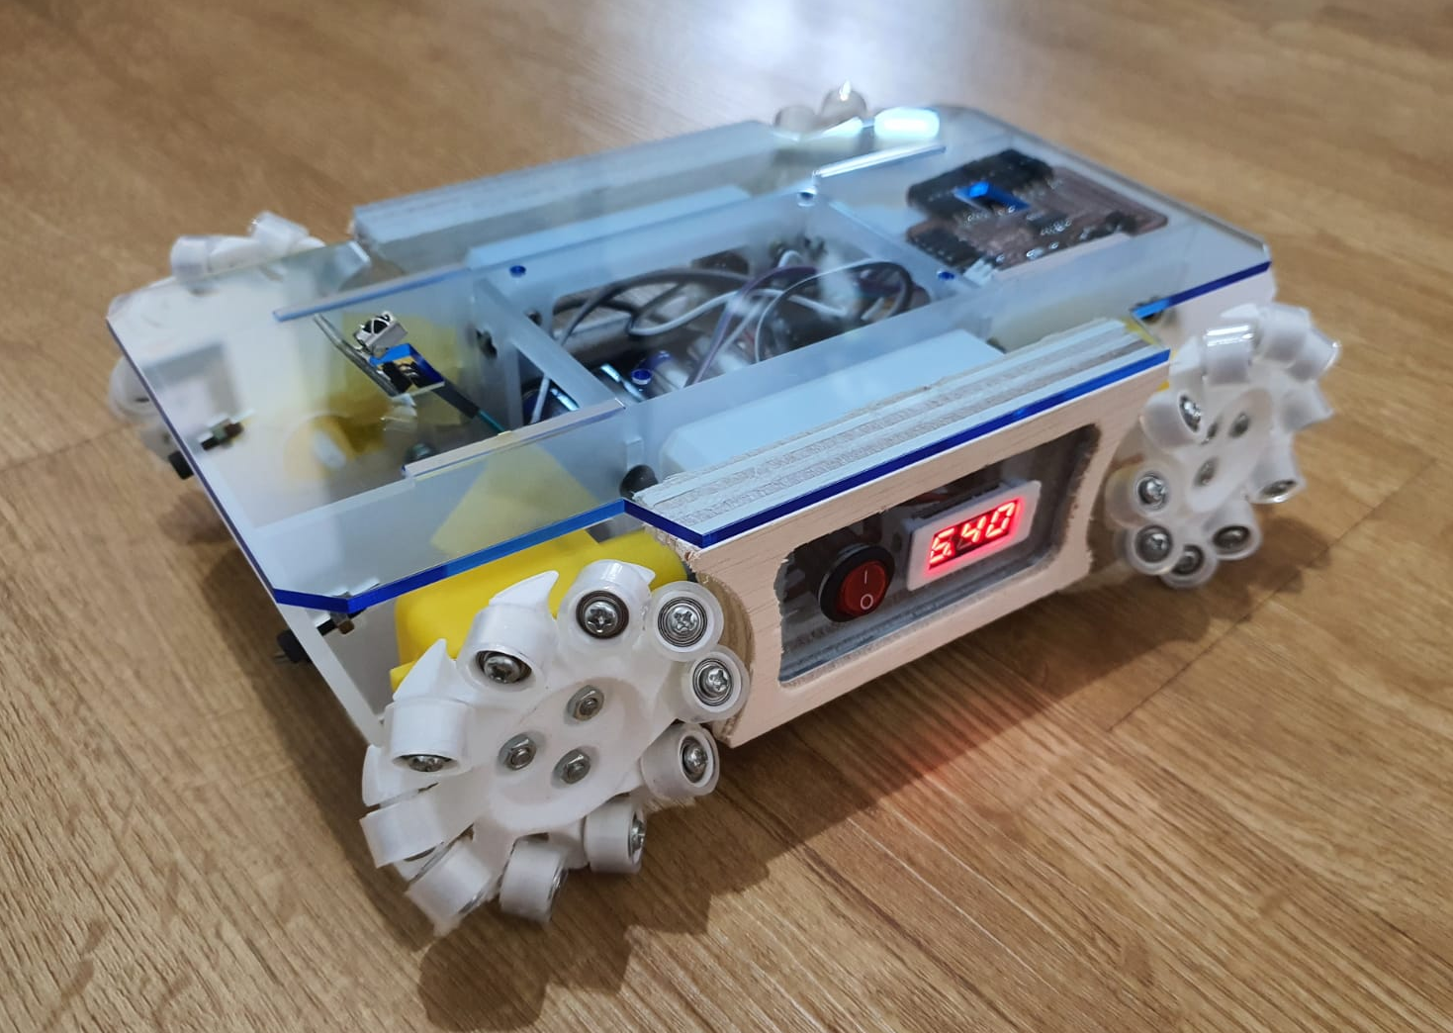
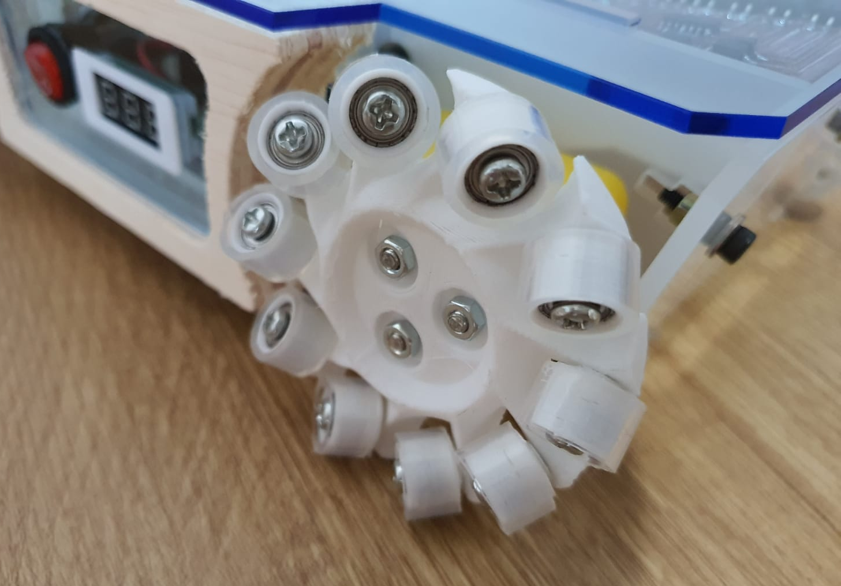
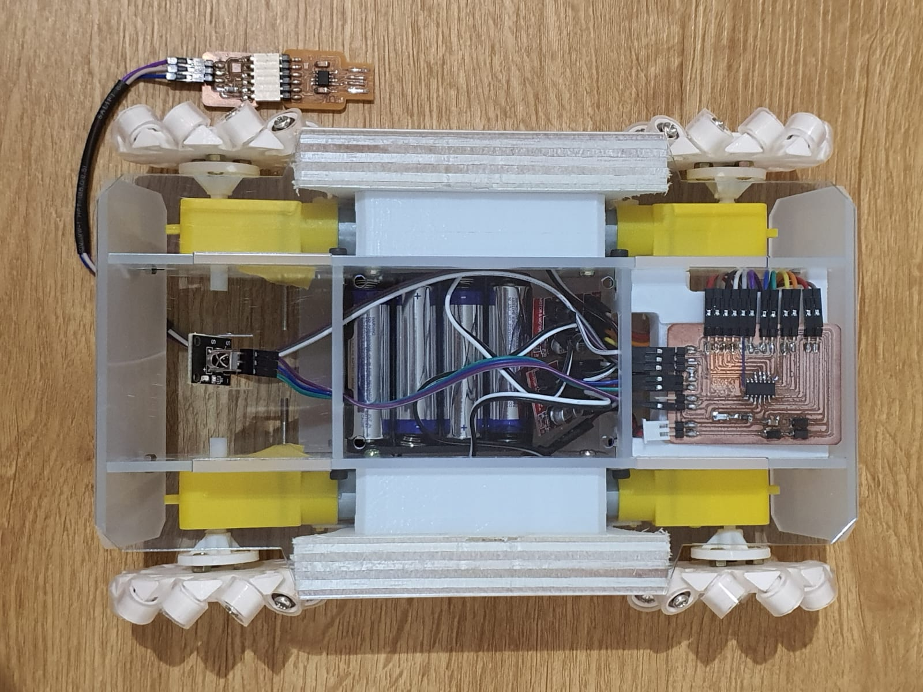
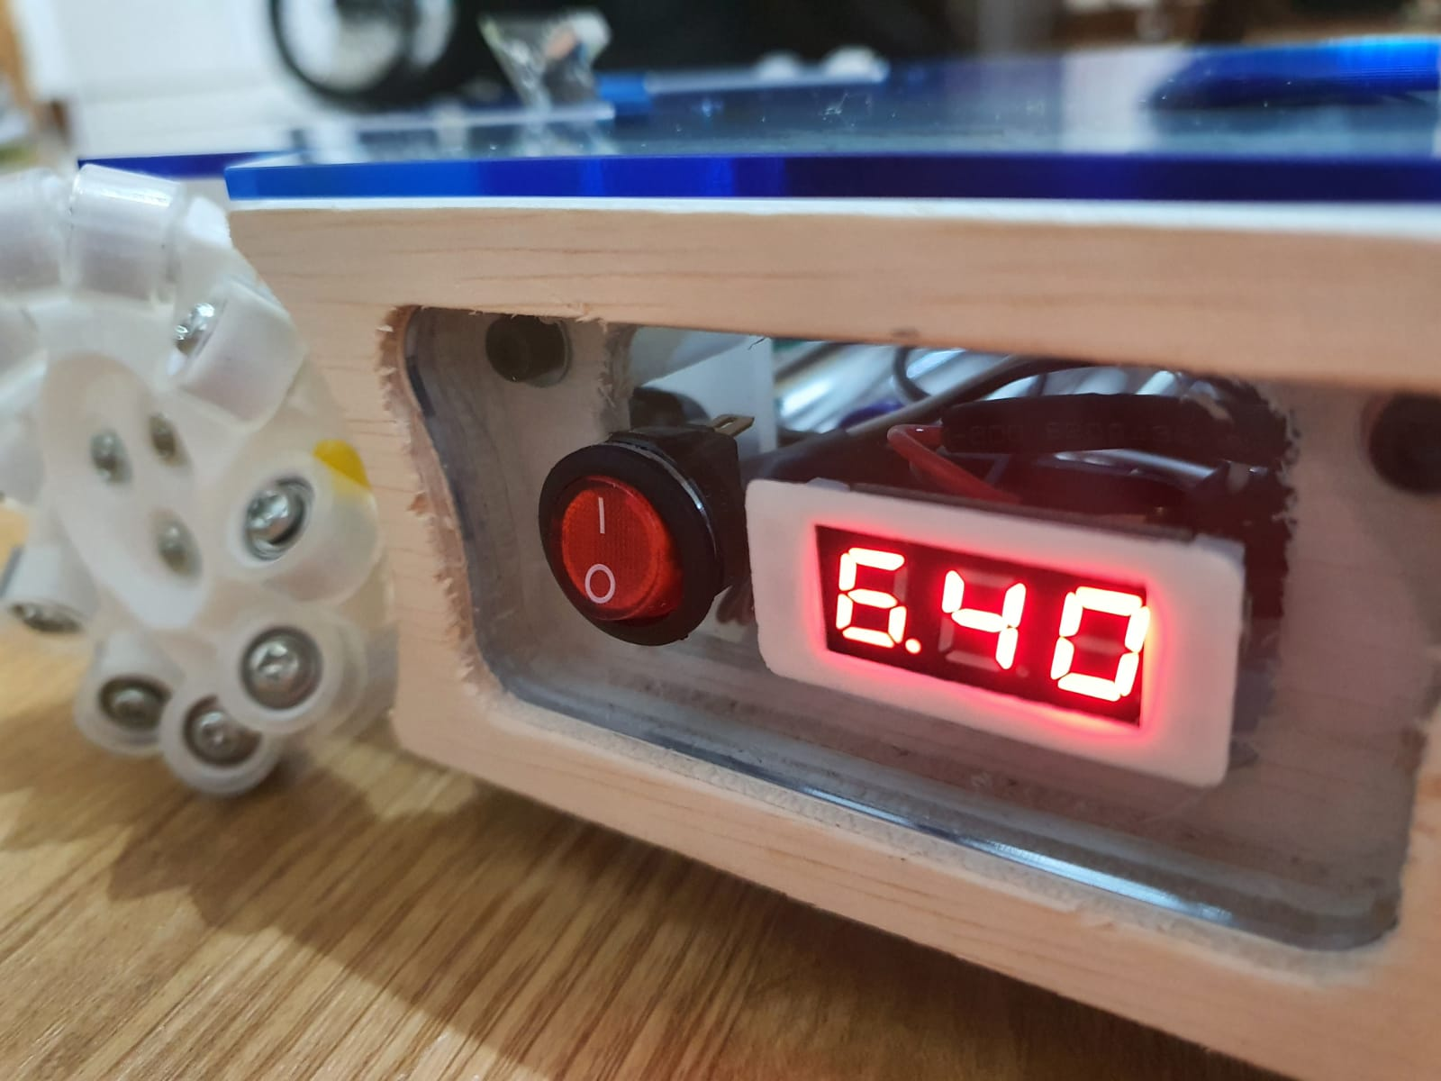
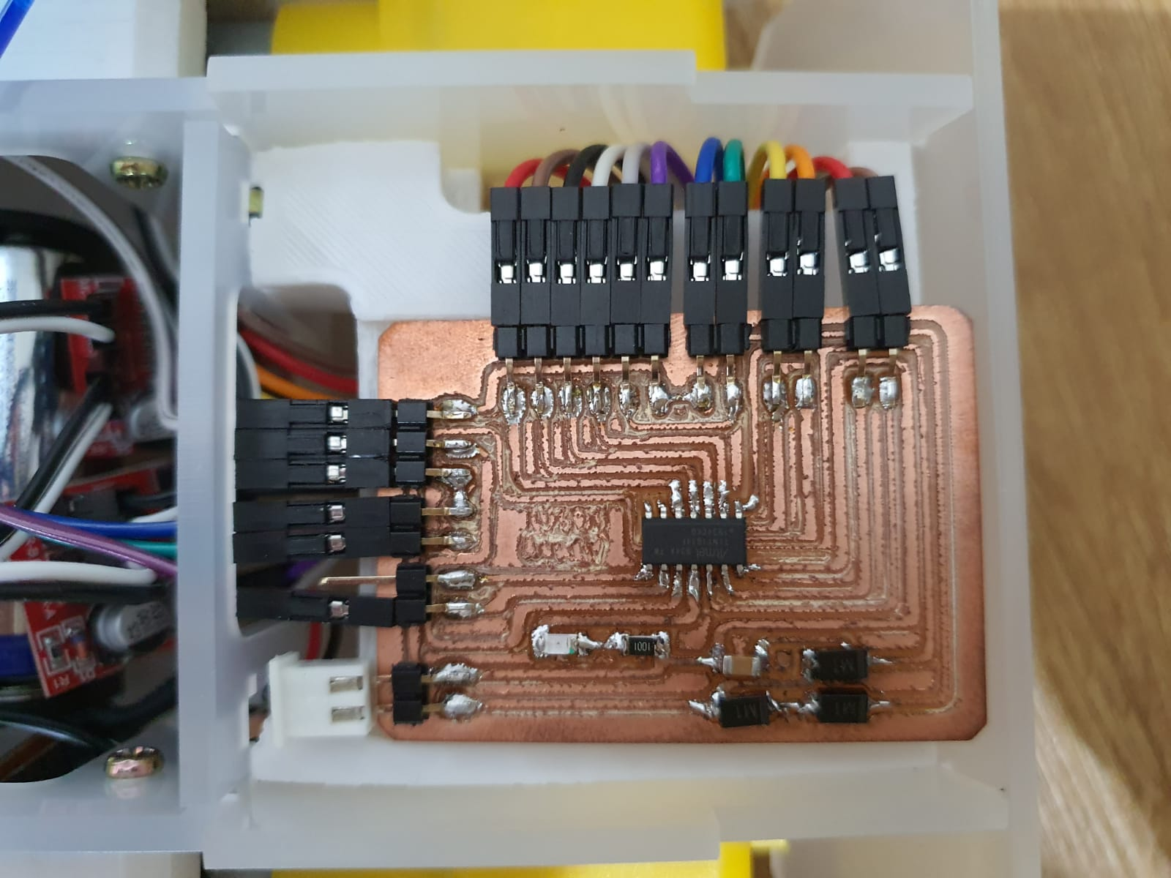
Mini Mecanum Wheel Vehicle
Features
Battery operated, uses 4 AA batteries.
Voltmeter to indicate battery life.
Able to move forward, backwards, sideways, diagonally and also turn.
Uses the ATtiny1614 microcontroller.
IR receiver for remote control. (Future expansion)
3D Printed Mecanum Wheels
The rollers are made using 8mm bearings and 10mm silicon pipe for grip.
Programmer
Power Supply
DC Motor
Frame – Laser cutting
Side – Large Format Machining
Custom PCB using the ATtiny1614
IR receiver
Motor Driver
On/Off Switch & Voltmeter

