Slide 1
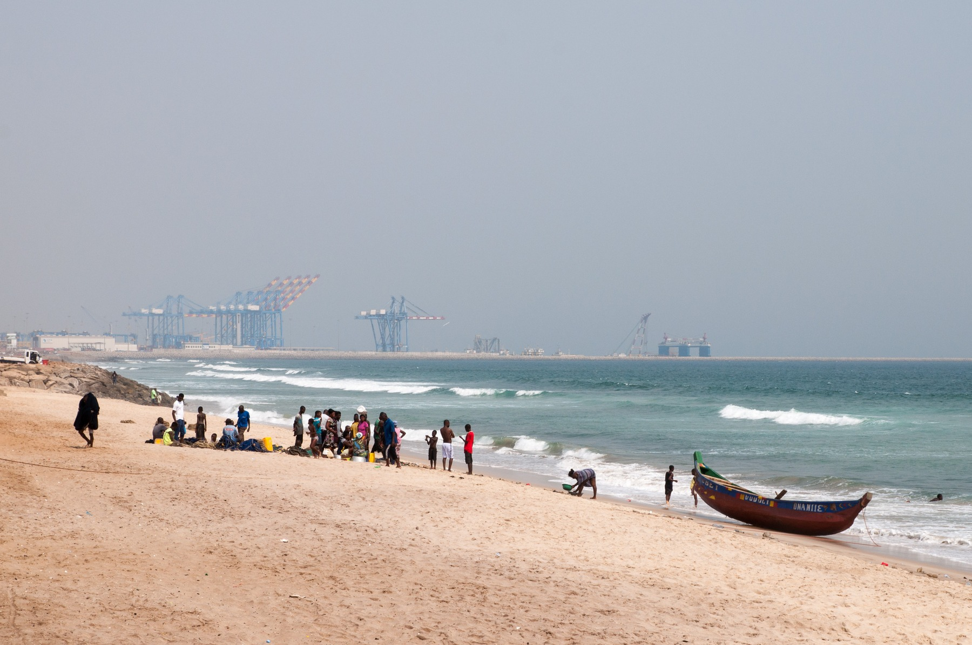
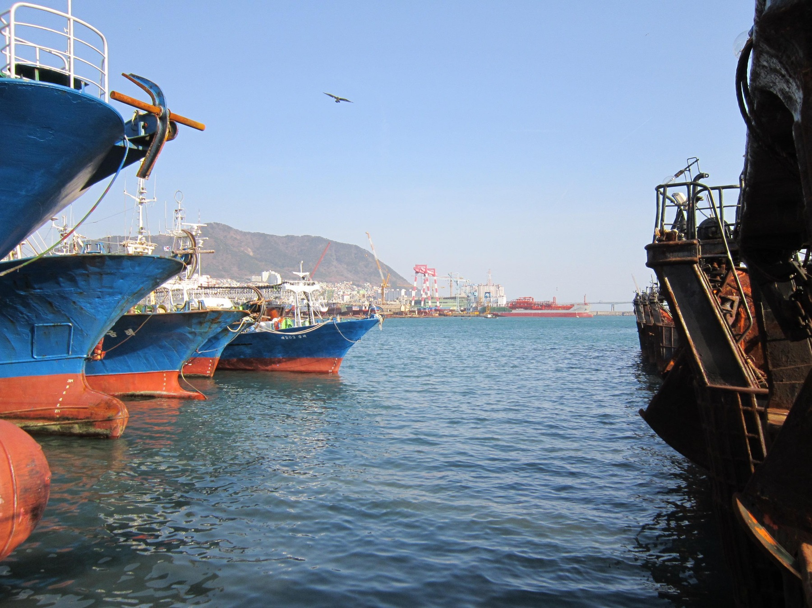
AFRICA & ASIA / AN INVESTIGATION IN SIX COUNTRIES
Africa & Asia:
Why did their
economic paths
diverge?
Testing culture against history, institutions,
policy and economic evidence.
Ghana
South Korea
Tema port · 2020
Busan harbour · 2012
SIX CASES. THREE ANCHORS.
NO SINGLE CONTINENTAL STORY.
Photographs: JulianGrayscales (2020), Tema port; Svwmal (2012), Busan harbour. Both are present-day context, not a 1960 baseline or evidence of relative performance. Full credits and licences: p. 27.
EVIDENCE LEDGER · EDITORIAL DRAFT
01

Slide 2
AFRICA & ASIA / 01 / THE QUESTION
Was slower growth caused by culture—or was culture also shaped by history and institutions?
The assignment is our question, not our answer. We compare six cases and ask which explanations survive the exceptions.
01
02
03
04
OBSERVE
→
PREDICT
→
TEST
→
REVISE
Start with a pattern. Make the mechanism explicit.
Look for a challenging case. Change the explanation.
01
The question
02–04
02
The starting line
05–09
03
Building capability
10–13
04
Culture under examination
14–17
05
Three ideas on trial
18–22
06
What survives
23–27
Not Africa versus Asia as two uniform blocs. Not a ranking of people.
A bounded comparison of histories, mechanisms and outcomes.
Method: original group framework. Evidence boundaries follow Hofstede (2011, pp. 6–8), McSweeney (2002, pp. 93–107), and the approved project theory matrix.
EVIDENCE LEDGER · EDITORIAL DRAFT
02

Slide 3
AFRICA & ASIA / 01 / OBSERVE
1960: close in income, different in history
GDP per capita · constant 2015 US dollars per person · observed 1960 values
Ghana
South Korea
US$1,101
US$1,038
Near parity is a starting question.
It is not a controlled experiment.
Botswana
US$394
Mauritius
US$1,419
Malaysia
US$1,266 †
Philippines
US$1,124
† Malaysia: retrospective territorial series. The 1960 value predates the federation’s 1963 formation and Singapore’s 1965 exit.
WHAT THIS CANNOT PROVE
Similar income levels do not mean identical starting conditions. These values do not identify causes or describe distribution within countries.
World Bank (2026), World Development Indicators (SRC-WDI-001). Frozen release: 13 July 2026; retrieved 6 October 2026. Data and locators: project CSVs; reference p. 26. Indicator: NY.GDP.PCAP.KD. Rounded to nearest US dollar.
EVIDENCE LEDGER · EDITORIAL DRAFT
03

Slide 4
AFRICA & ASIA / 01 / OBSERVE
What diverged—and what did not?
Structural transformation: workers move between sectors, productivity changes within sectors, and the economy’s production mix changes.
COUNTRY
INCOME / PERSON
AGRICULTURE JOBS
MANUFACTURING
1960 → 2020
US$ · 0–35,000
1991† → 2020
% · 0–100
1990 → 2020
% GDP · 0–30
Ghana
1,101 → 1,970
71.8 → 37.4
9.8 → 11
Botswana
394 → 6,254
12.6 → 19.5
4.8 → 5.7
Mauritius
1,419 → 9,534
19.6 → 5.3
20.4 → 10.7
South Korea
1,038 → 33,216
15.5 → 5.4
25.2 → 25.7
Malaysia
1,266 → 10,171
18.9 → 10.5
24.2 → 22.2
Philippines
1,124 → 3,199
44.1 → 24.5
gap → 17.7
Open dot = earlier value; country marker = 2020. † 1991 explicitly proxies 1990; no 1960 ILO series. Philippines 1990 manufacturing is not comparable: gap retained. Malaysia 1960 is retrospective; 2020 is the pandemic year. Full three-anchor income comparison: p. 13 and frozen CSVs.
WHAT THIS CANNOT PROVE
Employment shares are not productivity. Services growth does not automatically equal industrial upgrading; current-price manufacturing shares also reflect prices.
World Bank (2026), World Development Indicators (SRC-WDI-001). Frozen release: 13 July 2026; retrieved 6 October 2026. Data and locators: project CSVs; reference p. 26. GDP: NY.GDP.PCAP.KD; agriculture employment: SL.AGR.EMPL.ZS (ILO modelled); manufacturing: NV.IND.MANF.ZS. McMillan et al. (2014, p. 11).
EVIDENCE LEDGER · EDITORIAL DRAFT
04

Slide 5
AFRICA & ASIA / 02 / THE STARTING LINE
Colonialism changed the starting line
Political transitions happened at different times—and did not erase inherited economic structures.
1914 / HISTORICAL MAP
EDITORIAL PLACEHOLDER —
VERIFIED ASSET OR APPROVED COPY REQUIRED
ASSET-H1-LOC1914 · Linde; Wagner & Debes · Africa (1914)
Library of Congress item 2021668660. Item-level reuse statement checked; actual raster and original legend remain unverified. No invented boundary geometry.
1945 / 1948
South Korea
Japanese rule ends / Republic of Korea established
1946
Philippines
Independence; preceding Spanish and US rule
1957
Ghana
Independence
1957 / 1963
Malaysia
Malaya independence / federation formed
1966
Botswana
Independence from British protectorate
1968
Mauritius
Independence; earlier French and British rule
WHAT THIS CANNOT PROVE
A political date is not a comparable measure of state capacity. This timeline does not equate independence, state formation and territorial change.
World Bank (1985, p. 18); Maipose (2008, pp. 3–5); National Archives Department (n.d., “Independence”); Haggard et al. (1997, pp. 867–870); Asadullah et al. (2024, pp. 13–15); Dolan (1993), archival recheck pending.
EVIDENCE LEDGER · EDITORIAL DRAFT
05

Slide 6
AFRICA & ASIA / 02 / MECHANISMS
Different systems of rule
The useful comparison is what rule organised, extracted and left behind—not an empire label treated as destiny.
CLAIM
Administrative labels hide variation.
Evidence: British African councils differed in composition and operation; French West African investments also varied within an empire.
Limit: councils are not synonymous with democracy (Bolt et al., 2025; Huillery, 2009).
EVIDENCE
Korea is a disputed inheritance.
Kohli (1994) stresses organisational lineage under Japanese rule. Haggard et al. (1997) stress coercion, unequal ownership, division, war and post-1961 change.
Limit: continuity is not an uncontested causal finding.
LIMIT
Institutions on paper are not inclusion.
The Philippines’ Spanish and US legacies combine formal institutions and education with concentrated power (Dolan, 1993). Exact archival passages still need a clean-file recheck.
A British–French contrast cannot explain these experiences.
WHAT THIS CANNOT PROVE
Different mechanisms may coexist. None of these studies supplies a causal ranking of the six cases or demonstrates that colonial rule was beneficial overall.
Bolt et al. (2025, pp. 1–6, 18–20); Cogneau et al. (2018, pp. 5–7, 17–20); Huillery (2009, pp. 176–180, 203–208); Kohli (1994, pp. 1277–1284); Haggard et al. (1997, pp. 867–881); Dolan (1993), source caveat below.
EVIDENCE LEDGER · EDITORIAL DRAFT
06

Slide 7
AFRICA & ASIA / 02 / CONNECTED DEVELOPMENT
What did infrastructure connect?
Ghana’s railway case shifts the question from “How much track?” to “Which people, firms and markets became connected?”
1898–1918 / COLONIAL RAILWAY EXPANSION
Coast / ports
Mining areas
Cocoa producers
and urban markets
Kumasi / interior
SCHEMATIC, NOT SURVEY GEOMETRY
Solid: stated connection purpose. Dashed: later economic linkages, not a mapped railway route.
Original purpose
Later uses and effects
Connect the coast with mining areas and Kumasi; transport priorities were not designed as a universal social network.
Lower transport costs supported cocoa production and urbanisation. The later users and effects were not identical to the original purpose.
WHAT THIS CANNOT PROVE
A railway case cannot prove an Africa-wide mechanism, the net benefit of colonial rule, or that infrastructure alone caused subsequent growth.
Jedwab and Moradi (2012, pp. 1–4, 6–10; SRC-JEDWAB-MORADI12-001). Original editorial schematic based on cited facts. No source map is reproduced or traced.
EVIDENCE LEDGER · EDITORIAL DRAFT
07

Slide 8
AFRICA & ASIA / 02 / INHERITANCE
Independence inventory
Six dimensions, unequal evidence. Read each row as a dated context—not a score or a common-year ranking.
Ghana
Exports: cocoa dependence. Industry: import–export orientation. Skills: education base. Bureaucracy: not matched. Borders: independence territory, not a 1960 “culture” unit. Infrastructure: roads, rail; Tema under construction.
1957
Botswana
Exports: agriculture/cattle context; diamonds followed independence. Industry and infrastructure: very limited base. Skills: severe shortage. Bureaucracy: not matched. Borders: former protectorate.
1966
Mauritius
Exports: sugar dependence. Industry: sugar-centred. Skills and bureaucracy: no matched independence metric. Borders: island state. Infrastructure: no matched inventory. Later diversification is not an inherited condition.
1968
South Korea
Exports and industry: colonial inheritance disrupted by division and war. Skills and bureaucracy: contested continuity. Borders: division is fundamental. Infrastructure: disruption; no matched common-year stock.
1945–48
Malaysia
Exports: commodity-oriented inheritance. Industry: later electronics is not a starting asset. Skills: segmented opportunities. Bureaucracy: not matched. Borders: Malaya ≠ later federation. Infrastructure: no matched inventory.
1957–63
Philippines
Exports: agricultural orientation. Industry: no matched independence stock. Skills and bureaucracy: education and formal institutions alongside elite concentration. Borders/infrastructure: no matched inventory. Archival recheck pending.
1946
WHAT THIS CANNOT PROVE
The categories are not standardised indicators. “Not matched” means no comparable inventory is approved here—not that the capability or infrastructure was absent.
World Bank (1985, p. 18); Maipose (2008, pp. 3–5); Xenos (1970, p. 1); Svirydzenka and Petri (2014, pp. 5–8); Kohli (1994); Haggard et al. (1997); Asadullah et al. (2024, pp. 13–15); Dolan (1993), partial archival check.
EVIDENCE LEDGER · EDITORIAL DRAFT
08

Slide 9
AFRICA & ASIA / 02 / MAKE A CHOICE
You are president in 1960
Allocate 100 points across schools, factories, roads, health, security and state capacity. Write the trade-off—not just the total.
Schools
/ 100
Factories
/ 100
Roads
/ 100
Health
/ 100
Security
/ 100
State capacity
/ 100
TOTAL
= 100
Choose your constraint
Ghana: export dependence. Botswana: thin skills and infrastructure. Mauritius: sugar dependence. South Korea: recovery and security. Malaysia: uneven opportunities. Philippines: concentrated power.
WHAT THIS CANNOT PROVE
This exercise exposes trade-offs. It does not reveal one universally correct allocation, predict growth, or simulate the six countries’ actual budgets.
Classroom exercise: original group design, not a statistical model. Constraints derive from the approved historical inventory (p. 8) and World Bank (1993, pp. 4–7, 159–161). “1960” is the exercise anchor, not the independence date of every case.
EVIDENCE LEDGER · EDITORIAL DRAFT
09

Slide 10
AFRICA & ASIA / 03 / CAPABILITY
How industrial capability compounds
A conditional learning sequence—not an automatic cycle and not a recipe that travels unchanged.
01
↑
Education and skills
↓
People learn to absorb and improve production.
02
Infrastructure
↓
Reliable connections reduce practical bottlenecks.
03
Firms and suppliers
↓
Capabilities need organisations and domestic links.
04
Production
↓
Standards, routines and coordination are tested.
05
Exports and learning
↓
Markets can bring scale, technology and feedback.
06
Reinvestment and upgrading
Returns must build new skills—not just protect rents.
Learning feeds back; links can break.
BREAK POINTS: unreliable services · weak feedback · imported inputs without local learning · protected failure. External conditions shape every link.
WHAT THIS CANNOT PROVE
These links do not isolate a single cause. External access, distribution, resources, institutions and political choices change the sequence and its effects.
World Bank (1993, pp. 4–7, 20–26, 79–80, 127–130, 159–161); World Bank (2020, pp. 32–33, Box 2 pp. 44–47). Original editorial synthesis of approved mechanisms.
EVIDENCE LEDGER · EDITORIAL DRAFT
10

Slide 11
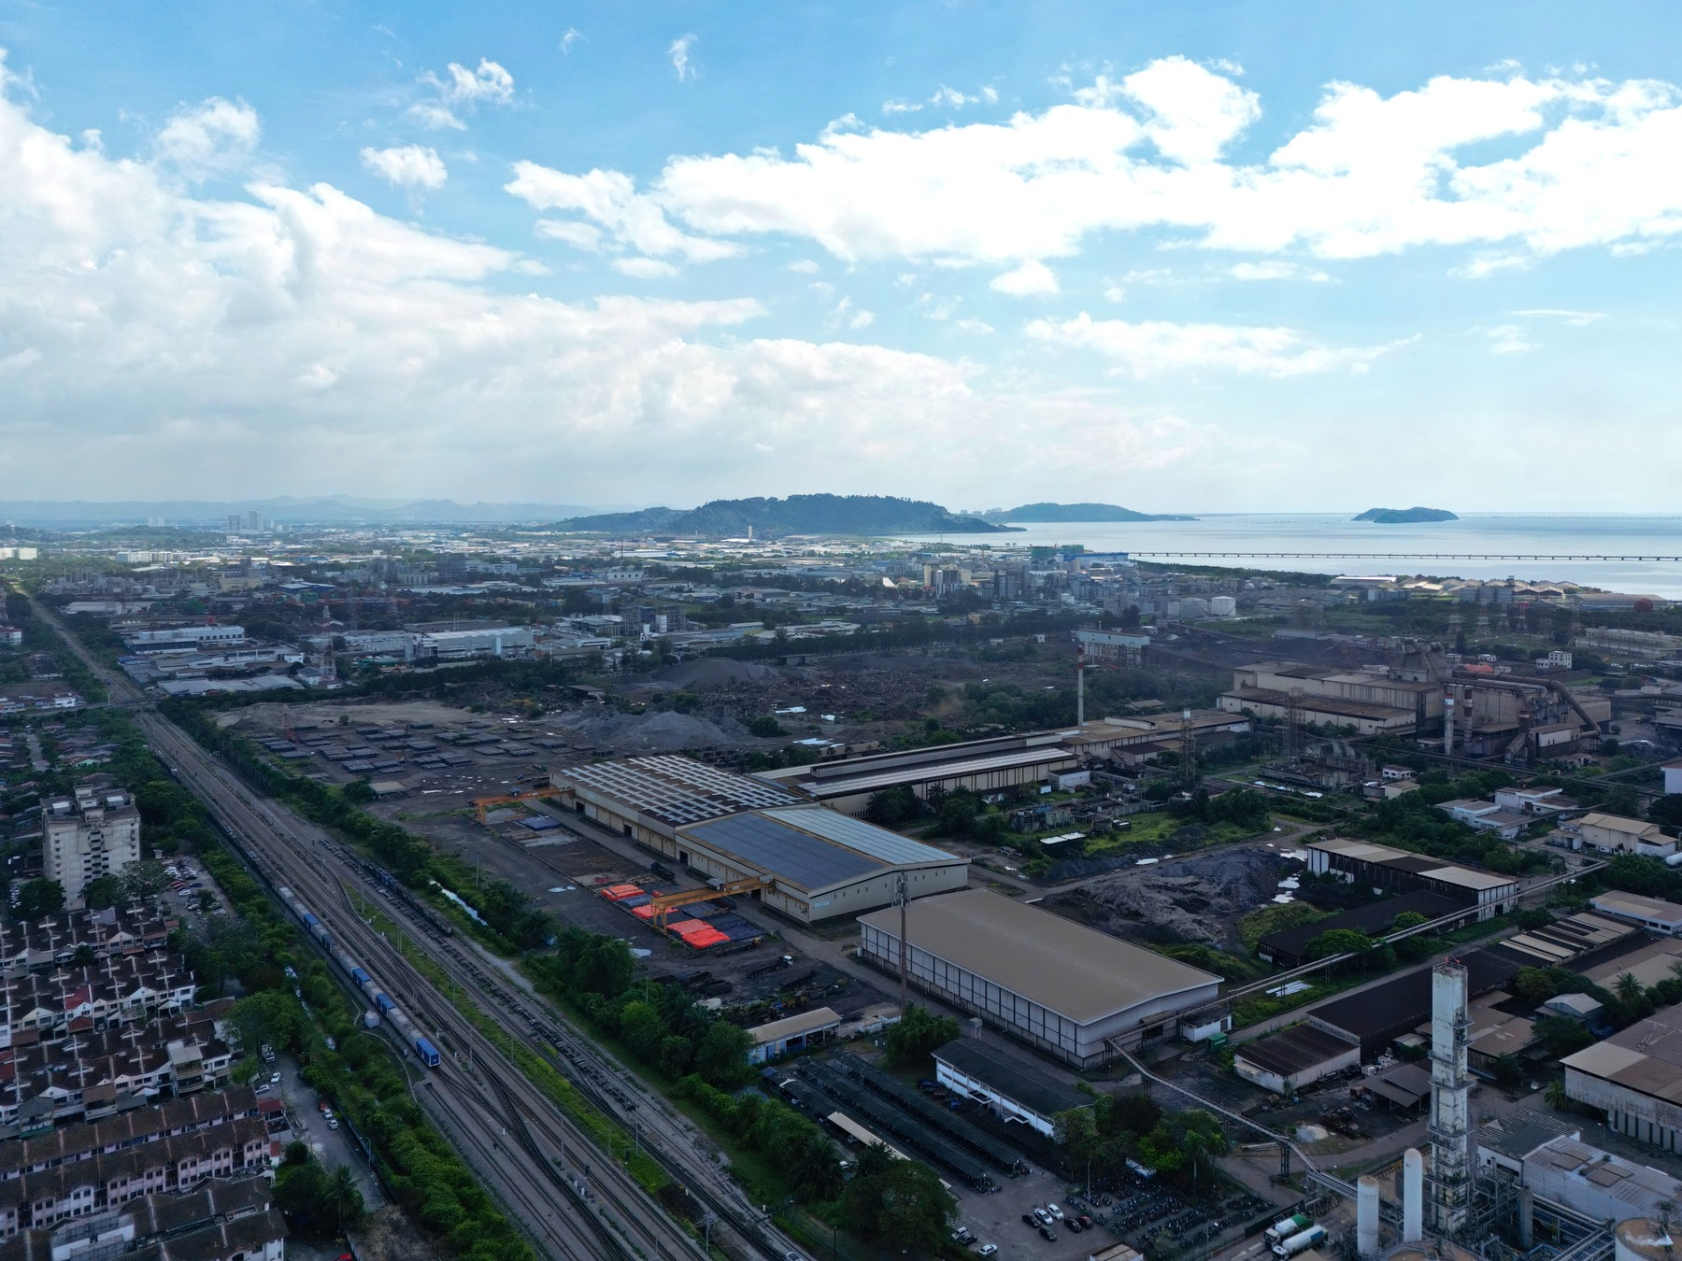
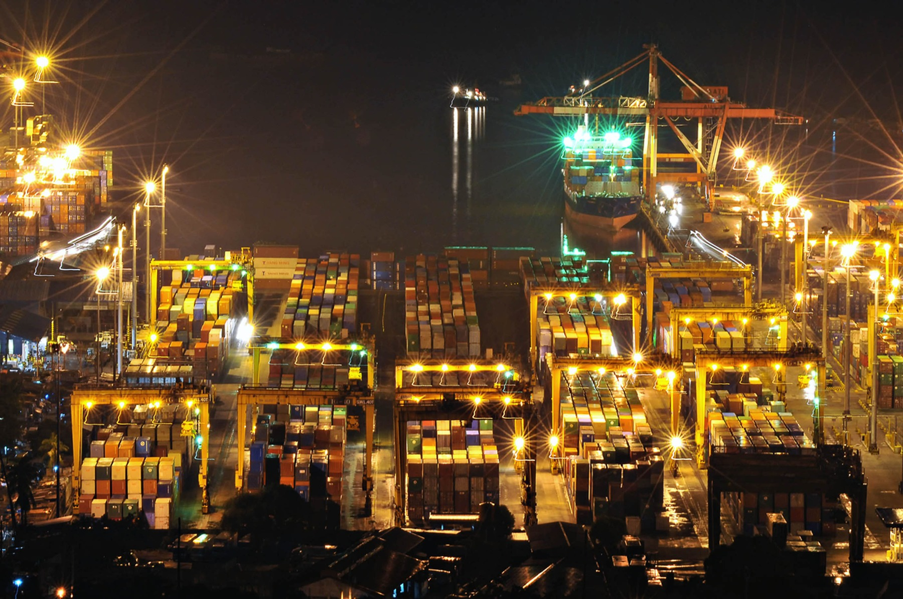
AFRICA & ASIA / 03 / FOLLOW THE PRODUCT
A product label does not reveal value added
“Made here”, “exported from here” and “capability retained here” answer different questions.
1
Imported inputs
Value may originate abroad.
2
Assembly
Domestic activity, but not the whole product value.
3
Logistics and services
Perai, Malaysia · 2024
Industrial setting; not evidence of local value captured. HundenvonPenang; CC BY-SA 4.0.
Transport, design and business services also matter.
4
Local suppliers
Domestic linkages can deepen—or remain thin.
5
Retained value and learning
Ask what remains, who receives it and what improves.
Manufactured exports ≠
manufacturing value added ≠
domestic technological capability.
Manila, Philippines · 2009
A port does not reveal cargo origin. Theurbanhistorian; CC BY-SA 3.0.
Malaysia and the Philippines show why assembly connections must be examined alongside imported inputs and domestic suppliers.
WHAT THIS CANNOT PROVE
A photograph or gross export total cannot identify domestic value captured, supplier depth, ownership, wages, technological capability or causality.
World Bank (2020, Box 2, pp. 44–47); Nasution (2000, pp. 19–20, Table 9); World Bank (1993, pp. 20–26). Journey is a conceptual diagram, not measured product shares or a six-country export series.
EVIDENCE LEDGER · EDITORIAL DRAFT
11

Slide 12
AFRICA & ASIA / 03 / SOUTH KOREA
Capability built over time
South Korea’s sequence combined recovery, coordinated investment, performance pressure and learning. It also contained costly mistakes.
1950s
Recovery and foundations
Recovery, agricultural change, education and infrastructure shaped the capacity to industrialise.
1960s
Coordination and discipline
Credit and investment coordination accompanied export incentives and performance pressure.
1970s
Heavy industry—and costs
Heavy and chemical industry expanded; policy also generated pressures, debt and bottlenecks.
1980s
Correction and upgrading
Adjustment and liberalisation accompanied deeper firm learning and technological upgrading.
Durable direction mattered only if institutions could
learn from failure and change what was not working.
WHAT THIS CANNOT PROVE
The sequence is multi-causal. It does not establish culture as the cause or mean that another country can copy the same national model or international setting.
World Bank (1993, pp. 20–26, 127–130, 159–161, 242). Interpretive dispute: Rodrik (1995), investment-coordination argument (registered working-paper abstract, not a page-specific causal estimate).
EVIDENCE LEDGER · EDITORIAL DRAFT
12

Slide 13
AFRICA & ASIA / 03 / THE CENTRAL COMPARISON
Ghana and South Korea: comparison, not experiment
GDP per capita · constant 2015 US dollars per person · three observed anchors
South Korea
US$33,216
35,000
30,000
20,000
US$9,673
10,000
Ghana
US$1,101
Ghana
US$1,970
US$856
0
1960
1990
2020
South Korea
US$1,038
16.9 : 1
Approximate 2020 ratio—not a causal estimate.
WHAT THIS CANNOT PROVE
A two-country trajectory cannot isolate culture, colonial rule, policy, institutions or any single cause.
World Bank (2026), World Development Indicators (SRC-WDI-001). Frozen release: 13 July 2026; retrieved 6 October 2026. Data and locators: project CSVs; reference p. 26. NY.GDP.PCAP.KD; pair CSV retrieved 4 October 2026. Straight connectors guide the eye only; no annual values are estimated. 2020 is the COVID-19 year.
EVIDENCE LEDGER · EDITORIAL DRAFT
13

Slide 14
AFRICA & ASIA / 04 / CULTURE UNDER EXAMINATION
Six dimensions, one warning label
National averages are historical, country-level lenses—not individual personalities, timeless truths or causal scores.
01
Power distance
Acceptance of unequal power. Tested only as a conditional mechanism.
02
Individualism / collectivism
Integration into groups and obligations to them. Not a trust score. Conditional lens.
03
Masculinity / femininity
Achievement and competition versus care and quality of life; historically gendered labels. Context only.
04
Uncertainty avoidance
Responses to ambiguity and uncertainty—not simply willingness to take risks. Context only.
05
Long-term orientation
Future-oriented adaptation and perseverance versus present/past obligations. Not policy duration. Conditional lens.
06
Indulgence / restraint
Social regulation of gratification. Not a measure of work ethic. Context only.
WHAT THIS CANNOT PROVE
Country-level averages cannot describe every individual. Associations between national indices and income do not establish cultural causation.
Hofstede (2011, pp. 6–8 and 9–16); McSweeney (2002, pp. 93–107). Definitions paraphrased, not reproduced. No country scores invented; missing country rows are not replaced with regional averages.
EVIDENCE LEDGER · EDITORIAL DRAFT
14

Slide 15
AFRICA & ASIA / 04 / MEASURE BEFORE COMPARING
How far can trust travel?
The target matters. A response about a bank, a neighbour or “most people” is not the same observation.
Personal / generalized
A judgement about other people; a familiar person and “most people” are different targets.
Family / close network
Cooperation with known ties; not automatically the opposite of wider cooperation.
Named institutions
Trust in courts, banks or government must name the institution and the question.
Governance perceptions
Institutional-performance indicators are not measures of interpersonal trust.
Survey responses
Question wording, year, population, weights and context shape the reported measure.
Radius of Trust asks about cooperation beyond close ties.
The present evidence cannot establish its strong causal form.
WHAT THIS CANNOT PROVE
There is no approved common six-country trust scale here. Contemporary responses cannot be back-cast to 1960 or used alone to explain national growth.
Organisation for Economic Co-operation and Development [OECD] (2017, pp. 41–44, 62–79); World Bank (2026), WGI methodological distinction; approved trust evidence pack and Radius of Trust matrix.
EVIDENCE LEDGER · EDITORIAL DRAFT
15

Slide 16
AFRICA & ASIA / 04 / A CONDITIONAL MECHANISM
Close networks: strength, boundary—or both?
A network can be a source of resilience and a boundary on cooperation. Neither outcome follows automatically from “collectivism”.
What close ties can provide
Where a boundary may appear
Credit, labour, mutual help, survival and resilience when formal systems are absent or costly.
Delegation to unfamiliar people and impersonal scaling may become harder—depending on organisations and enforcement.
Who would you trust
with money?
Family · a friend · a bank · a court-enforced contract
or an unfamiliar business partner?
DISCUSS, THEN CHANGE ONE CONDITION
Would your answer change with a reliable court, a guarantee, a long trading relationship or a different amount at risk?
WHAT THIS CANNOT PROVE
The diagram is a conditional hypothesis. It does not rank national cultures, equate family loyalty with corruption, or measure trust in any country.
Hofstede (2011, p. 11); OECD (2017, pp. 41–44); Svirydzenka and Petri (2014, pp. 5–8, 12). Approved theory matrix: Radius of Trust. The classroom question is discussion material, not national evidence.
EVIDENCE LEDGER · EDITORIAL DRAFT
16

Slide 17
AFRICA & ASIA / 04 / THE EVIDENCE BOUNDARY
Authority, time horizons and missing evidence
Test power distance and long-term orientation as conditional mechanisms. Keep unsupported growth stories closed.
Authority: coordination or silence?
Time horizons: whose horizon?
Hierarchy may organise action, but it may also weaken feedback. Test who can challenge decisions and whether errors are corrected.
Long-term orientation is not a policy-duration measure. Test observed investment, learning and correction over time.
Uncertainty avoidance
EVIDENCE INSUFFICIENT
Reopen with a specified direction, observed behaviour and matched timing—not a generic risk-taking story.
Masculinity / femininity
EVIDENCE INSUFFICIENT
Reopen with a valid contemporary measure, a clear mechanism and tests against institutional and economic alternatives.
Indulgence / restraint
EVIDENCE INSUFFICIENT
Reopen with a direct, timed link to saving or investment. Do not infer work ethic from income outcomes.
WHAT THIS CANNOT PROVE
National cultural measures cannot substitute for observed organisational behaviour, policy duration, investment or feedback. Mechanisms need their own evidence.
Hofstede (2011, pp. 9–16); McSweeney (2002, pp. 101–107); approved Hofstede critique pack and THEORY_EVIDENCE_MATRIX.md. No dimension is treated as a causal score.
EVIDENCE LEDGER · EDITORIAL DRAFT
17

Slide 18
AFRICA & ASIA / 05 / THREE IDEAS ON TRIAL
Can our three ideas survive the evidence?
Original group hypotheses—not established academic theories, national scores or causal estimates.
THE TEST STANDARD
Mechanism → prediction → supporting evidence →
challenging case → alternative explanation →
limitation → revision condition
COUNTRY
CONNECTED
TRUST
CONTINUITY
Ghana
Consistent; not causal
Unresolved
Unresolved
Botswana
Strong exception
Plausible mechanism
Accumulation warning
Mauritius
Conditional support
Substitutes qualified
Strong qualified support
South Korea
Multi-causal support
Unresolved channel
Duration + correction
Malaysia
Qualified support
Plausible substitutes
Qualified support
Philippines
Not sufficient
Challenges strong form
Support with warning
Next: inspect the strongest challenge—not only the best fit.
WHAT THIS CANNOT PROVE
Qualitative consistency is not causal identification. A supporting case can fit several competing explanations; an unresolved cell must remain unresolved.
Approved research/THEORY_EVIDENCE_MATRIX.md; data/charts/theory_evidence_matrix.csv; claim and source registries. Evidence includes World Bank (1993, 2020), Maipose (2008), Svirydzenka and Petri (2014), and OECD (2017).
EVIDENCE LEDGER · EDITORIAL DRAFT
18

Slide 19
AFRICA & ASIA / 05 / TEST 1
Connected Development
What if the decisive difference was not how much infrastructure existed, but whom it connected?
SUPPORTED
WITH EXCEPTIONS
Consistent evidence
South Korea, Malaysia and Mauritius fit a productive-network account: skills, firms, infrastructure and market access worked together.
Challenging case
Botswana’s income gains challenge inherited infrastructure as a prerequisite. Mineral rents and institutions complicate the network story.
Sufficiency fails
The Philippines shows that global connection can coexist with shallow domestic linkages. Export access is not the same as domestic learning.
REVISE / REJECT IF
Revise to the measured channel. Reject the causal ordering if deeper networks followed upgrading rather than preceding it.
WHAT THIS CANNOT PROVE
Connection alone neither establishes causality nor guarantees diversification. Investment, skills, institutions, resources and market access are bundled alternatives.
World Bank (1993, pp. 20–26); World Bank (2020, Box 2, pp. 44–47); Svirydzenka and Petri (2014, pp. 5–8); Maipose (2008, pp. 3–5, 8–11); Nasution (2000, pp. 19–20). Original group hypothesis.
EVIDENCE LEDGER · EDITORIAL DRAFT
19

Slide 20
AFRICA & ASIA / 05 / TEST 2
Radius of Trust
How far beyond family and close networks can economic cooperation scale?
INCONCLUSIVE
What remains plausible
What remains missing
Institutions and organisations may extend cooperation beyond close networks. Contracts, firms and other arrangements may substitute for personal familiarity.
Direct trust measures differ by target, question and year. Ghana and South Korea remain direct-trust gaps. There is no harmonised historical six-country test.
Do not turn an evidence gap
into a cultural verdict.
REOPEN ONLY WITH comparable, weighted trust measures linked in time to firm-scale outcomes—and tests net of institutional substitutes.
WHAT THIS CANNOT PROVE
The project cannot show that generalized trust caused firm scale or national growth. Governance indicators cannot close direct-trust gaps.
OECD (2017, pp. 41–44, 62–79); Svirydzenka and Petri (2014, pp. 5–8, 12); approved trust evidence pack and six-country theory matrix. WGI is retained only as governance context.
EVIDENCE LEDGER · EDITORIAL DRAFT
20

Slide 21
AFRICA & ASIA / 05 / TEST 3
Continuity + Adaptation
Can a country learn industrially if direction changes every few years—and can continuity correct failure?
SUPPORTED
WITH EXCEPTIONS
Duration + correction
South Korea, Mauritius, Malaysia and the Philippines are consistent with durable direction plus feedback, learning and adaptation.
Continuity can fail
Stable policy may protect weak firms or ineffective programmes. Continuing the same failure is not industrial learning.
Botswana’s warning
Accumulation without broad diversification is a warning—not a direct policy-duration test. Resources and institutional choices remain central.
REVISE / REJECT IF
Revise if continuity yields accumulation without variety; reject a strong claim when durable direction repeatedly preserves failure.
WHAT THIS CANNOT PROVE
Cases cannot isolate duration from state capacity, mineral rents, FDI, market access, shocks or prior success. Hofstede long-term orientation is not a duration measure.
World Bank (1993, pp. 127–130, 159–161, 242); Svirydzenka and Petri (2014, pp. 5–8, 17); World Bank (2020, Box 2); approved theory matrix for Malaysia and the Philippines. Maipose (2008, pp. 8–11).
EVIDENCE LEDGER · EDITORIAL DRAFT
21

Slide 22
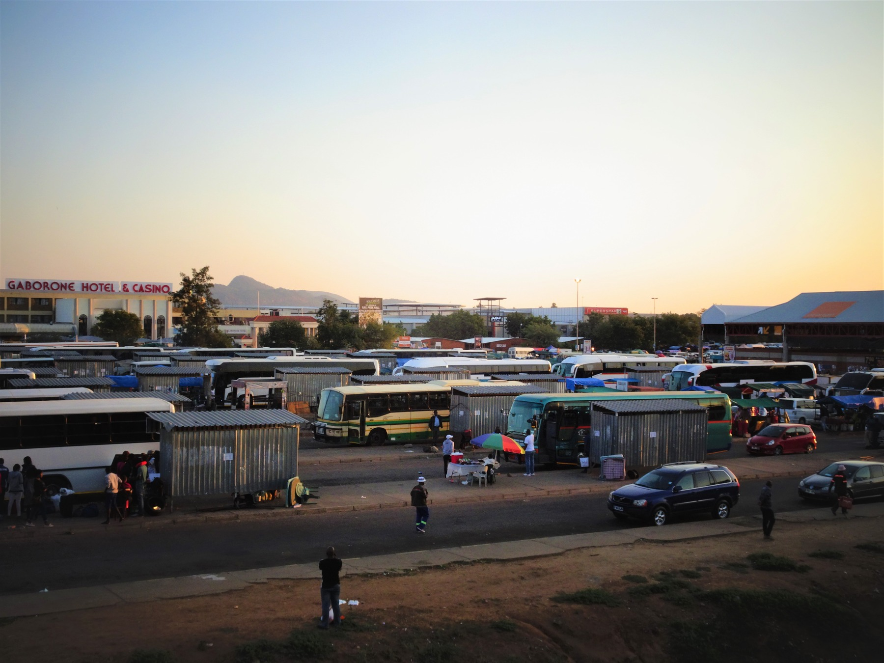

AFRICA & ASIA / 05 / THE EXCEPTIONS MATTER
The counterexamples change the answer
Four cases make a uniform continental story untenable. Each challenges a different shortcut.
Botswana
Supports: resource management and investment.
Challenges: inherited infrastructure as a prerequisite.
Cannot prove: broad diversification or a cultural cause.
Gaborone Bus Rank · 2015
Everyday mobility, not a growth measure.
Mauritius
Supports: adaptation and diversification.
Challenges: fixed cultural destiny.
Cannot prove: continuity alone caused growth.
Port Louis market · 2015
Commerce, not measured trust.
Malaysia
Philippines
Supports: coordinated productive links.
Challenges: exports = local capability.
Cannot prove: FDI guarantees upgrading.
Supports: the need for deeper linkages.
Challenges: one successful “Asia” model.
Cannot prove: culture caused interruption.
WHAT THIS CANNOT PROVE
These cases do not isolate culture or a universal growth formula. An exception changes the scope of a claim; it does not automatically establish its rival.
Maipose (2008, pp. 3–5, 8–11); Svirydzenka and Petri (2014, pp. 5–8); World Bank (2020, Box 2, pp. 44–47); Nasution (2000, pp. 19–20); approved theory matrix. Photographs: credits p. 27.
EVIDENCE LEDGER · EDITORIAL DRAFT
22

Slide 23
AFRICA & ASIA / 06 / SYNTHESIS
What the combined evidence says
The strongest bounded explanation centres on productive capability—not fixed regional culture.
PRODUCTIVE
CAPABILITY
History · institutions · resources · markets · policy
external conditions · culture
Divergence depended less on fixed regional culture than on whether states, firms, workers and external partners built and disciplined productive capabilities over time. Education, agricultural change, infrastructure, investment coordination, technology access and exports mattered in different sequences. Their effects depended on institutions, resources, distribution, history and international conditions. Culture may influence coordination, legitimacy and organisational practice, but it is not a stand-alone explanation.
Connected Development
Supported with exceptions
Radius of Trust
Inconclusive
Continuity + Adaptation
Supported with exceptions
WHAT THIS CANNOT PROVE
This is a bounded comparative interpretation, not an estimated causal decomposition. The six cases cannot represent every African or Asian economy.
Original group synthesis of approved theory matrix and evidence packs. World Bank (1993, pp. 4–7, 20–26, 79–80); World Bank (2020); Maipose (2008); Svirydzenka and Petri (2014); Hofstede (2011).
EVIDENCE LEDGER · EDITORIAL DRAFT
23

Slide 24
AFRICA & ASIA / 06 / TRANSFER MECHANISMS
What can travel—and what must adapt?
Lessons are conditional mechanisms to examine, not national models to transplant.
01
Build productive capabilities
Not only visible infrastructure. Ask whether people and firms can use it reliably and learn.
02
Connect the domestic economy
Link suppliers, workers, skills and markets—not just a port to the world.
03
Combine continuity with correction
Keep a direction long enough to learn; change policies that protect failure.
04
Support cooperation beyond close ties
Use institutions and organisations; do not assume national trust scores explain growth.
05
Adapt to the starting conditions
Resources, history, scale and international conditions shape what is feasible.
Transfer mechanisms, not myths.
Adapt lessons, not entire national models.
Original group conclusions grounded in the approved theory matrix: World Bank (1993, 2020); Maipose (2008); Svirydzenka and Petri (2014); OECD (2017). These are reasoned implications, not independently identified causal effects.
EVIDENCE LEDGER · EDITORIAL DRAFT
24

Slide 25
AFRICA & ASIA / 06 / THE OPEN QUESTION
If culture matters, can culture change?
The final question returns us to the first: culture may shape economic organisation—and also change with institutions, opportunities and experience.
Do not confuse a
historical pattern
with a permanent
national personality.
Culture is neither irrelevant nor sufficient. Cohort and historical change challenge a timeless reading of national averages (Beugelsdijk & Welzel, 2018). Our next question should name a mechanism, a context and evidence that could change our minds.
Draft status
Complete editorial draft — final evidence, rights and physical-print checks pending.
TEAM NAME: [TO BE CONFIRMED]
Complete source appendix: [LINK / QR PLACEHOLDER]
No live appendix address is approved. The local source registry, claim registry and chart CSVs remain the traceable master records.
Hofstede (2011, pp. 6–8, 16); Beugelsdijk and Welzel (2018, pp. 1469–1475, Figures 7–9). Essential references continue on p. 26; image credits on p. 27.
EVIDENCE LEDGER · EDITORIAL DRAFT
25

Slide 26
AFRICA & ASIA / SOURCE APPENDIX
Essential references
APA references for the evidence spine. Exact locators are in page source bands and the approved source registry.
World Bank. (2026). World Development Indicators [Data set]. Retrieved October 6, 2026, from
SOURCE ↗
World Bank. (1993). The East Asian miracle: Economic growth and public policy. Oxford University Press.
SOURCE ↗
World Bank. (2020). Structural transformation and labor market performance in Ghana.
SOURCE ↗
World Bank. (1985). Ghana: Industrial policy, performance and recovery (Report No. 5716-GH).
SOURCE ↗
Maipose, G. S. (2008). Policy and institutional dynamics of sustained development in Botswana (Commission on Growth and Development Working Paper No. 35). World Bank.
SOURCE ↗
Svirydzenka, K., & Petri, M. (2014). Mauritius: The drivers of growth-Can the past be extended? (IMF Working Paper No. 14/134). International Monetary Fund.
SOURCE ↗
Jedwab, R., & Moradi, A. (2012). Colonial investments and long-term development in Africa: Evidence from Ghanaian railways [Working paper]. Northeast Universities Development Consortium.
SOURCE ↗
Hofstede, G. (2011). Dimensionalizing cultures: The Hofstede model in context. Online Readings in Psychology and Culture, 2(1), Article 8.
SOURCE ↗
McSweeney, B. (2002). Hofstede's model of national cultural differences and their consequences: A triumph of faith—a failure of analysis. Human Relations, 55(1), 89–118.
SOURCE ↗
Organisation for Economic Co-operation and Development. (2017). OECD guidelines on measuring trust. OECD Publishing.
SOURCE ↗
Further cited works: Bolt et al. (2025); Cogneau et al. (2018); Huillery (2009); Kohli (1994); Haggard et al. (1997); Dolan (1993); Asadullah et al. (2024); Xenos (1970); Nasution (2000); McMillan et al. (2014); Beugelsdijk and Welzel (2018); National Archives Department (n.d.). Full registered APA entries accompany the production master; see appendix placeholder p. 25.
Reference text is copied from research/source_registry.csv, not generated by Canva. Additional supporting sources and verification status remain in the complete local registry.
EVIDENCE LEDGER · EDITORIAL DRAFT
26

Slide 27
AFRICA & ASIA / CREDITS / COLOPHON
Images, data and open gates
Every photograph has a country, place and date. Images provide context and human scale—not proof of culture, trust, productivity or causality.
JulianGrayscales (2020-02-08). Tema port. CC BY-SA 4.0. Wikimedia Commons.
SOURCE ↗
CC BY-SA 4.0 ↗
Svwmal (2012-04-08). South Korea Busan harbour. CC BY-SA 3.0. Wikimedia Commons.
SOURCE ↗
CC BY-SA 3.0 ↗
Sarvesh Lutchmun (2015-08-06). Bus Terminal in Gaborone, Botswana. CC BY-SA 4.0. Wikimedia Commons.
SOURCE ↗
CC BY-SA 4.0 ↗
Didier Baertschiger (2015-03-09). Mauritius - Port Louis (Central Market). CC BY-SA 2.0. Wikimedia Commons.
SOURCE ↗
CC BY-SA 2.0 ↗
HundenvonPenang (2024-01-27). Perai Industrial Zone, Seberang Perai, Penang. CC BY-SA 4.0. Wikimedia Commons.
SOURCE ↗
CC BY-SA 4.0 ↗
Theurbanhistorian (2009-07-18). Port of Manila. CC BY-SA 3.0. Wikimedia Commons.
SOURCE ↗
CC BY-SA 3.0 ↗
Data & figure credits
World Bank WDI / ILO modelled employment. Editable charts recreate approved frozen CSV values; original SVGs remain preserved. Native text and geometry are not flattened images. No annual interpolation or composite trust score.
OPEN GATES: 1914 map raster/legend; final source and rights review; physical A4 print, colour and classroom-screen tests. Team and appendix links remain placeholders. No publication-ready claim is made.
Rights records: research/asset_rights_register.csv and country_photography_audit.md, verified 8 October 2026. All images are placed uncropped and resized only. Recheck final asset use and licence compliance before publication.
EVIDENCE LEDGER · EDITORIAL DRAFT
27

