Slide 1
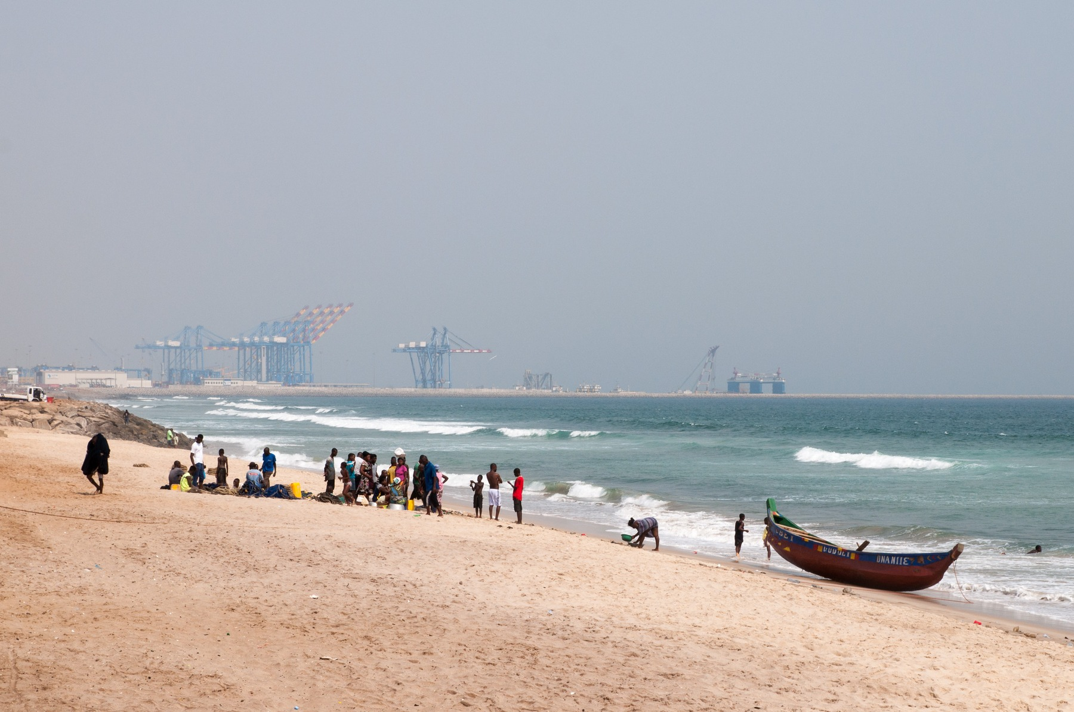
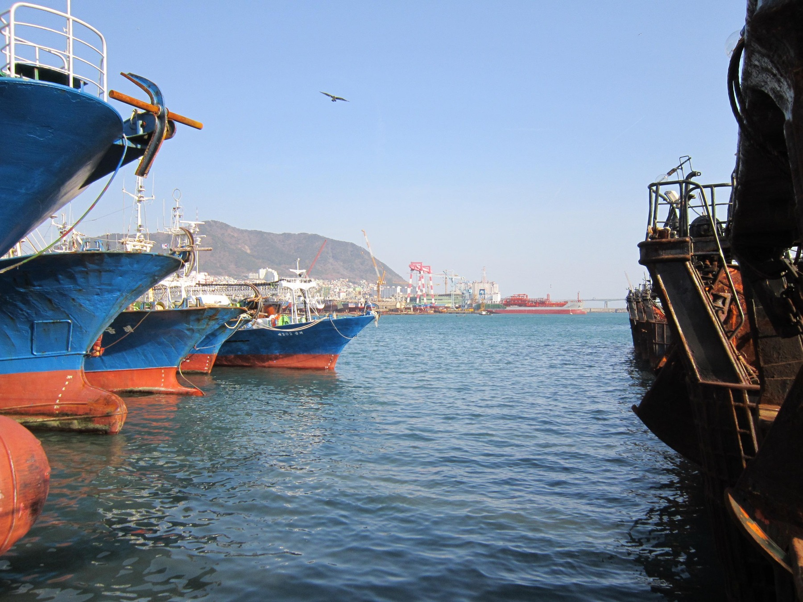
AFRICA & ASIA / SIX COUNTRIES. ONE BIG QUESTION.
Africa & Asia:
Why Did Their
Economic Paths
Diverge?
Testing culture against history, institutions,
policy and economic evidence.
Ghana
South Korea
Tema port · 2020
Trade and work in Ghana.
Busan harbour · 2012
Trade and work in South Korea.
DIFFERENT PATHS.
NO EASY ANSWER.
Photographs: JulianGrayscales (2020), Tema port; Svwmal (2012), Busan harbour. Context, not a regional ranking. Full credits and licences: p. 29.
AFRICA & ASIA
01

Slide 2
AFRICA & ASIA / START HERE
Culture—or a much bigger story?
We started with a question. Six countries made the answer more complicated.
Not one Africa.
Not one Asia.
Ghana and South Korea give us a striking comparison. Botswana, Mauritius, Malaysia and the Philippines challenge the easy explanations.
01
The gap
03–04
02
The starting line
05–08
03
Work, income and learning
09–14
04
Culture and trust
15–18
05
Our ideas on trial
19–23
06
What we think
24–26
OUR TAKE / GROUP VIEW
We think culture matters. But different histories, resources and starting points make “Africa versus Asia” the wrong shortcut.
Hofstede (2011, pp. 6–8, 9–16); McSweeney (2002, pp. 93–107). National averages are not individual traits or causal scores. Full references: p. 27.
AFRICA & ASIA
02

Slide 3
AFRICA & ASIA / THE GAP
1960: almost level. Not identical.
Ghana and South Korea were close in income per person—not in every starting condition.
US$1,101
US$1,038
Ghana
South Korea
Just US$63 apart.
Ghana
US$1,101
Botswana
US$394
Mauritius
US$1,419
South Korea
US$1,038
Malaysia
US$1,266 †
Philippines
US$1,124
Bar scale: US$0–1,500. † Malaysia: retrospective territorial series; 1960 predates the 1963 federation and Singapore’s 1965 exit.
KEEP IN MIND
Income per person is an average, not a typical wage or a measure of inequality. Similar income does not mean the same history.
World Bank (2026), World Development Indicators, NY.GDP.PCAP.KD; release 13 July 2026, retrieved 6 October 2026. GDP per capita, constant 2015 US dollars per person. Full reference: p. 27.
AFRICA & ASIA
03

Slide 4
AFRICA & ASIA / THE GAP
2020: the paths have split.
The same income measure. Six very different outcomes.
Ghana
US$1,970
Botswana
US$6,254
Mauritius
US$9,534
South Korea
US$33,216
Malaysia
US$10,171
Philippines
US$3,199
0
US$35,000
Different outcomes inside
both continents.
KEEP IN MIND
This is the COVID-19 year. The comparison does not measure purchasing power, freedom, health or the causes of growth.
World Bank (2026), World Development Indicators, NY.GDP.PCAP.KD; release 13 July 2026, retrieved 6 October 2026. GDP per capita, constant 2015 US dollars per person. Full reference: p. 27.
AFRICA & ASIA
04

Slide 5
AFRICA & ASIA / THE STARTING LINE
Find the countries. Then rewind.
These are present-day locations. Their political starting points came at different times.
Ghana
Botswana
Mauritius
South Korea
Malaysia
Philippines
1945 / 1948
South Korea
Japan → end of rule / Republic established
1946
Philippines
Spain, then United States → independence
1957
Ghana
Britain → independence
1957 / 1963
Malaysia
Britain → Malaya independence / federation
1966
Botswana
British protectorate → independence
1968
Mauritius
France, then Britain → independence
Historical 1914 map withheld: verified artwork and original legend still required.
KEEP IN MIND
The map is generalized and present-day—not a 1914 colonial map. Mauritius is located by a point. Independence dates do not measure state capacity.
World Bank (1985, p. 18); Maipose (2008, pp. 3–5); National Archives Department (n.d.); Haggard et al. (1997, pp. 867–870); Asadullah et al. (2024, pp. 13–15); Dolan (1993), archival recheck pending. Map: Natural Earth (n.d.), v5.1.1; full credit p. 29.
AFRICA & ASIA
05

Slide 6
AFRICA & ASIA / THE STARTING LINE
Same empire. Different inheritance.
Ask what colonial rule built, extracted and left behind—not just which flag it flew.
Built for whom?
British African councils varied. Investment also varied within French West Africa. An empire label hides important differences (Bolt et al., 2025; Huillery, 2009).
What survived?
Researchers disagree about Korea’s colonial inheritance. Organisation mattered, but so did coercion, unequal ownership, division, war and later policy change (Kohli, 1994; Haggard et al., 1997).
Who had access?
The Philippines combined formal institutions and education with concentrated power. Spanish and US rule cannot be explained by a British–French contrast (Dolan, 1993; recheck pending).
OUR TAKE / GROUP VIEW
Independence did not reset the economy. We think what countries inherited—and what they could build on afterwards—mattered more than the colonial flag alone.
KEEP IN MIND
These studies do not show that colonial rule was beneficial overall, or that one empire explains the six countries’ later paths.
Bolt et al. (2025, pp. 1–6, 18–20); Huillery (2009, pp. 176–180, 203–208); Kohli (1994, pp. 1277–1284); Haggard et al. (1997, pp. 867–881); Dolan (1993), archival passage recheck pending.
AFRICA & ASIA
06

Slide 7
AFRICA & ASIA / THE STARTING LINE
Track is not the whole story.
Ghana: the useful question is who the railway connected.
1898–1918 / GHANA
→
Coast and ports
Mining areas
→
Cocoa producers
Kumasi and markets
SCHEMATIC, NOT SURVEY GEOMETRY
Solid: original connections to mines and Kumasi.
Dashed: later economic links—not a mapped railway route.
Built to extract.
Used for more.
Lower transport costs also supported cocoa production and urban growth. Original purpose and later effects were not the same (Jedwab & Moradi, 2012).
KEEP IN MIND
One railway case cannot explain all of Africa or show that infrastructure alone caused growth. It does not establish the net benefit of colonial rule.
Jedwab and Moradi (2012, pp. 1–4, 6–10). Original schematic based on cited facts, not traced map geometry. Full reference: p. 27.
AFRICA & ASIA
07

Slide 8
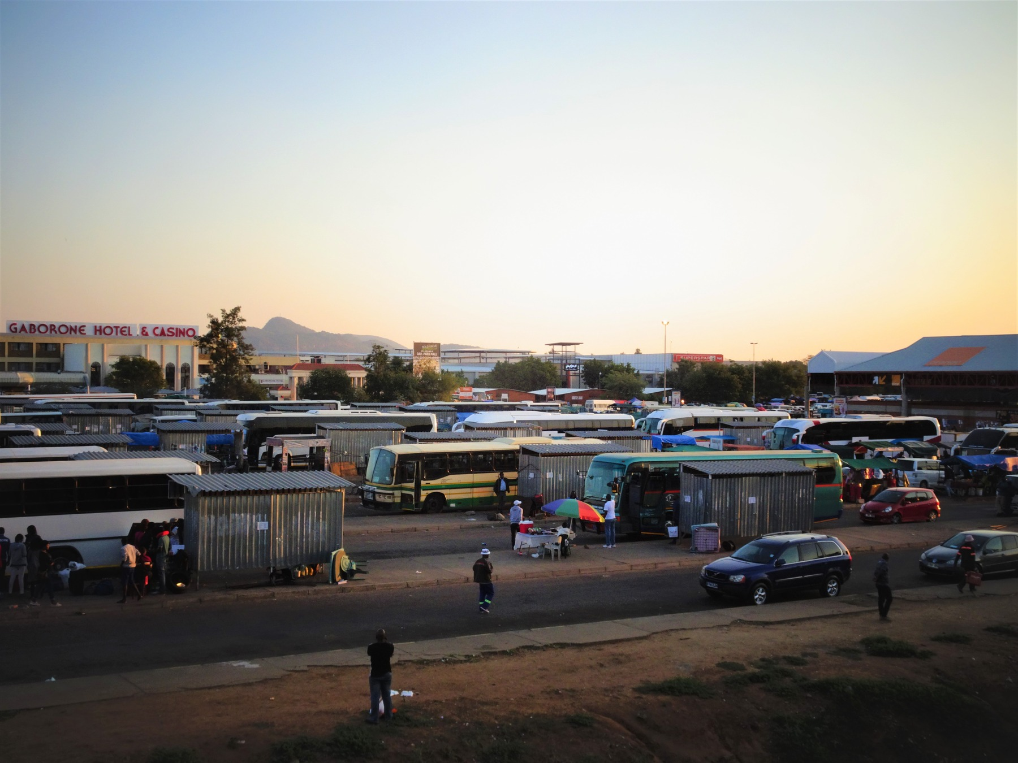
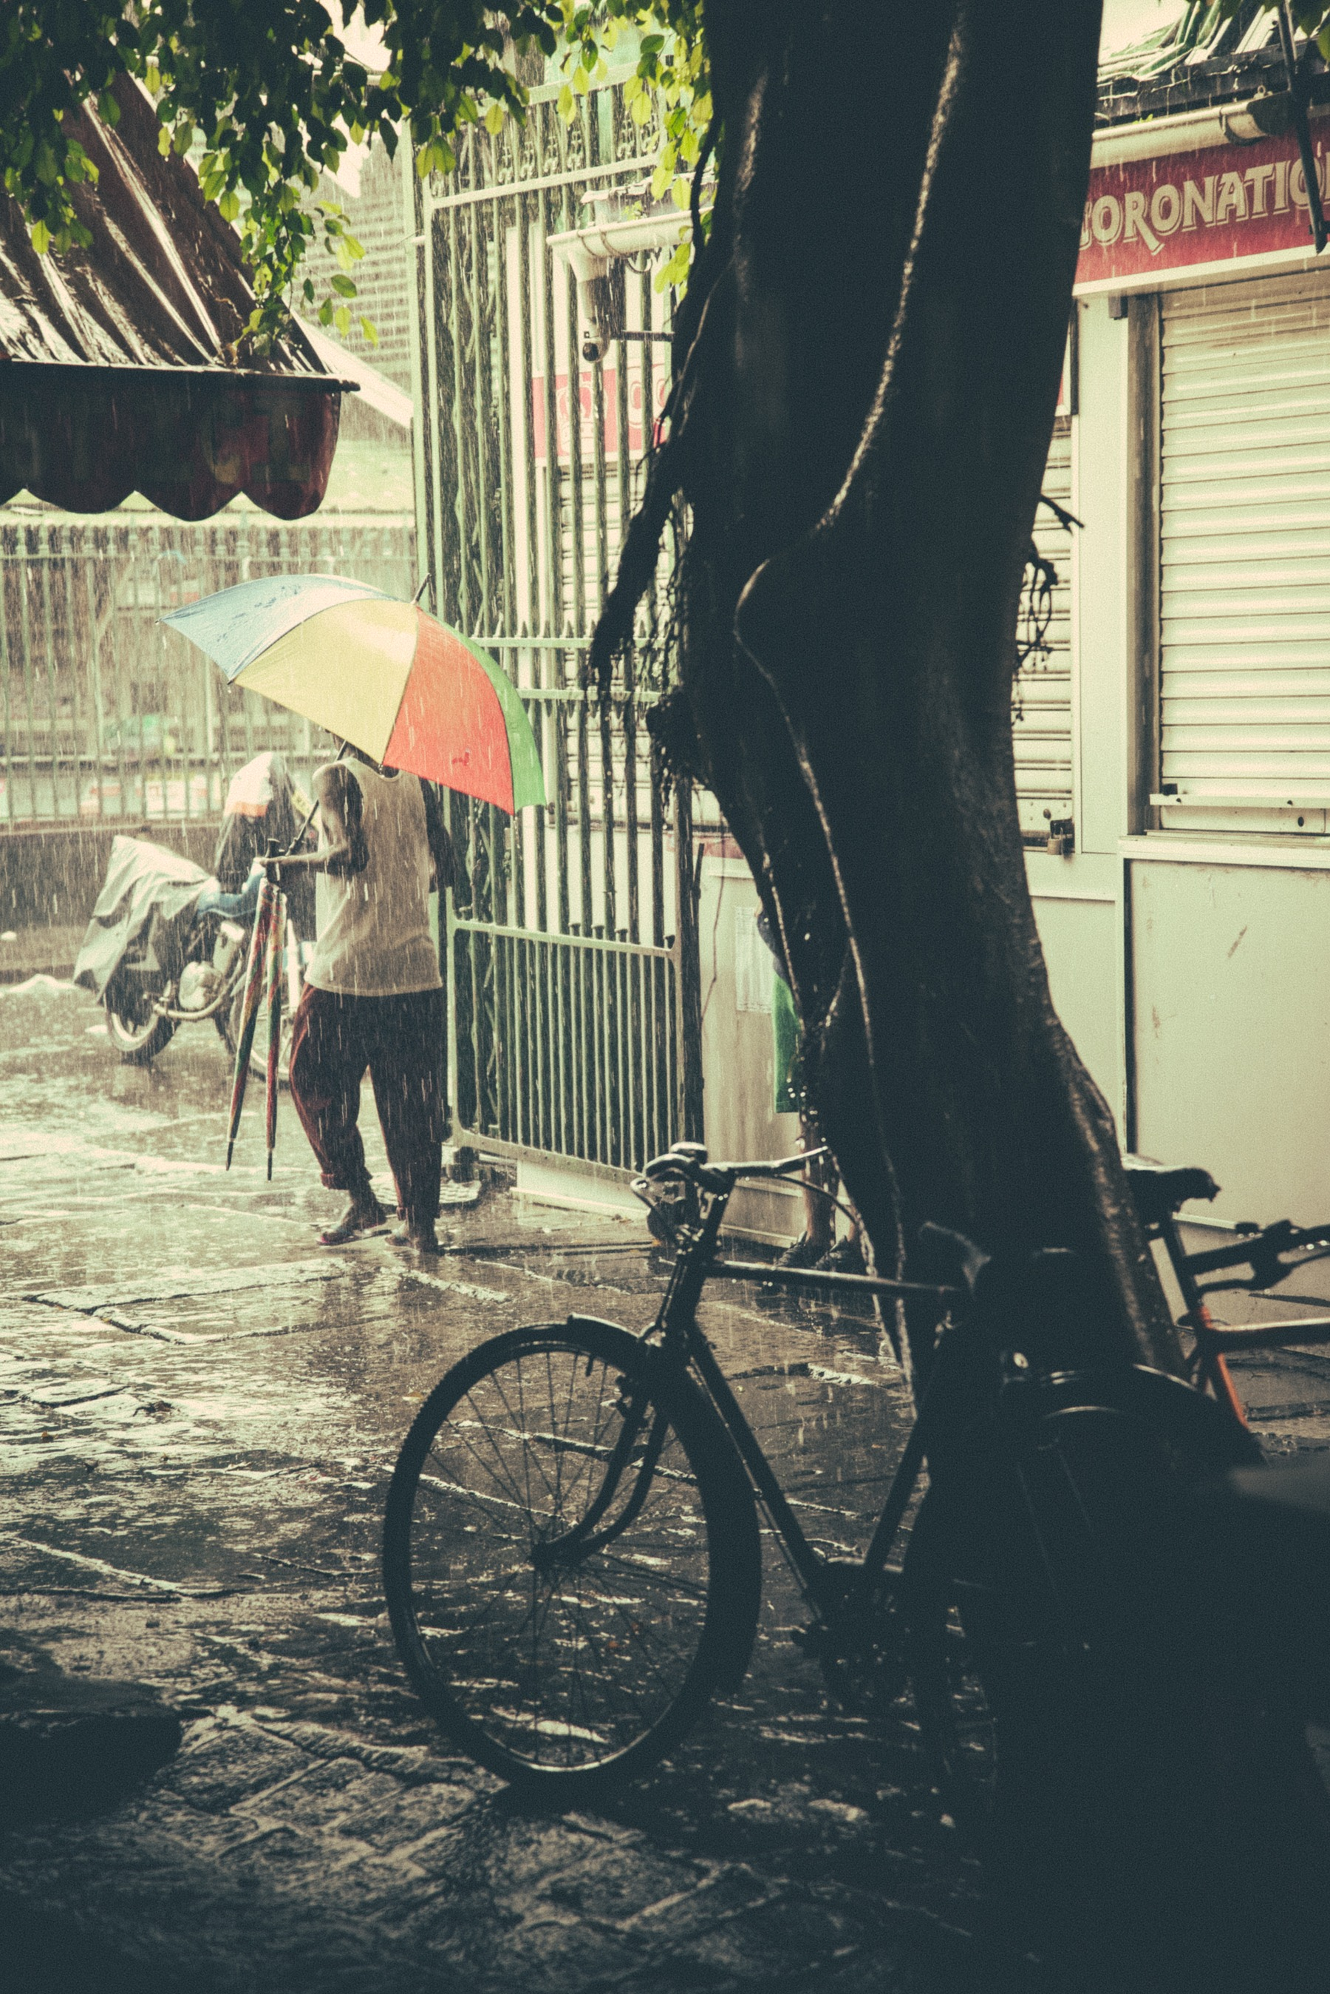
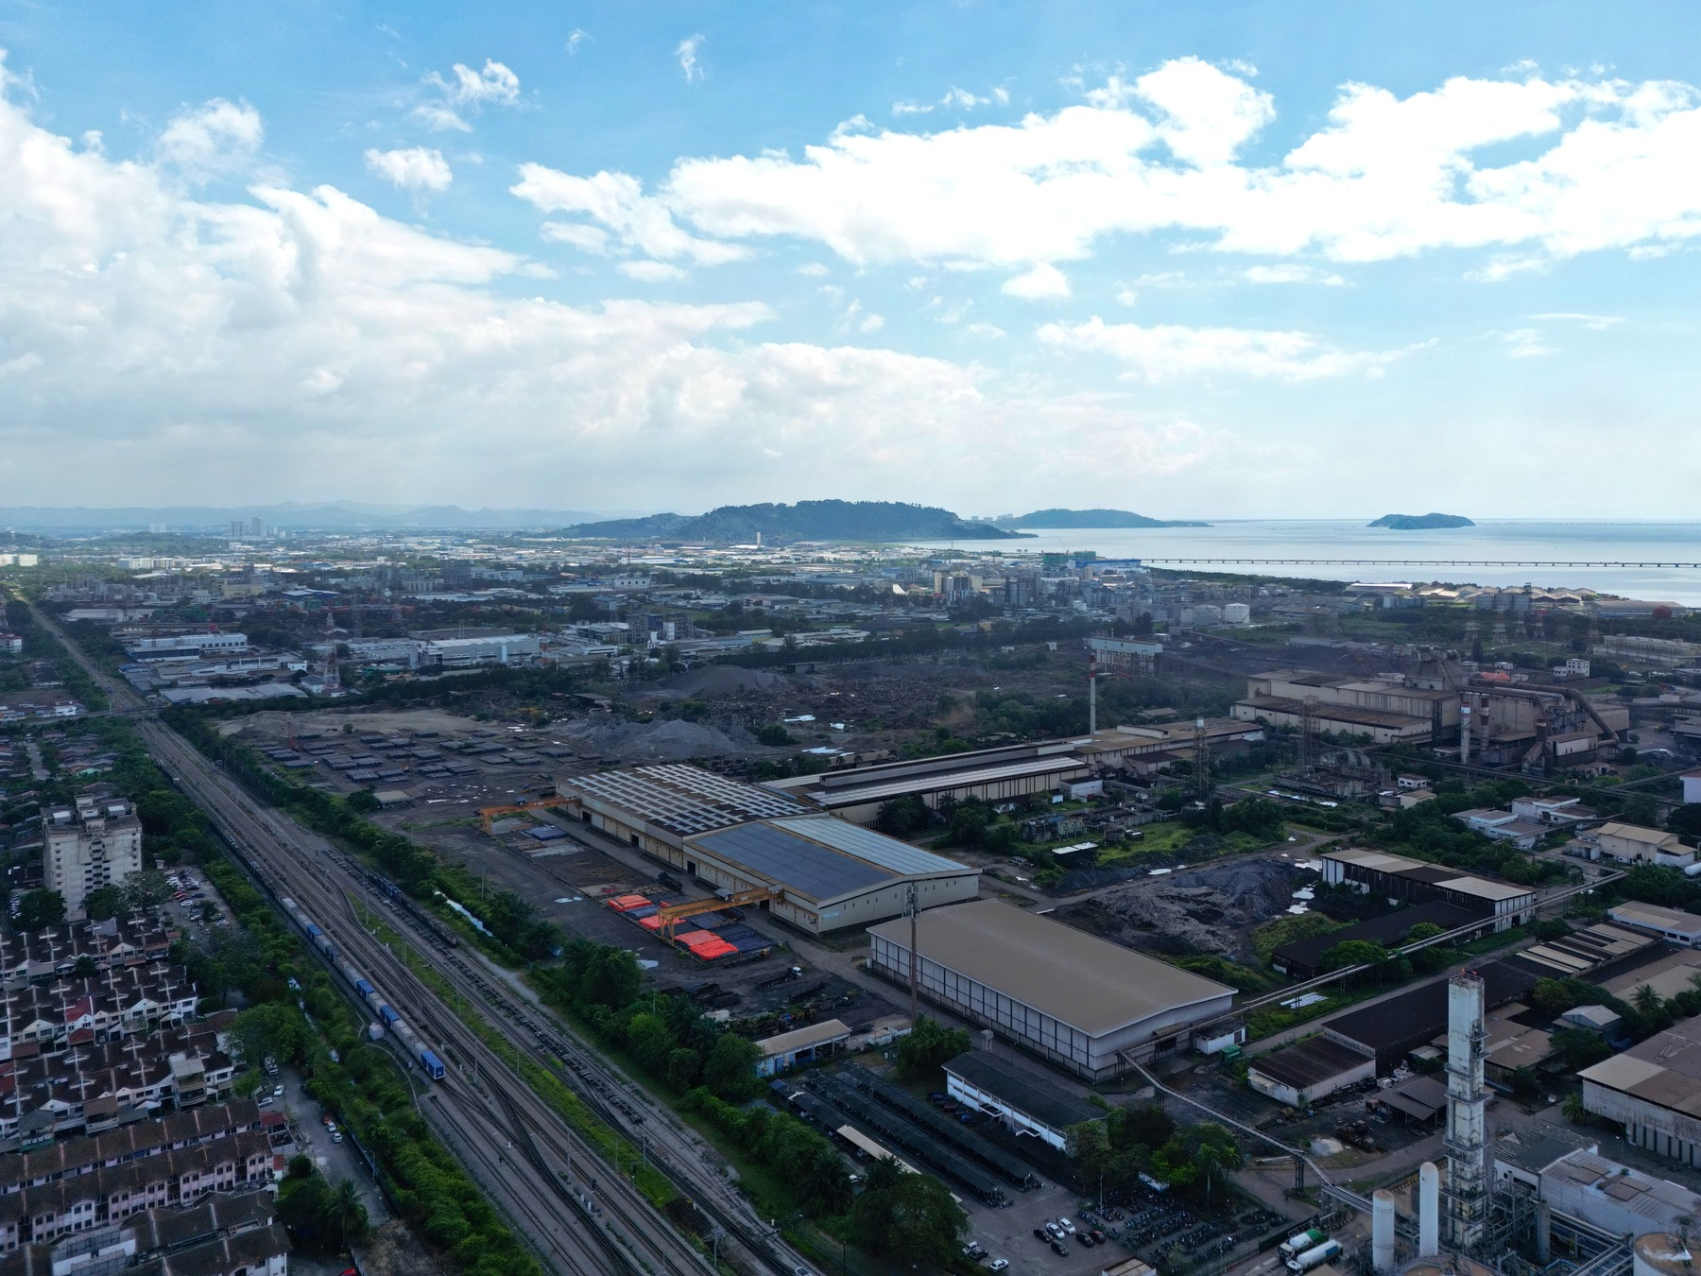
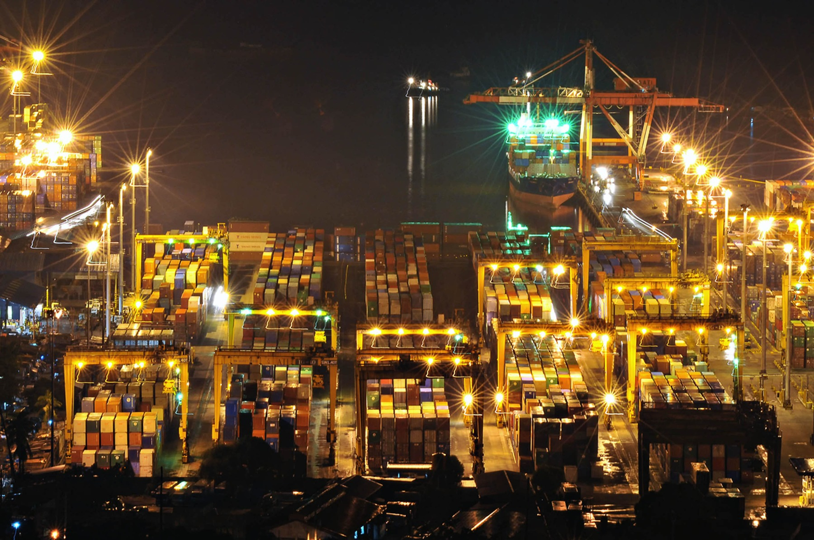
AFRICA & ASIA / THE STARTING LINE
Six countries. Six starting points.
What could each country build on—and what held it back?
Ghana
Cocoa exports; inherited roads, rail and Tema harbour.
Botswana
Few inherited public assets and limited skills; mineral income later changed the base.
Mauritius
Sugar dominated export earnings; diversification came later.
South Korea
Colonial inheritance was disrupted by division and war.
Malaysia
Commodity exports came before export manufacturing; federation formed in 1963.
Philippines
Formal institutions and education coexisted with concentrated power.
KEEP IN MIND
These are contemporary photographs, not scenes from independence. They give context, not proof of historical living conditions or causes.
World Bank (1985, p. 18); Maipose (2008, pp. 3–5); Xenos (1970, p. 1); Svirydzenka and Petri (2014, pp. 5–8); Haggard et al. (1997); Asadullah et al. (2024, pp. 13–15); Dolan (1993), archival recheck pending. Photo credits p. 29.
AFRICA & ASIA
08

Slide 9
AFRICA & ASIA / WORK
Fewer farm jobs. What came next?
Share of workers in agriculture, industry and services. Actual comparison: 1991 → 2020.
FARMING
INDUSTRY*
SERVICES
Upper thin bar: 1991. Lower thick bar: 2020. All bars use 0–100%.
Ghana
71.8 → 37.4%
9.0 → 15.2%
19.2 → 47.4%
Botswana
12.6 → 19.5%
21.3 → 15.0%
66.1 → 65.5%
Mauritius
19.6 → 5.3%
35.0 → 23.4%
45.4 → 71.3%
South Korea
15.5 → 5.4%
37.1 → 24.6%
47.4 → 70.0%
Malaysia
18.9 → 10.5%
32.8 → 26.2%
48.3 → 63.3%
Philippines
44.1 → 24.5%
16.6 → 18.7%
39.3 → 56.8%
* Industry includes mining, construction and utilities. 1991 is the visible proxy for 1990. 2020 is the pandemic year.
KEEP IN MIND
Moving out of farming does not automatically raise productivity. Industry includes mining, construction and utilities; services are not all high-skill jobs.
World Bank (2026), WDI / ILO modelled estimates: SL.AGR.EMPL.ZS, SL.IND.EMPL.ZS, SL.SRV.EMPL.ZS. 1991 proxies 1990; no approved 1960 series. Percent of employment. Release 13 July 2026; retrieved 6 October 2026.
AFRICA & ASIA
09

Slide 10
AFRICA & ASIA / INCOME
The numbers. Country by country.
GDP per capita means economic output per person—not total national GDP or a share of GDP.
1960
1990
2020
Ghana
1,101
856
1,970
Botswana
394
4,039
6,254
Mauritius
1,419
3,846
9,534
South Korea
1,038
9,673
33,216
Malaysia
1,266 †
4,185
10,171
Philippines
1,124
1,704
3,199
US dollars per person, at constant 2015 prices. Mini-bars all run from 0 to US$35,000; use the printed values for the small early-year differences.
KEEP IN MIND
Not a purchasing-power comparison or a measure of inequality. † Malaysia 1960 is a retrospective territorial series. 2020 is the pandemic year.
World Bank (2026), World Development Indicators, NY.GDP.PCAP.KD; release 13 July 2026, retrieved 6 October 2026. GDP per capita, constant 2015 US dollars per person. Full reference: p. 27.
AFRICA & ASIA
10

Slide 11
AFRICA & ASIA / LEARNING
Build. Learn. Improve. Repeat.
A country needs more than factories. People and firms need the ability to make better things.
Learn the skills
↓
Education helps people use and improve technology.
Make the connections
↓
Reliable power and transport help work get done.
Build firms and suppliers
↓
Local businesses need links, skills and organisations.
Make and improve
↓
Production tests quality, routines and coordination.
Sell and learn
↓
Export markets can bring scale and feedback.
Invest again
Use returns to upgrade—not just protect failure.
The chain breaks when power fails, feedback is ignored, or firms are protected from learning.
KEEP IN MIND
This is a possible learning sequence, not an automatic cycle. Institutions, resources, distribution and access to technology and markets shape every link.
World Bank (1993, pp. 4–7, 20–26, 79–80, 127–130, 159–161); World Bank (2020, pp. 32–33, Box 2 pp. 44–47). Full references: p. 27.
AFRICA & ASIA
11

Slide 12
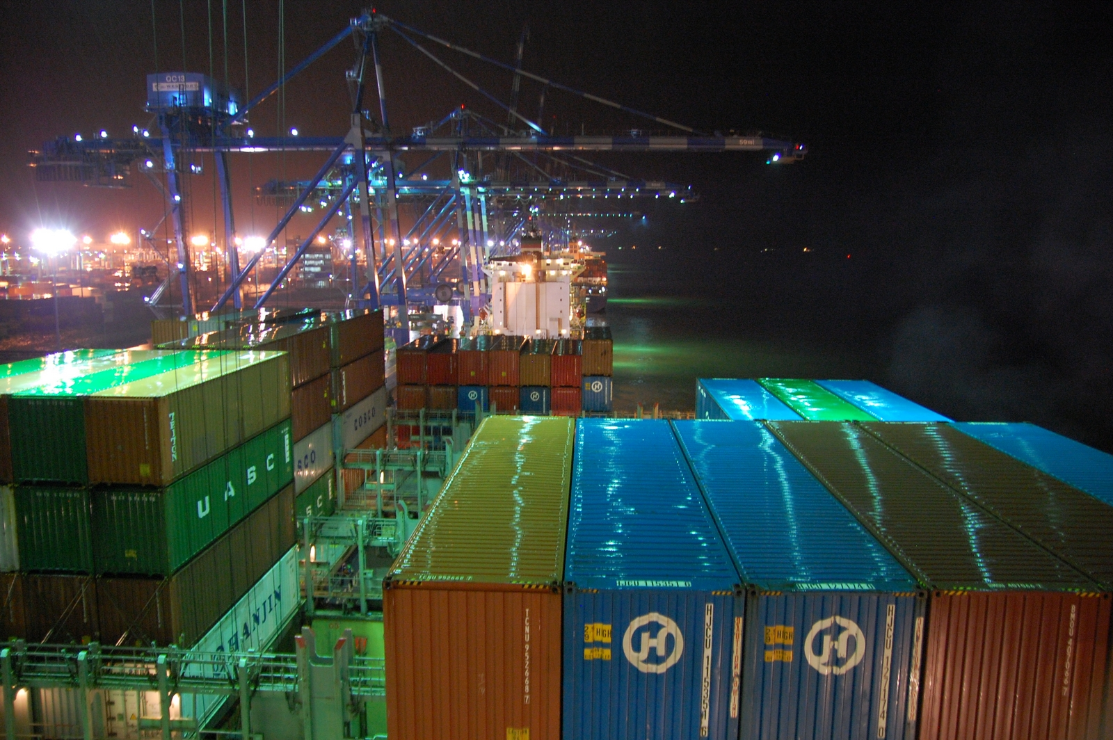
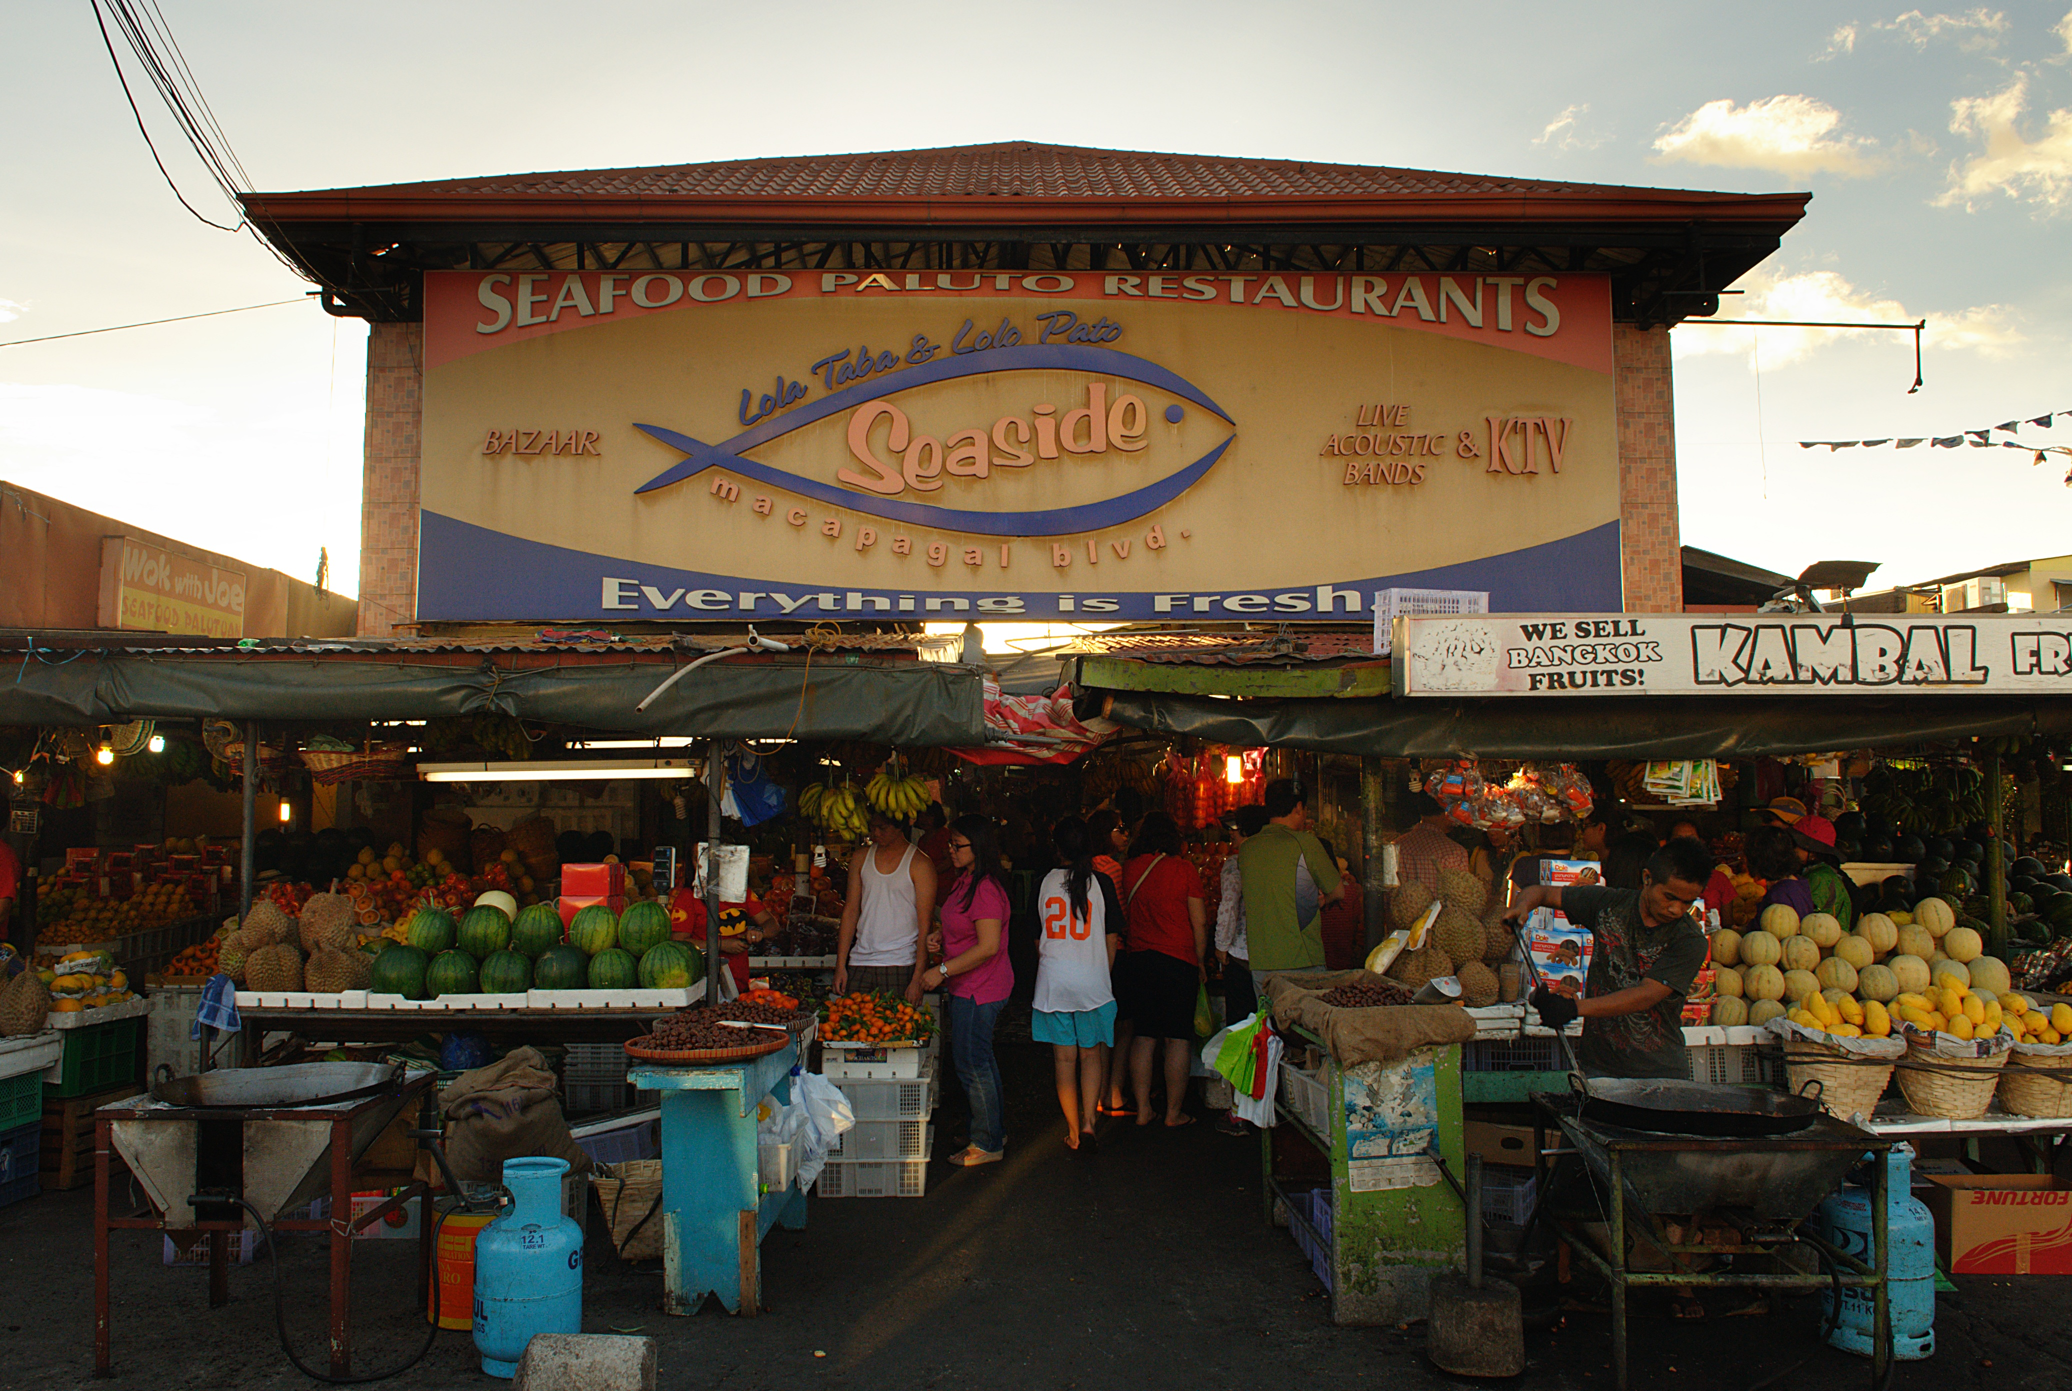
AFRICA & ASIA / FOLLOW THE PRODUCT
“Made here” is not the whole story.
A country can export a product without keeping all its value—or learning how to make its most complex parts.
Port Klang, Malaysia · 2009
Containers show movement—not local value kept.
Metro Manila, Philippines · 2013
Market exchange—not a national productivity measure.
→
→
INPUTS
ASSEMBLY
SUPPLIERS
Parts can come from abroad.
Local work is one part of the value.
Local links may deepen—or stay thin.
Exports ≠ local value ≠ local skills.
Manufacturing share measures production mix, not technological capability. More assembly does not automatically mean deeper domestic learning.
KEEP IN MIND
Export totals and photographs cannot reveal who keeps the value, how much is local, or which skills firms have learned.
World Bank (2020, Box 2, pp. 44–47); Nasution (2000, pp. 19–20, Table 9); World Bank (1993, pp. 20–26). Conceptual journey, not measured product shares. Photographs: jgmorard (2009), Port Klang; george ruiz (2013), Metro Manila; CC BY 2.0. Full credits p. 29.
AFRICA & ASIA
12

Slide 13
AFRICA & ASIA / SOUTH KOREA
Not an overnight miracle.
South Korea built skills and firms over time. It also made costly policy mistakes.
1950s
Recover
Education, agricultural change and infrastructure helped build foundations.
1960s
Coordinate
Credit and investment worked alongside export incentives and performance pressure.
1970s
Push—and pay
Heavy industry expanded, but brought debt, bottlenecks and other costs.
1980s
Correct and upgrade
Policy adjustment accompanied deeper firm learning and technological upgrading.
OUR TAKE / GROUP VIEW
Learn from South Korea. Don’t photocopy it. We value cooperation and long-term effort, but these are lessons to adapt—not proof of a superior culture.
KEEP IN MIND
The sequence cannot isolate culture as the cause. Other countries cannot copy its history, security setting or international opportunities.
World Bank (1993, pp. 20–26, 127–130, 159–161, 242). Rodrik (1995): competing investment-coordination argument; registered working-paper abstract, not a page-specific causal estimate.
AFRICA & ASIA
13

Slide 14
AFRICA & ASIA / GHANA + SOUTH KOREA
A huge gap. Not a controlled test.
GDP per capita · constant 2015 US dollars per person · 1960, 1990, 2020
South Korea
US$33,216
35k
30k
20k
10k
Ghana
US$1,970
0
1960
1990
2020
Ghana 1,101 / Korea 1,038
16.9 : 1
1990: Ghana 856 / Korea 9,673
Approximate income ratio in 2020.
Not a causal estimate.
KEEP IN MIND
A two-country trajectory cannot isolate culture, colonial rule, policy, institutions or any single cause. Straight lines connect anchors, not annual estimates.
World Bank (2026), World Development Indicators, NY.GDP.PCAP.KD; release 13 July 2026, retrieved 6 October 2026. GDP per capita, constant 2015 US dollars per person. Full reference: p. 27.
AFRICA & ASIA
14

Slide 15
AFRICA & ASIA / CULTURE
A lens. Not a national personality.
Hofstede’s six dimensions ask about patterns in societies—not what every person is like.
Power distance
How accepted is unequal power?
TEST CONDITIONALLY
Individualism / collectivism
How strongly are people tied to groups? Not a trust score.
TEST CONDITIONALLY
Masculinity / femininity
Competition and achievement versus care and quality of life. Historical labels.
CONTEXT ONLY
Uncertainty avoidance
How do people respond to ambiguity? Not simply risk-taking.
CONTEXT ONLY
Long-term orientation
Future-focused adaptation versus present and past obligations. Not policy duration.
TEST CONDITIONALLY
Indulgence / restraint
How strongly does society regulate gratification? Not work ethic.
CONTEXT ONLY
OUR TAKE / GROUP VIEW
Culture matters. It isn’t destiny. We think habits and shared expectations influence cooperation—but history, resources and institutions also shape what people can do.
KEEP IN MIND
National averages are historical, country-level lenses—not individual personalities, timeless truths or causal scores. Missing country scores are not invented.
Hofstede (2011, pp. 6–8, 9–16); McSweeney (2002, pp. 93–107). National averages are not individual traits or causal scores. Full references: p. 27.
AFRICA & ASIA
15

Slide 16
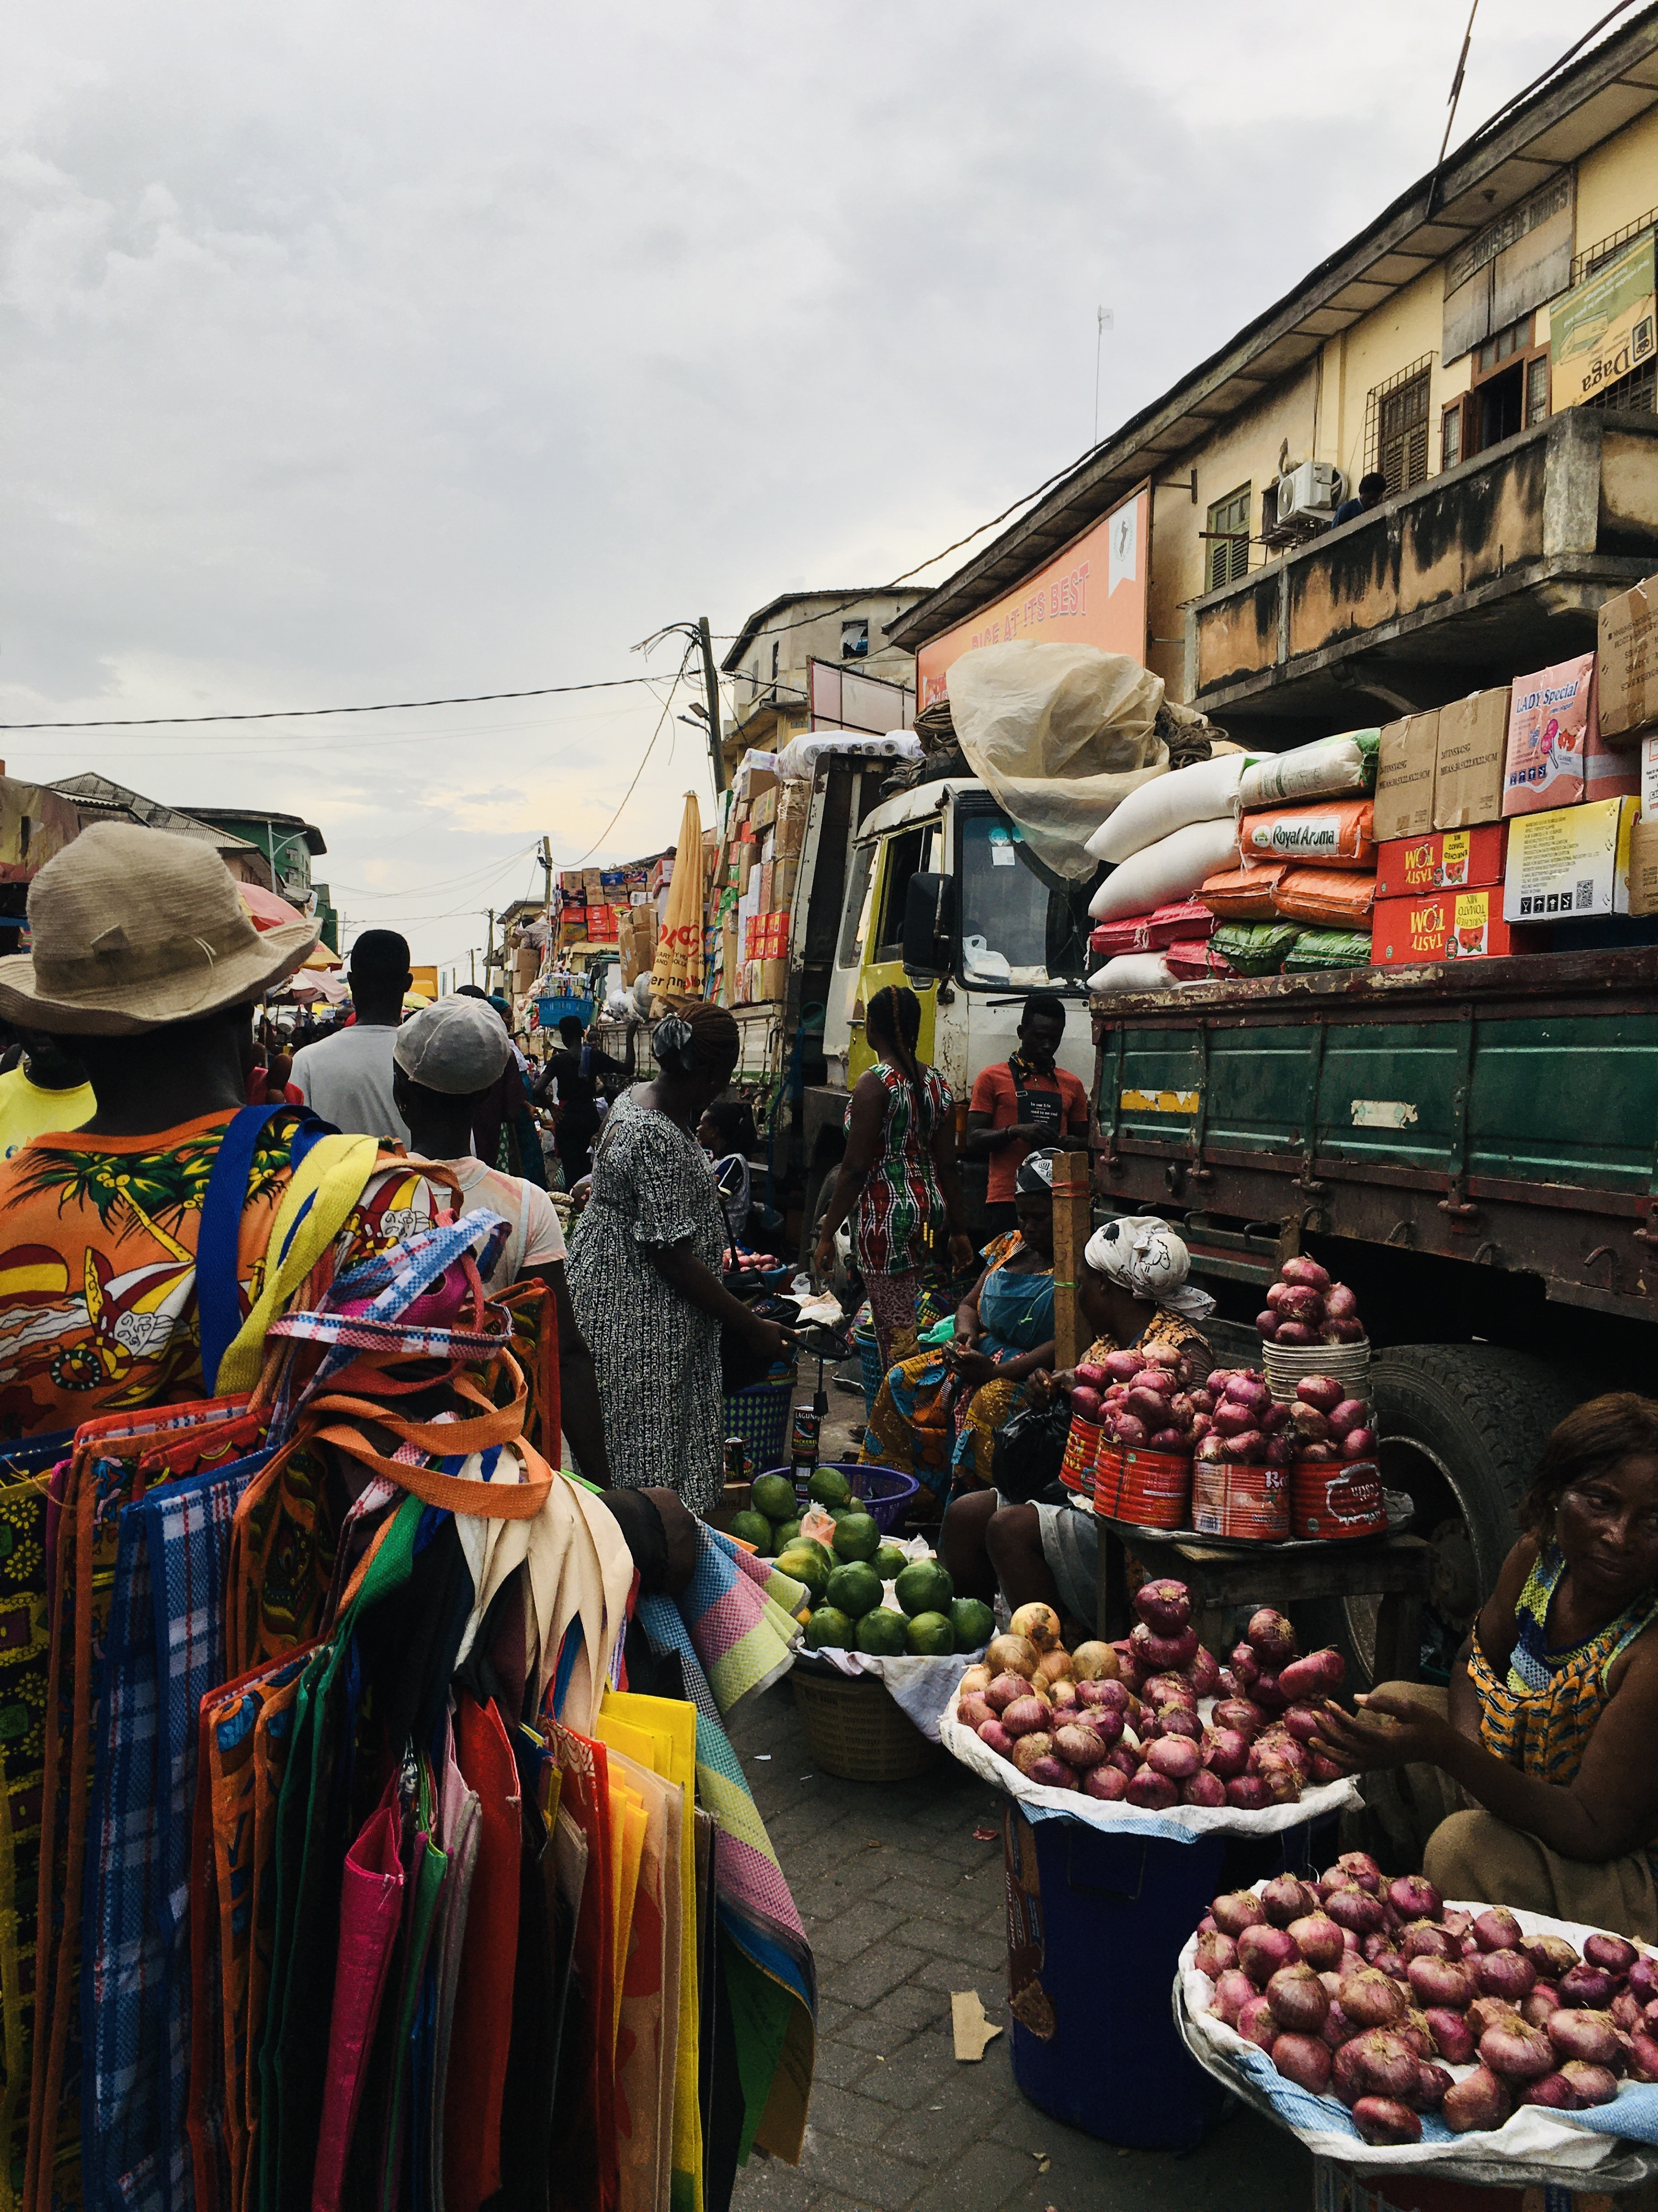
AFRICA & ASIA / TRUST
Trust whom—with what?
Trust in a relative, a bank and “most people” are not the same thing.
A PERSON
Someone you know is different from a stranger.
A NETWORK
Family and close contacts can support cooperation.
AN INSTITUTION
Name it: a court, a bank or a government.
Accra market, Ghana · 2020
Amuzujoe; CC BY-SA 4.0. Everyday trade—not a trust score. Full credit p. 29.
A SURVEY ANSWER
Wording, timing and who was asked all matter.
We cannot conclude that
“Asia trusts more”.
That was our initial impression—not a finding supported by comparable evidence across these six countries.
KEEP IN MIND
Governance indicators are not trust measures. Different questions, years and survey samples cannot be turned into one six-country trust ranking.
OECD (2017, pp. 41–44, 62–79); Svirydzenka and Petri (2014, pp. 5–8, 12). No comparable six-country direct-trust series is available for this comparison. Full references: p. 27.
AFRICA & ASIA
16

Slide 17
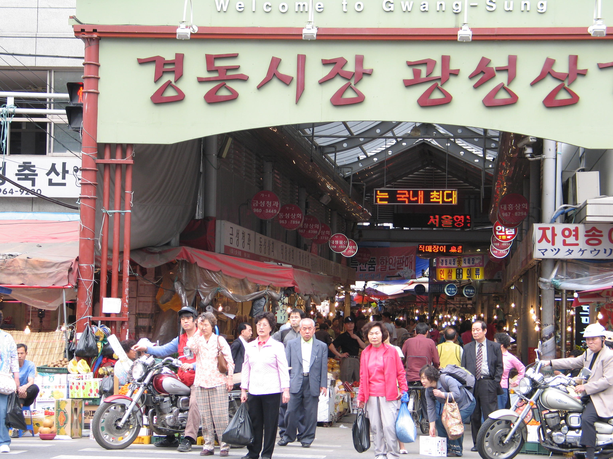
AFRICA & ASIA / CLOSE NETWORKS
Family first. Doors open—or closed?
Close ties can make cooperation easier. They can also make it harder for outsiders to join.
The strength
Credit, labour and mutual help can keep people and businesses going.
The boundary
Gyeongdong Market, Seoul · 2008
Gaël Chardon; CC BY-SA 2.0. Market context, not measured trust. Full credit p. 29.
Hiring outsiders or sharing control may be harder without reliable organisations and contracts.
Who would you trust with money?
Family? A friend? A bank? An unfamiliar partner backed by a reliable contract?
OUR TAKE / GROUP VIEW
We see family networks mainly as a strength. But conflict, exclusion and closed-minded decisions can turn that strength into a limit.
KEEP IN MIND
This is a conditional explanation and a discussion prompt—not a measure of any country’s culture, corruption or trust.
OECD (2017, pp. 41–44, 62–79); Svirydzenka and Petri (2014, pp. 5–8, 12). No comparable six-country direct-trust series is available for this comparison. Full references: p. 27.
AFRICA & ASIA
17

Slide 18
AFRICA & ASIA / POWER + TIME
Strong leadership. Honest feedback.
Planning ahead helps only if people can challenge mistakes.
Who can speak up?
Hierarchy may coordinate action—or silence the people who notice a problem.
Who changes course?
Long-term plans need feedback. A long-term-orientation score does not measure policy continuity.
NOT ENOUGH EVIDENCE FOR A GROWTH CLAIM
Uncertainty avoidance: need observed behaviour and matched timing.
Masculinity / femininity: need a clear mechanism and valid measures.
Indulgence / restraint: need a direct, timed link—not guessed work ethic.
OUR TAKE / GROUP VIEW
Strong government—for whose benefit? We support long-term planning, but leaders must serve the country, face accountability and change policies that fail.
KEEP IN MIND
Cultural scores cannot replace direct evidence about decisions, investment, policy duration or whether leaders actually correct failure.
Hofstede (2011, pp. 6–8, 9–16); McSweeney (2002, pp. 93–107). National averages are not individual traits or causal scores. Full references: p. 27.
AFRICA & ASIA
18

Slide 19
AFRICA & ASIA / OUR IDEAS ON TRIAL
Three ideas. Six reality checks.
These are our hypotheses—not established laws or national scores.
Ask how it works.
Look for the case that breaks it.
COUNTRY
CONNECTIONS
TRUST
CONTINUITY
Ghana
Fits, not causal
Unresolved
Unresolved
Botswana
Strong exception
Plausible channel
Diversification warning
Mauritius
Conditional support
Qualified substitutes
Strong qualified support
South Korea
Several causes
Unresolved channel
Duration + correction
Malaysia
Qualified support
Plausible substitutes
Qualified support
Philippines
Not enough alone
Challenges strong form
Support with warning
What would change our minds? Better measurements, a clear sequence in time, and evidence against competing explanations.
KEEP IN MIND
A case can fit more than one explanation. Support does not isolate a cause; missing evidence must stay missing.
Original group hypotheses tested against the six cases. Sources: World Bank (1993, 2020); Maipose (2008); Svirydzenka and Petri (2014); OECD (2017).
AFRICA & ASIA
19

Slide 20
AFRICA & ASIA / TEST 1 / CONNECTED DEVELOPMENT
More roads—or better connections?
What if the important difference is whom infrastructure connects?
SUPPORTED
WITH EXCEPTIONS
The fit
South Korea, Malaysia and Mauritius fit a story of skills, firms, infrastructure and markets working together.
The challenge
Perai Industrial Zone, Malaysia · 2024
HundenvonPenang; CC BY-SA 4.0. Industrial context, not proof of linkages. Full credit p. 29.
Botswana grew despite few inherited public assets. The Philippines shows that export access can coexist with thin domestic links.
Roads matter when people
and firms can use them.
Revise the claim if stronger connections followed growth rather than helped produce it.
KEEP IN MIND
Connections alone do not guarantee diversification. Skills, investment, resources, institutions and market access remain competing explanations.
Maipose (2008, pp. 3–5, 8–11); Svirydzenka and Petri (2014, pp. 5–8); World Bank (2020, Box 2, pp. 44–47); Nasution (2000, pp. 19–20). Full references: p. 27. World Bank (1993, pp. 20–26). Original group hypothesis.
AFRICA & ASIA
20

Slide 21
AFRICA & ASIA / TEST 2 / RADIUS OF TRUST
Can cooperation reach strangers?
Contracts, courts and organisations may let people work together without knowing each other first.
INCONCLUSIVE
A plausible idea
Reliable institutions may help cooperation extend beyond family and close contacts.
A missing test
We lack comparable direct-trust evidence across all six cases. Ghana and South Korea remain direct-trust gaps.
Trust matters to us.
The regional claim is unproven.
Reopen with comparable, weighted trust surveys linked in time to firm outcomes, while testing institutional alternatives.
KEEP IN MIND
We cannot show that generalized trust caused larger firms or national growth. Institutional substitutes and other causes remain unresolved.
OECD (2017, pp. 41–44, 62–79); Svirydzenka and Petri (2014, pp. 5–8, 12). No comparable six-country direct-trust series is available for this comparison. Full references: p. 27. Original group hypothesis.
AFRICA & ASIA
21

Slide 22
AFRICA & ASIA / TEST 3 / CONTINUITY + ADAPTATION
Keep the direction. Fix the mistakes.
A stable policy is useful only if it can learn.
SUPPORTED
WITH EXCEPTIONS
→
→
PLAN
LISTEN
CHANGE
Give firms and workers a direction.
Check what is actually working.
Stop protecting repeated failure.
The fit
The warning
South Korea, Mauritius, Malaysia and the Philippines are consistent with durable direction plus correction.
Continuity can preserve failure. Botswana warns that accumulating wealth is not the same as diversifying production.
Revise if lasting policy repeatedly protects failure rather than learning.
KEEP IN MIND
Policy duration cannot be separated here from state capacity, resources, foreign investment, market access, shocks or prior success.
Maipose (2008, pp. 3–5, 8–11); Svirydzenka and Petri (2014, pp. 5–8); World Bank (2020, Box 2, pp. 44–47); Nasution (2000, pp. 19–20). Full references: p. 27. World Bank (1993, pp. 127–130, 159–161, 242). Original group hypothesis.
AFRICA & ASIA
22

Slide 23
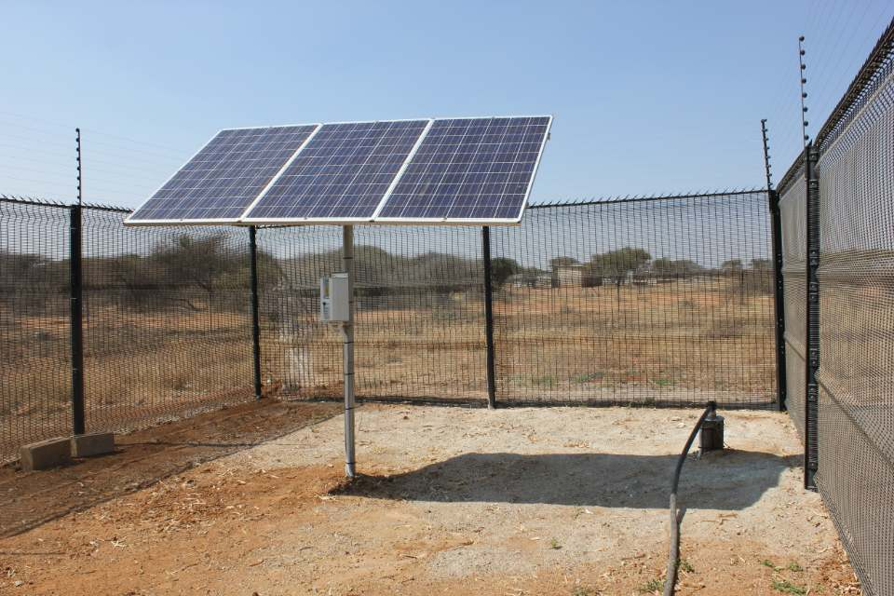

AFRICA & ASIA / THE EXCEPTIONS MATTER
The cases that break the shortcut.
Four countries stop us telling one simple continental story.
Botswana
Supports resource management and investment. Challenges the need for strong inherited infrastructure. Does not prove broad diversification.
Mochudi solar pumping · 2018
Infrastructure context, not a growth estimate.
Mauritius
Supports adaptation and diversification. Challenges fixed cultural destiny. Does not prove continuity alone caused growth.
Port Louis sugar terminal · 2025
Trade context, not a history series.
Malaysia
Philippines
Malaysia: exports can help, but do not prove local capability.
Philippines: global links alone are not enough. There is no single “Asia” path.
OUR TAKE / GROUP VIEW
Mauritius surprised us. Its small size challenged our assumptions about what a country needs to develop—and about one single African development story.
KEEP IN MIND
No case proves a universal formula. An exception challenges a claim; it does not automatically prove a rival explanation.
Maipose (2008, pp. 3–5, 8–11); Svirydzenka and Petri (2014, pp. 5–8); World Bank (2020, Box 2, pp. 44–47); Nasution (2000, pp. 19–20). Full references: p. 27. Photos: Paul tk (2018), Mochudi; Richard N Horne (2025), Port Louis. Full credits p. 29.
AFRICA & ASIA
23

Slide 24
AFRICA & ASIA / PUTTING IT TOGETHER
Build the ability to do more.
Skills. Reliable connections. Firms that learn. Institutions that make cooperation possible.
Different ingredients.
Different sequences.
Divergence depended less on fixed regional culture than on whether states, firms, workers and external partners built and disciplined productive capabilities over time. Education, agricultural change, infrastructure, investment coordination, technology access and exports mattered in different sequences. Their effects depended on institutions, resources, distribution, history and international conditions. Culture may influence coordination, legitimacy and organisational practice, but it is not a stand-alone explanation.
Connected Development
Supported with exceptions
Radius of Trust
Inconclusive
Continuity + Adaptation
Supported with exceptions
KEEP IN MIND
This is a bounded interpretation, not a calculation of each cause’s contribution. Six countries do not represent two whole continents.
Group synthesis: World Bank (1993, pp. 4–7, 20–26, 79–80); World Bank (2020); Maipose (2008); Svirydzenka and Petri (2014); Hofstede (2011).
AFRICA & ASIA
24

Slide 25
AFRICA & ASIA / OUR TAKE
A bigger economy. A better life?
For us, development is about what people can actually do and afford—not just a bigger GDP number.
Health.
Buying power.
Freedom.
Living standards.
OUR TAKE / GROUP VIEW
Higher income matters. But we also care about what that income buys, whether people are healthy, and whether they have more freedom. GDP alone cannot answer those questions.
What should travel?
Build skills and useful connections. Keep a direction, but correct failure. Help people cooperate beyond close ties. Adapt each lesson to the place.
Group values and interpretation, not a measured six-country wellbeing comparison. GDP charts: World Bank (2026), NY.GDP.PCAP.KD. Policy implications: World Bank (1993, 2020); Maipose (2008); Svirydzenka and Petri (2014); OECD (2017).
AFRICA & ASIA
25

Slide 26
AFRICA & ASIA / OUR ANSWER
Different starts.
No fixed destiny.
Culture matters—but the question is bigger than culture.
OUR TAKE / GROUP VIEW
We think “Why couldn’t Africa grow like Asia?” is misleading. Neither continent followed one path. Countries had different histories, resources, infrastructure and opportunities.
Our view changed.
We still think culture can shape trust and cooperation. But the evidence pushes us to ask what governments, firms and people could build—and what helped or blocked them.
If culture matters,
can culture change?
Group viewpoint informed by the six-country comparison. On cultural change: Hofstede (2011, pp. 6–8, 16); Beugelsdijk and Welzel (2018, pp. 1469–1475, Figures 7–9).
AFRICA & ASIA
26

Slide 27
AFRICA & ASIA / SOURCES
Where the evidence comes from.
Essential references. Exact page, table and indicator details sit beside the evidence.
World Bank. (2026). World Development Indicators [Data set]. Retrieved October 6, 2026, from
SOURCE ↗
World Bank. (1993). The East Asian miracle: Economic growth and public policy. Oxford University Press.
SOURCE ↗
World Bank. (2020). Structural transformation and labor market performance in Ghana.
SOURCE ↗
World Bank. (1985). Ghana: Industrial policy, performance and recovery (Report No. 5716-GH).
SOURCE ↗
Maipose, G. S. (2008). Policy and institutional dynamics of sustained development in Botswana (Commission on Growth and Development Working Paper No. 35). World Bank.
SOURCE ↗
Svirydzenka, K., & Petri, M. (2014). Mauritius: The drivers of growth-Can the past be extended? (IMF Working Paper No. 14/134). International Monetary Fund.
SOURCE ↗
Jedwab, R., & Moradi, A. (2012). Colonial investments and long-term development in Africa: Evidence from Ghanaian railways [Working paper]. Northeast Universities Development Consortium.
SOURCE ↗
Hofstede, G. (2011). Dimensionalizing cultures: The Hofstede model in context. Online Readings in Psychology and Culture, 2(1), Article 8.
SOURCE ↗
McSweeney, B. (2002). Hofstede's model of national cultural differences and their consequences: A triumph of faith—a failure of analysis. Human Relations, 55(1), 89–118.
SOURCE ↗
Organisation for Economic Co-operation and Development. (2017). OECD guidelines on measuring trust. OECD Publishing.
SOURCE ↗
Also cited: Bolt et al. (2025); Huillery (2009); Kohli (1994); Haggard et al. (1997); Dolan (1993); Asadullah et al. (2024); Xenos (1970); Nasution (2000); Beugelsdijk and Welzel (2018); National Archives Department (n.d.). Full registered entries accompany the production master. The online appendix link remains pending.
Complete source appendix: [LINK / QR PLACEHOLDER]. The full bibliography accompanies this edition; the online appendix link remains pending.
AFRICA & ASIA
27

Slide 28
AFRICA & ASIA / COLOPHON
About this edition.
Six cases. Three anchor years. Evidence, interpretation and group views kept separate.
Complete editorial draft — final evidence, rights and physical-print checks pending.
What is measured
What is our view
Income uses constant 2015 US dollars per person—not purchasing power. Employment uses a visible 1991 proxy for 1990. No annual values or trust scores are invented.
“Our take” passages reflect the group’s answers. They are opinions and interpretations—not additional research findings.
Still to check
Final citations and rights; actual-size A4 print; colour and classroom-screen readability. The historical 1914 map remains unavailable pending verified artwork and original legend.
TEAM NAME: [TO BE CONFIRMED]
Complete source appendix: [LINK / QR PLACEHOLDER]
Chart credits: World Bank WDI and ILO modelled employment. Charts use recorded observations, not invented annual values. Map: Natural Earth 1:110m Admin 0 Countries, v5.1.1; public-domain generalized present-day boundaries. Photo credits: p. 29.
AFRICA & ASIA
28

Slide 29
AFRICA & ASIA / CREDITS
The people behind the pictures.
Twelve country-specific photographs. Images give context—not proof of culture, trust or growth.
Ghana
JulianGrayscales (2020-02-08). Tema port · CC BY-SA 4.0.
Amuzujoe (2020-11-27). Market Accra · CC BY-SA 4.0.
Image A ↗
Licence ↗
Image B ↗
Licence ↗
Botswana
Sarvesh Lutchmun (2015-08-06). Bus Terminal in Gaborone, Botswana · CC BY-SA 4.0.
Paul tk (2018-09-14). MochudiBotswanaSolarPanel · CC BY-SA 4.0.
Image A ↗
Licence ↗
Image B ↗
Licence ↗
Mauritius
Didier Baertschiger (2015-03-09). Mauritius - Port Louis (Central Market) · CC BY-SA 2.0.
Richard N Horne (2025-04-03). Port Louis, Mauritius, Bulk Sugar Terminal Quay · CC BY 4.0.
Image A ↗
Licence ↗
Image B ↗
Licence ↗
South Korea
Svwmal (2012-04-08). South Korea Busan harbour · CC BY-SA 3.0.
Gaël Chardon (2008-04-21). Korea-Seoul-Gyeongdong Market-01 · CC BY-SA 2.0.
Image A ↗
Licence ↗
Image B ↗
Licence ↗
Malaysia
HundenvonPenang (2024-01-27). Perai Industrial Zone, Seberang Perai, Penang · CC BY-SA 4.0.
jgmorard (2009-03-01). 090301.020.PortKlang · CC BY 2.0.
Image A ↗
Licence ↗
Image B ↗
Licence ↗
Philippines
Theurbanhistorian (2009-07-18). Port of Manila · CC BY-SA 3.0.
george ruiz (2013-01-04). The Philippines — seaside market in Manila · CC BY 2.0.
Image A ↗
Licence ↗
Image B ↗
Licence ↗
Map: Natural Earth. (n.d.). Admin 0 – Countries, 1:110m Cultural Vectors (v5.1.1). Public-domain data; generalized present-day boundaries, not historical geometry. Mauritius is located by point at this scale.
MAP SOURCE ↗
All photographs resized only, without cropping or content changes. Source-page and licence links are attached below. Check the licence terms before reusing or changing an image.
AFRICA & ASIA
29

