Slide 1
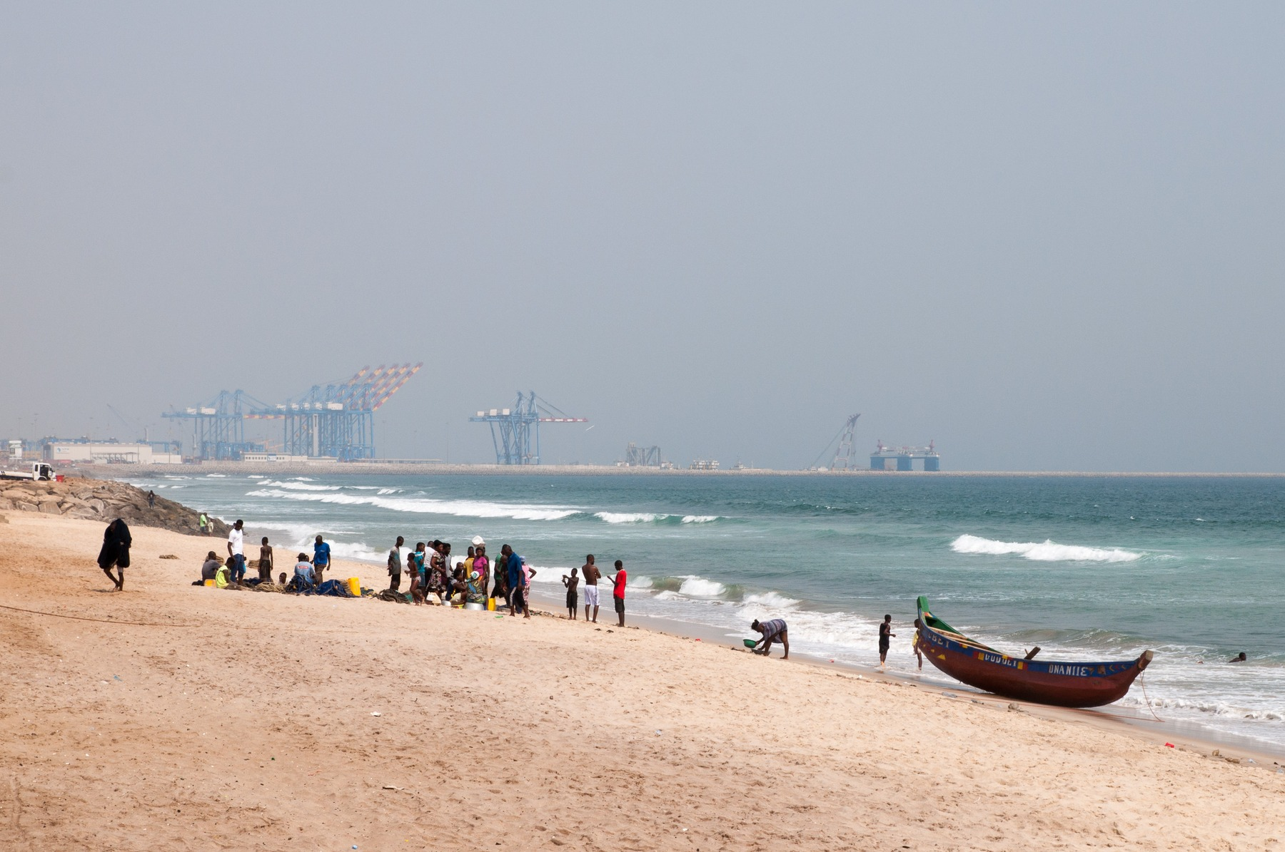
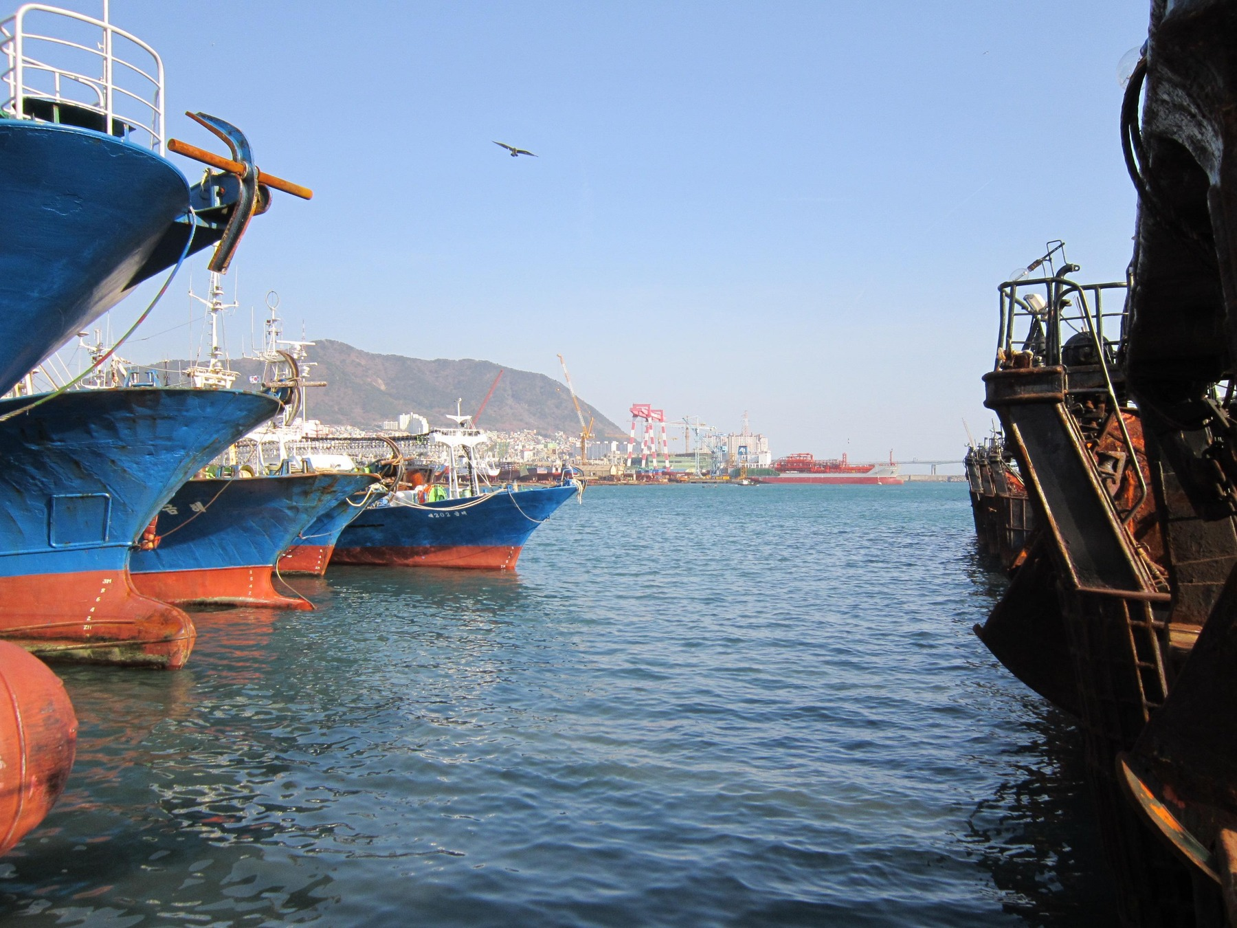
AFRICA & ASIA / SIX COUNTRIES. ONE BIG QUESTION.
Africa & Asia:
Why Did Their
Economic Paths
Diverge?
Ghana
Botswana
Mauritius
South Korea
Malaysia
Philippines
Testing culture against history, institutions,
policy and economic evidence.
GHANA
SOUTH KOREA
Tema port · 2020
Busan harbour · 2012
SIX COUNTRIES.
MORE THAN ONE EXPLANATION.
Photographs: JulianGrayscales (2020), Tema port; Svwmal (2012), Busan harbour. Full credits and licences: p. 28.
AFRICA & ASIA
01

Slide 2
AFRICA & ASIA / START HERE
Culture—or a much bigger story?
We started with a question. Six countries made the answer more complicated.
Ghana
Botswana
Mauritius
South Korea
Malaysia
Philippines
Six countries.
Six different paths.
Ghana and South Korea give us a striking comparison. Botswana, Mauritius, Malaysia and the Philippines challenge the easy explanations.
01
The gap
03–04
02
The starting line
05–08
03
Work, income and learning
09–14
04
Culture and trust
15–18
05
Our ideas on trial
19–23
06
What we think
24–26
OUR TAKE / GROUP VIEW
We think culture matters. But different histories, resources and starting points make “Africa versus Asia” the wrong shortcut.
Hofstede (2011, pp. 6–8, 9–16); McSweeney (2002, pp. 93–107). National averages are not individual traits or causal scores. Full references: p. 27.
AFRICA & ASIA
02

Slide 3
AFRICA & ASIA / THE GAP
1960: Ghana and Korea start close.
Ghana and South Korea were close in income per person—not in every starting condition.
Ghana
Botswana
Mauritius
South Korea
Malaysia
Philippines
US$1,101
US$1,038
Ghana
South Korea
Just US$63 apart.
Ghana
US$1,101
Botswana
US$394
Mauritius
US$1,419
South Korea
US$1,038
Malaysia
US$1,266 †
Philippines
US$1,124
Bar scale: US$0–1,500. † Malaysia: retrospective territorial series; 1960 predates the 1963 federation and Singapore’s 1965 exit.
Income per person is an average, not a typical wage or a measure of inequality. Similar income does not mean the same history.
World Bank (2026), World Development Indicators, NY.GDP.PCAP.KD; release 13 July 2026, retrieved 6 October 2026. GDP per capita, constant 2015 US dollars per person. Full reference: p. 27.
AFRICA & ASIA
03

Slide 4
AFRICA & ASIA / THE GAP
2020: the paths have split.
The same income measure. Six very different outcomes.
Ghana
Botswana
Mauritius
South Korea
Malaysia
Philippines
Ghana
US$1,970
Botswana
US$6,254
Mauritius
US$9,534
South Korea
US$33,216
Malaysia
US$10,171
Philippines
US$3,199
0
US$35,000
Different outcomes inside
both continents.
This is the COVID-19 year. The comparison does not measure purchasing power, freedom, health or the causes of growth.
World Bank (2026), World Development Indicators, NY.GDP.PCAP.KD; release 13 July 2026, retrieved 6 October 2026. GDP per capita, constant 2015 US dollars per person. Full reference: p. 27.
AFRICA & ASIA
04

Slide 5
AFRICA & ASIA / THE STARTING LINE
Find the countries. Then rewind.
These are present-day locations. Their political starting points came at different times.
Ghana
Botswana
Mauritius
South Korea
Malaysia
Philippines
1945 / 1948
South Korea
Japan → end of rule / Republic established
1946
Philippines
Spain, then United States → independence
1957
Ghana
Britain → independence
1957 / 1963
Malaysia
Britain → Malaya independence / federation
1966
Botswana
British protectorate → independence
1968
Mauritius
France, then Britain → independence
Historical 1914 map withheld: verified artwork and original legend still required.
The map is generalized and present-day—not a 1914 colonial map. Mauritius is located by a point. Independence dates do not measure state capacity.
World Bank (1985, p. 18); Maipose (2008, pp. 3–5); National Archives Department (n.d.); Haggard et al. (1997, pp. 867–870); Asadullah et al. (2024, pp. 13–15); Dolan (1993), archival recheck pending. Map: Natural Earth (n.d.), v5.1.1; full credit p. 28.
AFRICA & ASIA
05

Slide 6
AFRICA & ASIA / THE STARTING LINE
Same empire. Different inheritance.
Ask what colonial rule built, extracted and left behind—not just which flag it flew.
Built for whom?
British African councils varied. Investment also varied within French West Africa. An empire label hides important differences (Bolt et al., 2025; Huillery, 2009).
What survived?
Researchers disagree about Korea’s colonial inheritance. Organisation mattered, but so did coercion, unequal ownership, division, war and later policy change (Kohli, 1994; Haggard et al., 1997).
Who had access?
The Philippines combined formal institutions and education with concentrated power. Spanish and US rule cannot be explained by a British–French contrast (Dolan, 1993; recheck pending).
OUR TAKE / GROUP VIEW
Independence did not reset the economy. We think what countries inherited—and what they could build on afterwards—mattered more than the colonial flag alone.
These studies do not show that colonial rule was beneficial overall, or that one empire explains the six countries’ later paths.
Bolt et al. (2025, pp. 1–6, 18–20); Huillery (2009, pp. 176–180, 203–208); Kohli (1994, pp. 1277–1284); Haggard et al. (1997, pp. 867–881); Dolan (1993), archival passage recheck pending.
AFRICA & ASIA
06

Slide 7
AFRICA & ASIA / THE STARTING LINE
Ghana’s railway reached new users.
Ghana: the useful question is who the railway connected.
1898–1918 / GHANA
→
Coast and ports
Mining areas
→
Cocoa producers
Kumasi and markets
SCHEMATIC, NOT SURVEY GEOMETRY
Solid: original connections to mines and Kumasi.
Dashed: later economic links—not a mapped railway route.
Built to extract.
Used for more.
Lower transport costs also supported cocoa production and urban growth. Original purpose and later effects were not the same (Jedwab & Moradi, 2012).
One railway case cannot explain all of Africa or show that infrastructure alone caused growth. It does not establish the net benefit of colonial rule.
Jedwab and Moradi (2012, pp. 1–4, 6–10). Original schematic based on cited facts, not traced map geometry. Full reference: p. 27.
AFRICA & ASIA
07

Slide 8
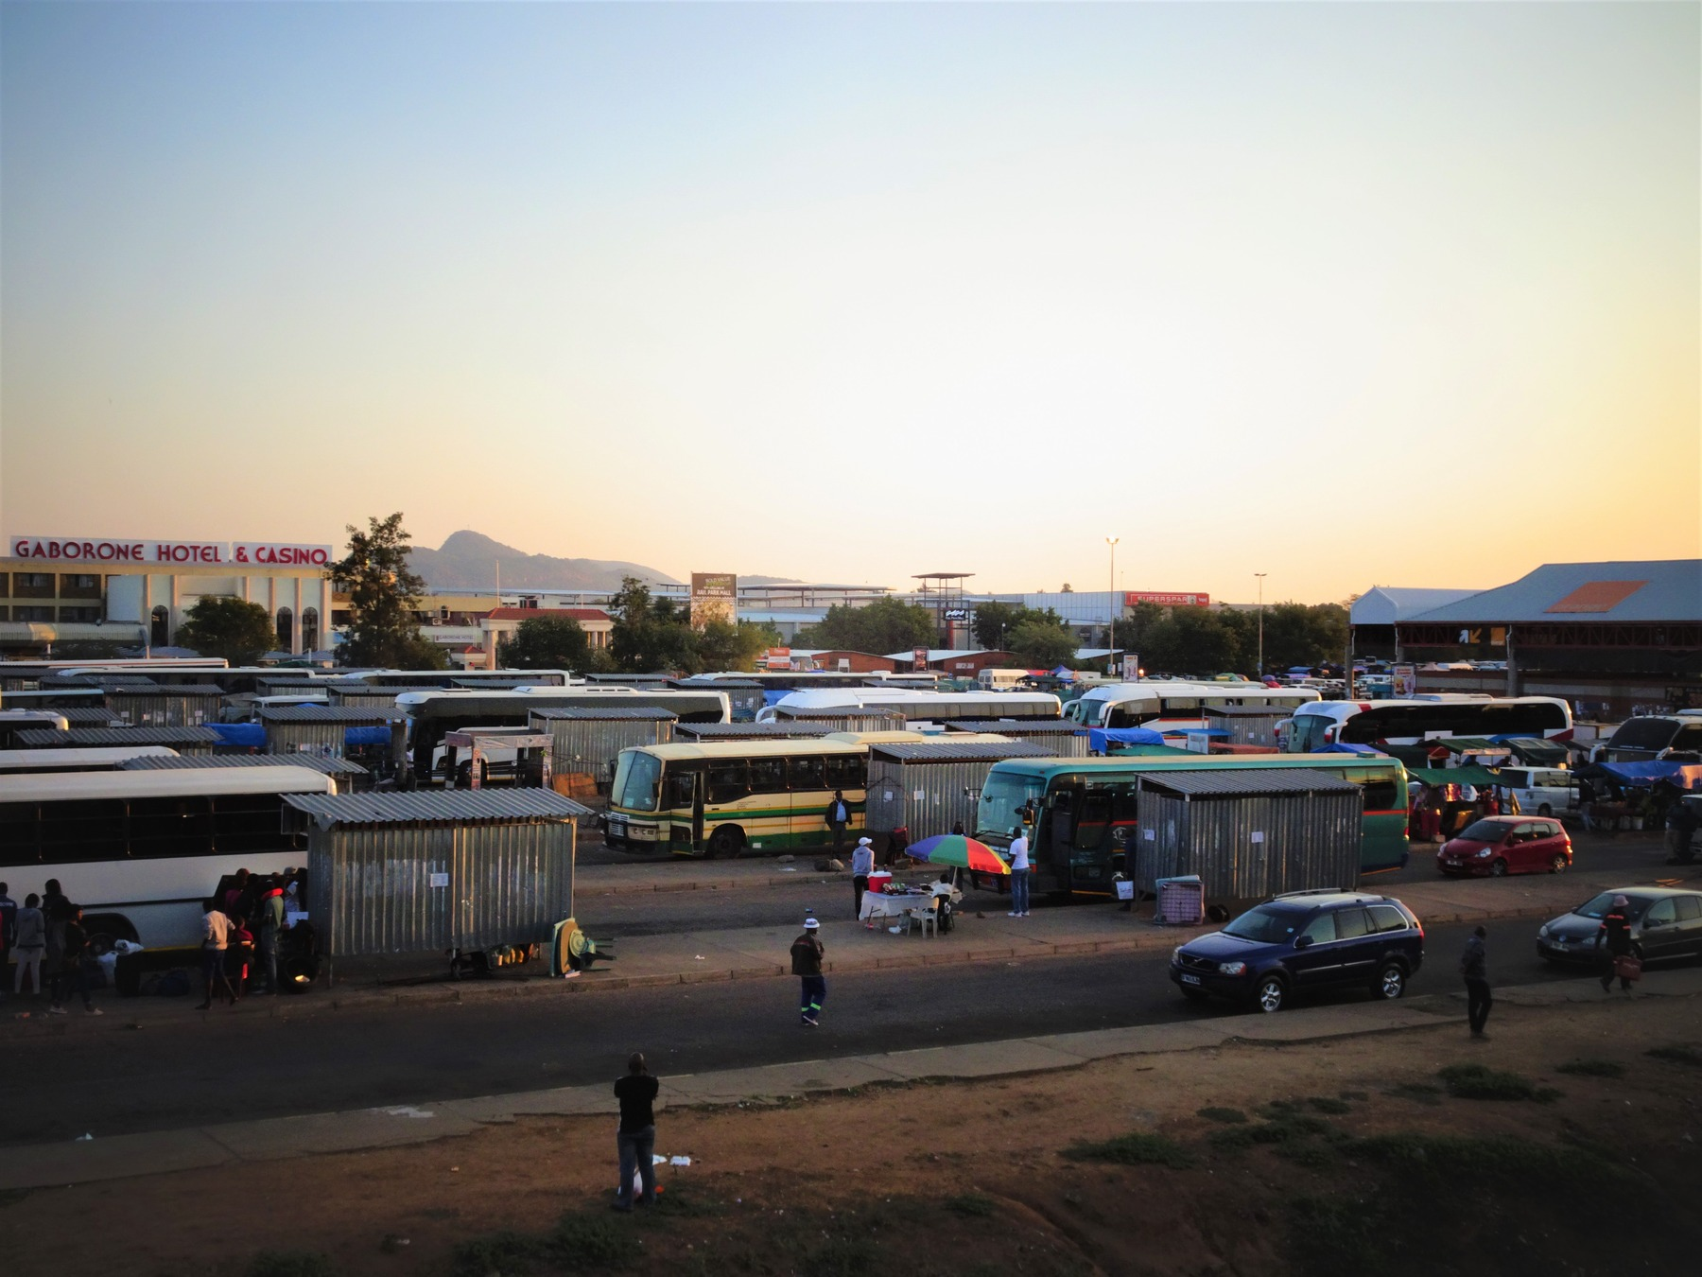
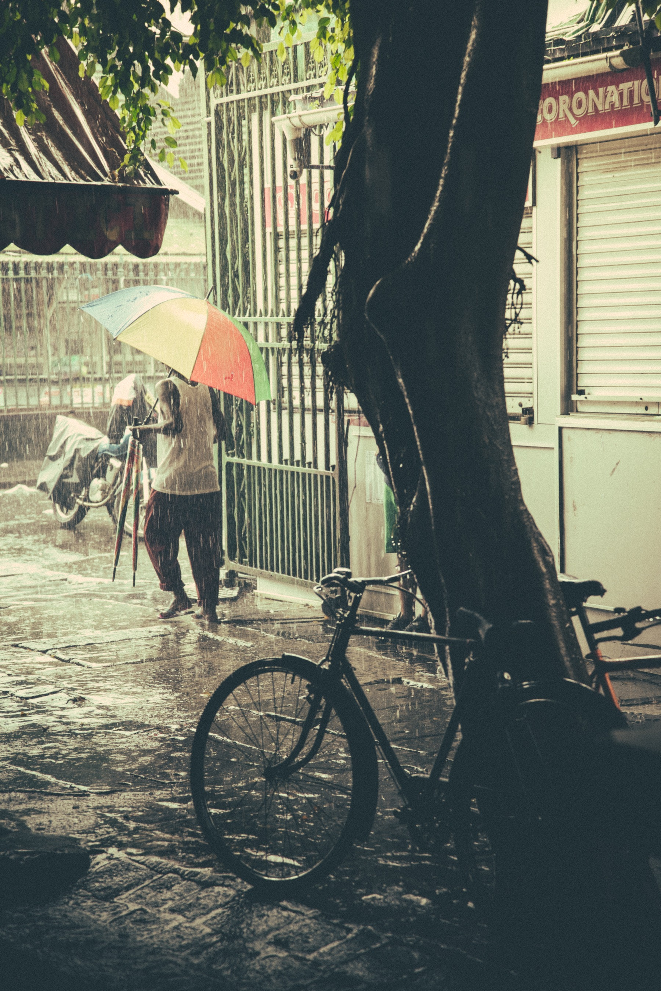
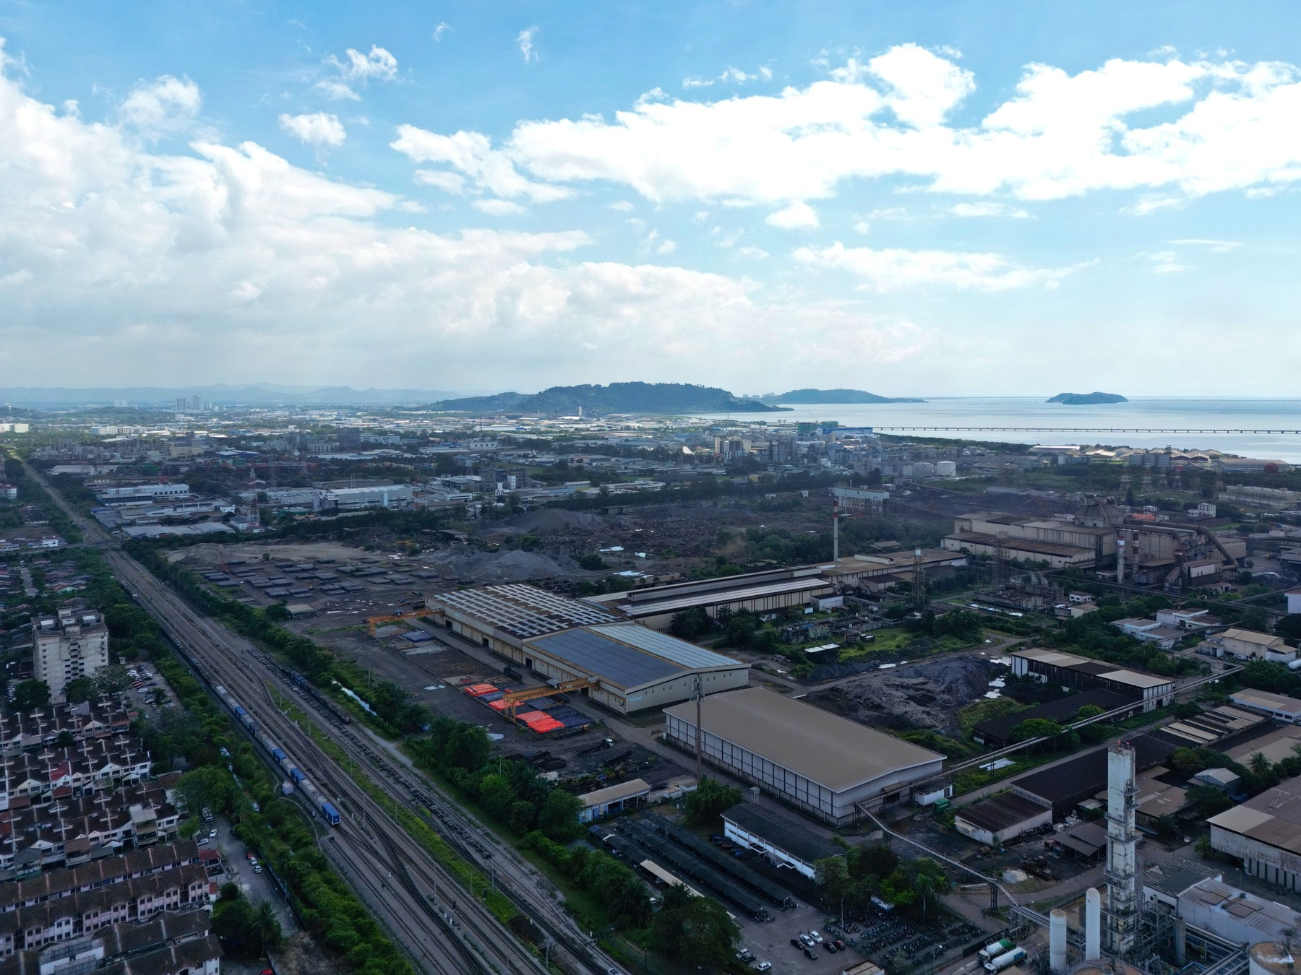
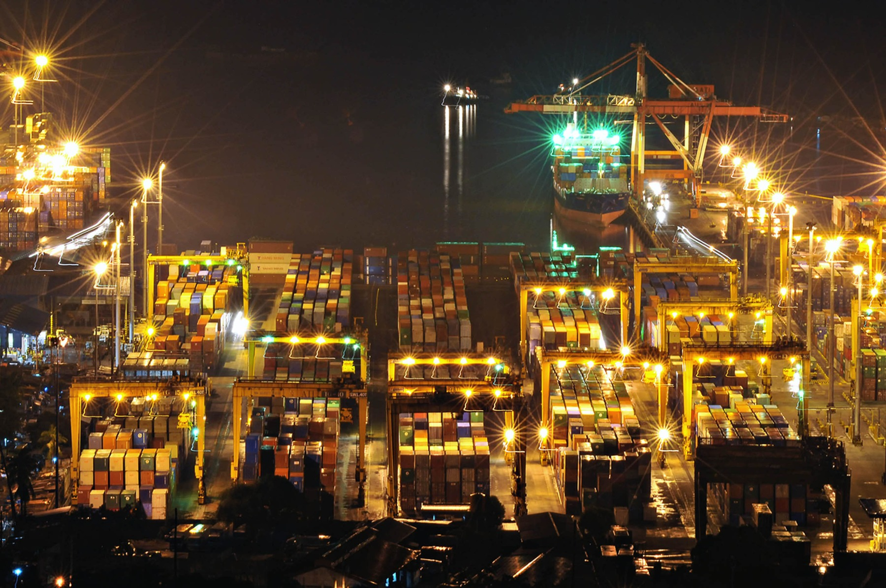
AFRICA & ASIA / THE STARTING LINE
What each country inherited.
Different resources, skills and infrastructure shaped what countries could do next.
Ghana
Cocoa exports; inherited roads, rail and Tema harbour.
Botswana
Few inherited public assets and limited skills; mineral income later changed the base.
Mauritius
Sugar dominated export earnings; diversification came later.
South Korea
Division and war disrupted the colonial inheritance.
Malaysia
Commodity exports came before export manufacturing.
Philippines
Formal institutions and education coexisted with concentrated power.
Contemporary photographs give country context; they are not scenes from independence or proof of a growth mechanism.
World Bank (1985, p. 18); Maipose (2008, pp. 3–5); Xenos (1970, p. 1); Svirydzenka and Petri (2014, pp. 5–8); Haggard et al. (1997); Asadullah et al. (2024, pp. 13–15); Dolan (1993), archival recheck pending. Photo credits p. 28.
AFRICA & ASIA
08

Slide 9
AFRICA & ASIA / WORK
Jobs moved. The mix changed.
Two full-width bars per country show where people worked: 1991 and 2020.
Ghana
Botswana
Mauritius
South Korea
Malaysia
Philippines
FARMING
INDUSTRY*
SERVICES
Ghana
1991
2020
Farm 71.8→37.4 / Industry 9.0→15.2 / Services 19.2→47.4
Botswana
1991
2020
Farm 12.6→19.5 / Industry 21.3→15.0 / Services 66.1→65.5
Mauritius
1991
2020
Farm 19.6→5.3 / Industry 35.0→23.4 / Services 45.4→71.3
South Korea
1991
2020
Farm 15.5→5.4 / Industry 37.1→24.6 / Services 47.4→70.0
Malaysia
1991
2020
Farm 18.9→10.5 / Industry 32.8→26.2 / Services 48.3→63.3
Philippines
1991
2020
Farm 44.1→24.5 / Industry 16.6→18.7 / Services 39.3→56.8
Each bar = 100% of employment. Values below each pair are percentages, 1991 → 2020. * Industry includes mining, construction and utilities.
Moving out of farming does not automatically raise productivity. Industry includes mining, construction and utilities. Services are not all high-skill jobs.
World Bank (2026), WDI / ILO modelled estimates: SL.AGR.EMPL.ZS, SL.IND.EMPL.ZS, SL.SRV.EMPL.ZS. Percent of employment. 1991 proxies 1990; no 1960 series. Release 13 July 2026; retrieved 6 October 2026.
AFRICA & ASIA
09

Slide 10
AFRICA & ASIA / INCOME
Six countries. Three snapshots.
Economic output per person, in constant 2015 US dollars. Read down each year to compare.
1960
1990
2020
Ghana
US$1,101
US$856
US$1,970
Botswana
US$394
US$4,039
US$6,254
Mauritius
US$1,419
US$3,846
US$9,534
South Korea
US$1,038
US$9,673
US$33,216
Malaysia
US$1,266 †
US$4,185
US$10,171
Philippines
US$1,124
US$1,704
US$3,199
Every value is US dollars per person, adjusted to constant 2015 prices. Compare countries within a column; compare years across a row.
GDP per capita is not total national GDP, purchasing power or a typical wage. † Malaysia 1960 is a retrospective territorial series. 2020 is the pandemic year.
World Bank (2026), World Development Indicators, NY.GDP.PCAP.KD; release 13 July 2026, retrieved 6 October 2026. GDP per capita, constant 2015 US dollars per person. Full reference: p. 27.
AFRICA & ASIA
10

Slide 11
AFRICA & ASIA / LEARNING
Build. Learn. Improve. Repeat.
Capability grows through repeated practice—not one factory or one policy.
Ghana
Botswana
Mauritius
South Korea
Malaysia
Philippines
Skills
1
Reinvestment
Infrastructure
6
2
LEARN
AGAIN
Exports + learning
Firms + suppliers
5
3
4
Production
A workshop wheel: turning effort into learning.
This is a possible learning sequence, not an automatic cycle. Institutions, resources, distribution and access to technology and markets shape every link.
World Bank (1993, pp. 4–7, 20–26, 79–80, 127–130, 159–161); World Bank (2020, pp. 32–33, Box 2 pp. 44–47). Full references: p. 27.
AFRICA & ASIA
11

Slide 12
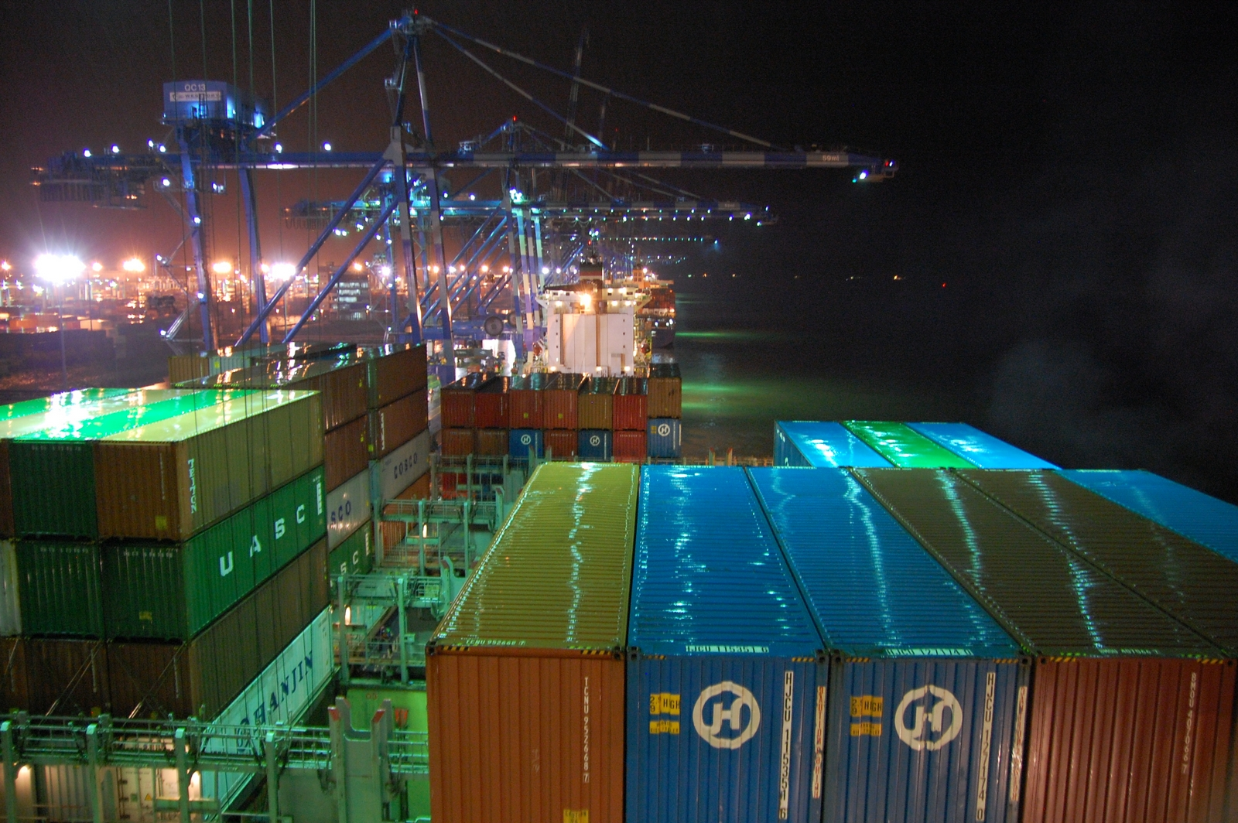
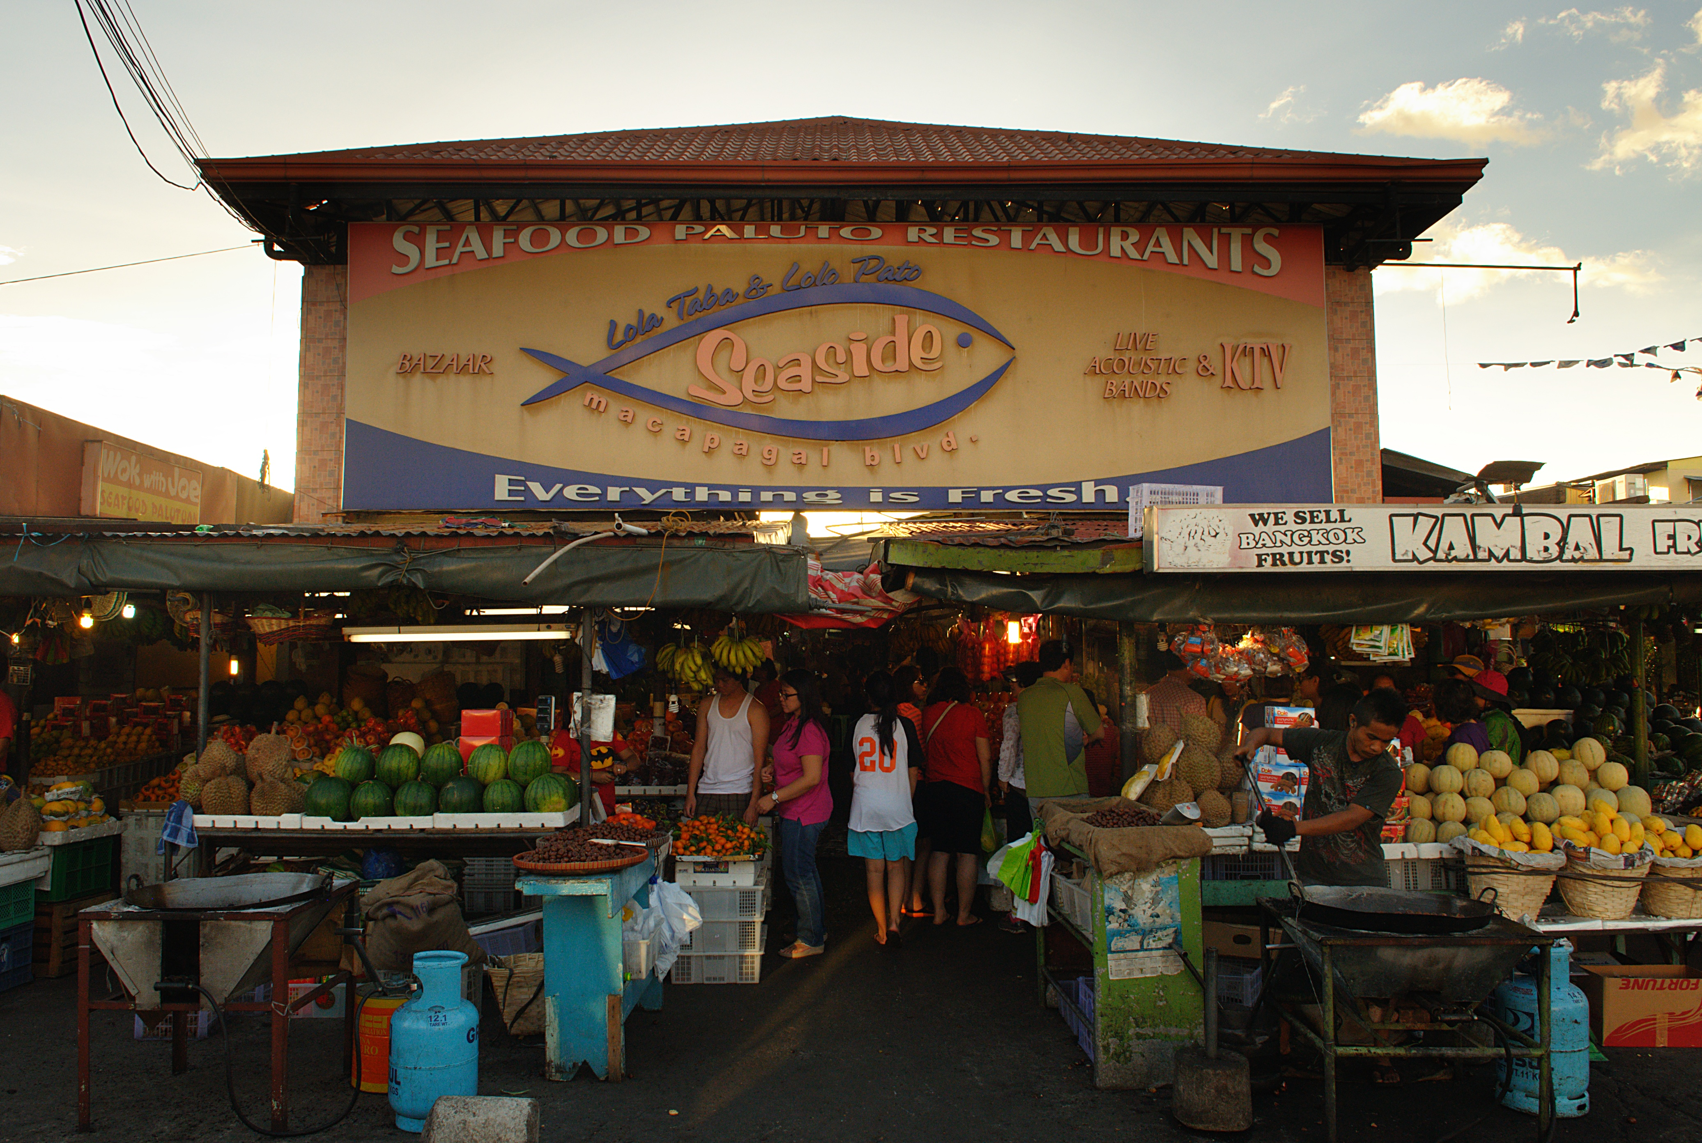
AFRICA & ASIA / FOLLOW THE PRODUCT
“Made here” is not the whole story.
A country can export a product without keeping all its value—or learning how to make its most complex parts.
Ghana
Botswana
Mauritius
South Korea
Malaysia
Philippines
Port Klang, Malaysia · 2009
Containers show movement—not local value kept.
Metro Manila, Philippines · 2013
Market exchange—not a national productivity measure.
→
→
INPUTS
ASSEMBLY
SUPPLIERS
Parts can come from abroad.
Local work is one part of the value.
Local links may deepen—or stay thin.
Exports ≠ local value ≠ local skills.
Manufacturing share measures production mix, not technological capability. More assembly does not automatically mean deeper domestic learning.
Export totals and photographs cannot reveal who keeps the value, how much is local, or which skills firms have learned.
World Bank (2020, Box 2, pp. 44–47); Nasution (2000, pp. 19–20, Table 9); World Bank (1993, pp. 20–26). Conceptual journey, not measured product shares. Photographs: jgmorard (2009), Port Klang; george ruiz (2013), Metro Manila; CC BY 2.0. Full credits p. 28.
AFRICA & ASIA
12

Slide 13
AFRICA & ASIA / SOUTH KOREA
Not an overnight miracle.
South Korea built skills and firms over time. It also made costly policy mistakes.
SOUTH KOREA / LEARNING OVER TIME
1950s
Recover
Education, agricultural change and infrastructure helped build foundations.
1960s
Coordinate
Credit and investment worked alongside export incentives and performance pressure.
1970s
Push—and pay
Heavy industry expanded, but brought debt, bottlenecks and other costs.
1980s
Correct and upgrade
Policy adjustment accompanied deeper firm learning and technological upgrading.
OUR TAKE / GROUP VIEW
Learn from South Korea. Don’t photocopy it. We value cooperation and long-term effort, but these are lessons to adapt—not proof of a superior culture.
The sequence cannot isolate culture as the cause. Other countries cannot copy its history, security setting or international opportunities.
World Bank (1993, pp. 20–26, 127–130, 159–161, 242). Rodrik (1995): competing investment-coordination argument; registered working-paper abstract, not a page-specific causal estimate.
AFRICA & ASIA
13

Slide 14
AFRICA & ASIA / GHANA + SOUTH KOREA
Two paths. A 16.9-to-1 gap.
GDP per capita · constant 2015 US dollars per person · 1960, 1990, 2020
South Korea
US$33,216
35k
30k
20k
10k
Ghana
US$1,970
0
1960
1990
2020
Ghana 1,101 / Korea 1,038
16.9 : 1
1990: Ghana 856 / Korea 9,673
Approximate income ratio in 2020.
Not a causal estimate.
A two-country trajectory cannot isolate culture, colonial rule, policy, institutions or any single cause. Straight lines connect anchors, not annual estimates.
World Bank (2026), World Development Indicators, NY.GDP.PCAP.KD; release 13 July 2026, retrieved 6 October 2026. GDP per capita, constant 2015 US dollars per person. Full reference: p. 27.
AFRICA & ASIA
14

Slide 15
AFRICA & ASIA / CULTURE
Meet Hofstede. Then test the idea.
Hofstede grouped survey responses into six dimensions of national culture. They are lenses for questions—not scores that explain growth.
Power distance
How accepted is unequal power?
CONDITIONAL TEST
Individualism / collectivism
How strongly are people tied to groups? Not a trust score.
CONDITIONAL TEST
Masculinity / femininity
Competition and achievement versus care and quality of life. Historical labels.
CONTEXT ONLY
Uncertainty avoidance
Responses to ambiguity—not simply risk-taking.
CONTEXT ONLY
Long-term orientation
Future-focused adaptation versus present/past obligations. Not policy duration.
CONDITIONAL TEST
Indulgence / restraint
Social regulation of gratification. Not work ethic.
CONTEXT ONLY
OUR TAKE / GROUP VIEW
Culture matters. It isn’t destiny. We think shared expectations influence cooperation, while history, resources and institutions shape what people can do.
National averages are historical, country-level lenses—not individual personalities, timeless truths or causal scores. Missing country scores are not invented.
Hofstede (2011, pp. 6–8, 9–16); McSweeney (2002, pp. 93–107). National averages are not individual traits or causal scores. Full references: p. 27.
AFRICA & ASIA
15

Slide 16
AFRICA & ASIA / TRUST
Trust whom—with what?
Trust in a relative, a bank and “most people” are not the same thing.
A PERSON
Knowing someone is different from trusting a stranger.
A NETWORK
Family and contacts can support cooperation.
COOPERATE
AN INSTITUTION
Name it: a court, bank or government.
A SURVEY ANSWER
Wording, timing and who was asked all matter.
Trust is not one common scale.
“Asia trusts more” was our initial impression—not a finding supported by comparable evidence across these six countries.
Governance indicators are not trust measures. Different questions, years and survey samples cannot be turned into one six-country trust ranking.
OECD (2017, pp. 41–44, 62–79); Svirydzenka and Petri (2014, pp. 5–8, 12). No comparable six-country direct-trust series is available for this comparison. Full references: p. 27.
AFRICA & ASIA
16

Slide 17
AFRICA & ASIA / CLOSE NETWORKS
Family first. Doors open—or closed?
Close ties can help people cooperate. They can also shut outsiders out.
The strength
Credit, labour and mutual help can keep people and businesses going.
The boundary
WHO GETS IN?
Hiring outsiders or sharing control may be harder without reliable organisations and contracts.
Who would you trust with money?
Family? A friend? A bank? An unfamiliar partner backed by a reliable contract?
OUR TAKE / GROUP VIEW
We see family networks mainly as a strength. But conflict, exclusion and closed-minded decisions can turn that strength into a limit.
This is a conditional explanation and a discussion prompt—not a measure of any country’s culture, corruption or trust.
OECD (2017, pp. 41–44, 62–79); Svirydzenka and Petri (2014, pp. 5–8, 12). No comparable six-country direct-trust series is available for this comparison. Full references: p. 27.
AFRICA & ASIA
17

Slide 18
AFRICA & ASIA / LEADERSHIP
Lead. Listen. Change course.
Long-term direction works better when people can challenge mistakes.
01
02
03
LEAD
LISTEN
CHANGE COURSE
Set a useful direction.
Let people challenge mistakes.
Fix what is not working.
A steady direction. Room to turn.
Hierarchy can coordinate action—or silence feedback. Look at actual decisions and results, not just cultural scores.
OUR TAKE / GROUP VIEW
Strong government—for whose benefit? We support planning ahead, but leaders must serve the country and face accountability when policies fail.
National cultural scores cannot replace direct evidence about leadership, policy duration, investment or correction.
Hofstede (2011, pp. 6–8, 9–16); McSweeney (2002, pp. 93–107). National averages are not individual traits or causal scores. Full references: p. 27.
AFRICA & ASIA
18

Slide 19
AFRICA & ASIA / OUR IDEAS ON TRIAL
Three roads into the question.
Connections. Cooperation. Direction + correction. We test each idea against the six countries.
Cooperation
Connections
Direction +
correction
THREE IDEAS. NOT THREE CERTAINTIES.
Connections: supported with exceptions.
Trust: inconclusive.
Continuity + adaptation: supported with exceptions.
A supporting case may fit several explanations. These qualitative comparisons do not isolate a single cause.
Original group hypotheses and six-country matrix. Sources: World Bank (1993, 2020); Maipose (2008); Svirydzenka and Petri (2014); OECD (2017).
AFRICA & ASIA
19

Slide 20

AFRICA & ASIA / TEST 1 / CONNECTED DEVELOPMENT
Connections must reach further.
Three conceptual country diagrams show different linkage stories—not measured infrastructure levels.
South Korea
Malaysia
Philippines
Build deeper links
Deepen local supply
Connection is not enough
Skills, firms and markets developed together. Several causes contributed.
Global production can create opportunities; local supplier capability still matters.
Exports and global links can coexist with gaps in domestic production networks.
SUPPORTED WITH EXCEPTIONS
Botswana challenges inherited infrastructure as a prerequisite for income growth.
Country outlines are generalized and independently fitted, not a common map scale. All links and node counts are fictional—not actual roads or an infrastructure ranking. Connections alone do not establish causality.
Maipose (2008, pp. 3–5, 8–11); Svirydzenka and Petri (2014, pp. 5–8); World Bank (2020, Box 2, pp. 44–47); Nasution (2000, pp. 19–20). Full references: p. 27. World Bank (1993, pp. 20–26). Outlines: Natural Earth (n.d.), 1:110m, public domain.
AFRICA & ASIA
20

Slide 21
AFRICA & ASIA / TEST 2 / RADIUS OF TRUST
Trust helps. Can we prove the link?
Our question: does cooperation beyond family help businesses grow? Our answer: plausible—but not established by this comparison.
WHAT WE EXPECT
Reliable contracts help strangers work together.
WHAT WE FOUND
The six countries do not have a comparable direct-trust evidence base here. Ghana and South Korea remain direct-trust gaps.
OUR TAKE / GROUP VIEW
Trust matters to us. But “Asia trusts more” was our initial impression—not a finding this evidence can support.
VERDICT: INCONCLUSIVE
Governance indicators are not direct-trust measures. Comparable surveys, timing and tests of alternative explanations are needed.
OECD (2017, pp. 41–44, 62–79); Svirydzenka and Petri (2014, pp. 5–8, 12). No comparable six-country direct-trust series is available for this comparison. Full references: p. 27.
AFRICA & ASIA
21

Slide 22
AFRICA & ASIA / TEST 3 / CONTINUITY + ADAPTATION
Keep direction. Correct mistakes.
Lasting policy helps only if a country learns and adapts.
South Korea
Coordinated investment and export pressure; later correction and upgrading.
Mauritius
A sugar base followed by diversification and adaptation.
Malaysia
Commodity exports followed by export manufacturing and supplier challenges.
Philippines
Global links and formal institutions did not remove weak domestic linkages.
Botswana
Mineral-led accumulation shows that wealth and diversification differ.
The lesson: keep what works. Change what fails.
Supported with exceptions—not a universal recipe. State capacity, resources, FDI, market access, shocks and prior success remain alternative explanations.
Maipose (2008, pp. 3–5, 8–11); Svirydzenka and Petri (2014, pp. 5–8); World Bank (2020, Box 2, pp. 44–47); Nasution (2000, pp. 19–20). Full references: p. 27. World Bank (1993, pp. 127–130, 159–161, 242).
AFRICA & ASIA
22

Slide 23
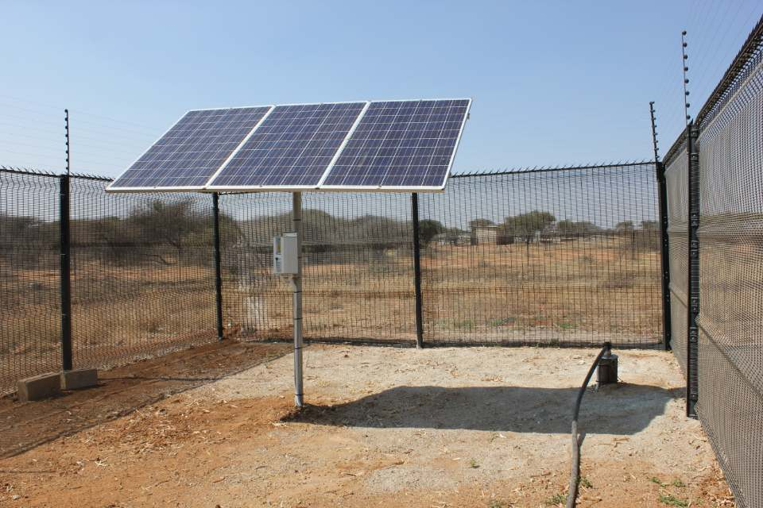
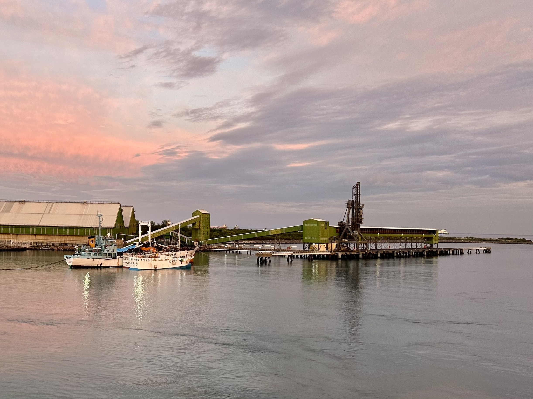
AFRICA & ASIA / THE EXCEPTIONS MATTER
Four cases change the story.
Four countries stop us telling one simple continental story.
Botswana
Supports resource management and investment. Challenges the need for strong inherited infrastructure. Does not prove broad diversification.
Mochudi solar pumping · 2018
Infrastructure context, not a growth estimate.
Mauritius
Supports adaptation and diversification. Challenges fixed cultural destiny. Does not prove continuity alone caused growth.
Port Louis sugar terminal · 2025
Trade context, not a history series.
Malaysia
Philippines
Malaysia: exports can help, but do not prove local capability.
Philippines: global links alone are not enough. There is no single “Asia” path.
OUR TAKE / GROUP VIEW
Mauritius surprised us. Its small size challenged our assumptions about what a country needs to develop—and about one single African development story.
No case proves a universal formula. An exception challenges a claim; it does not automatically prove a rival explanation.
Maipose (2008, pp. 3–5, 8–11); Svirydzenka and Petri (2014, pp. 5–8); World Bank (2020, Box 2, pp. 44–47); Nasution (2000, pp. 19–20). Full references: p. 27. Photos: Paul tk (2018), Mochudi; Richard N Horne (2025), Port Louis. Full credits p. 28.
AFRICA & ASIA
23

Slide 24
AFRICA & ASIA / PUTTING IT TOGETHER
Different ingredients. Different outcomes.
Development depends on how the ingredients work together—not one fixed regional culture.
History
Institutions
Resources
Skills
Markets
Culture
PRODUCTIVE CAPABILITY
Divergence depended less on fixed regional culture than on whether states, firms, workers and external partners built and disciplined productive capabilities over time. Education, agricultural change, infrastructure, investment coordination, technology access and exports mattered in different sequences. Their effects depended on institutions, resources, distribution, history and international conditions. Culture may influence coordination, legitimacy and organisational practice, but it is not a stand-alone explanation.
Conceptual recipe illustration, not measured contributions or a universal recipe. Six countries do not represent two whole continents.
Group synthesis: World Bank (1993, pp. 4–7, 20–26, 79–80); World Bank (2020); Maipose (2008); Svirydzenka and Petri (2014); Hofstede (2011).
AFRICA & ASIA
24

Slide 25
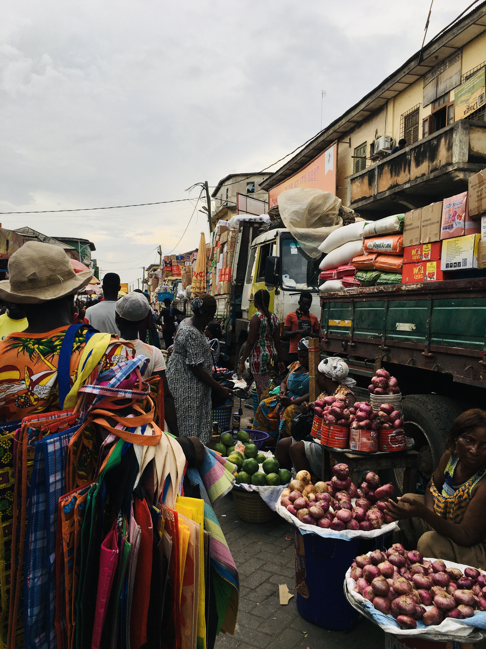
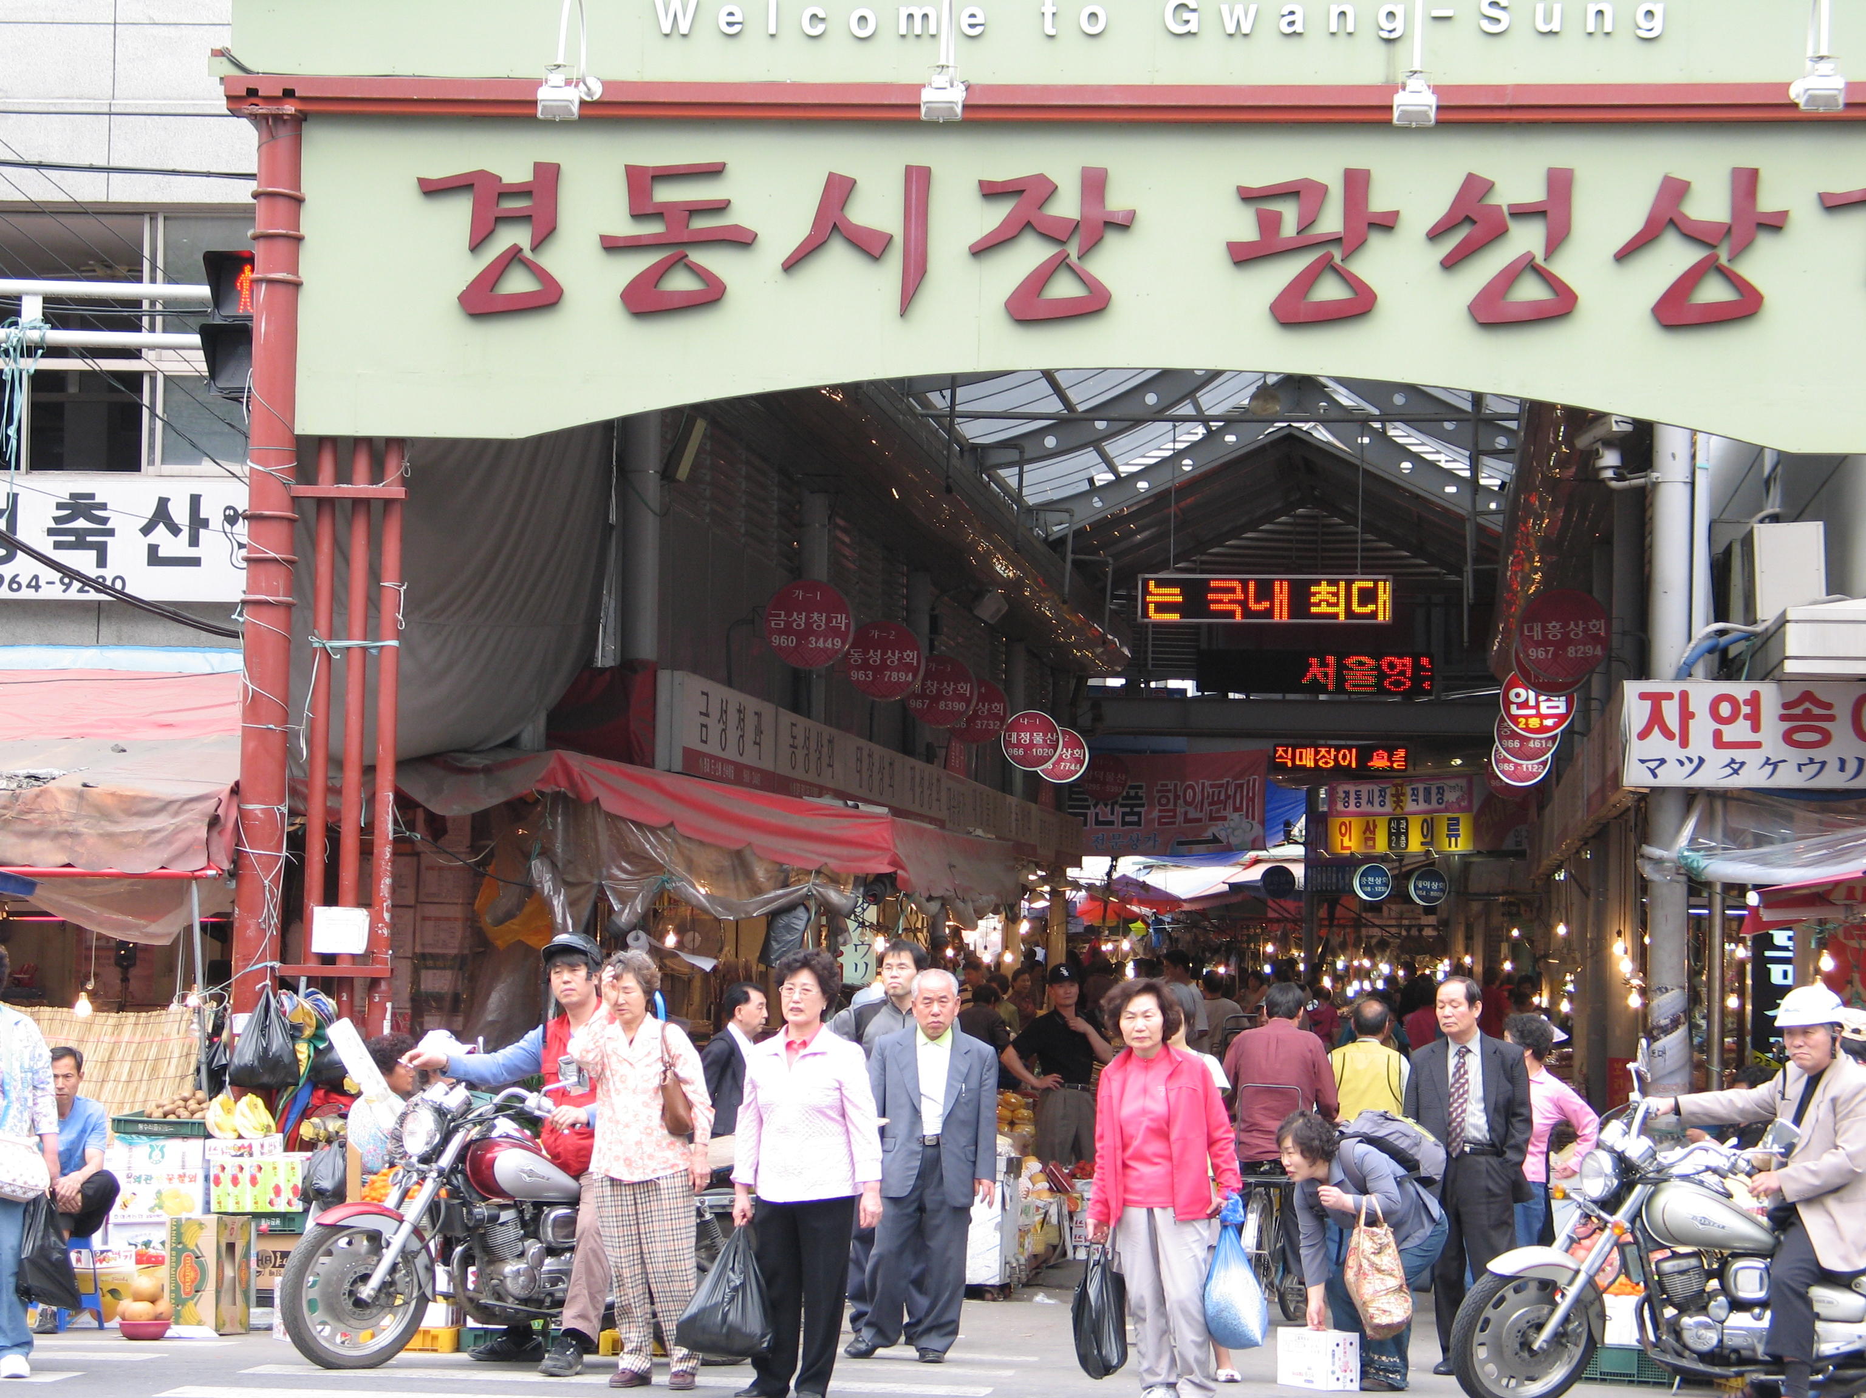
AFRICA & ASIA / OUR TAKE
Development should feel like a better life.
Our priorities: health, buying power, freedom and living standards. Not just a bigger GDP.
Ghana
Botswana
Mauritius
South Korea
Malaysia
Philippines
GHANA / ACCRA MARKET · 2020
SOUTH KOREA / SEOUL MARKET · 2008
Everyday places. Actual people.
For us, higher income matters because of the life it can support: what people can buy, whether they are healthy, and whether they have more freedom.
These market photographs show human-scale context, not measured health, freedom, purchasing power or family life.
Group values, not a six-country wellbeing ranking. GDP: World Bank (2026), NY.GDP.PCAP.KD. Photographs: Amuzujoe (2020), Accra; Gaël Chardon (2008), Seoul. Full credits and licences: p. 28.
AFRICA & ASIA
25

Slide 26
AFRICA & ASIA / OUR ANSWER
Different starts. Paths can change.
Culture matters. So do history, resources, institutions and what countries build next.
DIFFERENT INHERITANCES → NEW CHOICES
Ghana
Cocoa exports
→
Botswana
Limited public assets
→
Mauritius
Sugar exports
→
South Korea
Division and war
→
Malaysia
Commodity exports
→
Philippines
Concentrated power
→
History shapes the start.
It does not fix the finish.
OUR TAKE / GROUP VIEW
We think the original Africa-versus-Asia question is too simple. Culture plays a part, but different starting points and opportunities make the answer much bigger.
Schematic starting conditions, not a quantitative ranking or forecast.
Group viewpoint informed by the six-country comparison. Inheritance sources: pp. 5–8. Cultural change: Hofstede (2011, pp. 6–8, 16); Beugelsdijk and Welzel (2018, pp. 1469–1475, Figures 7–9).
AFRICA & ASIA
26

Slide 27
AFRICA & ASIA / SOURCES + COLOPHON
Sources. Credits. What remains open.
Complete editorial draft — final evidence, rights and physical-print checks pending.
World Bank. (2026). World Development Indicators [Data set]. Retrieved October 6, 2026, from
World Bank. (1993). The East Asian miracle: Economic growth and public policy. Oxford University Press.
World Bank. (2020). Structural transformation and labor market performance in Ghana.
World Bank. (1985). Ghana: Industrial policy, performance and recovery (Report No. 5716-GH).
Maipose, G. S. (2008). Policy and institutional dynamics of sustained development in Botswana (Commission on Growth and Development Working Paper No. 35). World Bank.
Svirydzenka, K., & Petri, M. (2014). Mauritius: The drivers of growth-Can the past be extended? (IMF Working Paper No. 14/134). International Monetary Fund.
Jedwab, R., & Moradi, A. (2012). Colonial investments and long-term development in Africa: Evidence from Ghanaian railways [Working paper]. Northeast Universities Development Consortium.
Hofstede, G. (2011). Dimensionalizing cultures: The Hofstede model in context. Online Readings in Psychology and Culture, 2(1), Article 8.
McSweeney, B. (2002). Hofstede's model of national cultural differences and their consequences: A triumph of faith—a failure of analysis. Human Relations, 55(1), 89–118.
Organisation for Economic Co-operation and Development. (2017). OECD guidelines on measuring trust. OECD Publishing.
Still to check: final citations and rights; A4 print, colour and classroom readability. Historical 1914 map remains withheld pending verified artwork and original legend.
TEAM NAME: [TO BE CONFIRMED]
Complete source appendix: [LINK / QR PLACEHOLDER]
Data: World Bank WDI / ILO modelled employment. Map: Natural Earth 1:110m Admin 0 Countries v5.1.1, public domain. Full image credits: p. 28.
AFRICA & ASIA
27

Slide 28
AFRICA & ASIA / CREDITS
The people behind the pictures.
Twelve country-specific photographs. Images give context—not proof of culture, trust or growth.
Ghana
JulianGrayscales (2020-02-08). Tema port · CC BY-SA 4.0.
Amuzujoe (2020-11-27). Market Accra · CC BY-SA 4.0.
Image A ↗
Licence ↗
Image B ↗
Licence ↗
Botswana
Sarvesh Lutchmun (2015-08-06). Bus Terminal in Gaborone, Botswana · CC BY-SA 4.0.
Paul tk (2018-09-14). MochudiBotswanaSolarPanel · CC BY-SA 4.0.
Image A ↗
Licence ↗
Image B ↗
Licence ↗
Mauritius
Didier Baertschiger (2015-03-09). Mauritius - Port Louis (Central Market) · CC BY-SA 2.0.
Richard N Horne (2025-04-03). Port Louis, Mauritius, Bulk Sugar Terminal Quay · CC BY 4.0.
Image A ↗
Licence ↗
Image B ↗
Licence ↗
South Korea
Svwmal (2012-04-08). South Korea Busan harbour · CC BY-SA 3.0.
Gaël Chardon (2008-04-21). Korea-Seoul-Gyeongdong Market-01 · CC BY-SA 2.0.
Image A ↗
Licence ↗
Image B ↗
Licence ↗
Malaysia
HundenvonPenang (2024-01-27). Perai Industrial Zone, Seberang Perai, Penang · CC BY-SA 4.0.
jgmorard (2009-03-01). 090301.020.PortKlang · CC BY 2.0.
Image A ↗
Licence ↗
Image B ↗
Licence ↗
Philippines
Theurbanhistorian (2009-07-18). Port of Manila · CC BY-SA 3.0.
george ruiz (2013-01-04). The Philippines — seaside market in Manila · CC BY 2.0.
Image A ↗
Licence ↗
Image B ↗
Licence ↗
Map: Natural Earth. (n.d.). Admin 0 – Countries, 1:110m Cultural Vectors (v5.1.1). Public-domain data; generalized present-day boundaries, not historical geometry. Mauritius is located by point at this scale.
MAP SOURCE ↗
All photographs resized only, without cropping or content changes. Source-page and licence links are attached below. Check the licence terms before reusing or changing an image.
AFRICA & ASIA
28

