Slide 1

Visual Servoing of a Handheld Monocular Camera
12931681 – Marcus Hickel, 12949044 – Anthony Nguyen

Slide 2

High-Level Requirements
Ability to communicate between USB camera and MatLab
Ability to recognise a distinct pattern
Ability to recognise the position and movement of the pattern
Ability to determine the direction of the pattern from origin
Ability to track the pattern from the origin
Ability to display directions to the operator for panning the camera
Ability to display directions to the operator for rotating the camera

Slide 3
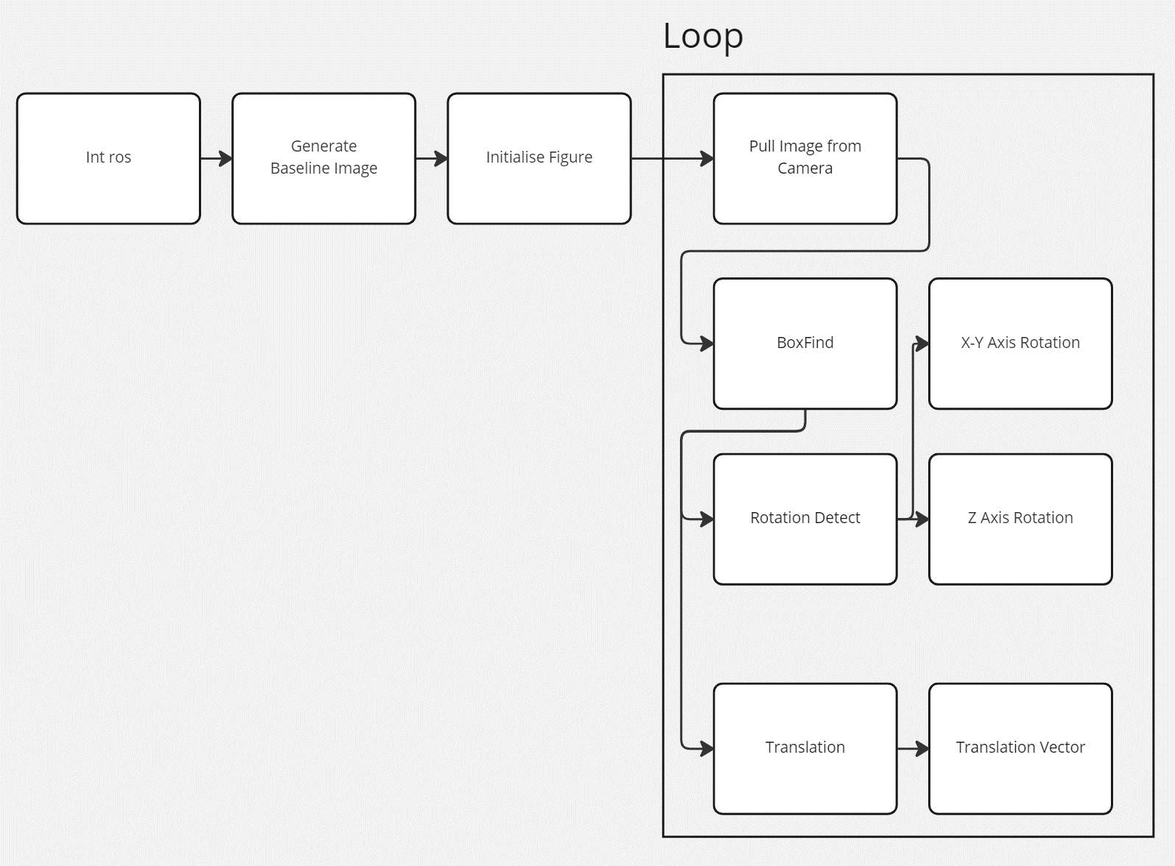
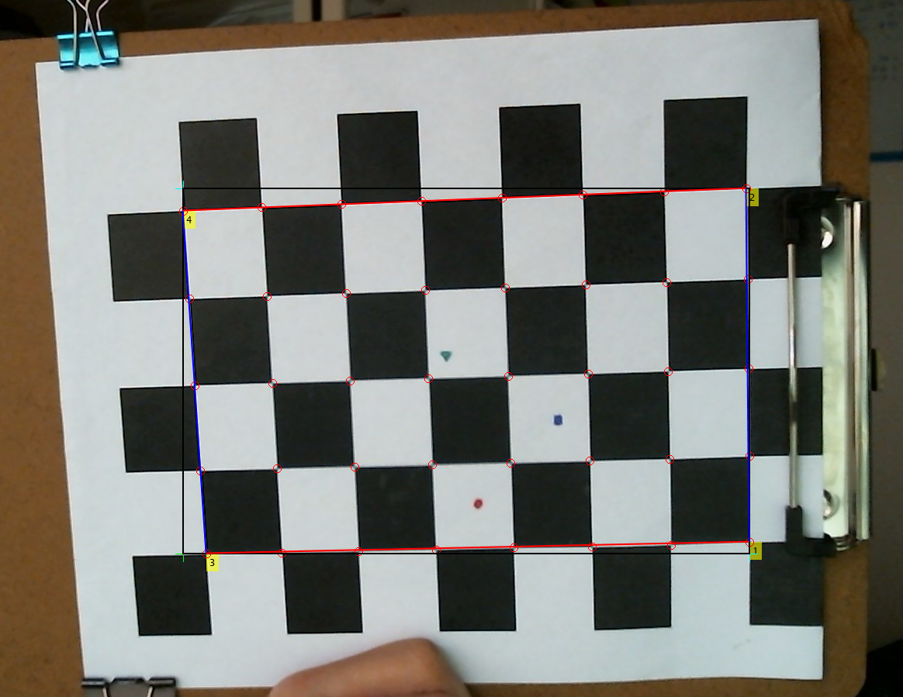
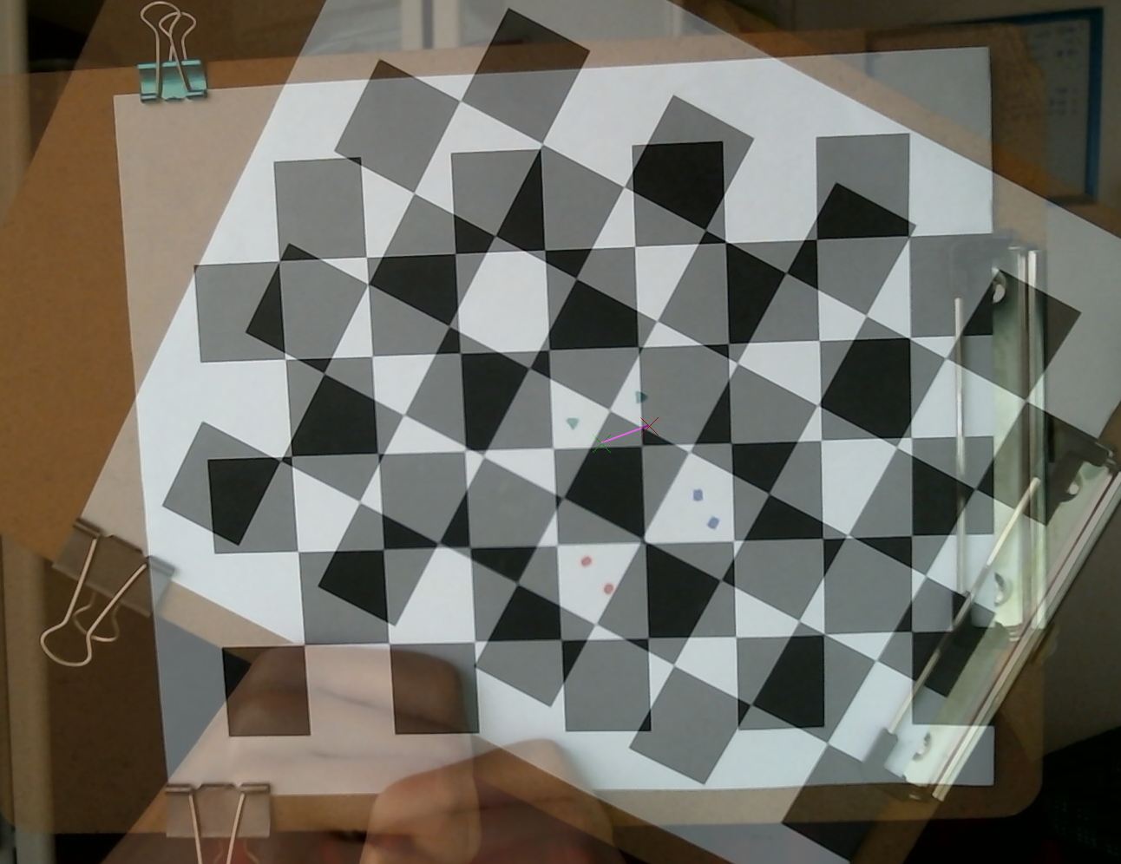
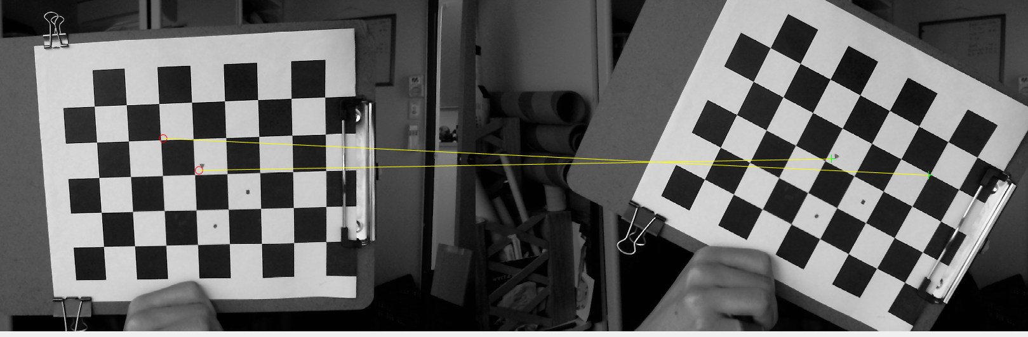
Flowchart

Slide 4
Demo

Slide 5

Questions?

