Slide 1
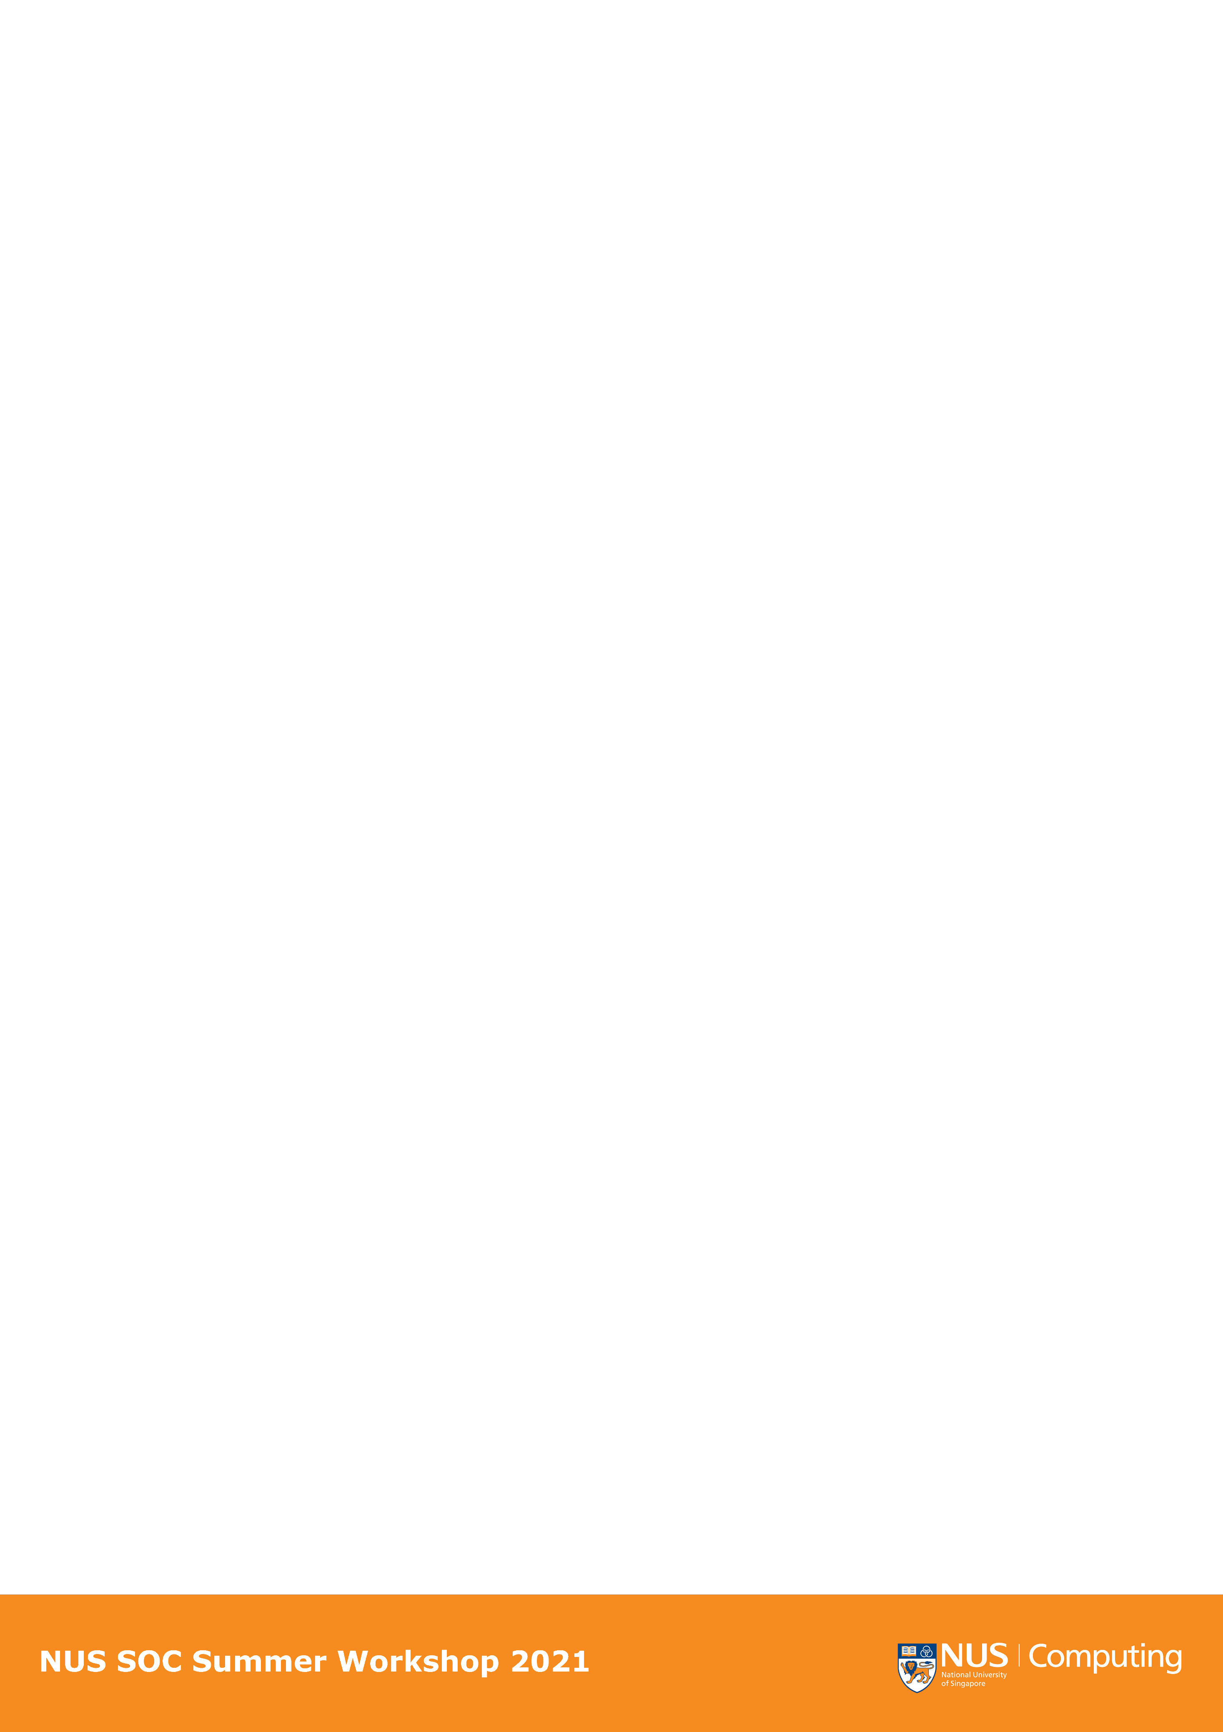
What Factors
Affect
Airbnb Price
in Melbourne
——How to gain more profit in Airbnb competition
Deepakshi Mathur
Li Leshu
Li Zhengji
Zhang Danting
Zhang Jing
SWS3019_08

Slide 2

Introduction
Sharing economy – housing
01
Airbnb - not sure how to start?
THREE factors

Slide 3
Room Type
02

Slide 4
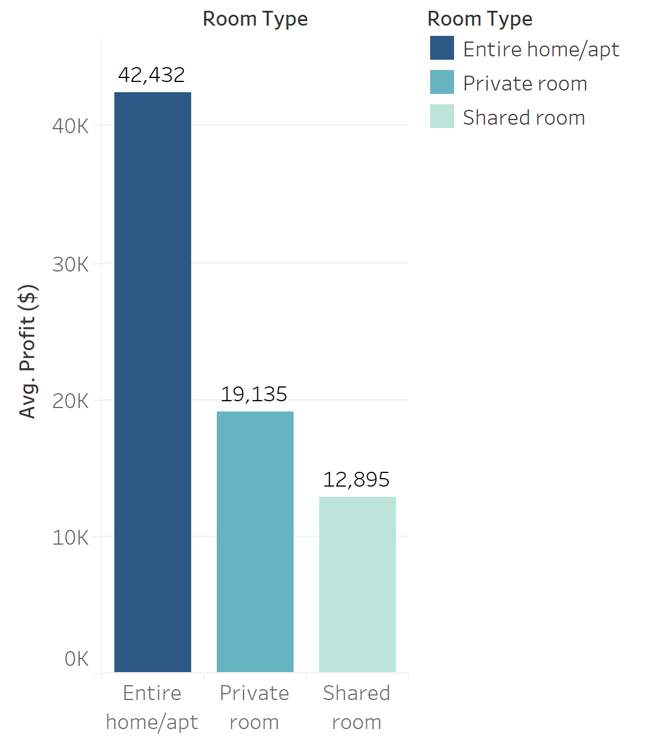
02
ROOM TYPE
THREE ROOM TYPE
63.19%
Entire home/apt
35.12%
Private room
1.69%
Shared room
$ 42, 432
In Melbourne’s Airbnb Houses,
Entire home/apartment presents the highest average profit comparing to other types.
AVG. Profit = AVG((365-[Availability 365])) * AVG([Price])

Slide 5
Location
03

Slide 6
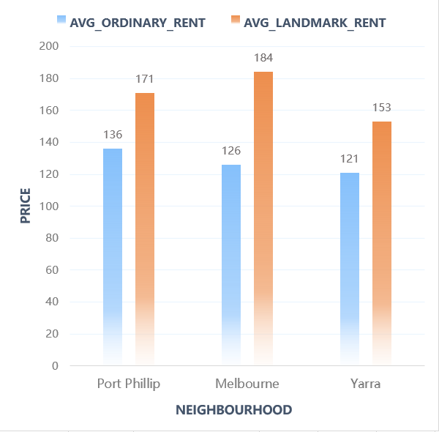
03
RENT COMPARISON
PERCENTAGE DIFFERENCE:
Port Phillip 25.7%
Melbourne 46.0%
Yarra 26.4%
Landmarks generally have higher rents!

Slide 7
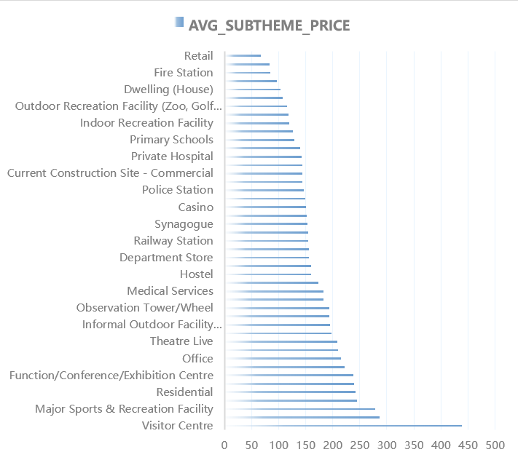
03
IF YOU WERE A LANDLORD…
Visitor Centre?
.
Residential?

Slide 8
Timeline
04

Slide 9
04
Timeline
Occupancy
Average Daily Rate
Revenue Per Available Room
Three indicators to measure the performance level of the hotel industry

Slide 10
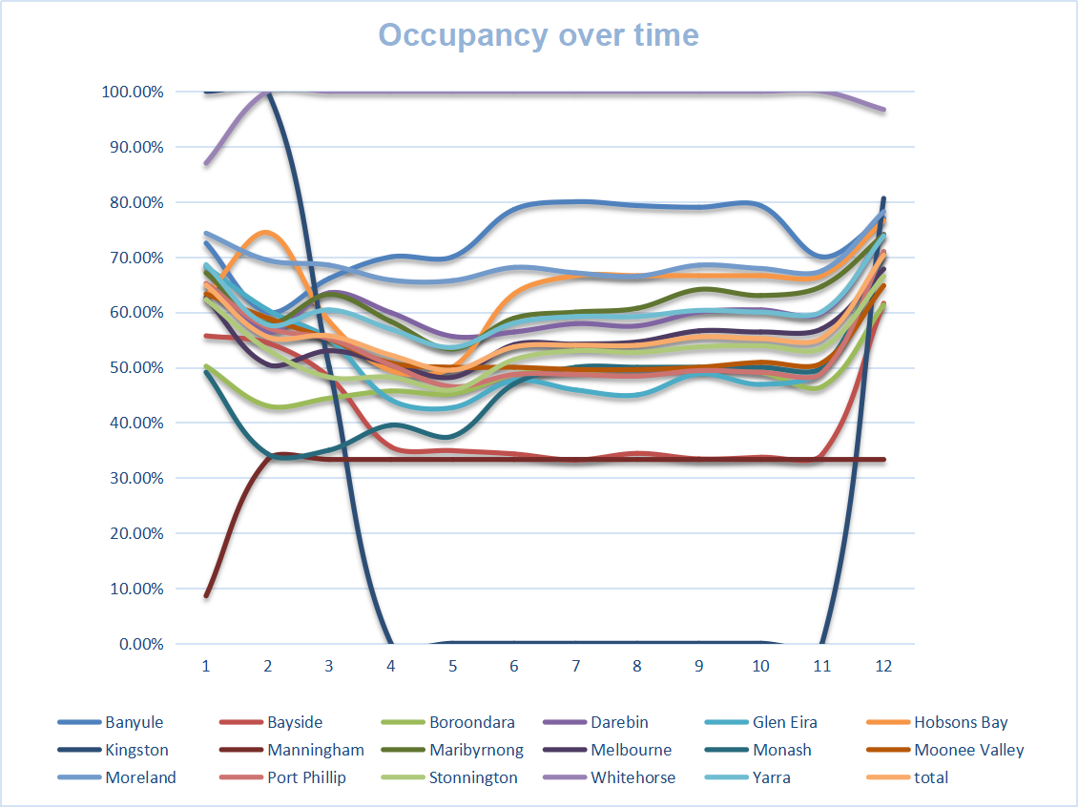
04
Occupancy in 17 neighborhoods

Slide 11
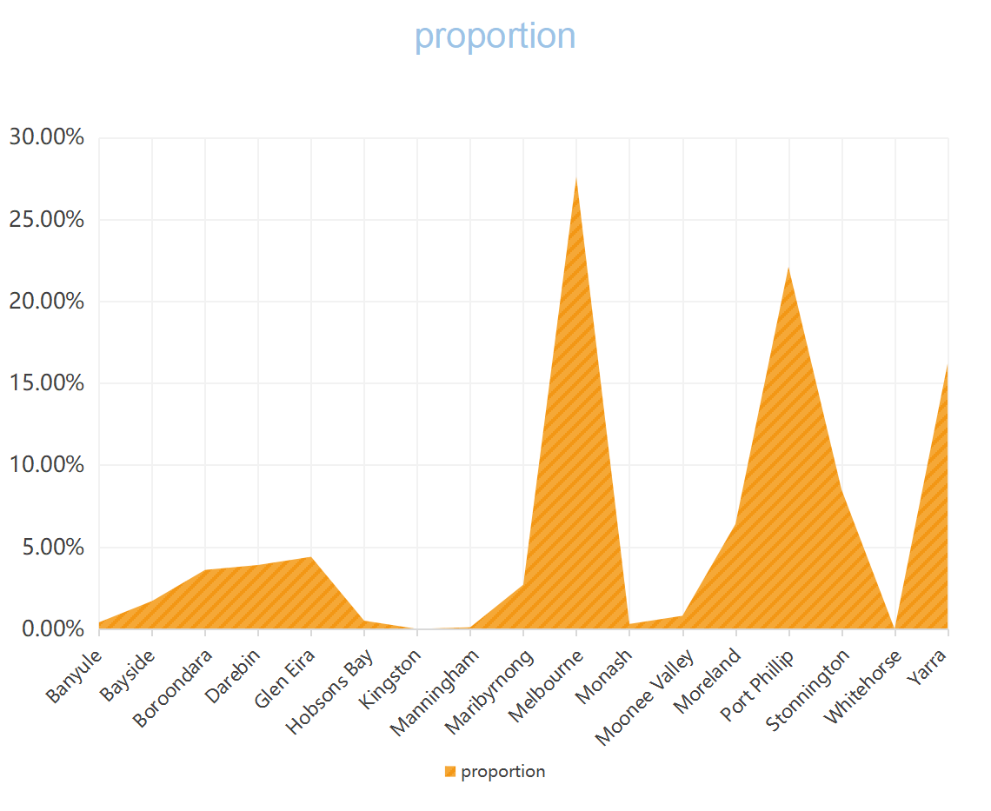
04
Typical group
Top 3 Airbnb housing ownership

Slide 12
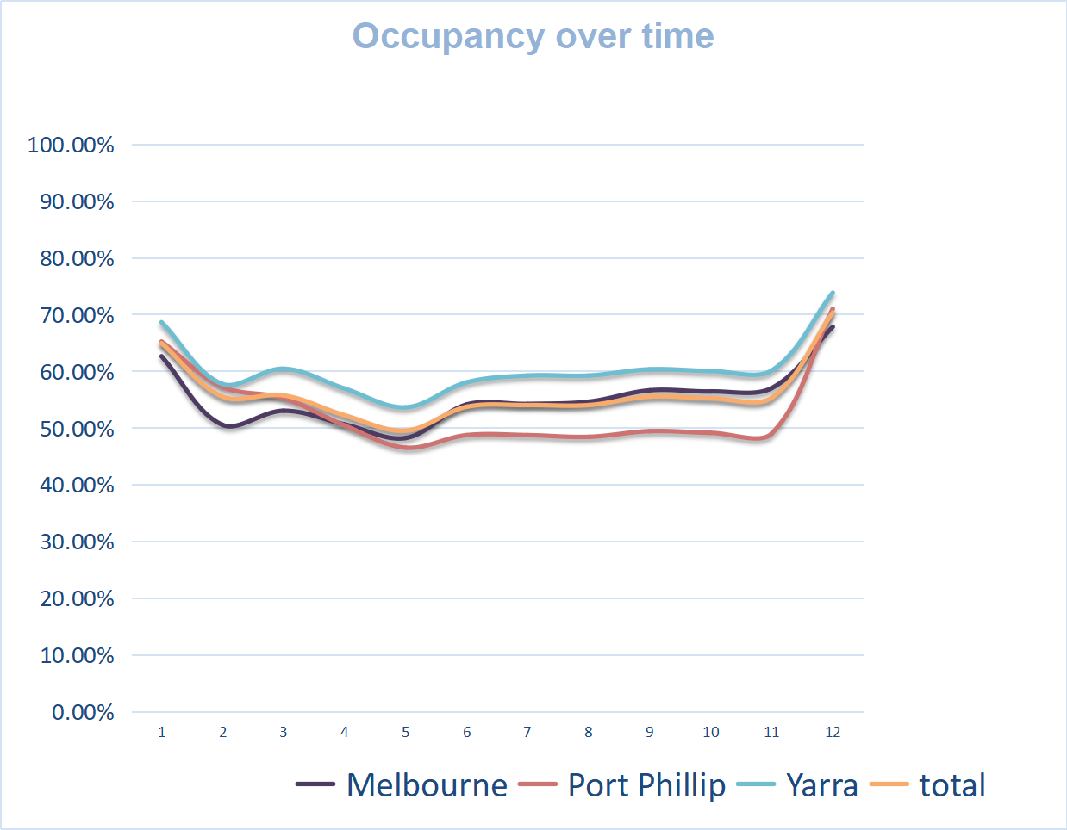
04
Typical group
In most of Melbourne’s Airbnb Houses,
January and December are the peak season for house rental.

Slide 13
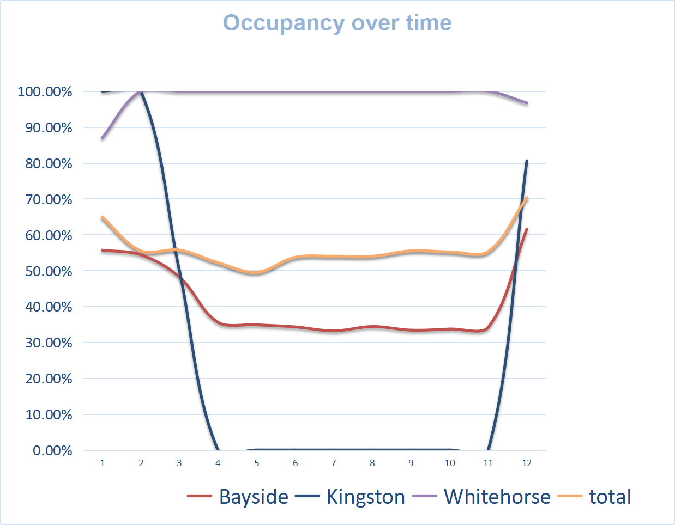
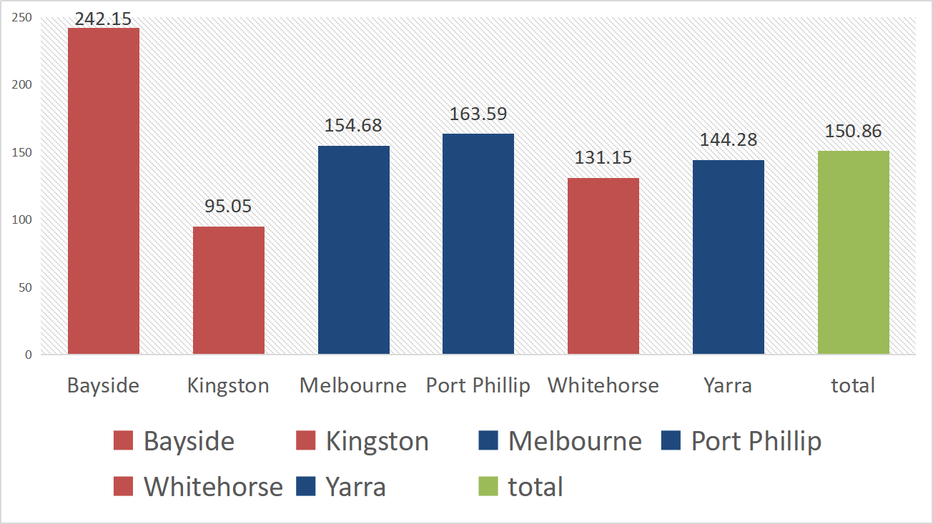
04
Special group

Slide 14
Reviews
05

Slide 15
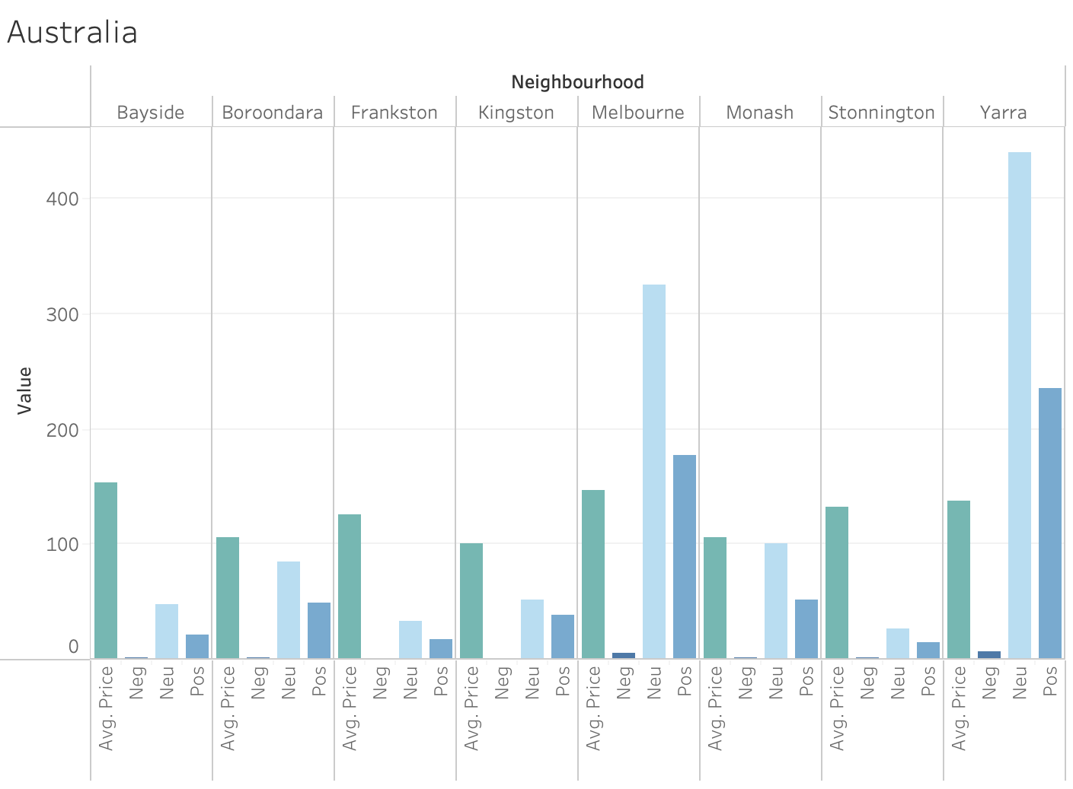
05
ANALYSIS OF THE REVIEWS
Neighbourhoods with highest Average Prices
Neighbourhood | Average Price (in $)
Bayside | 153.2
Melbourne | 146.4
Yarra | 137.6
In entire Australia, Bayside, Melbourne and Yarra
are the top three neighbourhoods with maximum
average price with respect to the polarity of
comments received by reviewers

Slide 16
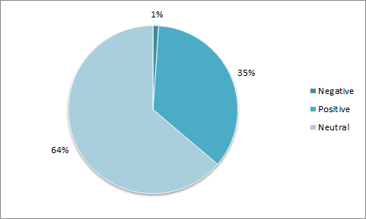
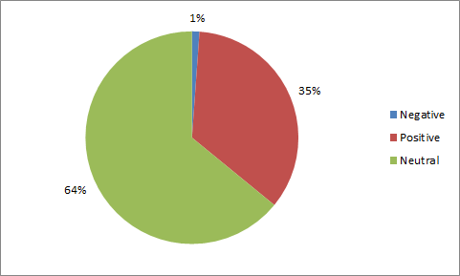
05
REVIEW POLARITIES
AUSTRALIA
MELBOURNE

Slide 17
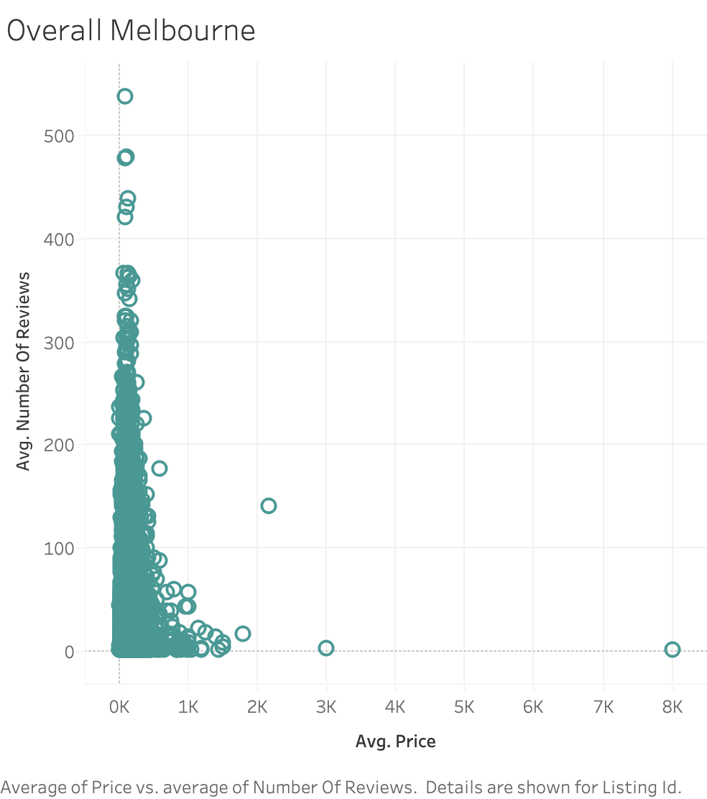
05
DEPENDENCY OF PRICE ON REVIEWS
From the plot, we can clearly see that
The price is inversely proportional to
The number of reviews
Listing Id | Avg. Number Of Reviews | Avg. Price
2449576 | 538 | 100
16181637 | 1 | 8000

Slide 18
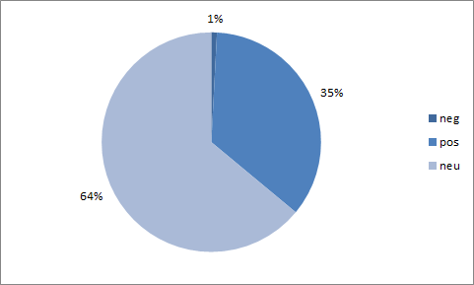
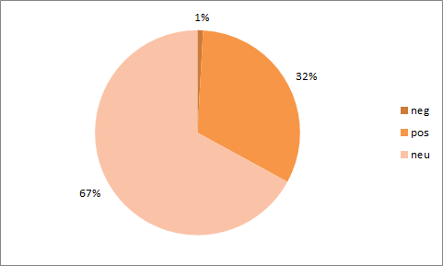
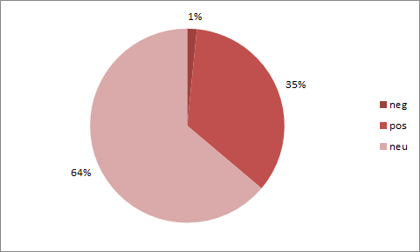
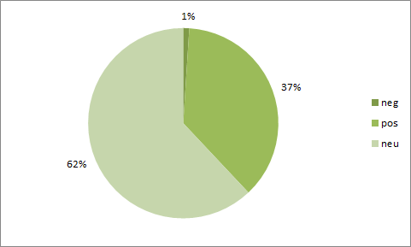
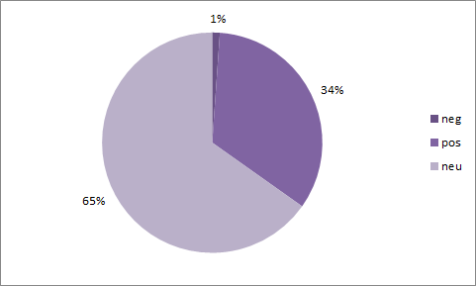
05
TOP 5 LISTINGS IN MELBOURNE
2449576
3125217
1603051
411059
74548

Slide 19
05
TOP 5 LISTINGS IN MELBOURNE
LISTING | NUMBER OF REVIEWS | SENTIMENT OF THE REVIEWS | AVERAGE PRICE (IN $)
2449576 | 479 | NEUTRAL | 109
1603051 | 439 | NEUTRAL | 129
411059 | 367 | NEUTRAL | 132
3125217 | 150 | NEUTRAL | 364
74548 | 64 | NEUTRAL | 366

Slide 20
Conclusion
06

Slide 21
06
Conclusion
TO RAISE YOUR RENT
Rent out your house as an entire room/apartment.
Your room/apartment is near a landmark.
Visitor Centre $400
Major Sports & Recreation Facility $300
Residential Area $300
Exhibition Centre $200

Slide 22
06
Conclusion
IN OFF SEASON
TO INCREASE OCCUPANCY BY:
Decreasing rent to $100 (>$100)
Discounting the rent by half (<$100)

Slide 23
Q & A

