Slide 1



Introduction to Azure Data Factory
Marcus Larsson
Wednesday, 17 June 2020
https://github.com/MarcusMLarsson/Azure-Data-Factory-Demo
Marcus.larsson@cgi.com

Slide 2

What is Azure Data Factory (ADF)?
ADF is a cloud ETL and data integration tool
ADF enables you to quickly and efficiently create automated data pipelines
without having to write any or little amount of code!

Slide 3
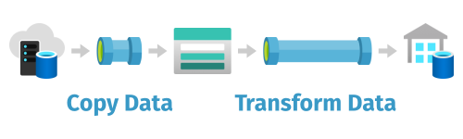
What can you do with Azure Data Factory?
Azure Data Factory can be used to ingest and transform data.
You can ingest data from ¹
On-premises data stores
Cloud data stores
SaaS applications
You can convert file formats, zip and unzip files, and map columns– all in one task.
See link for supported data stores and file formats

Slide 4
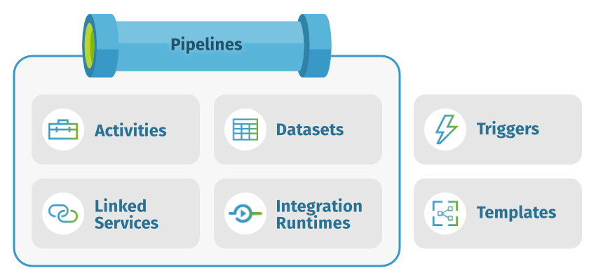
A deeper dive into Azure Data Factory

Slide 5


ADF - Cloud ETL
SSIS - On-premise ETL
High volume of data
Batch & Streaming
Structured, unstructured & schema-drift
Hybrid, Managed, Scale up
Pay as you go
Drag and Drop & Code (CLI & SDK)
C#, Python, PowerShell CLI
Medium volume of data
Batch
Structured
On-premises, Own harwader, Scale out
Licenses
Drag and drop
VB, C# & Biml

Slide 6
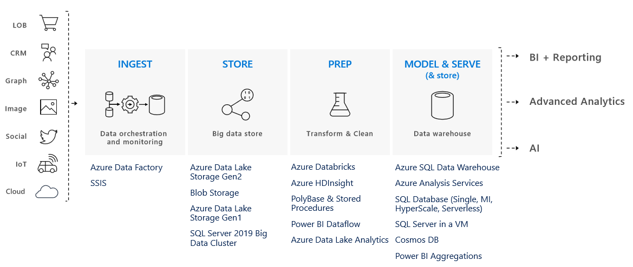
Delivering a Modern Data Warehouse with ADF

Slide 7
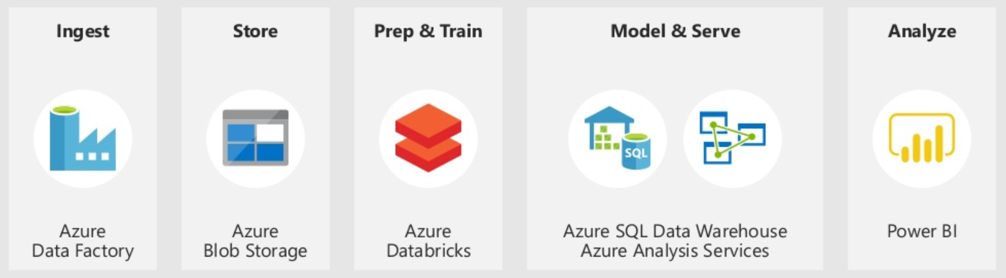
Demo

