Slide 1



Introduction to Azure Data Factory
Marcus Larsson
Wednesday, 17 June 2020
https://github.com/MarcusMLarsson/Azure-Data-Factory-Demo
Marcus.larsson@cgi.com

Slide 2

What is Azure Data Factory (ADF)?
ADF is a cloud ETL and data integration tool
ADF enables you to quickly and efficiently create automated data pipelines
without having to write any or little amount of code!

Slide 3
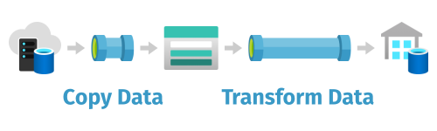
What can you do with Azure Data Factory?
Azure Data Factory can be used to ingest and transform data.
More than 80 SaaS applications
On-premises data stores
Cloud data stores

Slide 4
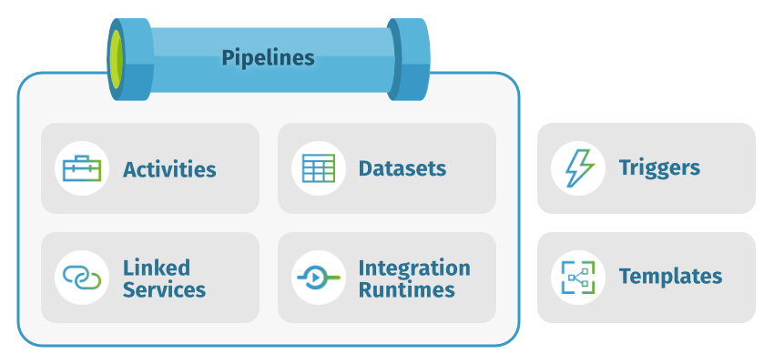
A deeper dive into Azure Data Factory

Slide 5


ADF - Cloud ETL
SSIS - On-premise ETL
High volume of data
Batch & Streaming
Structured, unstructured & schema-drift
Hybrid, Managed, Scale up
Pay as you go
Drag and Drop & Code (CLI & SDK)
C#, Python, PowerShell CLI
Medium volume of data
Batch
Structured
On-premises, Own harwader, Scale out
Licenses
Drag and drop
VB, C# & Biml

Slide 6
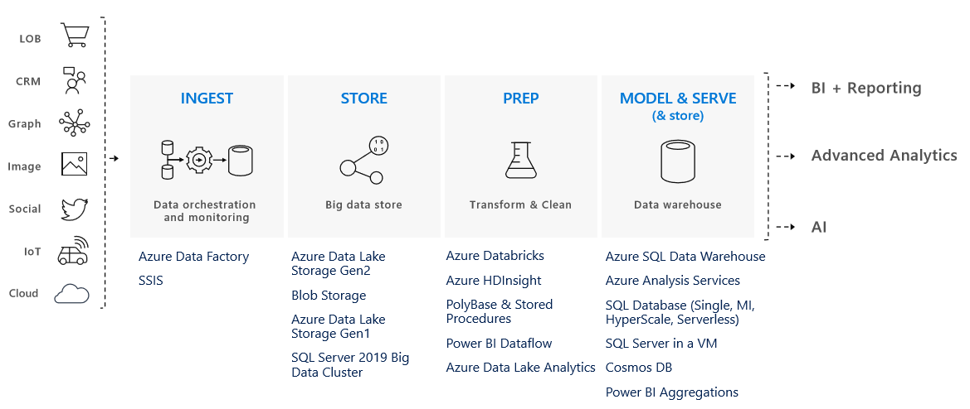
Delivering a Modern Data Warehouse with ADF

Slide 7
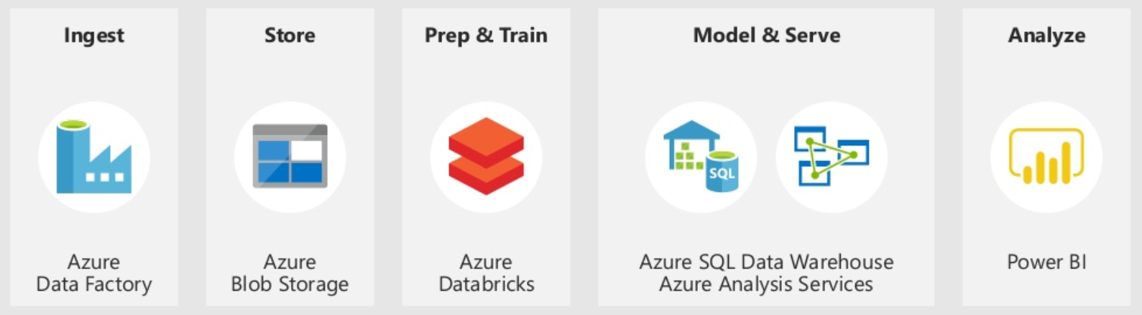
Demo

