Slide 1

Credit Card Frauds Detection
Final project proposal
TEAM2: CHENLIAN XU, QIANLI MA

Slide 2
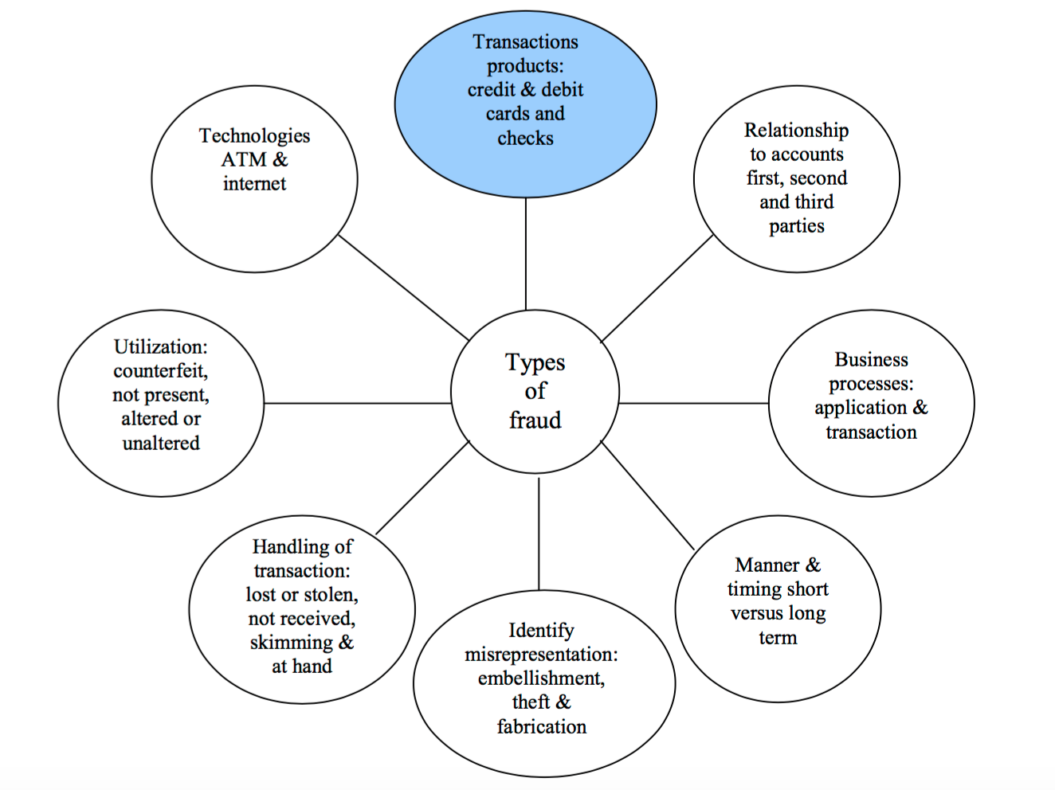
Background
Fraud means obtaining services/goods and/or money by unethical means, and is a growing problem all over the world nowadays.

Slide 3
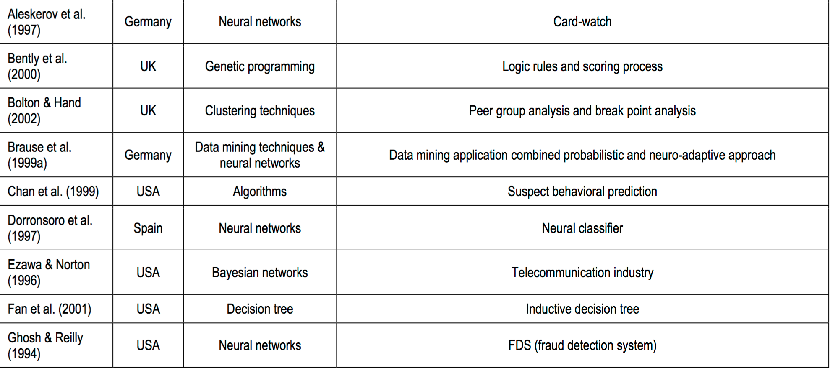
Background

Slide 4
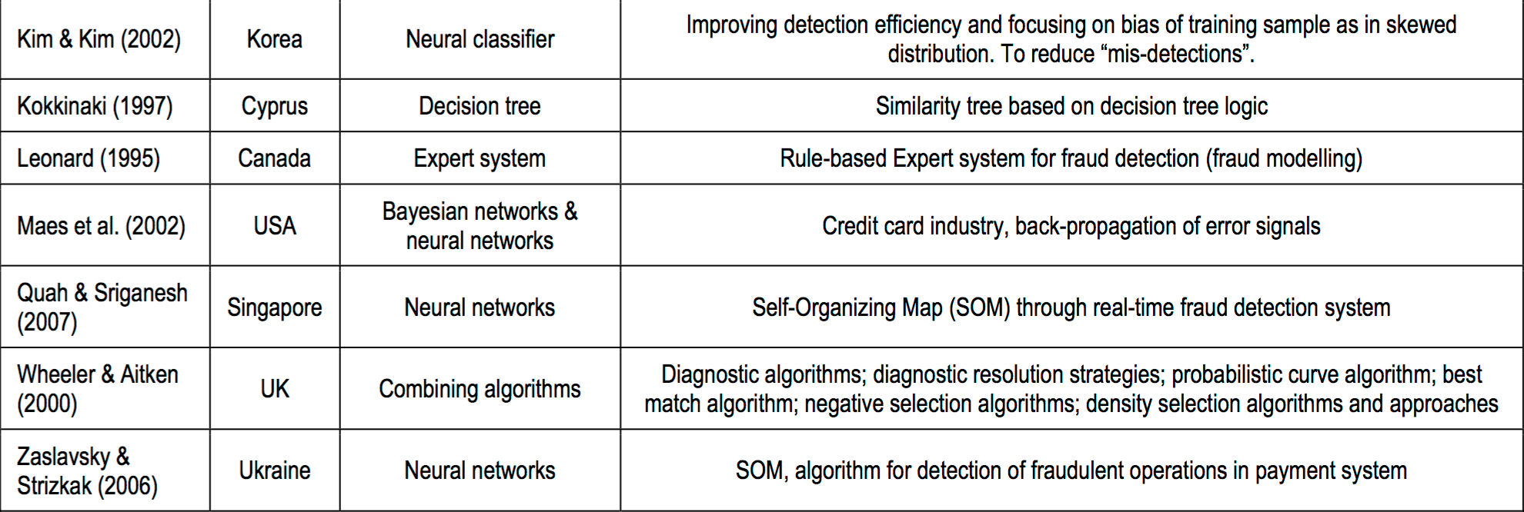
Background

Slide 5
Goals
1. Accurately predict credit card fraud cases using imbalanced data
2. To protect card holders' and commercial banks' benefits
3. Review and compare different fraud detection techniques and select the best model by trade-offs of different evaluation methods

Slide 6
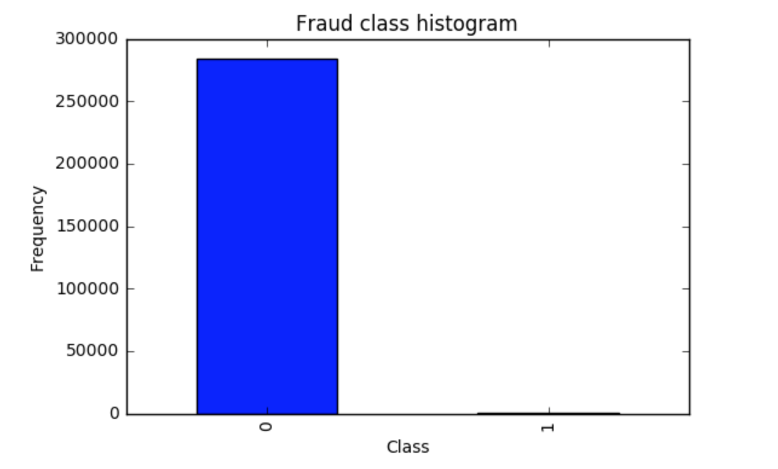
Data
https://www.kaggle.com/mlg-ulb/creditcardfraud
Anonymized credit card transactions labeled as fraudulent or genuine
492 frauds out of 284,807 transactions
The dataset is highly unbalanced, the positive class (frauds) account for 0.172% of all transactions.

Slide 7
Process Outline
1. Data Cleaning
handling outliers
computing missing values
2. EDA
3. Feature Engineering
Notes:
Try out PySpark in data cleaning and feature engineering (might not be necessary)

Slide 8
Process Outline
4. Model Fitting
5.1 Biased penalty SVM (class-weighted SVM)
whole dataset VS resampled dataset :
5.2 Logistic Regression
5.3 Random Forest
5.4 Gradient Boosting Tree
Notes:
Resampling method is a class of methods that estimate the test error by holding out a subset of the training set from the fitting process, and then applying the statistical learning method to those held out observations.
This is a clear example where using a typical accuracy score to evaluate our classification algorithm. For example, if we just used a majority class to assign values to all records, we will still be having a high accuracy, BUT WE WOULD BE CLASSIFYING ALL "1" INCORRECTLY!

Slide 9
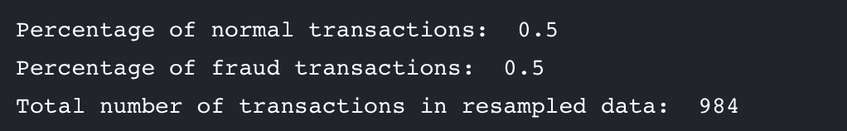
Resampling
Resampling the data to have an approximate 50-50 ratio
OVER-sampling: adding copies of the under-represented class (better when you have little data) (biased penalty SVM)
UNDER-sampling: deletes instances from the over-represented class (better when you have lot's of data)

Slide 10
Process Outline
5. Feature Selection
6. Model Selection:
tuning the hyperparameters of each model
R², Accuracy Rate, Recall Rate, Precision, AUC
7. Pipeline design
8*. Deployment
9*. Web Application
Notes:
Accuracy = (TP+TN)/total
Precision = TP/(TP+FP)
Recall = TP/(TP+FN)

Slide 11
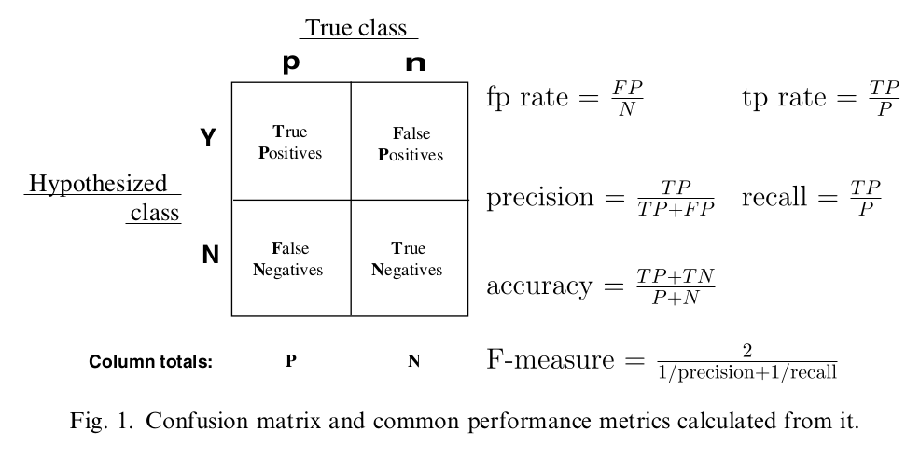
Model Selection

Slide 12
Initial Idea of the whole picture
fraud report
model design and building
e.g. 3 out 4 models say that this transaction is predicted as a fraud
predict the reported transaction
using cached model
model deployment
misjudging reported/
routine dataset update
stored uploaded transactions
termly model update

Slide 13
Milestone
Timeframe | Delivery
Day 1-2 | Data Cleaning and EDA
Day 3-4 | Feature Engineering, Model Fitting, Feature Selection
Day 5-8 | Model Selection
Day 9-10 | Pipeline Design, Deployment, Web API

Slide 14
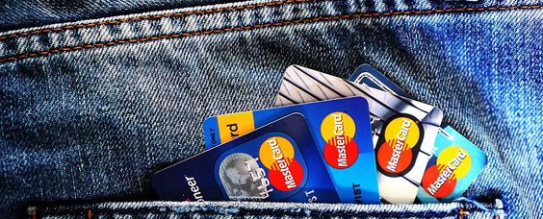
Thank you!
Team 2

