Slide 1
Regularization & Cross Validation
Professor: Srikanth Krishnamurthy
Presented by: Chenlian Xu
Qianli Ma
Mar 3, 2018

Slide 2
Overfitting
What is it?
How to prevent it?

Slide 3




Overfitting
Normal Fitting
Serious Overfitting
Data
Overfitting

Slide 4
Overfitting
Underfitting
High Bias
Normal Fitting
Bias-Variance Tradeoff
Overfitting
High Variance

Slide 5
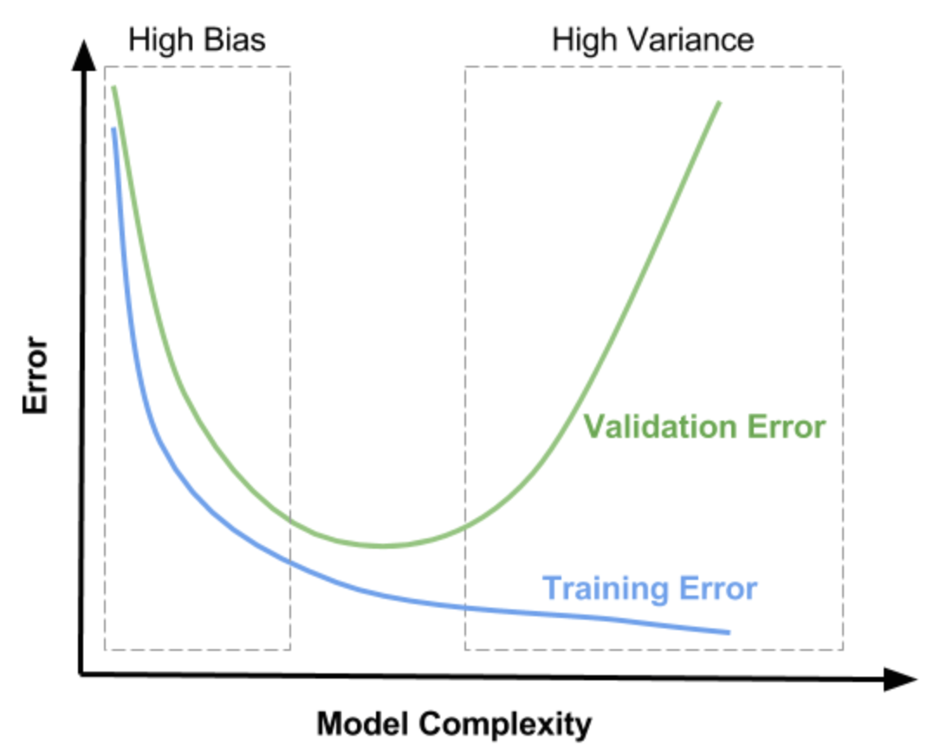
Overfitting
Bias-Variance Tradeoff

Slide 6
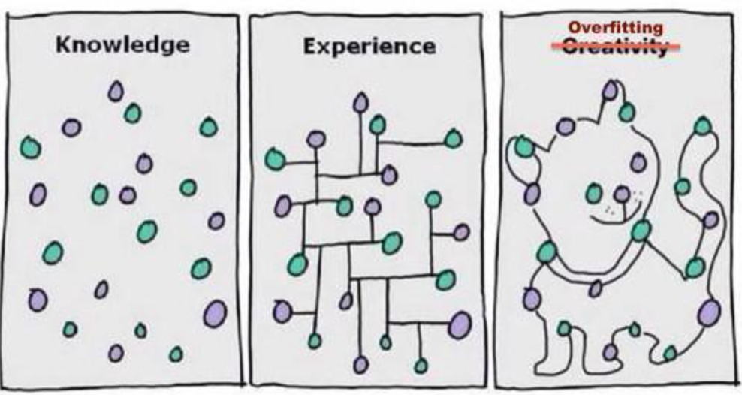
Overfitting
Too many features
Fit the train set very well
Fail to generalize to new examples

Slide 7
How to prevent overfitting?
1 Reduce number of features
Manually select
Model selection algorithm
2 Regularization
sparsity
Reduce values of parameters

Slide 8
Regularization
L1, L2, Elastic Net

Slide 9
Regularization
Reduces overfitting by adding a complexity penalty to the loss function

Slide 10
L1 & L2 Regularization
L1 LASSO (Least absolute shrinkage and selection operator)
L2 Ridge

Slide 11
Elastic Net
Elastic Net
linearly combines the L1 and L2 penalties of the lasso and ridge methods
L1
L2

Slide 12
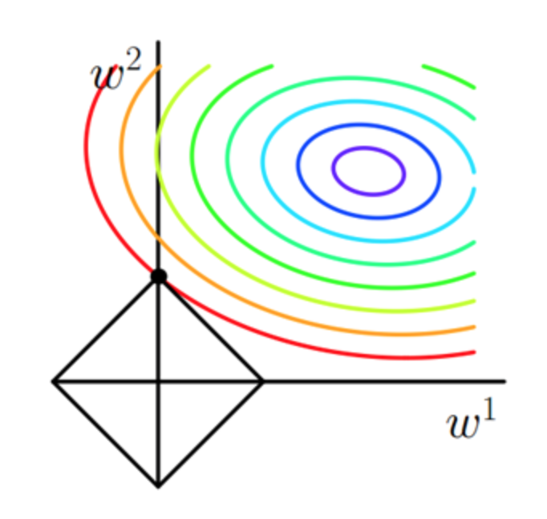
Effect of L1 Regularization
L1 LASSO (Least absolute shrinkage and selection operator)
L1 Regularization encourages sparsity

Slide 13
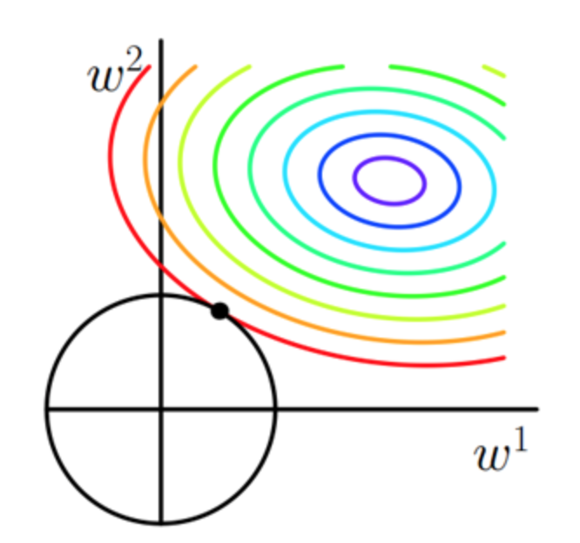
Effect of L2 Regularization
L2 Ridge
As λ increases, sum of squares decreases
Weight decay

Slide 14
Regularization
Reduces overfitting
Reduces variance
Minimizes the test-set error
Minimizes the R_{in}

Slide 15
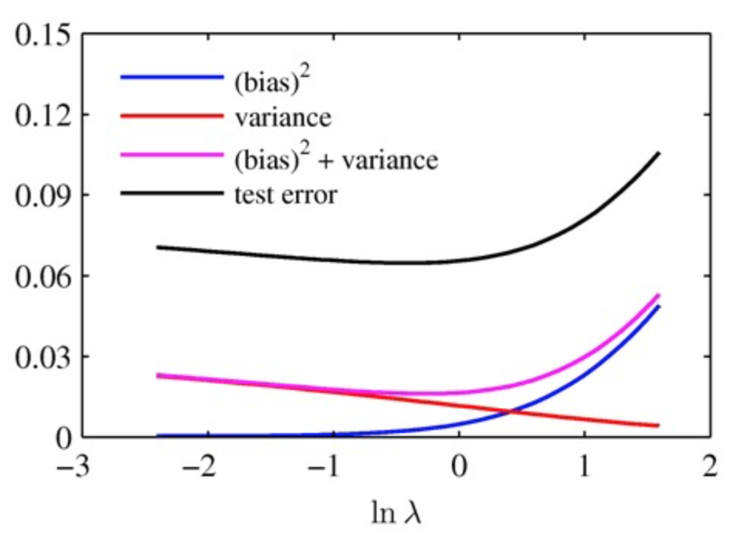
Regularization

Slide 16
Only Regularization?
λ₁, λ₂, λ₃...
“Optimal” λ ?
We need a validation set
learn, test
R_{in1}, R_{in2}, R_{in3}…

Slide 17
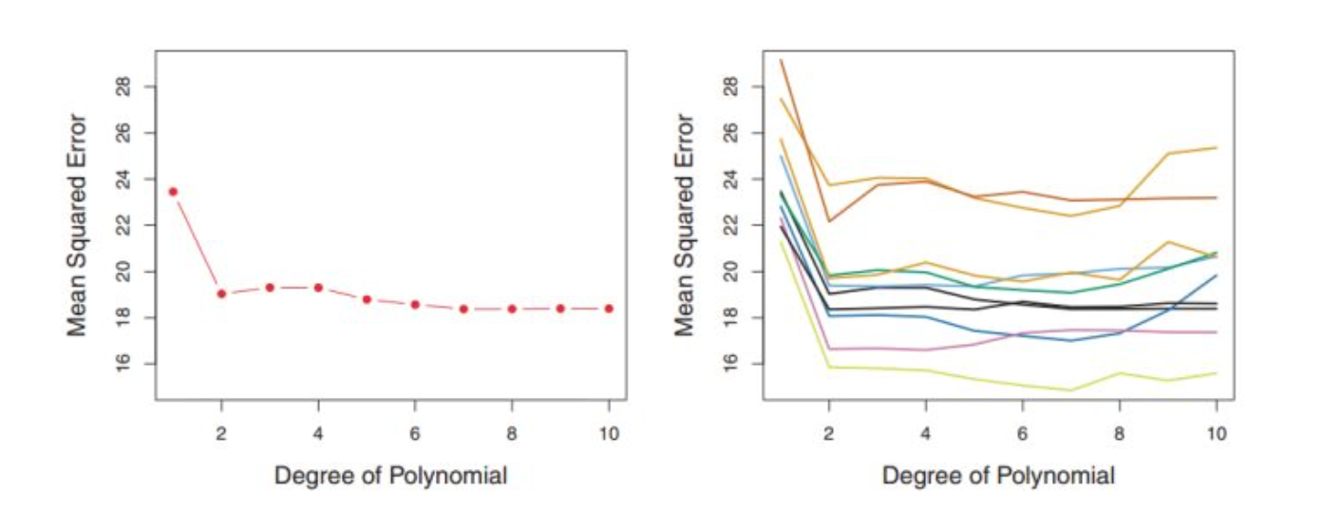
Why do we need Cross Validation?
Validation Set
You don’t even use me for modeling!
Train Set
small validation set ⇒ large error in estimated loss
large validation set ⇒ small training set ⇒ bad model

Slide 18
Cross Validation
Estimate the “optimal” λ by using it

Slide 19
K-fold cross validation
Divide the dataset into k blocks
for k = 1 to k
train on blocks except kth block, test on kth block average the results, choose best λ.
Train Block
Validation Block

Slide 20
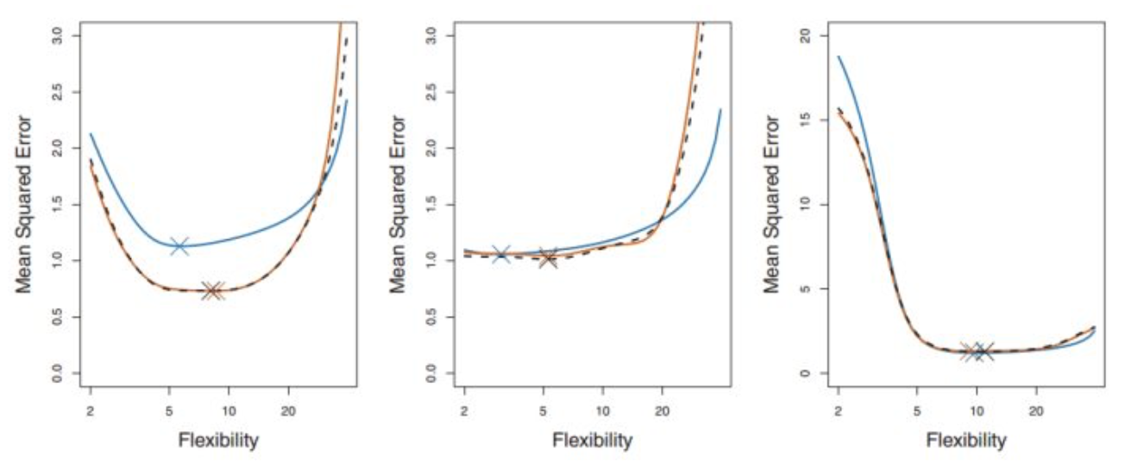
K-fold cross validation
Common cases: K = 5, 10 or K = N (LOOCV)
High computation cost: K folds × many choices of model or λ
LOOCV
10-fold CV

Slide 21
Summary
Regularization
&
Cross Validation

Slide 22
Regularization & Cross Validation
Trading off bias and variance is hard.
Degree of Polynomial ⤴ Bias ⤵ Variance ⤴
Regularization penalizes hypothesis complexity
L2 regularization leads to small weights
L1 regularization leads to many zero weights (sparsity)
Cross-validation enables selection of regularization penalties by estimating test-set error on parts of the training set

Slide 23
Demo
Regularization
&
Cross Validation

