Slide 1

Project Part 1. Fitting an unknown function
By: Criste George, Fogoș Mihai, Nichita Marcus

Slide 2
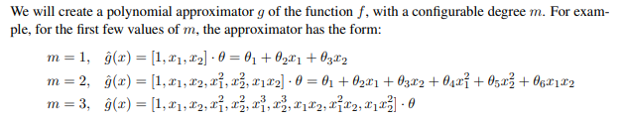
Our Task
We were given a data set with values for “id” and for “val”, each containing input and output variables.
We had to use linear regression in order to approximate a set of values to match as closely as possible the graphical representation of the provided model.

Slide 3
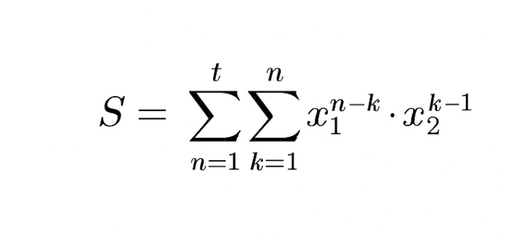
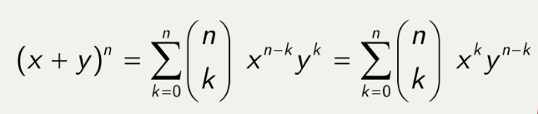
Our Solution
We started from the Newton’s Binomial Expansion formula and after a series of computations we concluded that the results were very close to the regressors we needed, but not exactly them.
Than we came with an idea of using two sums to add each degree of the computation to reach the final and exact values for the regressors.
Our final formula where:
t – the degree of the final polynomial
n – the degree of the current regressor
Newton’s Binomial Expansion

Slide 4
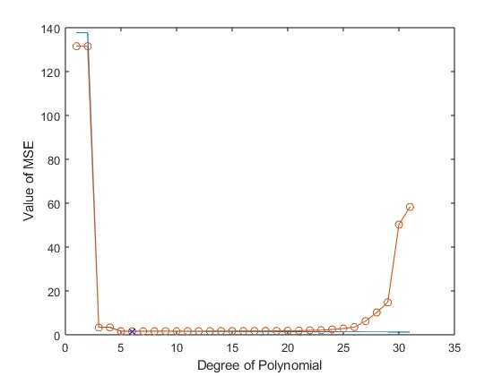
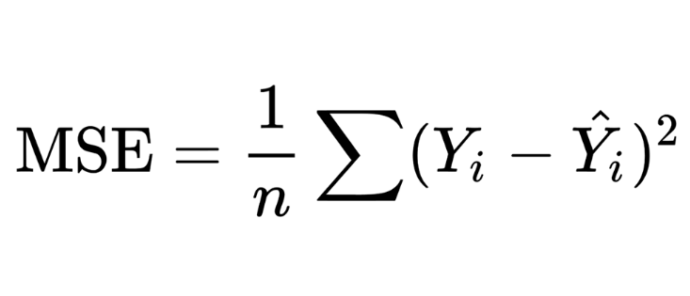
Mean Squared Error
The Mathematical formula for MSE
The MSE represents the measure of how close a model’s predictions are to the actual values.
Our plot of the MSEs: the MSE of “id” and the MSE of “val”

Slide 5
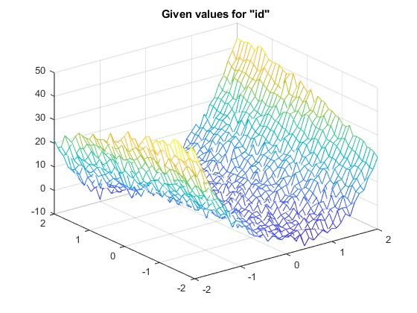
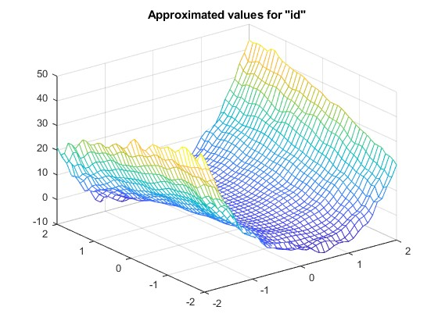
The identification plots

Slide 6
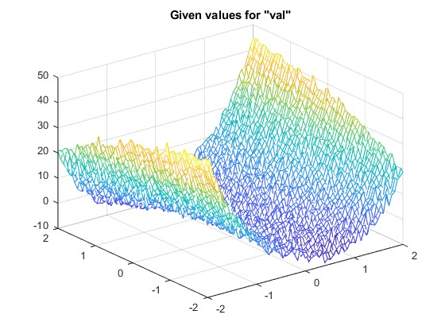
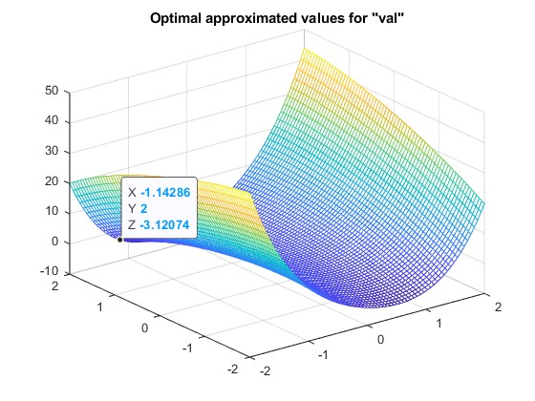
The optimal degree of polynomial
Resulting from our computations, we concluded that the optimal degree of polynomial is 6.

Slide 7
Discussions points
We chose the optimal degree of the polynomial by looking for the minimum value of the MSE.
The model was performing alright on the identification data and it performed almost perfectly on the validation data, having an error of only 1.6087.
We observe overfitting of the data after degree 26.

Slide 8
Overall conclusion
In conclusion, we developed a polynomial approximator and we found the optimal degree for our model.
The model is achieving and MSE values of 1.6 on the validation data-set, as mentioned before, and avoids overfitting seen in higher degree models.

Slide 9
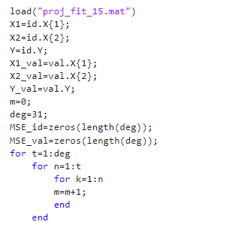
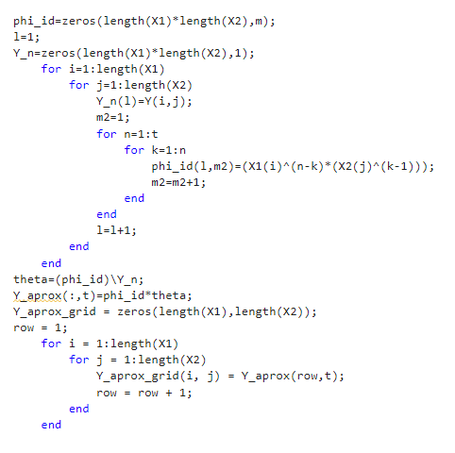
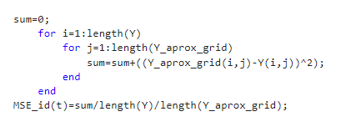

Slide 10
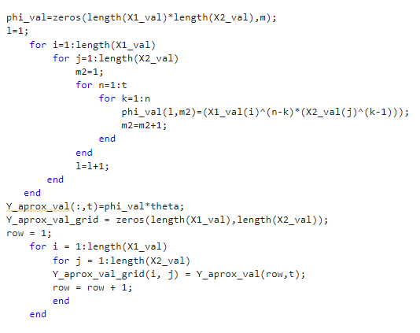
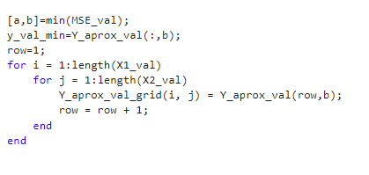
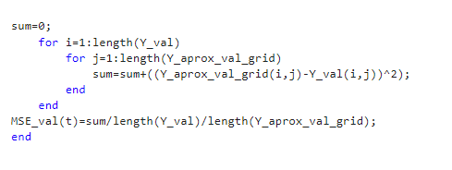

Slide 11
