Slide 1

Project Part 2. Nonlinear ARX identification
By: Criste George, Fogoș Mihai,
Nichita Marcus

Slide 2

Our Task
We were given two data sets, one for the identification part and one for validation part of the project, each of them containing input and output variables.
We had to develop a black-box model for the given system using a nonlinear ARX model implementation.

Slide 3


Nonlinear ARX Approximator Structure
The system is modeled using a polynomial nonlinear ARX model. The current output is expressed as a nonlinear function of past outputs and inputs: $\hat{y}$(k)=p(d(k)).
The regressor vector is defined as: $d\left(k\right){=[y\left(k−1\right), …, y\left(k−n_{a}\right),u\left(k−n_{k}\right),…,u(k−n_{k}−n_{b}+1)]}^{T}$
p(⋅) is a multivariate polynomial of degree m in the regressor variables.
The model is nonlinear in the regressors and linear in the parameters.
The linear ARX model is a special case obtained when m=1.

Slide 4


Our Solution
$$S=\sum_{n=1}^{t}{\sum_{k=1}^{n}{x_{1}^{n−k}∗x_{2}^{k−1}}}$$
$$S=\sum_{n=1}^{t+1}{\sum_{k=1}^{n}{y^{n−k}∗u^{k−1}}}$$
We started by using the formula for regressor construction from the first part of project and after some computations we concluded that we needed small modifications in order to achieve the right results for the new regressors.
Our initial formula, from part 1 of the project where:
t – the degree of the final polynomial
n – the degree of the current regressor
Our final formula where:
t – the degree of the final polynomial
n – the degree of the current regressor

Slide 5

Important Aspects
Linear Regression formulation: $\hat{y}$(k)=$φ^{T}$(k)*$θ$, where $θ$ contains the unknown polynomial coefficients.
Model operation modes:
One-step ahead prediction (uses measured past outputs)
Simulation (uses previously simulated outputs)

Slide 6
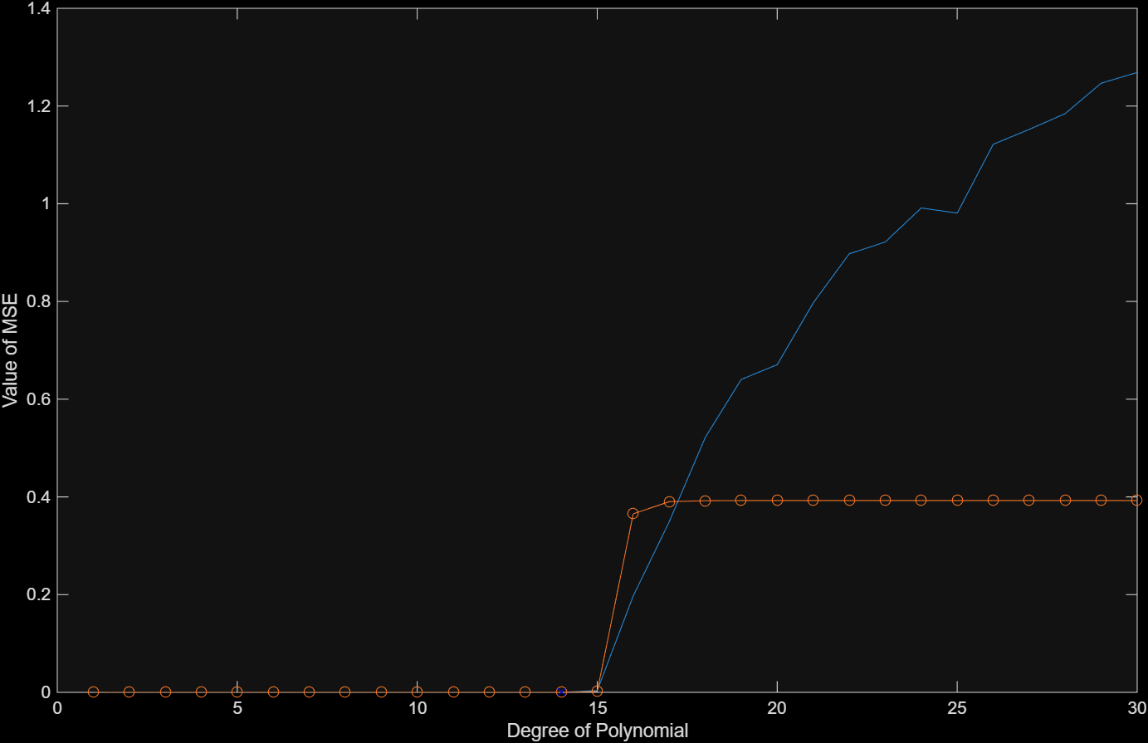

Mean Squared Error
$$MSE=\frac{1}{n}\sum{{(Y_{i}−{\hat{Y}}_{i})}^{2}}$$
The Mathematical formula for MSE
The MSE represents the measure of how close a model’s predictions are to the actual values.
Our plot of the MSEs: the MSE of “id” and the MSE of “val”

Slide 7
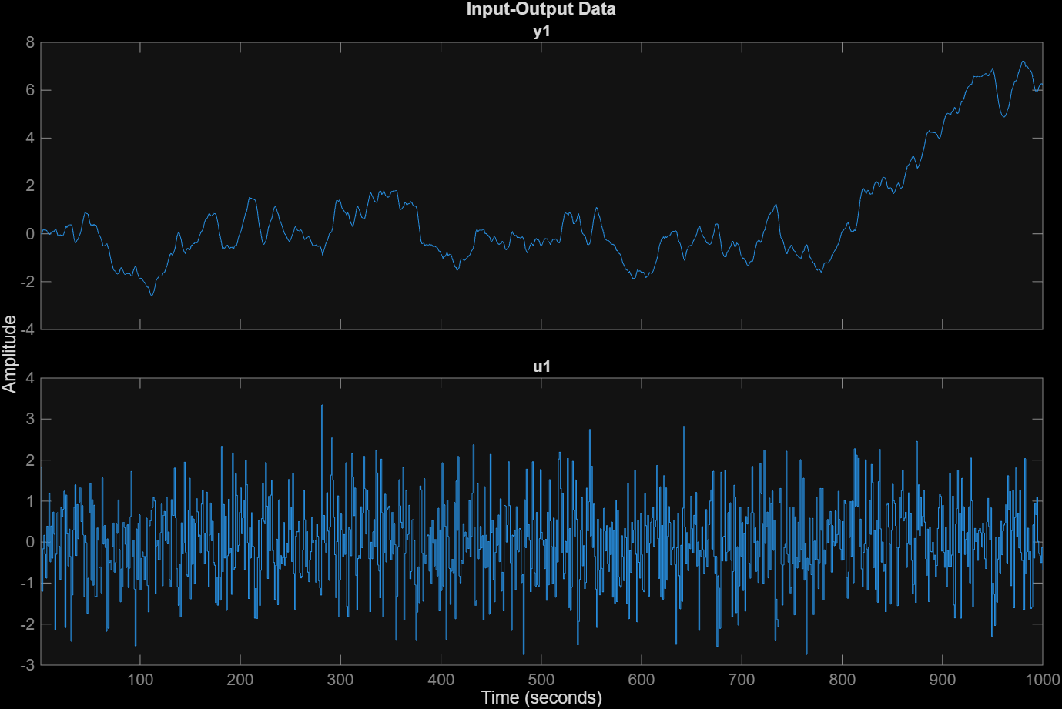
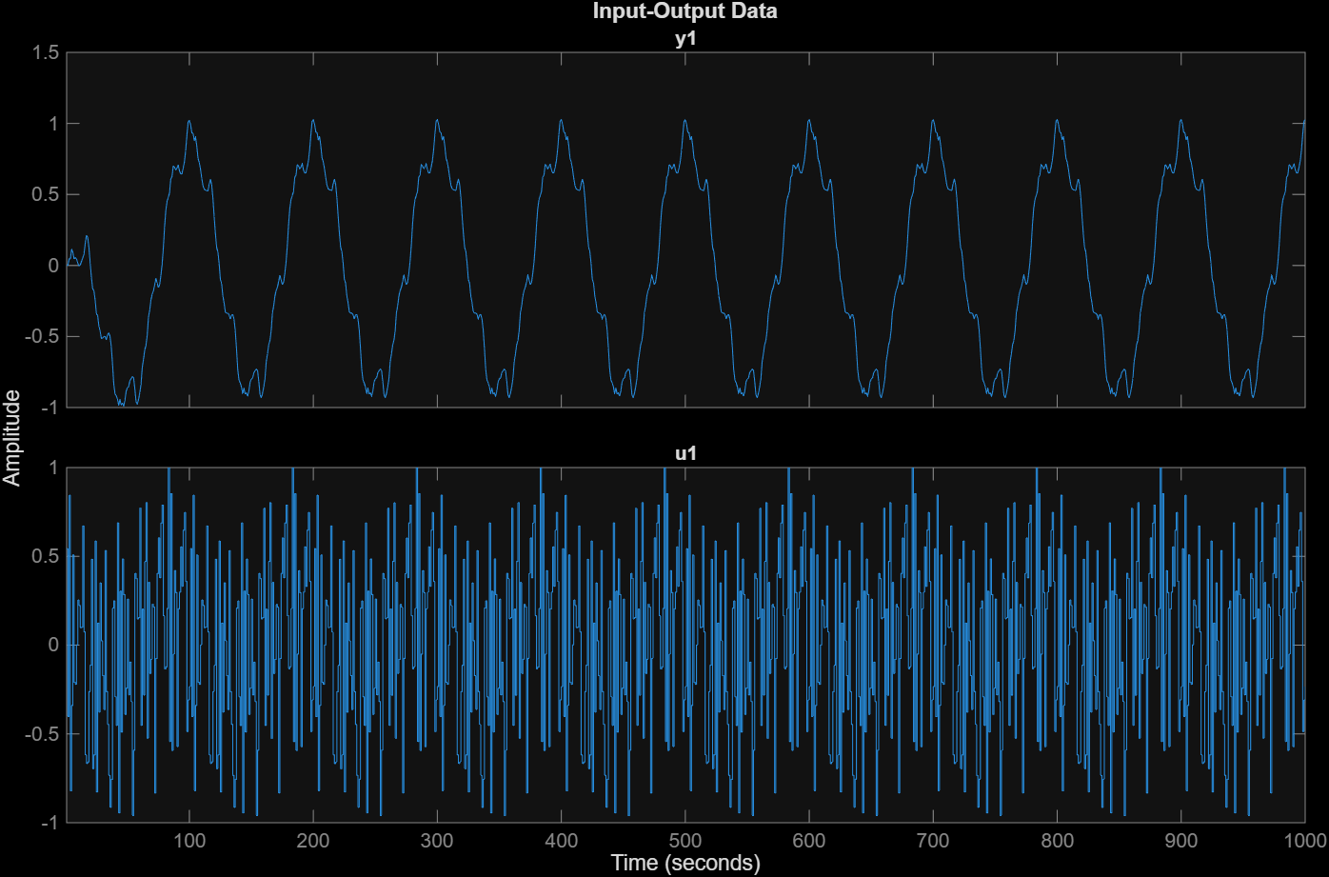
The ID and VAL plots
ID
VAL

Slide 8
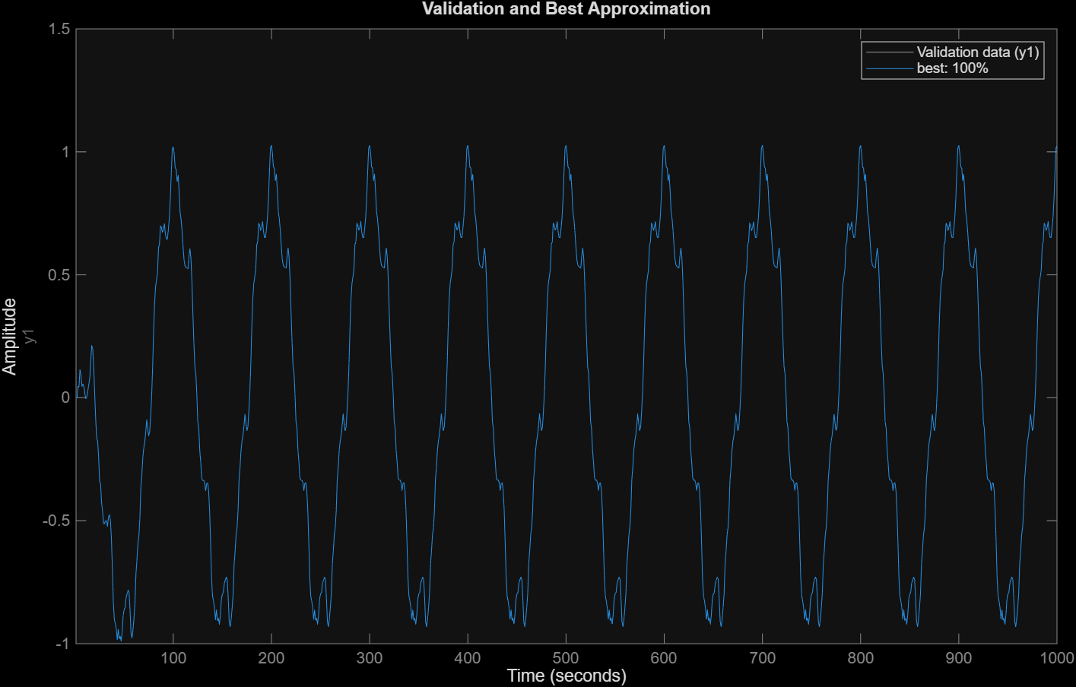
The Best Approximation
As you can see on the plot, here is the comparison between the validation and the best model obtained by us which is at the degree 14 of the polynomial.

Slide 9
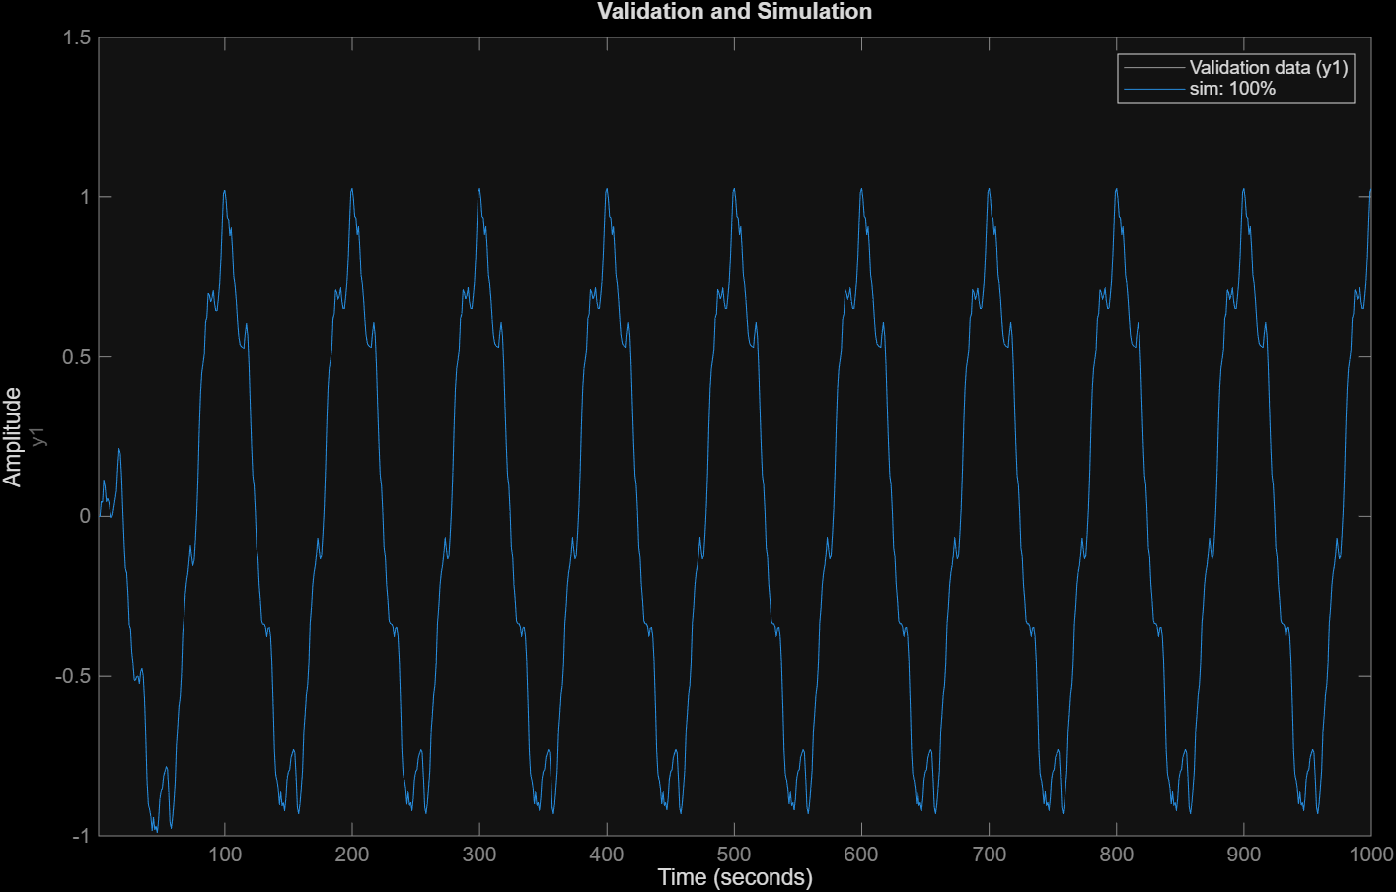
The Simulation vs Validation plot

Slide 10
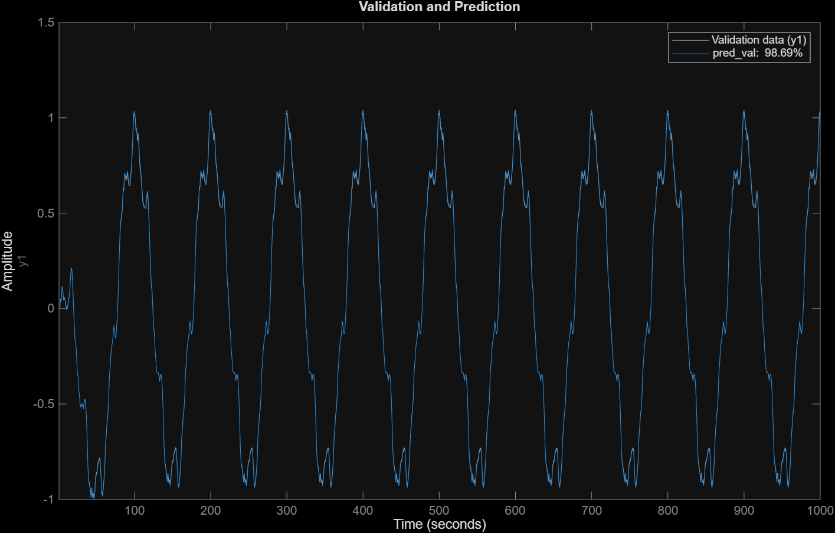
The Prediction vs Validation plot

Slide 11
Discussions points
We chose the optimal degree of the polynomial by looking for the minimum value of the MSE.
The model was performing alright on the identification data and it performed almost perfectly on the validation data, having an error of only 6.71e-19.
We observe overfitting of the data after degree 15.

Slide 12
Overall conclusion
A polynomial nonlinear ARX model was successfully identified to approximate the unknown system using input–output data.
The model captured nonlinear dynamics while remaining linear in the parameters, allowing efficient estimation via least squares.
Validation results showed good prediction and simulation performance, confirming the suitability of the nonlinear ARX approach for black-box system identification.

Slide 13
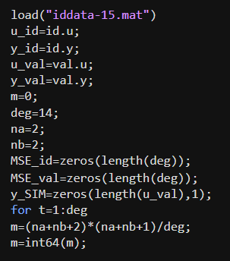
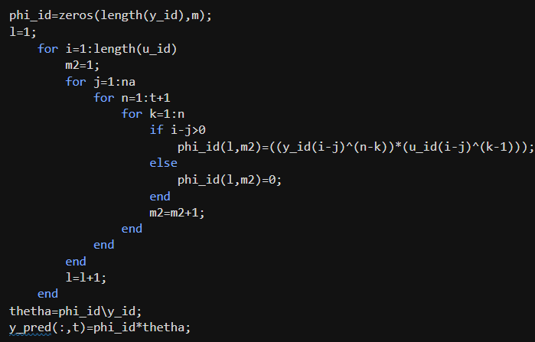
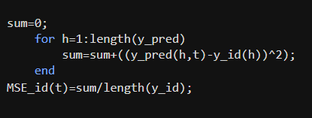

Slide 14
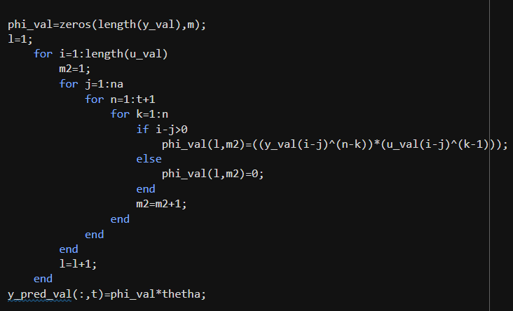
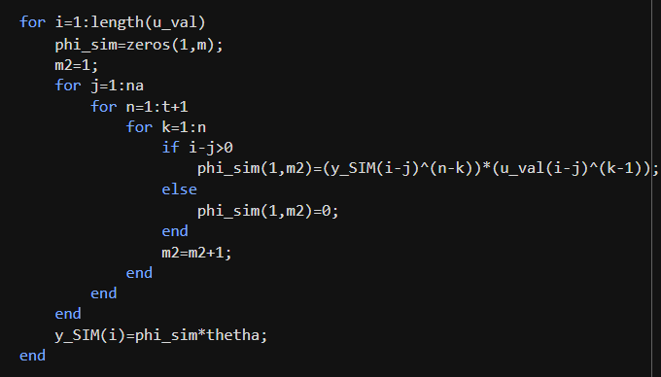
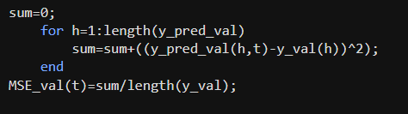

Slide 15
