Slide 1
CryoDrill: Near-Data Processing in Deep and Cold Storage Hierarchies
Marcus Paradies, German Aerospace Center (DLR)
01/15/2019, CIDR

Slide 2



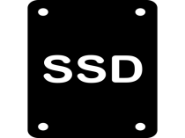





The Storage Hierarchy and Its (Current) Coverage in DB Research
DNA
Tape
Disk
Flash
Memory
LLC
Offline/ Nearline
Nearline/ Offline
Online

Slide 3


Slide 4
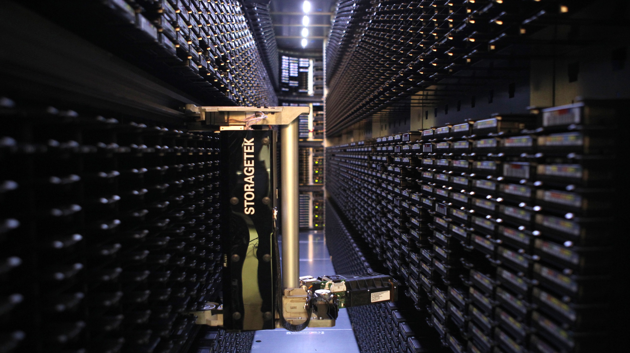
Active Data Archives for Scientific Data

Slide 5
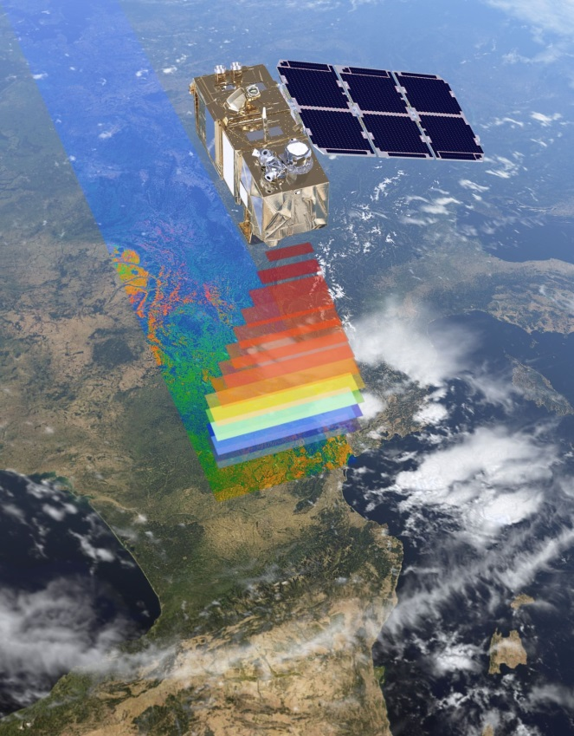
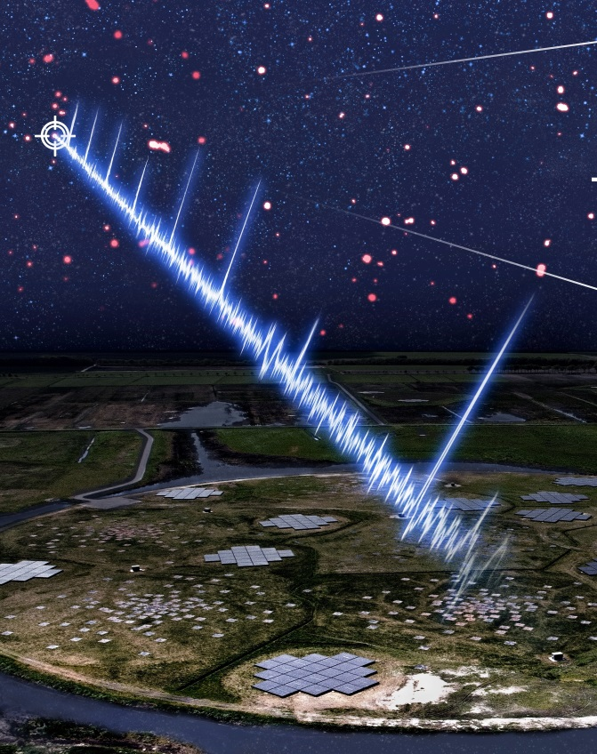
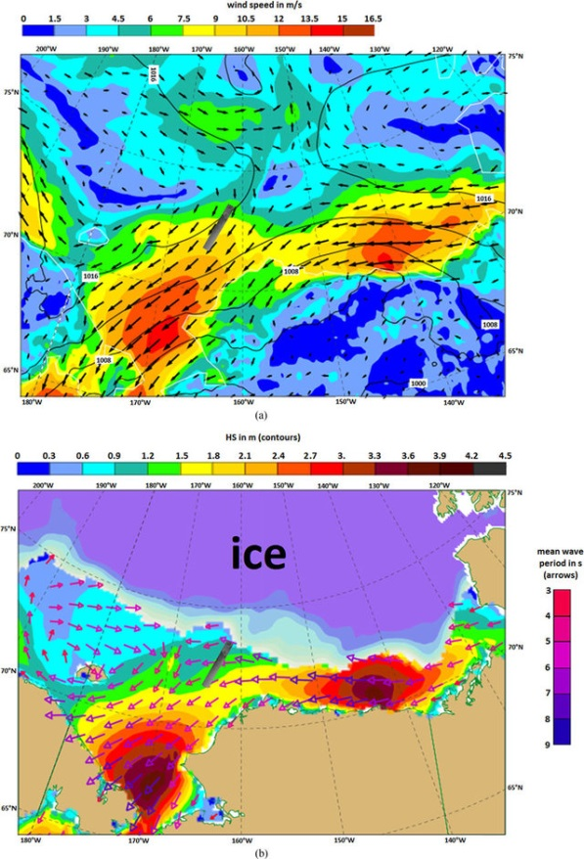
Scientific Application Domains
Earth Observation
Radio Astronomy
Weather Forecasting
Archive: 14 PB
Disk Cache: 175 TB
Archive: 50 PB
Disk Cache: 750 TB
Archive: 100 PB
Disk Cache: 1.34 PB

Slide 6





Data Movement as Major Performance Bottleneck
Active data archives (and their catalogs) are like Amazon, but just for data.
No SLAs on access latency, usually between minutes and hours
Tail latency can be multiple days
Historic data analysis can easily request 100s of TB
…
Compute Facilities
Disk Cache N
Disk Cache 1
Data Archive

Slide 7

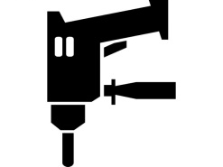



CryoDrill---Near-Data Processing for Cold Storage
Focus on nearline storage (archival disks, tape)
I‘d like to encourage everyone to not forget the nearline storage layer! It‘s not considered a sexy research topic, but it has a high potential impact and is fun to work on!
Consider all NDP opportunities (in-network, in-storage)
Push data reduction ops down the storage hierarchy

