Slide 1
Plasma Diagnostic Techniques Lecture 2: Optical Emission Spectroscopy
Deborah O’Connell
York Plasma Institute

Slide 2
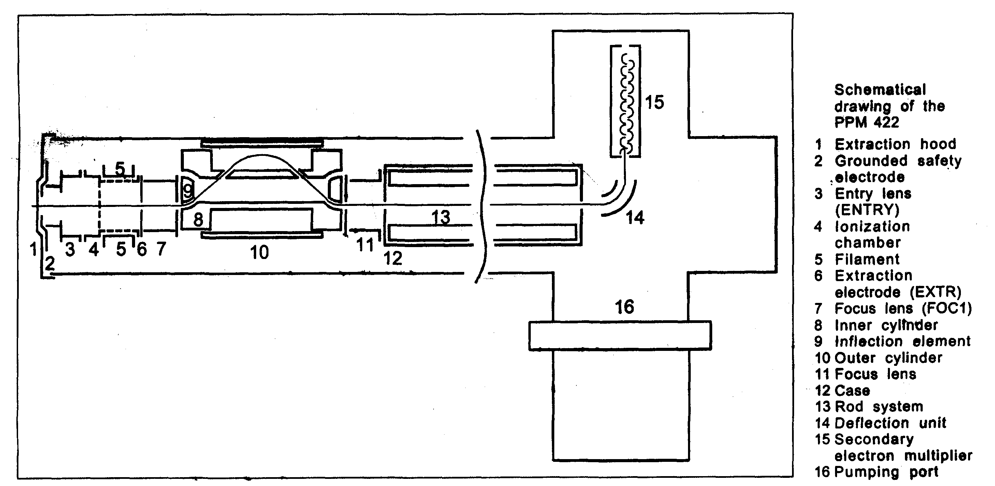
Mass spectrometry
Mass spectrometry
neutral particles and ions
energy distribution functions
non-intrusive
direct
complicated in detail
external measurement
reactive gases

Slide 3
Mass spectrometry
Example: Capacitively coupled plasma - dual frequency
Mass resolved ion energy distribution functions

Slide 4
How do we measure plasma quantities?
Optical diagnostics
in principle all plasma parameters
non-intrusive
high temporal and spatial resolution
Plasma physics
Optical diagnostics
Atomic & molecular physics

Slide 5
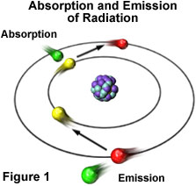
Optical diagnostics
Emission spectroscopy
passive
simple
robust
indirect
model based
data needed
Laser spectroscopy
direct
highly reliable
active
involving
expensive
⇒ Combination of passive and active methods

Slide 6
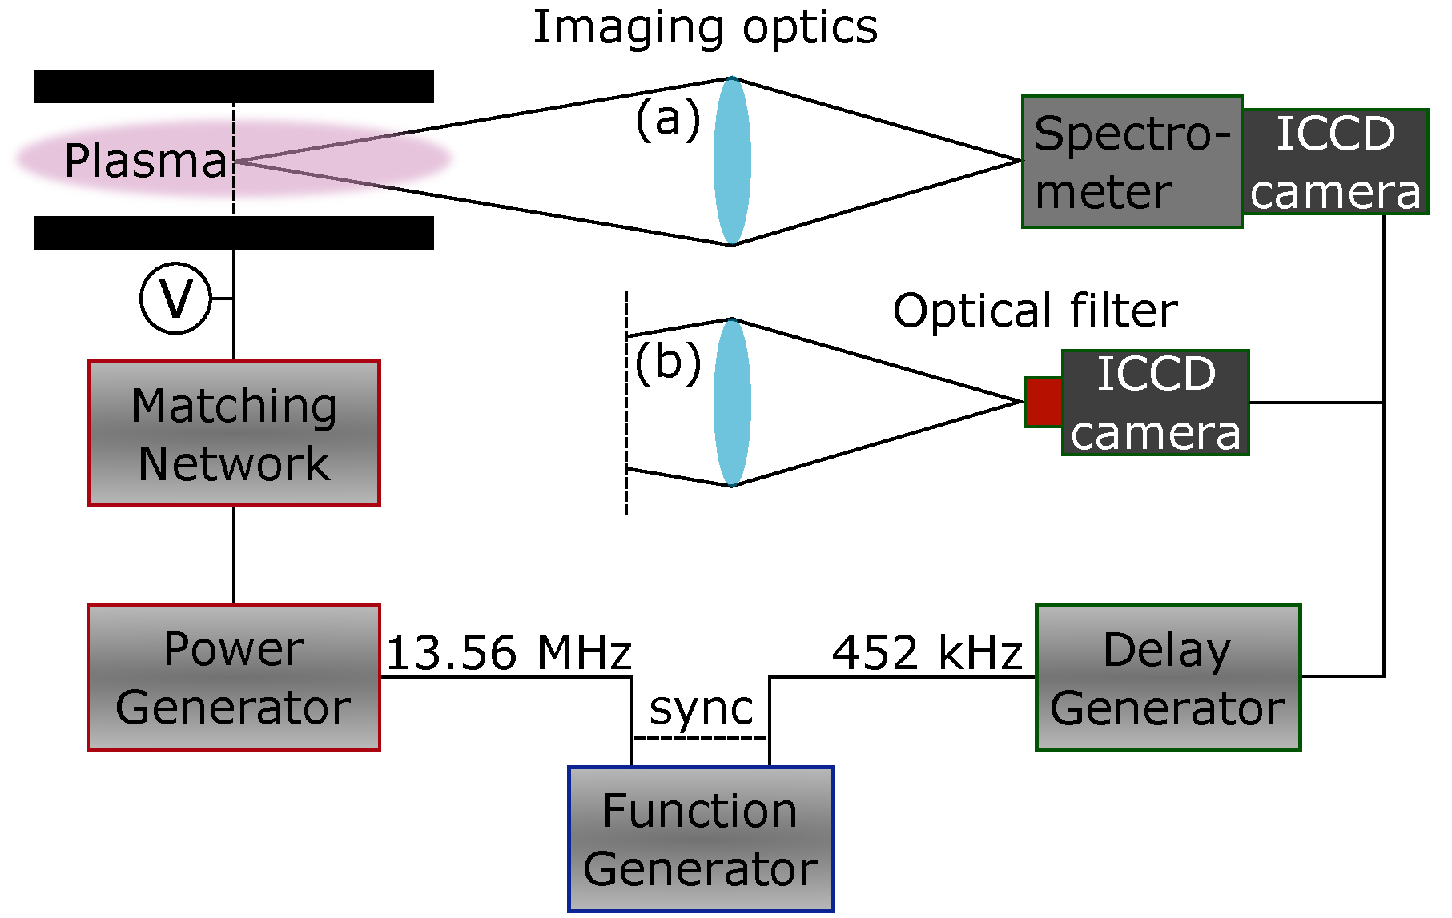
Typical optical emission set-up
Plasma / light source
Imaging
Wavelength discrimination
Detector

Slide 7
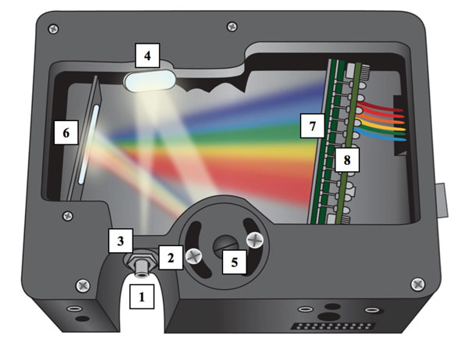
Optical spectrometer

Slide 8
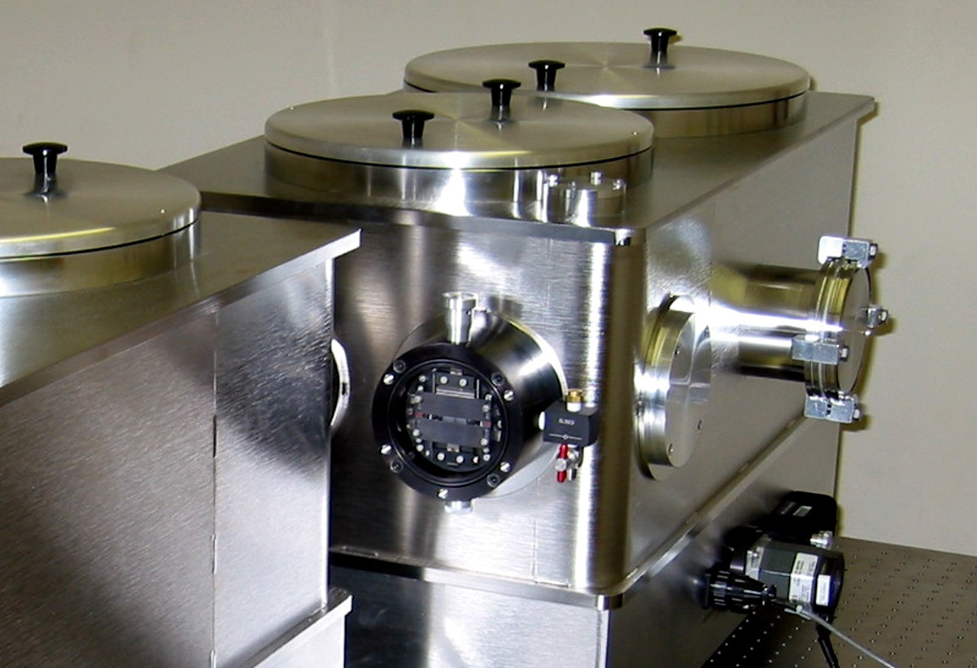
Vacuum spectrometer

Slide 9
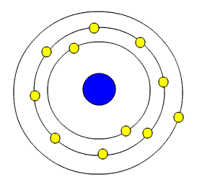
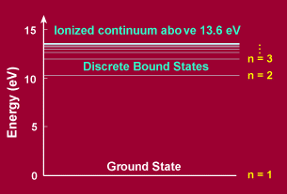
The Bohr Model of the Atom
Electrons in atoms and molecules can also be raised to higher energy states – electronically excited states
Nucleus
electrons
Electrons can only be in specific orbits around the central nucleus
These orbits have discrete energy states

