Slide 1
Plasma Diagnostic Techniques Optical Emission Spectroscopy Lecture 6
Deborah O’Connell
York Plasma Institute

Slide 2
Optical transitions: Spontaneous emission
Spontaneous emission
The discrete (line emission) energy E_{ik} of the corresponding photon is directly related to the frequency ν_{ik} (wavelength λ_{ik}) of the emitted photon.
The number of emitted photons per unit volume and time:
is given by the product of the Einstein coefficient A_{ik} and the population density n_{i} in level i.
The Einstein coefficient A_{ik} describes the statistical (quantum-mechanics) optical transition probability for photon emission from a higher energy level i to a lower energy level k.

Slide 3
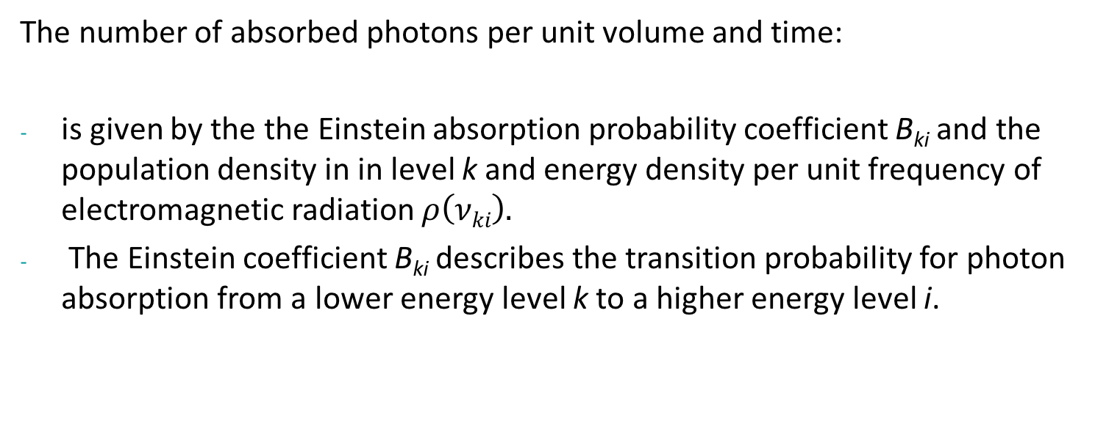
Optical transitions: Photon absorption
Photon absorption
The discrete (line emission) energy E_{ik} of the corresponding photon is directly related to the frequency ν_{ik} (wavelength λ_{ik}) of the emitted photon.
The number of absorbed photons per unit volume and time:
is given by the the Einstein absorption probability coefficient B_{ki} and the population density in in level k and energy density per unit frequency of electromagnetic radiation $ρ\left(νki\right).$
The Einstein coefficient B_{ki} describes the transition probability for photon absorption from a lower energy level k to a higher energy level i.

Slide 4
Optical transitions: Stimulated emission
Stimulated emission
The discrete (line emission) energy E_{ik} of the corresponding photon is directly related to the frequency ν_{ik} (wavelength λ_{ik}) of the emitted photon.
The number of emitted photons per unit volume and time:
The Einstein coefficient B_{ik} describes the transition probability for photon transition induced by stimulated emission from a higher energy level i to a lower energy level k.

Slide 5
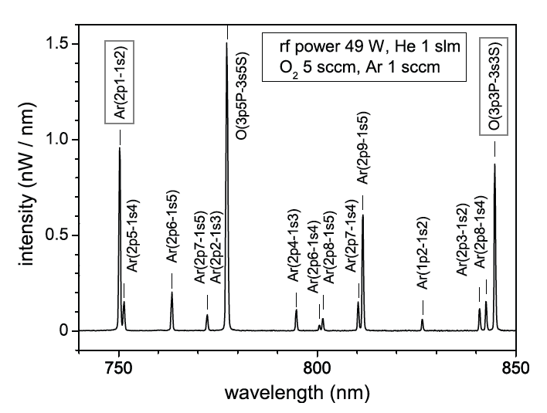
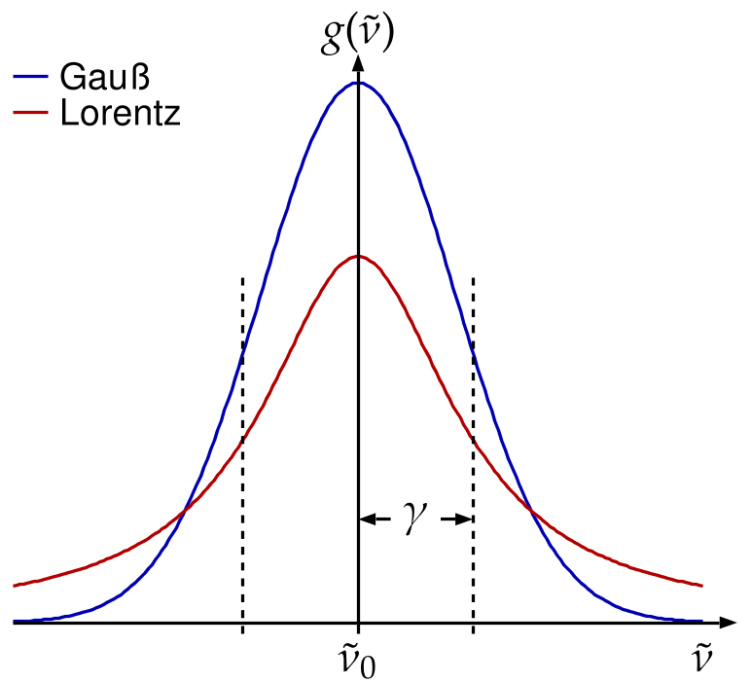
Spectral line profiles - motivation
So far we have been focussing on various plasma equilibrium models to analyse intensities of line emission from molecules, atoms or ions.
With high-resolution spectrometers it is also possible to resolve and analyse the shape of emission (absorption) lines.
This shape is influenced by various mechanisms and can contain very valuable information about plasma parameters, e.g. temperatures, densities, field strengths, etc.

Slide 6
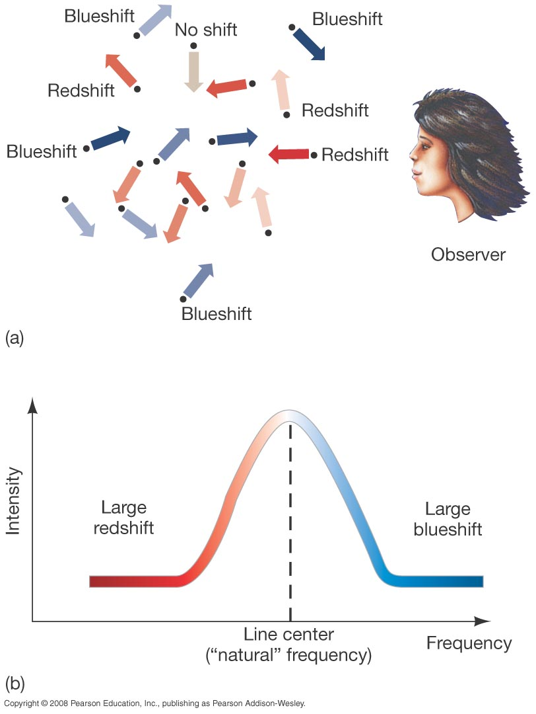

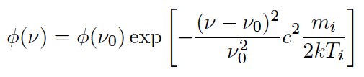
Line profiles – Doppler broadening
Thermal motion of the emitting particles along the direction of the observer causes Doppler shifts:
For a Maxwellian velocity distribution function the spectral line shape of the photon flux Φ is given by a Gaussian profile:

Slide 7
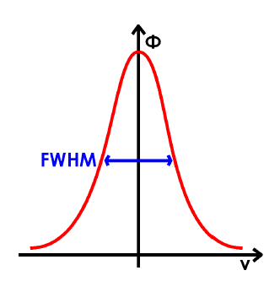
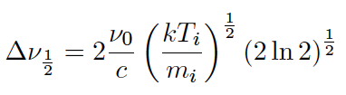
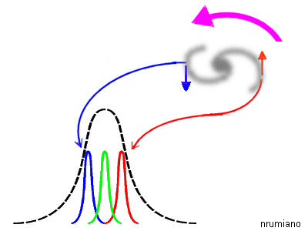
Line profiles – Doppler broadening
The full width at half maximum (FWHM) is given by:
This is a frequently used technique for temperature measurements.
Non-isotropic shifts are very important in astrophysics to determine the movement of objects.

Slide 8
Line profiles – energy, frequency, wavelength
Energy spread in quantum states corresponds to frequency and wavelengths spread in line profiles:
Be careful with the inverse correlation between frequency and wavelength! – non-linear

Slide 9
Line profiles – natural broadening
Heisenberg’s uncertainty principle:
Natural lifetime of an excited state corresponds to a minimum energy uncertainty and associated line broadening.

Slide 10
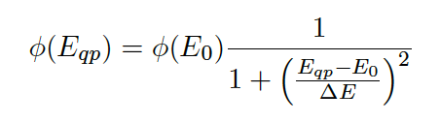
Line profiles – natural broadening
The spectral line shape of the photon flux Φ in terms of energy is given by a Lorentzian profile around the energy E₀ at the line centre:
ΔE gives the width of the curve.
Natural line broadening is typically the smallest broadening effect.

Slide 11
Line profiles – pressure broadening
Collision induced pressure broadening is similar to natural broadening and occurs due to a collision induced reduction of the effective lifetime.
k_{q} : quenching coefficient with species Q
n_{q} : density of species Q

Slide 12
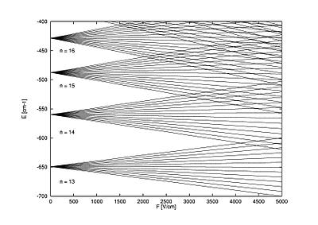
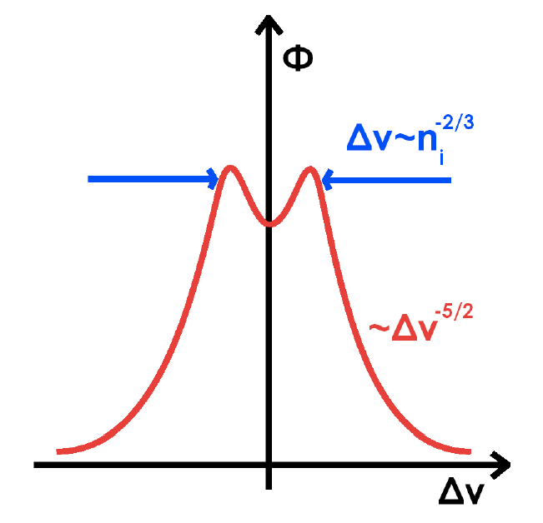
Line profiles – Stark broadening
Broadening can also be caused by electric microfields due to nearby ions.
These microfields shift the quantum energy states by the Stark effect.
The scaling of the effect on the spectral line profile is complex and non-monotonic – example see figure.
It is an active research field and an often employed diagnostics for E-field and plasma density measurements.
Similarly, broadening caused by the Zeeman effect is used for B-field measurements.

Slide 13
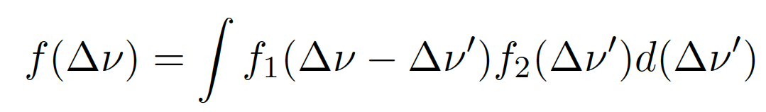
Combination of broadening effects
Diagnostics based on line broadening can be very powerful, but different broadening effects typically contribute simultaneously.
This requires a careful judgement of the investigated regime and appropriate de-convolution techniques.
The convolution of different effects is generally iteratively given by:

Slide 14
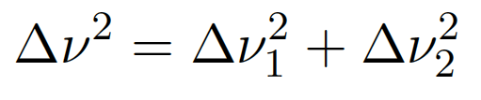
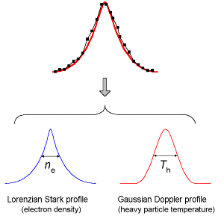
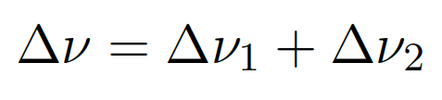
De-convolution of broadening effects
The experimental profile of the spectrometer system can play a very important part in the overall profile.
Simple cases are combinations of Gaussian profiles only or Lorentzian profiles only:
(Gaussian profiles)
(Lorentzian profiles)
More typical are combinations of both in so called Voigt profiles. Extensive data bases exist for their analysis – see example in figure.

Slide 15
Electromagnetic waves in plasmas
York Plasma Institute

Slide 16
Radiative transfer

Slide 17
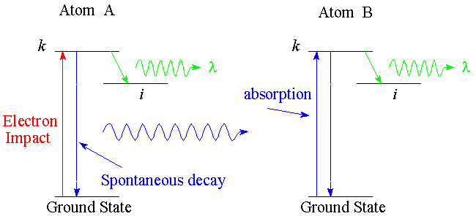
Radiative transfer: example
Reabsorption of emitted radiation can play an important part in radiative transfer – see illustration.
An emitted photon is reabsorbed by a neighbouring atom and subsequently gets a ‘second chance’ to emit radiation through the same or a different transition.

Slide 18
Radiative transfer: example
Reabsorption can be included in the effective decay rate of excited states.
Optically thin: g_{ik}=1
Optically thick: g_{ik}=0

Slide 19
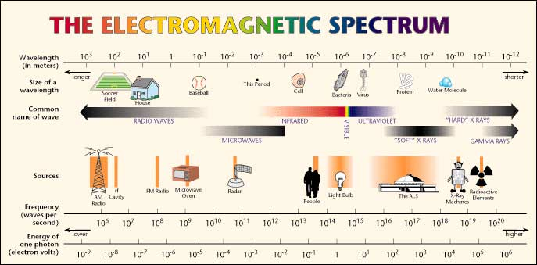
The electromagnetic spectrum
http://en.wikibooks.org/wiki/Communication_Systems/Wave_Propagation

