Slide 1
Large Language Model Enabled Wargame Analysis
MAJ Marcus Boswell
Maj Dylan Kowal CPT Brad Dinkel
ENS Kelly Bye
Notes:
POC Slide
Brad: Intro, BLUF, Problem Statement
Marcus: Scope and Workflow
Kelly: Text Recognition and OCR
Dylan: Metadata and Chunking
Marcus: Query to Question

Slide 2
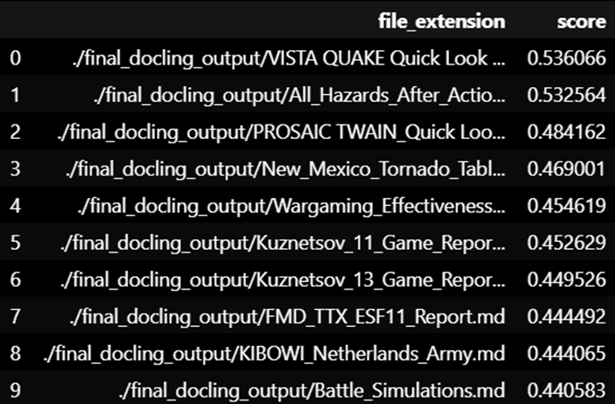
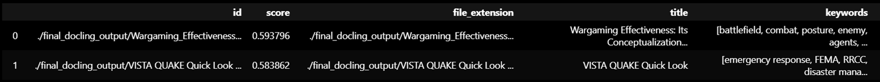
Bottom Line Up Front
Stakeholder Question – What are the lessons learned from wargames related to Pacific readiness?
Query – Pacific Readiness
Filter – INDOPACOM
Result
Top 10 Reports identified
Top 25 Chunks identified
Notes
Manual metadata sourcing took 40+ man-hours, Program takes 5 hours
Validated on JWICS
Local and API based LLM's used for thorough front-end processing
Simple NLP techniques used for similarity scores
Filterable database

Slide 3
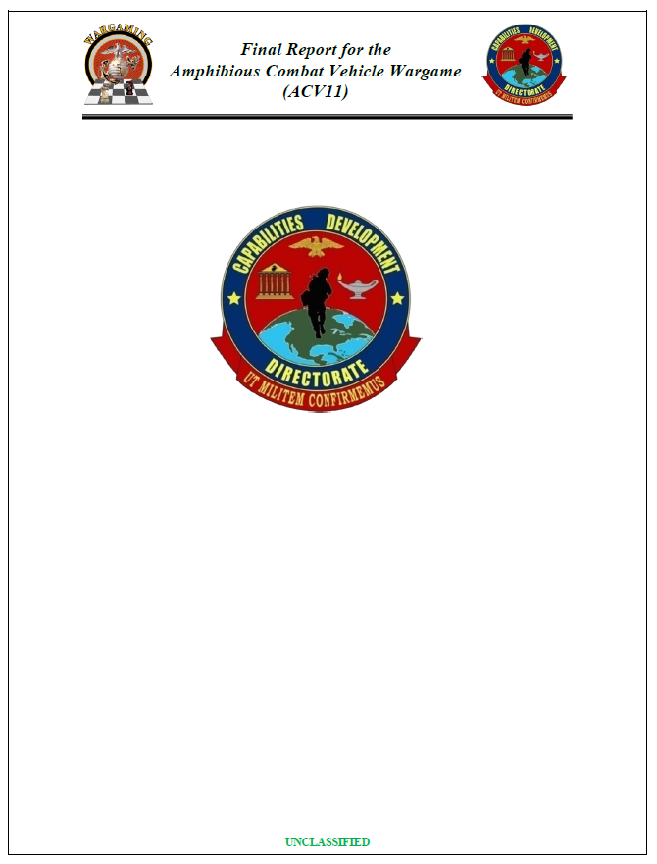
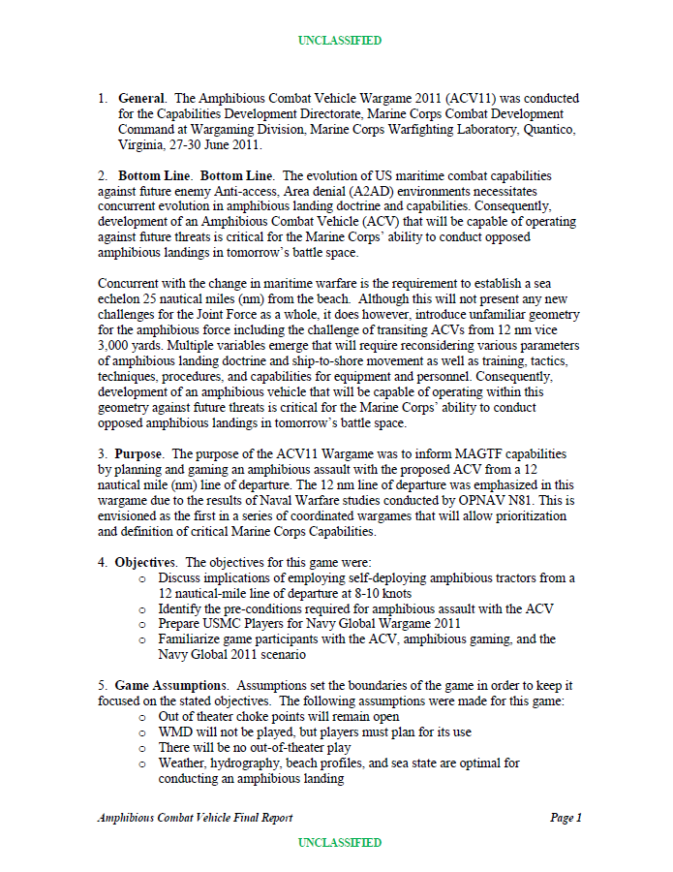
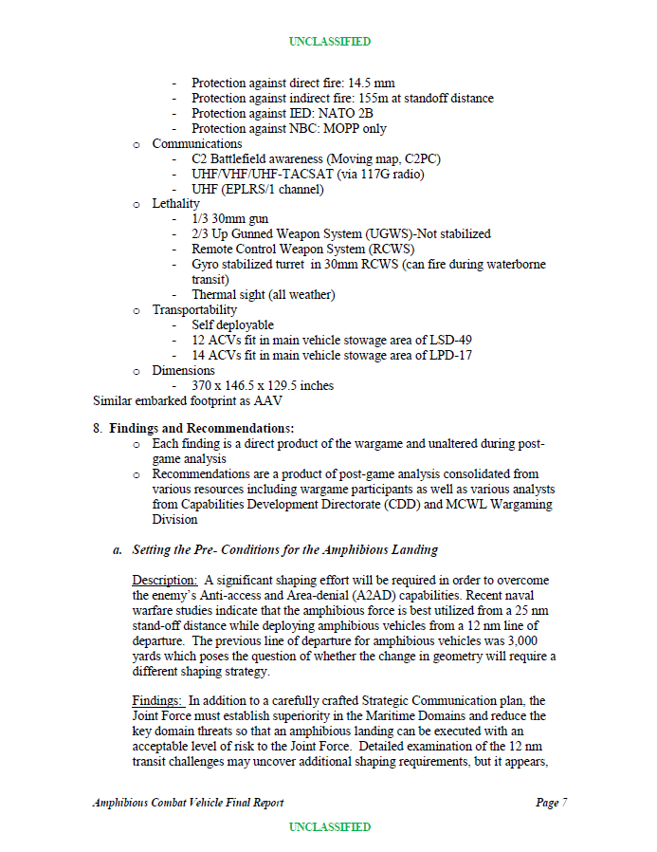
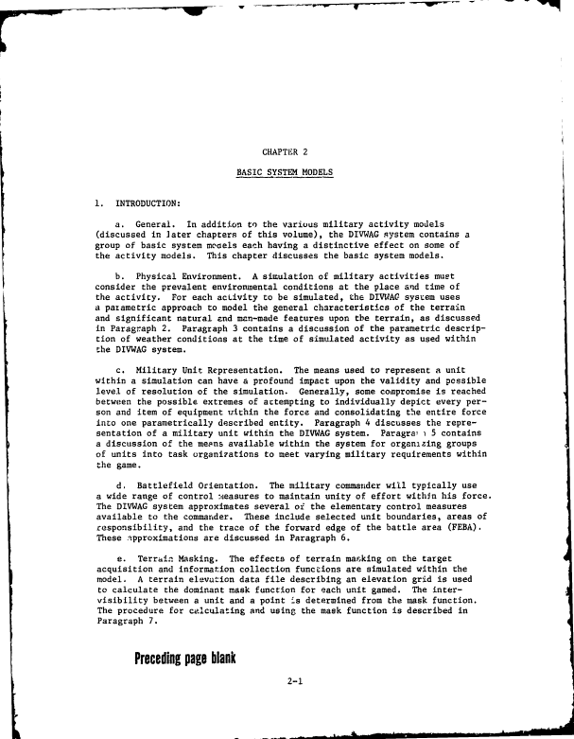
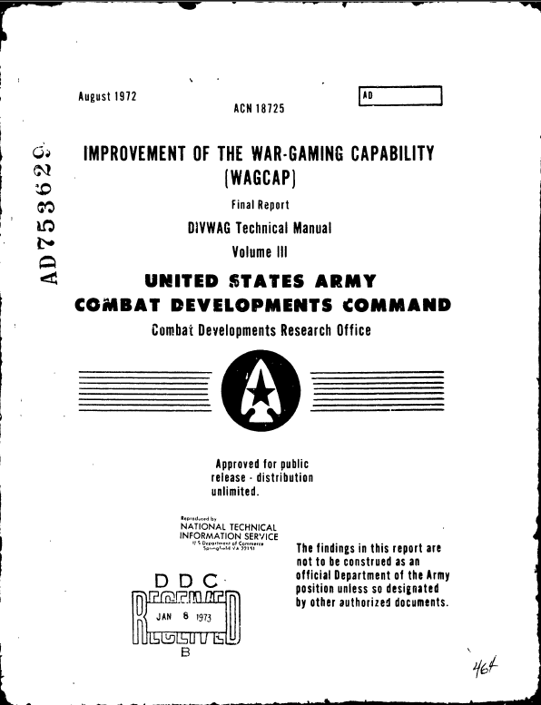
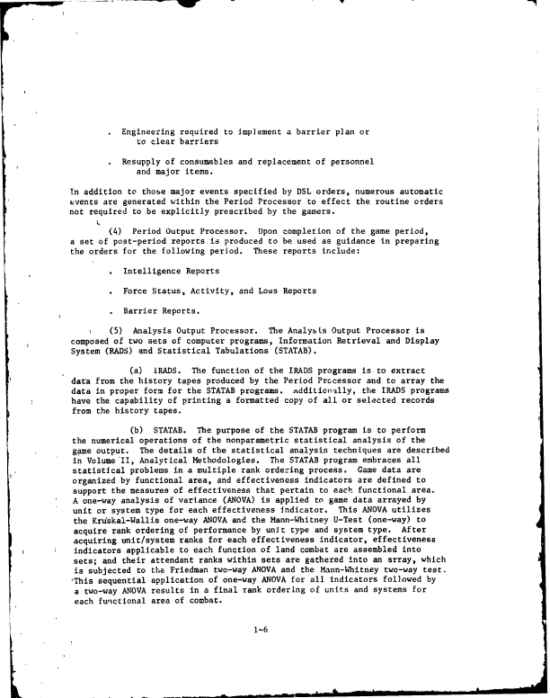
Problem Statement
Where it Starts
Data set: 3000+ Documents (40-50 added each year)
Range: 1950's – Present
Scope: All domains covered with multiple organizations
Result
Titles: 10 Relevant Documents
Chunks: Relevant Sections
Summary: An answer (future work)
Query
REPORT

Slide 4
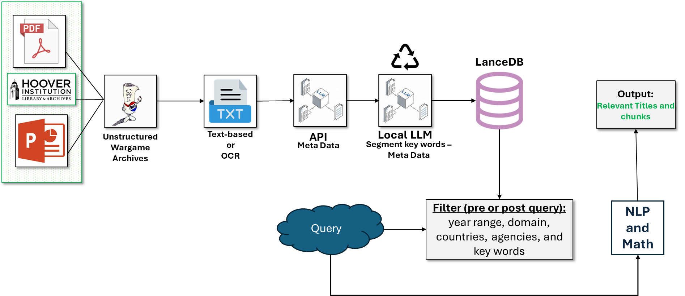
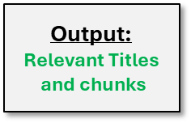
Our Scope and the workflow
Package 1
Package 1
Stopping point
Package 2
Starting point
Notes:
DPs
Project Phase line
Stopping point
Phases
Database Creation
Querry Database
Querry goes to LLM
Deployment
Vertical Dash Line in TXT. Current Status Line
Kelly’s Code:
Call the API
Update the lance database schema, scrub the
Brad, Call a directory and work through the subfolder
Get the extension from the main directory from PDF
Find anything with .pdf and the location
Key term calls from the chunks

Slide 5
Text Recognition and OCR
Package 1
Package 1
Stopping point
Package 2
Starting point
Notes:
DPs
Project Phase line
Stopping point
Phases
Database Creation
Querry Database
Querry goes to LLM
Deployment
Vertical Dash Line in TXT. Current Status Line
Kelly’s Code:
Call the API
Update the lance database schema, scrub the
Brad, Call a directory and work through the subfolder
Get the extension from the main directory from PDF
Find anything with .pdf and the location
Key term calls from the chunks

Slide 6
Our Scope and the workflow
Package 1
Package 1
Stopping point
Package 2
Starting point
Notes:
First we processed wargame pdfs using pdf processing software

Slide 7
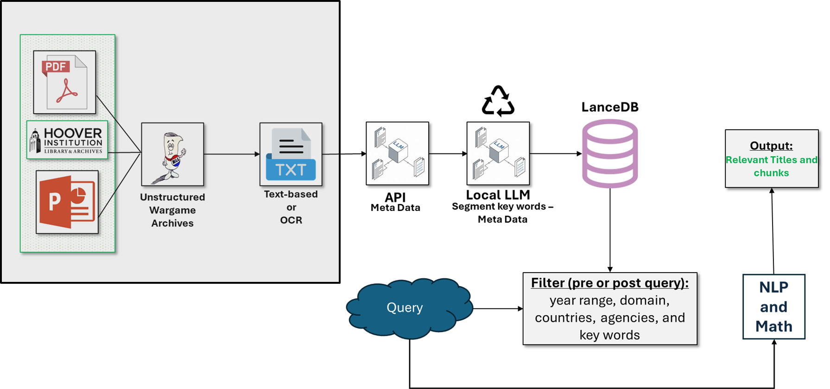
Text Recognition and OCR
Key Takeaways:
Processing works best on text-based PDFs
OCR does not capture old documents well
Constraints and Limitations
Limited to OCR tools available on JWICS
Time
~1 hour on HPC vs 12+ hours off HPC
Recommendations:
Build algorithm to detect and clean poor OCRs to reduce LLM API calls that fail.
Time intensive, parallelize as much as possible.
Notes:
To input these docs into the LLM, we had to process the PDFs using text recognition and optical character recognition. In this case, we used docling, but there are many OCRs available.
Overall we found that docling works well, except for old documents that are image-based. OCR often breaks up words, inserts special characters, or misses key letters in a word as seen in the example on the next slide.

Slide 8
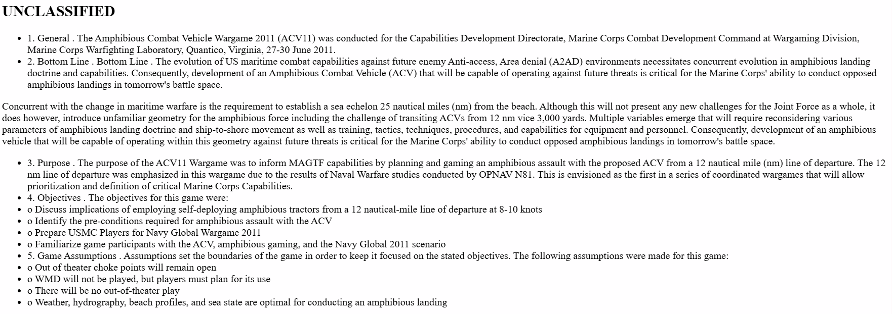

Key Takeaway Break-Out
Input Docs.
Good Example
Text Chunks
Input Docs.
Bad Example
Text Chunks
Notes:
In the green box, we see a good example of PDF parsing for a text-based PDF. Notice that there are no highlighted words in the text chunks box
In the red box, we see a bad example of PDF parsing for an old, image-based PDF. On the right, we’ve highlighted several words. In white In White, we see where The text chunking worked
In Green, we see text that is recoverable through association or a list of pre-defined words
In Yellow we see text is confusing or may not be recoverable
Do we have any sense of what number of documents are good vs. bad? Percent of good docs. ?

Slide 9
Text Recognition and OCR
Key Takeaways:
Processing works best on text-based PDFs
OCR does not capture old documents well
Constraints and Limitations
Limited to OCR tools available on JWICS
Time
~1 hour on HPC vs 12+ hours off HPC
Recommendations:
Build algorithm to detect and clean poor OCRs to reduce LLM API calls that fail.
Time intensive, parallelize as much as possible.
Notes:
I was able to implement this off of JWICS, but for sponsor implementation on JWICS, there is more infrastructure to build to be able to use docling
Additionally, processing the PDFs takes around an hour for each document. If running parallel on local machine, this takes over 12 hours.
If running parallel on a high performance computer, takes just over an hour.
To improve on this parsing pipeline, we recommend
Building an algorithm to detect and clean these green and yellow chunks
And parallelizing this process as much as possible

Slide 10
Metadata and Chunking
Package 1
Package 1
Stopping point
Package 2
Starting point
Notes:
DPs
Project Phase line
Stopping point
Phases
Database Creation
Querry Database
Querry goes to LLM
Deployment
Vertical Dash Line in TXT. Current Status Line
Kelly’s Code:
Call the API
Update the lance database schema, scrub the
Brad, Call a directory and work through the subfolder
Get the extension from the main directory from PDF
Find anything with .pdf and the location
Key term calls from the chunks

Slide 11
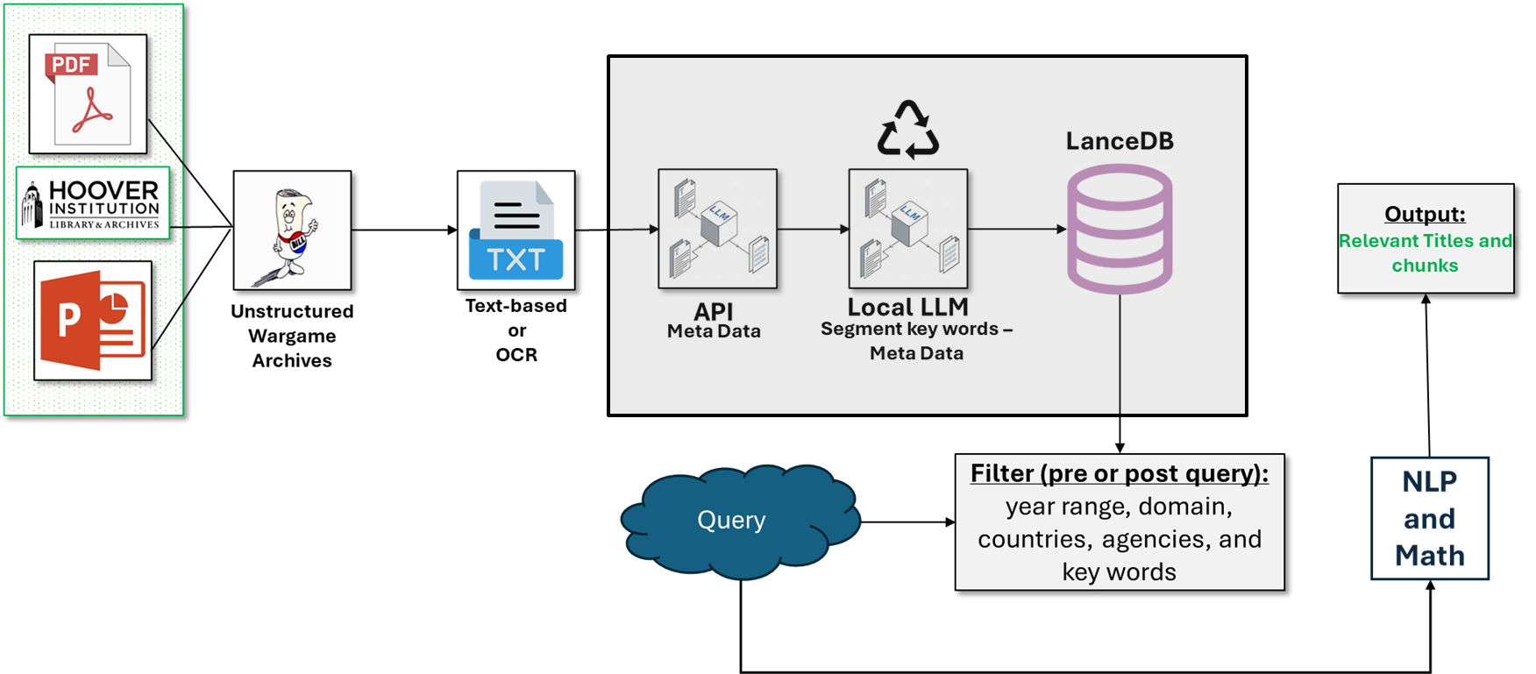
Metadata and Chunking
Key Takeaways:
The metadata captured in the database can be adjusted to fit the key categories based upon end user desires.
Older scanned documents, with poor OCR results tend to fail when retrieving metadata via LLM API calls.
Build out “other” categories when you are restricting allowed outputs from LLMs to decrease number of failure API calls.
Constraints and Limitations
Limited to available LLMs and embedding models available on JWICS.
Limited API calls to large LLM (>70b parameters).
16GB CPU to host embedding model and small LLMs (< 10b parameters).
Recommendations:
Build algorithm to detect and clean poor OCRs to reduce LLM API calls that fail.
Time intensive, parallelize as much as possible.
Notes:
Common errors include TRADOC being put in as a COCOM, PACOM being put in instead of INDOPACOM, some are easy to fix and others are hard to capture.

Slide 12
Metadata and Chunking
Outer Loop
Body of Documents
Lance Database Schema
{'file_extension': './final_docling_output/(U)_ACV11_Final_Report.md’,
'title': 'Final Report for the Amphibious Combat Vehicle Wargame (ACV11)’,
'date of publication': datetime.date(2011, 6, 30),
'domain': array(['Maritime', 'Land'], dtype=object),
'agency': array(['US Marine Corps', 'US Navy'], dtype=object),
'COCOM': array(['PACOM'], dtype=object),
'country': array(['United States'], dtype=object),
'category': 'capability’,
'purpose': 'The purpose of the ACV11 Wargame was to inform MAGTF capabilities by planning and gaming an amphibious assault with the proposed ACV from a 12 nautical mile (nm) line of departure. ‘,
'key words': array(['purpose', 'objectives', 'game assumptions', 'concept', 'gameplay', 'design', 'development', 'planning', 'strategy', 'implementation'], dtype=object)}
API
Inner Loop
Chunks
Lance Database Schema
Local LLM

Slide 13
Query – Answer
Package 1
Package 1
Stopping point
Current Status
Package 2
Starting point
Notes:
DPs
Project Phase line
Stopping point
Phases
Database Creation
Querry Database
Querry goes to LLM
Deployment
Vertical Dash Line in TXT. Current Status Line
Kelly’s Code:
Call the API
Update the lance database schema, scrub the
Brad, Call a directory and work through the subfolder
Get the extension from the main directory from PDF
Find anything with .pdf and the location
Key term calls from the chunks

Slide 14
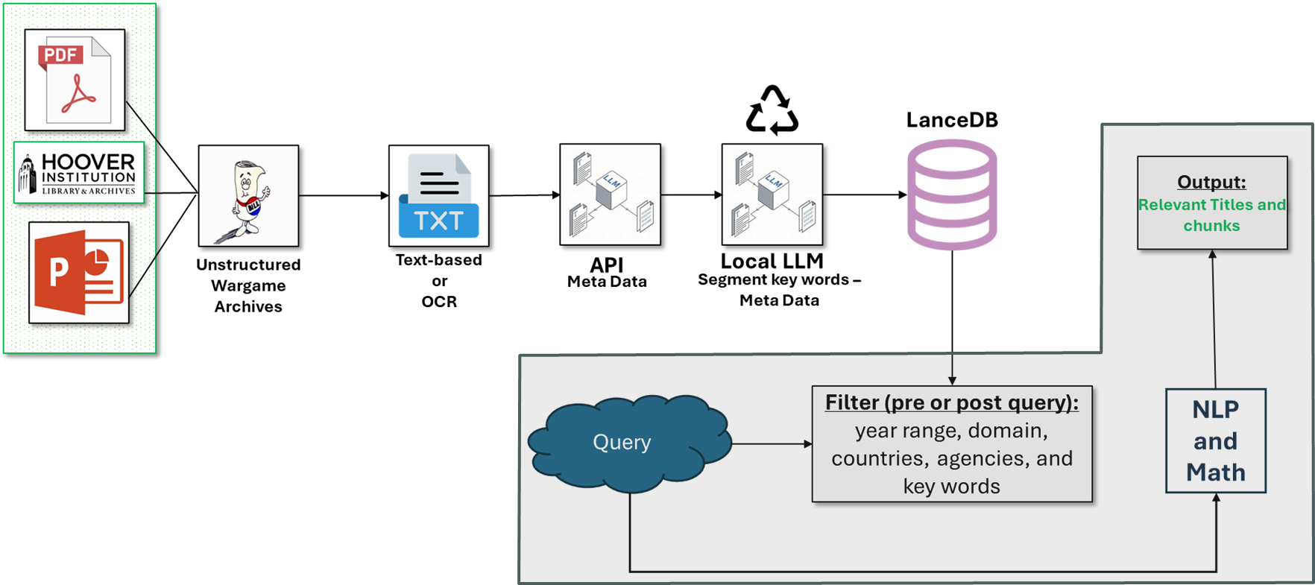
Query – Answer Methodology
Key Takeaways:
The top chunk does not always relate to the top document.
Scores are relative to each dataset and don’t have an absolute meaning
Keyword filter does not replace accurate keywords in query.
Database filter is a conjunctive (AND) between fields and
a disjunctive (OR) inside of a field. (Process OR CONOP) AND (USA OR Russia).
Constraints and Limitations
User Base: Wargaming team with coding proficiency
Cosine similarity will not be as accurate as an LLM but is faster.
Recommendations:
Front end streamlit app is helpful but comes with risks.
Explore different methods of scoring and ranking chunks
LLM (TGI) will be necessary for generating actual answers or summaries.
Retrieval-Augmentation-Generation (RAG) can be implemented with the top 10 documents to generate high quality summaries and search for patterns (strategic strengths and weaknesses) among the documents.

Slide 15
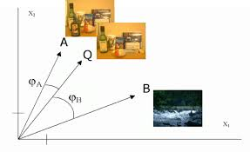

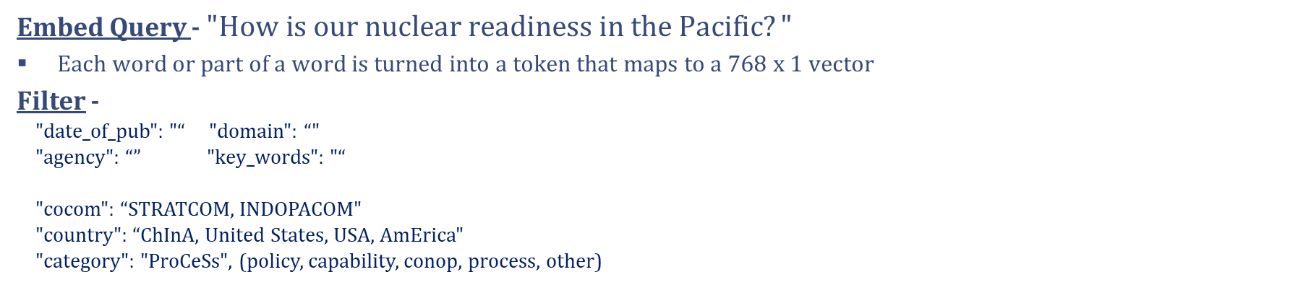
Query – Answer Methodology
Embed Query - $"How is our nuclear readiness in the Pacific?"$
Each word or part of a word is turned into a token that maps to a 768 x 1 vector
Filter -
"date_of_pub": "“ "domain": “"
"agency": “” "key_words": "“
"cocom": “STRATCOM, INDOPACOM"
"country": “ChInA, United States, USA, AmErica"
"category": "ProCeSs", (policy, capability, conop, process, other)
Score
Output
Chunk
Document
Chunk
Document
Top Chunk | Score
Wargaming_Effectiveness | 0.583862
Top Document | Avg Score
VISTA QUAKE Quick | 0.536066

Slide 16
Query – Answer Methodology
Key Takeaways:
The top chunk does not always relate to the top document.
Scores are relative to each dataset and don’t have an absolute meaning
Keyword filter does not replace accurate keywords in query.
Database filter is a conjunctive (AND) between fields and
a disjunctive (OR) inside of a field. (Process OR CONOP) AND (USA OR Russia).
Constraints and Limitations
User Base: Wargaming team with coding proficiency
Cosine similarity will not be as accurate as an LLM but is faster.
Recommendations:
Front end streamlit app is helpful but comes with risks.
Explore different methods of scoring and ranking chunks
LLM (TGI) will be necessary for generating actual answers or summaries.
Retrieval-Augmentation-Generation (RAG) can be implemented with the top 10 documents to generate high quality summaries and search for patterns (strategic strengths and weaknesses) among the documents.

Slide 17
Next Steps and Future Work
Next Steps
Database launch
Search workflow management
Streamlit app for non-coder interface
Transition workflow to JWICS
Future Work
Refine metadata fields
LLM procedure for end of year wargame report
Notes:
Future work: Perform end-to-end test: ingestion → query → report

Slide 18
Questions

Slide 19
Metadata and Chunking
Metadata Fields:
file extensions
title
date of publication
agency
domain (forced category)
country
COCOM (forced category)
wargame category (forced category)
purpose of wargame
key words (chunk specific)
Example:
{'file_extension': './final_docling_output/(U)_ACV11_Final_Report.md’,
'title': 'Final Report for the Amphibious Combat Vehicle Wargame (ACV11)’,
'date of publication': datetime.date(2011, 6, 30),
'domain': array(['Maritime', 'Land'], dtype=object),
'agency': array(['US Marine Corps', 'US Navy'], dtype=object),
'COCOM': array(['PACOM'], dtype=object),
'country': array(['United States'], dtype=object),
'category': 'capability’,
'purpose': 'The purpose of the ACV11 Wargame was to inform MAGTF capabilities by planning and gaming an amphibious assault with the proposed ACV from a 12 nautical mile (nm) line of departure. ',
'key words': array(['purpose', 'objectives', 'game assumptions', 'concept', 'gameplay', 'design', 'development', 'planning', 'strategy', 'implementation'], dtype=object)}

Slide 20
Metadata and Chunking
Forced Categories:
class COCOM(str, Enum):
INDOPACOM = "INDOPACOM"
PACOM = "PACOM"
CENTCOM = "CENTCOM"
EUCOM= "EUCOM"
AFRICOM = "AFRICOM"
NORTHCOM ="NORTHCOM"
SOUTHCOM = "SOUTHCOM"
SPACECOM = "SPACECOM"
CYBERCOM = "CYBERCOM"
SOCOM = "SOCOM"
STRATCOM = "STRATCOM"
TRANSCOM = "TRANSCOM"
Other= "Other"
class Domain(str, Enum):
Land = "Land"
Maritime = "Maritime"
Air = "Air"
Space ="Space"
Cyberspace= "Cyberspace"
Other= "Other"
class Wargame_type(str, Enum):
policy_decision = "policy"
capbility_requirement= 'capability'
conop_strategy = 'conop'
process_org = "process"
other= "other"
Current Metadata Fields:
class SearchSchema(BaseModel, use_enum_values=True):
title: str = Field(description="the title of the wargame paper")
date_of_pub: date = Field(description="...",
example=["1999-12-01","2001-01-30","2010-04-15"])
agency: List[str] = Field(description="...")
domain: List[Domain] = Field(description="...")
country: List[str] = Field(description="...")
cocom: List[COCOM] = Field (description="...")
category: Wargame_type = Field(description= "...")
purpose: str = Field(description="Brief summary of the purpose of the wargame, no more than a paragraph long")

Slide 21
Methodology
Document Ingestion and Data Curation
Convert PowerPoint and PDF files into raw text using OCR or native extraction. Clean and format extracted text for downstream processing.
docling gets layout and bbox of text in documents calls on EasyOCR (OCR) as needed to read text and docling export into markdown format
langchain.text_splitter.MarkdownTextSplitter (to prepare segments)
Database Creation
Extract and define structured metadata fields:
Title, Scenario, Participants, Region, Findings, Agency, Domain, Keywords
openai API call (JWICS) to LLM, feed as much of document as possible to get best context and most accurate metadata
NIPR Google Gemini API call or openai API call TRAC Monterey model to replicate the function
Store metadata and segmented documents in a vectorized form using LanceDB.
pandas, pyarrow, json , pydantic
Lancedb for vector database storage
langchain_huggingface.embeddings.HuggingFaceEndpointEmbeddings
User Query System
Query interface accepts year range, domain, country, agency, and keyword filters. Matches are retrieved via semantic search using vector similarity.
rank_bm25 for keyword ranking
rerankers[transformers] for result enhancement
langchain_community.vectorstores.LanceDB
LLM Summarization (Kowal & Boswel LLM project)
Leverage a local or API-based HuggingFace endpoint to generate quick summaries of wargames. Designed to return titles or full summaries based on user prompts.
openai API call to LLM to digest individual wargame reports and summarize key takeaways
openai API call to LLM to digest all summaries and provide trend of wargame key takeaways
.

Slide 22
Constraints, Limitations, and Assumptions
Constraints:
Computational Environment: Local machine on JWICS (16GB RAM)
Python Package Limitations: Only pre-approved, JWICS available libraries
Limitations:
Time: Limited time available for the project.
LLM Access: Small LLM locally (e.g. Llama-7b-chat) hosted securely on JWICS — limited external API calls to larger LLMs
Document Quality: Assume non-standard, low-quality PDFs and varied formats
OCR Reliability: Text extraction may fail on highly degraded or poorly scanned documents
Metadata Structure: No consistent schema — must infer from text patterns
Assumptions
User Base: Wargaming Team, coders
Human-in-the-Loop: Prototype operates without human tagging or correction
Focus: Feasibility study and functional prototype, not production-ready deployment
Notes:
Limitation Time

Slide 23
Agenda
Problem Statement
Project Goal
Constraints, Limitations, and Assumptions
Workflow Overview
In-depth review
Next Steps and Future Work
Questions
More of a project flow, start with a query
Workflow: Include pros, cons, limitations of our methodology
Project map/location on each slides
Workflow location and then “zoom in” on each technique (tool needed to improve step). This gives them a way forward.
More time for questions at the end
Three sections 6-7 slides aim for 10 total slides
DO WE ACTUALLY NEED THIS???

Slide 24
Problem Statement
Current Challenge:
The manual review of wargame documents takes time and expertise. Extracting and summarizing key insights is labor-intensive and inconsistent.
Proposed Solution:
Develop a Method to:
Process large amounts of PDFs into ‘chunks’ (OCR and Text based processing).
Extract metadata from reports.
Embed key words with each chunk.
Organize data into a structured, searchable database.
Enable user queries to retrieve relevant titles, sections, and findings.
Objective:
Reduce reporting time
Improve accuracy, speed, and scalability
Develop reusable code to help new team members understand past wargames quickly
Enable faster onboarding so new analysts can deliver high-quality reports with minimal ramp-up

Slide 25
Current Progress
Input Docs.
Good Example
Text Chunks
Input Docs.
Bad Example
Text Chunks
Notes:
In the Bad Example: White: The text chunking worked
Green: The text is recoverable through association or a list of pre-defined words
Yellow: The text is confusing or may not be recoverable
Do we have any sense of what number of documents are good vs. bad? Percent of good docs. ?

