Slide 1
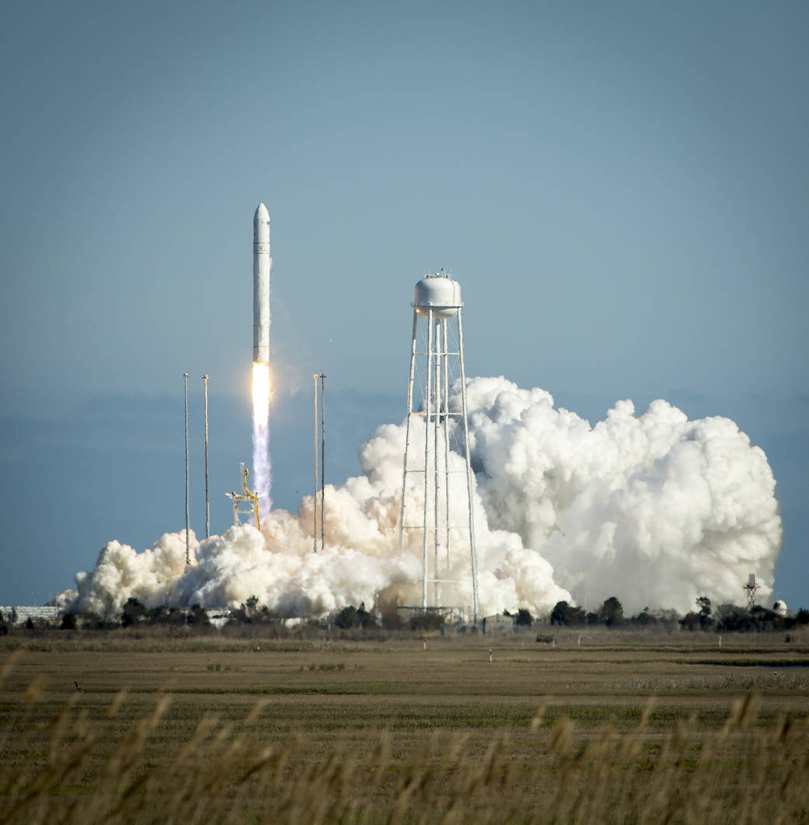
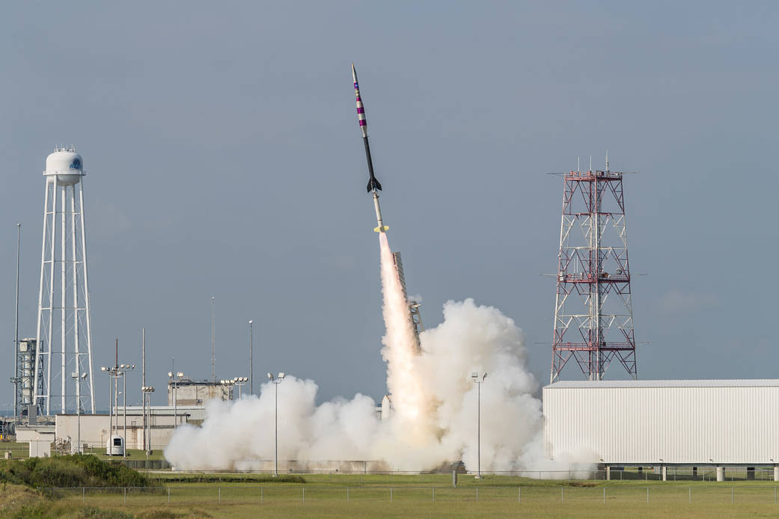
Nitrous Oxide, Oxygen and their Uses as Oxidizers
Marcus Takvam Lexanderª, Sverre Emanuel Dårflot Olsenª
a Institutt for kjemi, Norges teknisk-naturvitenskapelige universitet, 7491 Trondheim.
Nitrous Oxide and elementary Oxygen are both common oxidizers in rocketry. The two are similar in that they have a very low boiling point (cite SI) and they both use oxygen as the oxidiziizisi. Nitrous oxide has the additional benefit of decomposing into its constituent elements, oxygen and nitrogen. This increases the pressure, and as such it does not require a pump or added gas; the pressure from the tank remains somewhat stable.
Oxygen as an oxidizer is useful, as measuring mass flow is simple due to its paramagnetic properties.^{[3]}
Both oxidizers are very powerful. As such, they can use almost anything as fuel. Some common types are polyethylene and hydroxyl-terminated polybutadiene. Some less common and more exotic fuels include salami, as well as most foodstuffs.
Oxygen and Nitrous Oxide are relevant in hybrid and liquid rocket motors. In both cases, the stored liquid turns gaseous upon entering the chamber, where it reacts violently with the fuel grain.
Nitrous Oxide is also useful as a cold gas propellant; as it self stabilizes pressure by decomposing into nitrogen and oxygen, there is less of a pressure drop than if there was no decomposition. This helps greatly in cold gas propulsion.
[5]
[4]
References:
1. Dyer, J., et al., Design and Development of a 100km Nitrous Oxide/Paraffin Hybrid Rocket Vehicle, in 43rd AIAA/ASME/SAE/ASEE Joint Propulsion Conference & Exhibit. 2007, American Institute of Aeronautics and Astronautics.
2. Harvey, K., et al., Fredericksburg High School Aeroscience Program - Nozzle and Fuel Grain Material Study, in 43rd AIAA/ASME/SAE/ASEE Joint Propulsion Conference & Exhibit. 2007, American Institute of Aeronautics and Astronautics.
3. Kovacich, R.P., et al., Highly accurate measurement of oxygen using a paramagnetic gas sensor. Measurement Science and Technology, 2006. 17(6): p. 1579.
4. NASA. 2013.
5. NASA. 2018.
6. Zakirov, V., et al., Nitrous oxide as a rocket propellant. Acta Astronautica, 2001. 48(5-12): p. 353-362.

