Slide 1
Calorimeter Energy Regression
Machine learning architectures for electron energy calibration - Lorenzetti Shower Framework

Slide 2
Model Comparison - Test Set Metrics
model | MSE | RMSE | MAE | R2 | bias_mu | resolution_sigma | n_dropped
ResNet_MLP | 0.6994 | 0.8363 | 0.4732 | 0.9947 | -0.0047 | 0.0267 | 0
MLP_tuned | 0.9789 | 0.9894 | 0.5333 | 0.9926 | 0.0021 | 0.0298 | 0
CNN1D | 4.1694 | 2.0419 | 1.3971 | 0.9687 | 0.0007 | 0.0734 | 0
MLP_deep | 9.8724 | 3.1420 | 2.2709 | 0.9259 | 0.0063 | 0.0905 | 0
GBR | 15.0527 | 3.8798 | 3.0240 | 0.8870 | 0.0105 | 0.1129 | 0
MLP_shallow | 18.3823 | 4.2875 | 3.3379 | 0.8620 | 0.0112 | 0.1243 | 0

Slide 3
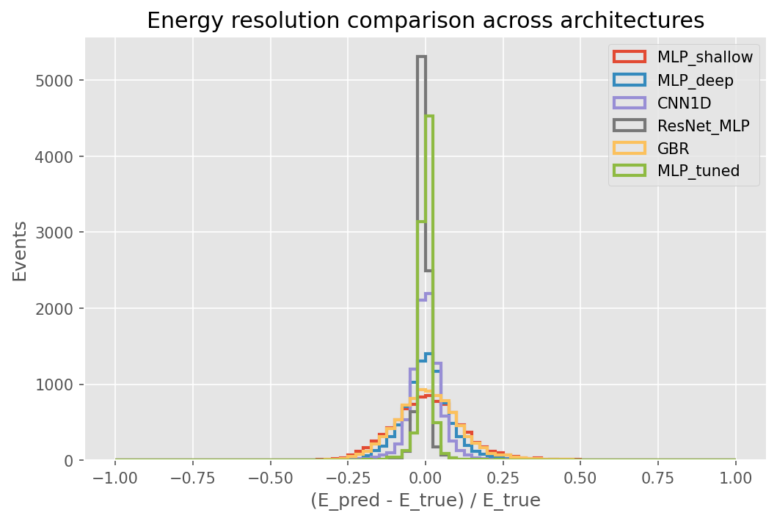
Energy Resolution Comparison

Slide 4
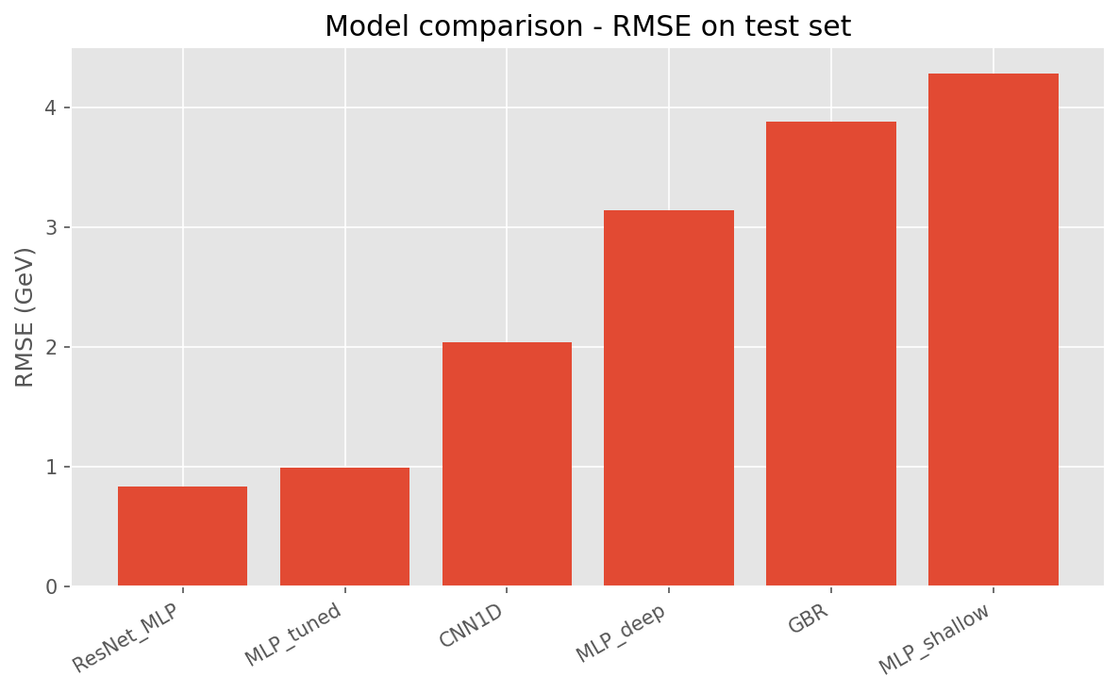
RMSE Comparison Across Architectures

