Slide 1
Problem _____

Slide 2
Solution ___

Slide 3




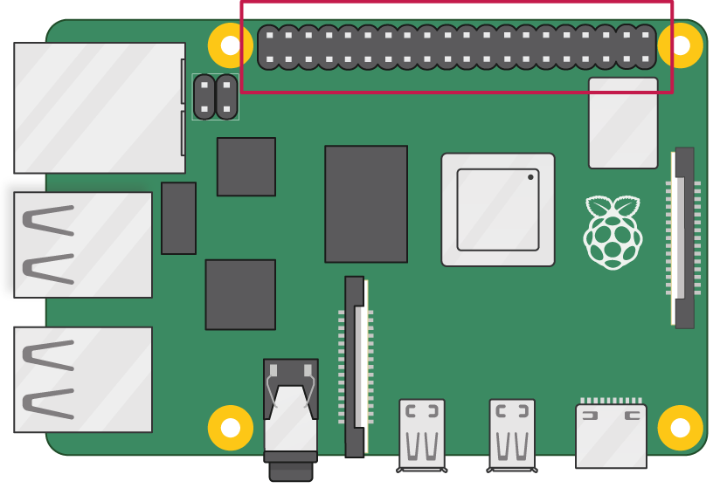




Fleek
PROJECT
LOGO
LEDS
&
RESISTORS
KEEPERS & PRICEFEEDS????? MERGE LOGO& POLYGON&LOGO

Slide 4

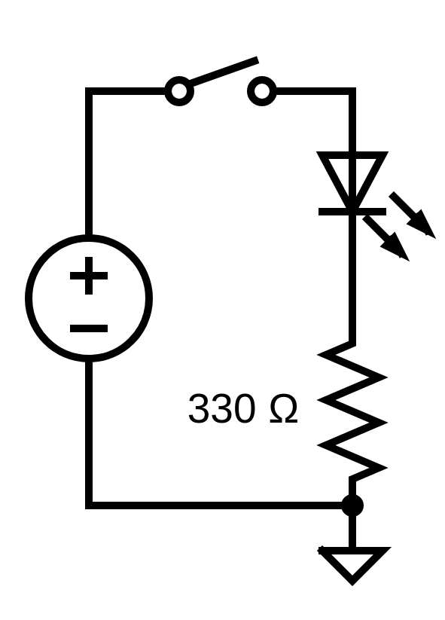
Hardware Wiring
Raspberry Pi 4
GPIO Pinout
LED & Resistors
Pins
LED
13 (GPIO 27)
Red
16 (GPIO 23)
Blue
11 (GPIO 17)
Yellow
15 (GPIO 22)
Green
GPIO
3.3V
LED
Pin 39 (GND)

Slide 5
How hardware reads data WSS Polygon ___

Slide 6
Hardhat [Unit and Integration] ____

