Slide 1

Problem 1: Electric Meters Maintenance
-Utility works need to travel to locations [time waster]
-Then, manually switch power on or off [slow]

Slide 2


Problem 2: Human Error
-Meters can be accidentally switched
[person across from me moved out but my power was cut]

Slide 3
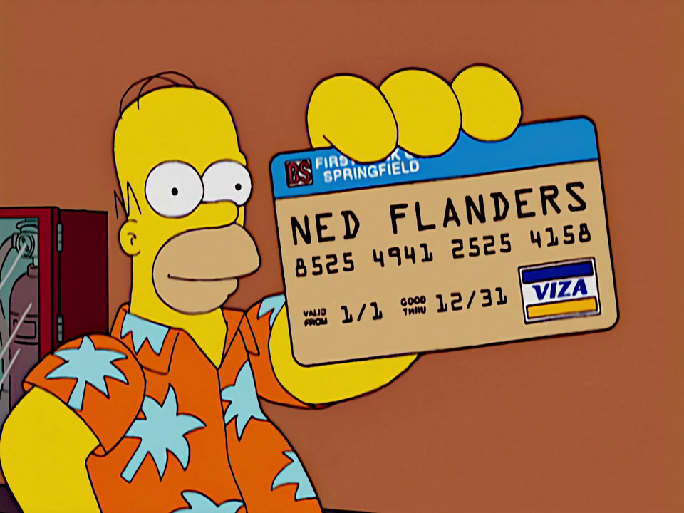
Problem 3: Identity Theft
-People can lie about their identity and renew electric contract under the old electric contract holder’s name

Slide 4

Solution: ElectricKeeper
Automated hybrid smart contract communicating with hardware to turn meters off when subscriptions expire

Slide 5




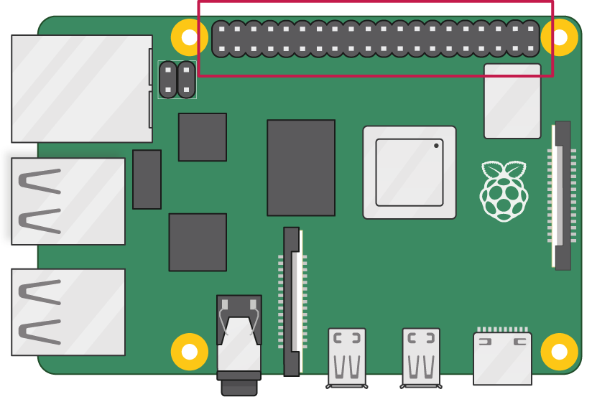


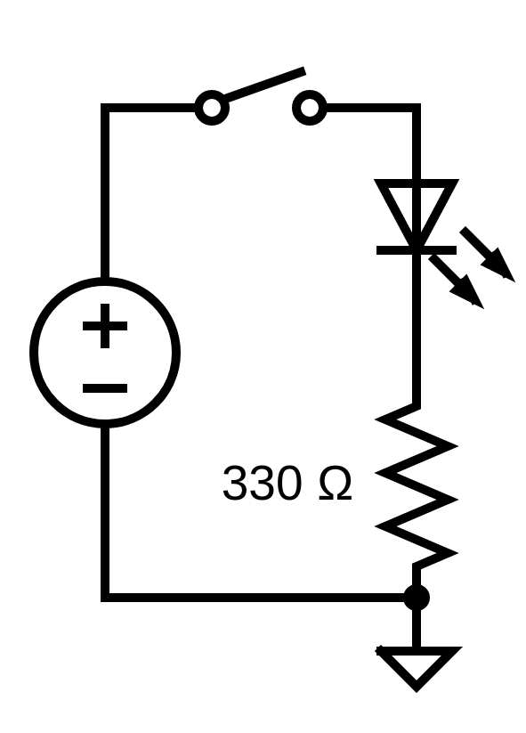



Fleek
ElectricKeeper
GPIO
3.3V
LED
Pin 39 (GND)

Slide 6

Hardware Wiring
Raspberry Pi 4
GPIO Pinout
LED & Resistors
Pins
LED
13 (GPIO 27)
Red
16 (GPIO 23)
Blue
11 (GPIO 17)
Yellow
15 (GPIO 22)
Green
GPIO
3.3V
LED
Pin 39 (GND)

Slide 7
How hardware reads data WSS Polygon
____Marcus___

Slide 8
Flowchart Buy
____Marcus___

Slide 9
Flowchart Turn Off
____Marcus___

Slide 10
Chainlink Pricefeeds to Emulate Stablecoins
____Kieran Matic Pricfeed___

Slide 11
Hardhat [Integration]
____Kieran Matic Pricfeed___

Slide 12
Chainlink Keepers Automate Power Mangement
____Jon test code with no pricefeeds/keepers______

Slide 13
Hardhat [Unit]
____Jon keepers explain______

Slide 14
Message Notificaions Expirations
____Johanna______

Slide 15
Front End Layout?
____Johanna______

