Slide 1
Fair Trade?
“Just trust us.”
$
GOLD
Traditional finance

Slide 2

Cash4Gold: Lowball Offers
“[The offer, ] it’s incredibly low” - Don Palmieri [Gem Certification & Assurance President]
Figure 1: Lowballing 81% under fair value. Counter offer still 61% under value.

Slide 3

Chainlink Gold Price Feed Aggregator
Figure 2: Chainlink Oracles reporting the price of gold together.

Slide 4

Fair trade.
“TRUTH > TRUST”
$
GOLD

Slide 5

Chainlink Price Feed Aggregators
Figure 3: Chainlink Oracles reporting gold, silver and oil prices.

Slide 6

WeiGold
-Commodities vending machine powered by fair Chainlink Price Feed Aggregators.
-Fees are transparent to buyers and are easy to change for contract admins.
-WEI: smallest unit for Ethereum.
-WEIgh: determine object weight or value.

Slide 7













Fleek
Website
SG90 Servos

Slide 8
Hardware+Blockchain
SG90 Servos

Slide 9
Smart Contract Flowchart: Buyer
State=0
Options
Buy Gold
Buy Silver
Buy
Oil
(State&4)==0
AND
(ETH/XAU)*SCALE>0
AND
MSG.VALUE==
(ETH/XAU)*SCALE?
(State&2)==0
AND
(ETH/XAG)*SCALE>0
AND
MSG.VALUE==
(ETH/XAG)*SCALE?
(State&1)==0
AND
(ETH/WTI)*SCALE>0
AND
MSG.VALUE==
(ETH/WTI)*SCALE?
F
F
F
T
T
T
Gold bought.
State=+4.
Emit event for servo.
Silver bought.
State=+2.
Emit event for servo.
Oil bought.
State=+1.
Emit event for servo.

Slide 10
Smart Contract Flowchart: Admin
Options
Change Scale_Fee
Change
State
SCALE_FEE!=VAR
AND
MSG.SENDER==OWNER?
payable(Owner).transfer(address(this).balance)
NewState<8
AND
State!=NewState
AND
MSG.SENDER==OWNER?
F
F
T
T
T
SCALE_FEE=VAR
[SCALE=
(1000+SCALE_FEE)
/1000].
Emit event for FrontEnd.
address(this).balance>0
REFILL ITEMS!
State=NewState
Emit event for servo.
F
Withdraw Ethereum Automatically

Slide 11

Hardware Wiring
Raspberry Pi 4
GPIO Pinout
SG90 Servos
Pins
Buy
13 (GPIO 27)
2 (5V)
30 (GND)
Gold
16 (GPIO 23)
4 (5V)
34 (GND)
Silver
11 (GPIO 17)
1 (3v3)
39 (GND)
Oil

Slide 12
Hardware Control Flowchart
Starting State
Subscribed:
Waiting for Event
Trigger Emission for
Latest State
Node.js: require('web3')
(State&4==0) => Servo3 Close
OR
(State&4==1) => Servo3 Open
(State&2==0) => Servo2 Close
OR
(State&2==1) => Servo2 Open
(State&1==0) => Servo1 Close
OR
(State&1==1) => Servo1 Open
Node.js: require('pi-blaster.js')

Slide 13
FrontEnd+Blockchain
Fleek
Website

Slide 14

IPFS Gateway Outages
Figure 4: Uniswap offering solutions to IPFS gateway outages.

Slide 15
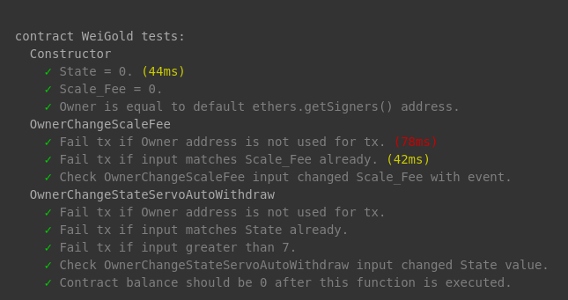
Hardhat + Solidity Coverage Tests
-Solidity Coverage reviews Hardhat tests:
-unit (deterministic)
-integration (external data [contracts and oracles] )
-Deployed to Rinkeby network with Chainlink pricefeeds. Therefore, mock contracts not needed.
________ “Solidity Coverage” Screenshot For Contracts comlpeted ____

Slide 16
References
Figure 1: https://www.youtube.com/watch?v=4eOmDnx_gKw
Figure 2: https://data.chain.link/ethereum/mainnet/commodities/xau-usd
Figure 3: https://data.chain.link/ethereum/mainnet/commodities
Figure 4: https://twitter.com/uniswap/status/1327481767348080641?lang=en
Figure 4: https://betterprogramming.pub/how-to-write-smart-contracts-that-optimize-gas-spent-on-ethereum-30b5e9c5db85
Figure 5: https://ethereum.stackexchange.com/questions/3067/why-does-uint8-cost-more-gas-than-uint256

Slide 17
NOTES:
-5 MINUTE VIDEO MAX
-Video demo after slides or after WeiGold intro?
-CHECK TITLE AND BODY SIZES

