Slide 1
Fair Trade?
“Just trust us.”
$
GOLD
Traditional finance

Slide 2

Cash4Gold: Lowball Offers
“[The offer...] it’s incredibly low” - Don Palmieri [Gem Certification & Assurance President]
Figure 1: Lowballing 81% undervalue. Counter offer still 61% under value.

Slide 3

Chainlink Gold Price Feed Aggregator
Figure 2: Chainlink oracles reporting gold’s price together.

Slide 4

Fair trade.
“TRUTH > TRUST”
$
GOLD

Slide 5

Chainlink Price Feed Aggregators
Figure 3: Chainlink oracles reporting gold, silver and oil prices.

Slide 6

WeiGold
-Commodities vending machine powered by fair Chainlink Price Feed Aggregators.
-Fees are transparent to buyers and are easy to change for contract admins.
-WEI: smallest unit for Ethereum.
-WEIgh: determine object weight or value.

Slide 7






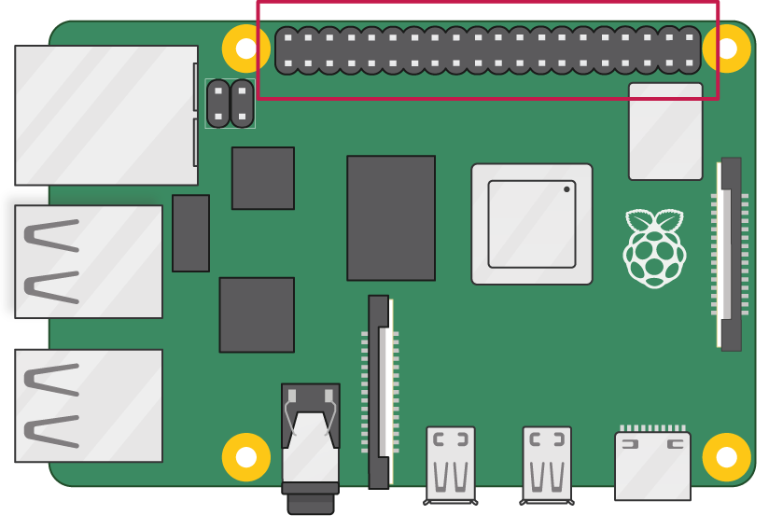






Fleek
Website
SG90 Servos

Slide 8
Hardware+Blockchain
SG90 Servos

Slide 9

Hardware Wiring
Raspberry Pi 4
GPIO Pinout
SG90 Servos
Pins
Buy
13 (GPIO 27)
2 (5V)
30 (GND)
Gold
16 (GPIO 23)
4 (5V)
34 (GND)
Silver
11 (GPIO 17)
1 (3v3)
39 (GND)
Oil

Slide 10
Hardware Control Flowchart
Starting State
Subscribed:
Waiting for Event
Trigger Emission for
Latest State
Node.js: require('web3')
(State&4==0) => Servo3 Close
OR
(State&4==1) => Servo3 Open
(State&2==0) => Servo2 Close
OR
(State&2==1) => Servo2 Open
(State&1==0) => Servo1 Close
OR
(State&1==1) => Servo1 Open
Node.js: require('pi-blaster.js')

Slide 11
Gas Optimization
Figure 4: EVM opcodes for smart contract logic. Red: expensive. Green: cheap.

Slide 12
Opcode Optimization
uint ScaleFee_State (256 bits)
(253 bits) 000 (last 3 bits)
Price = (1000+ScaleFee)/1000 State: [Gold sold? Silver old? Oil sold?]
Opcode bitwise operations [SHR + AND]:
ScaleFee = (ScaleFee_State>>3) [Shift 3 bits]
State = (ScaleFee_State&7) [AND Mask to look at first 3 bits]
Example set [SHL + ADD]:
ScaleFee = 1000 => Binary(1111101000<<3) = Binary(1111101000000)= 8000
State = 7
ScaleFee_State = 8000 + 7 = 8007 (Binary: 1111101000111)
Example restore [SHR + AND]:
ScaleFee_State = 8007 (Binary: 1111101000111)
ScaleFee = Binary(1111101000111>>3) = Binary(1111101000) = 1000
State = Binary(1111101000111&7) = Binary(111) = 7

Slide 13
State = 0
Buy
Gold
Silver
Oil
(ScaleFee_State&4)==0
AND
MSG.VALUE==
(ETH/XAU)*((1000+
(ScaleFee_State>>3))/
1000)?
(ScaleFee_State&2)==0
AND
MSG.VALUE==
(ETH/XAG)*((1000+
(ScaleFee_State>>3))/
1000)?
(ScaleFee_State&1)==0
AND
MSG.VALUE==
(ETH/WTI)*((1000+
(ScaleFee_State>>3))/
1000)?
F
F
F
T
T
T
Gold bought.
ScaleFee_State=+4.
Emit event for
servo and FrontEnd.
Silver bought.
ScaleFee_State=+2.
Emit event for
servo and FrontEnd.
Oil bought.
ScaleFee_State=+1.
Emit event for
servo and FrontEnd.

Slide 14
MSG.SENDER
==
OWNER?
F
Change State
T
Withdraw
Change Scale_Fee
Scale_Fee
!=
update_Scale_Fee?
update_State<8
AND
State != update_State?
address(this).balance>0?
F
F
F
T
T
T
ScaleFee_State =
(update_Scale_Fee<<3) +
(ScaleFee_State&7)
Emit event for
servo and FrontEnd.
ScaleFee_State =
((ScaleFee_State>>3)<<3) +
update_State
Emit event for
servo and FrontEnd.
payable(Owner).transfer(address(this).balance)
Not critical to servo or Buy logic.
Do not emit event to save gas.

Slide 15


Hardhat Smart Contract Tests
+

Slide 16

Integration Tests
-External data [contracts and oracles]
-WeiGold has had its pricefeed contract address functions tested successfully

Slide 17


Unit Tests: Hardhat + Solidity Coverage
-Tests based on logic flowchart to prevent bugs [not vulnerabilities, which are subtle]

Slide 18
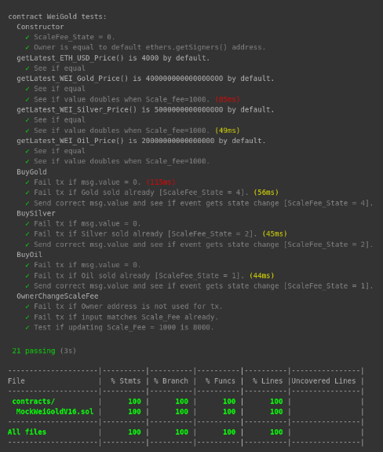
Mock Tests: Hardhat + Solidity Coverage
-Emulates oracle based logic (useful for improving Solidity Coverage tests)

Slide 19
FrontEnd+Blockchain
Fleek
Website

Slide 20

IPFS Gateway Outages
Figure 5: Uniswap offering solutions to IPFS gateway outages.

Slide 21
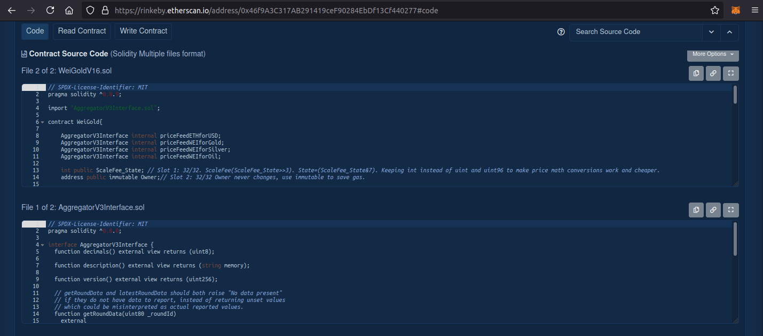
Etherscan Published Source Code

Slide 22
References
Figure 1: https://www.youtube.com/watch?v=4eOmDnx_gKw
Figure 2: https://data.chain.link/ethereum/mainnet/commodities/xau-usd
Figure 3: https://data.chain.link/ethereum/mainnet/commodities
Figure 4: https://github.com/crytic/evm-opcodes
Figure 5: https://twitter.com/uniswap/status/1327481767348080641?lang=en

