Slide 1
Fair Trade?
SAY: “Are you really getting the best price for what you want to buy? Who do you know to trust?”
Traditional finance
$
GOLD
“Just trust us.”

Slide 2

Cash4Gold: Lowball Offers
“[The offer,] it’s incredibly low” - Don Palmieri [Gem Certification & Assurance President]
Figure 1: Lowballing 81% under fair value. Counter offer still 61% under value.

Slide 3

Chainlink Price Feed Aggregators
Figure 2: Chainlink Oracles reporting the price of gold together.

Slide 4

Fair trade.
$
GOLD
“TRUTH > TRUST”

Slide 5

WeiGold
-Commodities vending machine with fair value prices via Chainlink Price Feed Aggregators.
-Wei: smallest unit for Ethereum
-Weigh: weighing objects in weight or value

Slide 6
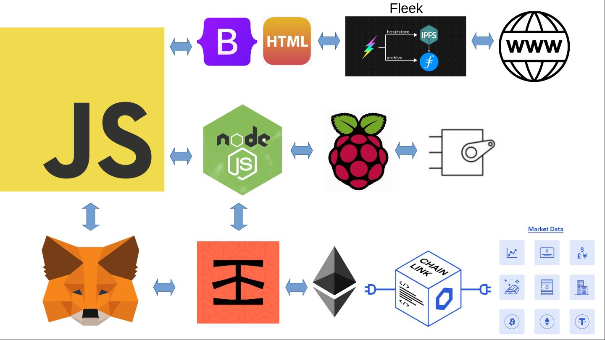
OVERVIEW DIAGRAM [Javascript critical]

Slide 7
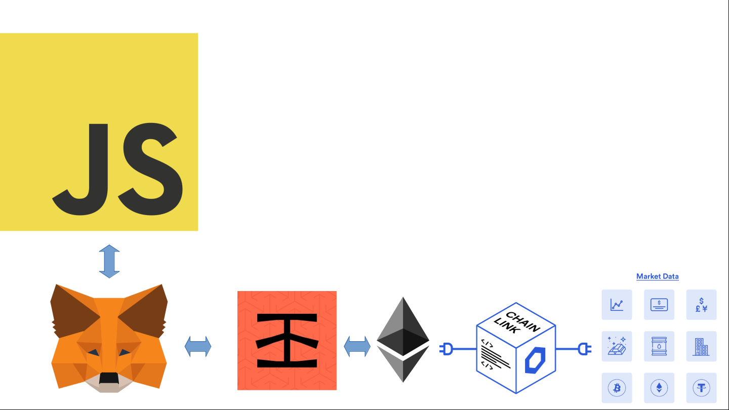
BLOCKCHAIN DIAGRAM

Slide 8
FLOWCHART: CONTRACT SMART CONTRACT - BUYER
State=0
Options
Buy Gold
Buy
Oil
Buy Silver
(State&4)==0
AND
MSG.VALUE ==
(ETH/XAU)*SCALE?
(State&2)==0
AND
MSG.VALUE ==
(ETH/XAG)*SCALE?
(State&1)==0
AND
MSG.VALUE ==
(ETH/WTI)*SCALE?
N
N
N
Y
Y
Y
Gold bought.
State=+4.
Emit event for servo.
Silver bought.
State=+2.
Emit event for servo.
Oil bought.
State=+1.
Emit event for servo.

Slide 9
FLOWCHART: SMART CONTRACT – OWNER
Options
Change Scale Fee
Change
State
SCALE_FEE!=VAR
AND
MSG.SENDER==OWNER?
payable(Owner).transfer(address(this).balance);
NewState<8
AND
State!=NewState
AND
MSG.SENDER==OWNER?
N
N
Y
Y
Y
SCALE_FEE=VAR
[SCALE=
(1000+SCALE_FEE)
/1000].
Emit event for frontend.
address(this).balance>0
AND
MSG.SENDER==OWNER?
REFILL ITEMS!
Then:
State=NewState
Emit event for servo.
Withdraw Ethereum Automatically
N

Slide 10

HARDWARE DIAGRAM ___[piblaster library]__

Slide 11


Hardware Wiring
Raspberry Pi 4
GPIO Pinout
SG90 Servos
Pins
Buy
13 (GPIO 27)
2 (5V)
30 (GND)
Gold
16 (GPIO 23)
4 (5V)
34 (GND)
Silver
11 (GPIO 17)
1 (3v3)
39 (GND)
Oil

Slide 12
FLOWCHART: WEB3.JS+SERVO CONTROL [piblaster library]
Starting State
Wait for Event Trigger Emission
(State&4==0) => Servo3 Close
OR
(State&4==1) => Servo3 Open
(State&2==0) => Servo2 Close
OR
(State&2==1) => Servo2 Open
(State&1==0) => Servo1 Close
OR
(State&1==1) => Servo1 Open

Slide 13
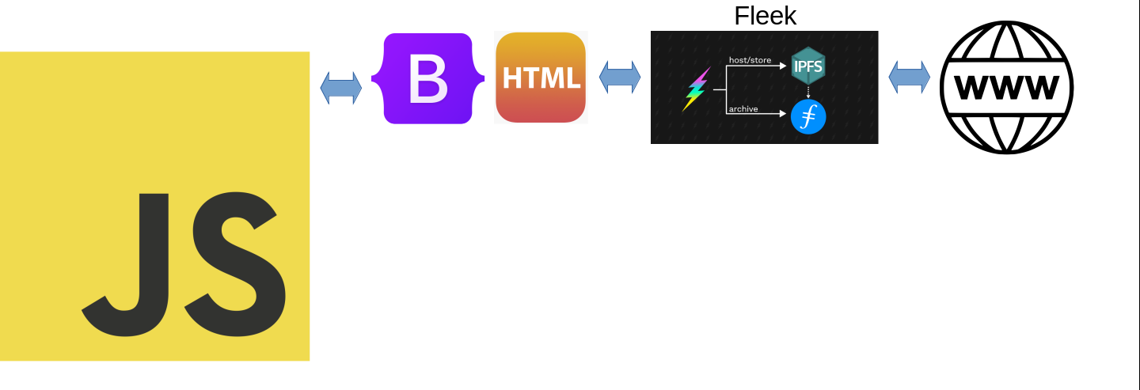
FRONT END – IPFS/FILECOIN with Fleek

Slide 14

FRONT END – CLOUDFARE IPFS GATEWAY OUTAGE UNISWAP
Figure 3: Uniswap offering solutions to IPFS gateway outages.

Slide 15
PROGRAMMING – HARDHAT TESTING
__PHOTO_TEST_RESULTS_CONTRACT__

Slide 16
References
Figure 1: https://www.youtube.com/watch?v=4eOmDnx_gKw
Figure 2: https://data.chain.link/ethereum/mainnet/commodities/xau-usd
Figure 3: https://twitter.com/uniswap/status/1327481767348080641?lang=en
Figure 4: https://betterprogramming.pub/how-to-write-smart-contracts-that-optimize-gas-spent-on-ethereum-30b5e9c5db85
Figure 5: https://ethereum.stackexchange.com/questions/3067/why-does-uint8-cost-more-gas-than-uint256

Slide 17
NOTES:
-5 MINUTE VIDEO MAX
-CHECK TITLE AND BODY SIZES

Slide 18


[CUT IF LOW ON TIME RECORD]PROGRAMMING – Solidity gas optimization uint256 native data type less gas not setting it to 0 too __
Figure 5: ___
Figure 4: uint256 is the __

Slide 19









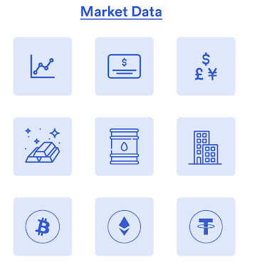


COPY RAW
Fleek

