Slide 1

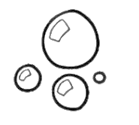

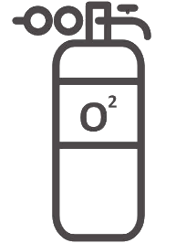



Intelligent Fish Tank
Temperature Detection
Temperature sensor & heating rods
Set suitable temperature range
Alarm when too high or low
Water Quality Detection
Water quality detector
Filter system to reduce the impurity
Oxygen Detection
Oxygen sensor & air pump
Set oxygen threshold
Flow Control
Simulate natural environment
Easy for fish to eat
Auto Feeder
Regular feeding time
Adjustable amount of food
Brilliant Lights
Different styles to choose
Promote the growth of plants
Team 36 Xintong Lin, Chaoyi Yang, Haoshi Huang

