Slide 1
PowerShell testing with Pester
Not just unit testing!

Slide 2
Here’s me testing before Pester
function Expect($value, $expected, $description){
if ($value -eq $expected){
#we're ok
write-host "$description - PASSED" -BackgroundColor DarkGreen -ForegroundColor white
} else {
write-host "$description - FAILED (Expected: $expected, Actual: $value)" -BackgroundColor red -fore White
}
}

Slide 3
Test what?
Unit testing
Integration Testing
System Testing
Infrastructure Testing

Slide 4
What is Pester
Testing framework (not just unit testing)
Open Source
Works with 2.0 and above
Ships with 5.0!!!!
This was the first open source shipped as part of a Microsoft product
Currently on Version 3.x
4.x has some new stuff. ☺

Slide 5
What does a Pester test look like
It’s just PowerShell script (a DSL for a test)
Describe ‘what am I testing’ {
Context ‘what is the setting’{
it ‘does something’ {
$result=<perform an operation>
$result | Should Be Like ‘*result*’
}
it ‘blows up of you pass a zero’ {
{<perform an operation> -parm 0} | should throw “an error”
}
}
}

Slide 6
Pester “assertions”
Should / Should Not
Be
BeExactly
BeGreaterThan/BeLessThan
BeLike/BeLikeExactly
BeOfType
Exist (filename on pipeline)
Contain/ContainExactly (filename on pipeline)
Match/MatchExactly
Throw
BeNullOrEmpty

Slide 7
Getting results
Run the script!
Invoke-Pester –path <script>
Why two ways?
-passthru on Invoke-Pester returns objects (duh!) describing the results.
Useful in build process/continuous integration

Slide 8
Seems pretty easy…what else is there? BeforeEach and AfterEach blocks
Can be defined in Describe or Context blocks
Run before/after each “It” block
Before blocks in Describe are run before Before blocks in Context
After blocks in Describe are run after After blocks in Context
<Describe-before>
<Context-before>
It
<Context-after>
<Describe-after>

Slide 9
InModuleScope!
Allows you to test internals of module (i.e. things that aren’t exported)
Import-Module AModule
InModuleScope Amodule {
Describe ‘Something internal’ {
it ‘has a module-level variable’{
$hiddenVariable | Should Not BeNullOrEmpty
} }
}

Slide 10
The TestDrive!
A PSDrive defined by Pester to isolate the filesystem
Random folder name inside $env:Temp
Testdrive:\SomeFile.txt
$testDrive is the full path
in case you have to compare paths or use .NET methods

Slide 11
Mocking intro
Mocking is the act of creating a substitute function in place of an existing function in order to remove an external dependency.
For example, consider testing this function:
Function Get-CurrentDayOfWeek{
(get-date).DayOfWeek
}
Since you don’t know what day you’re going to test it on, you need to “mock” the get-date (or, provide a mock for get-date…I’ve heard it both ways).

Slide 12
Mocking continued
Describe ‘My dayofweek function’{
context ‘On Tuesday, 8/1/2017’ {
Mock Get-date {return [datetime]’8/1/2017’}
it ‘Outputs Tuesday on 8/1/2017’{
get-currentdayofweek | should be Tuesday
}
}
context 'On Wednesday 8/2/2017' {
Mock Get-date {return [datetime]’8/2/2017’}
it ‘Outputs Wednesday on 8/2/2017’{
get-currentdayofweek | should be Wednesday
}
}
}

Slide 13
Mocking continued again
You can have multiple mocks of the same function using ParameterFilters
Mock Get-ChildItem { return @{FullName = "B_File.TXT"} } -ParameterFilter { $Path -eq "$env:temp\me" }
Mock Get-ChildItem { return @{FullName = "A_File.TXT"} }
If none of the parameter filters match the passed parameters, the original function is used

Slide 14
What else could you mock?
Reading a file (cert, registry key)?
Getting a directory listing?
Results from a database
Website contents
Restarting a computer
Joining a domain (or unjoining)

Slide 15
Checking Mocks
Sometimes, you want to make sure that your mocks are called. To do that, you need “Assert-MockCalled”
Assert-MockCalled Get-Date
There are options to say
how many times (exactly or at least)
what scope (It, Describe, or Context)
What parameters (parameterfilter)

Slide 16
Verifiable Mocks
Mocks can be specified with the –Verifiable switch.
The Assert-VerifiableMocks checks to see if every mock with the –Verifiable switch specified has been called.
If not, it throws an exception (which Pester catches)

Slide 17
Code Coverage
With the –CodeCoverage parameter, you can have Pester generate code coverage statistics for your tests.
You can…
pass a filename which is analyzed
Pass a filename and a function name
Pass start/end line numbers
Note: coverage is based on the structure of the AST, and only includes places in the script where you can create breakpoints.

Slide 18
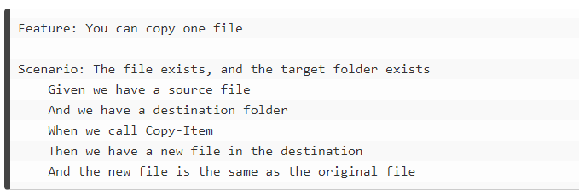
Coming in Pester 4.0 - Gherkin!
Very different looking
Splits tests into specifications (*.feature) and steps (*.steps.ps1)
Feature files are something like English (stolen from Kevin Marqette):

Slide 19
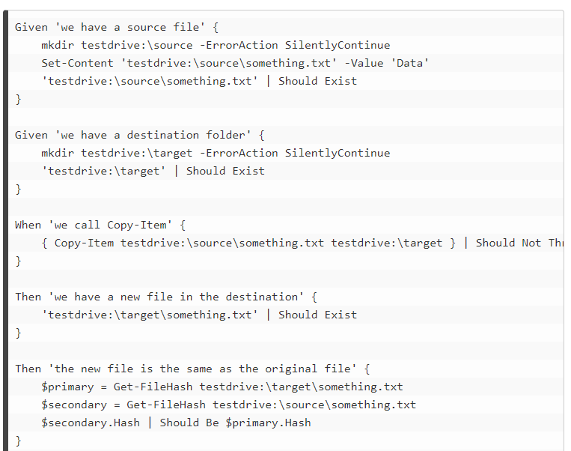
Gherkin – Part 2
Step file – DSL in PowerShell for actual test

Slide 20
OVF – Operation Validation Framework
Ships with Server 2016, PowerShell 5 (5.1?)
Framework wrapping Pester
Module-based
In module path, Diagnostics/Simple and Diagnostics/Comprehensive folders
In those folders, Pester tests (of the module)
Invoke-OperationValidation –ModuleName <module> -TestType <simple|comprehensive>
Runs the appropriate Pester tests.
I’m excited about OVF -

Slide 21
Watchmen
“Wraps” OVF tests
Provides notifications, actions, etc. for failed tests

Slide 22
PoshSpec
DSL for infrastructure testing
Based in Pester, but the pattern is slightly different (notice, no It {}
Lots of infrastructure-specific test types.
Example, from the wiki:
Describe 'Services' {
Service w32time Status { Should Be Running }
Service bits Status { Should Be Stopped }
}
Describe 'Files' {
File C:\inetpub\wwwroot\iisstart.htm { Should Exist }
File C:\inetpub\wwwroot\iisstart.htm { Should Contain 'text-align:center' }
}
Describe 'Registry' {
Registry HKLM:\SOFTWARE\Microsoft\Rpc\ClientProtocols { Should Exist }
Registry HKLM:\SYSTEM\CurrentControlSet\Services\Tcpip\Parameters\ "SyncDomainWithMembership" { Should Be 1 }
Registry 'HKLM:\SOFTWARE\Callahan Auto\' { Should Not Exist }
}

Slide 23
Other projects
Remotely – run pester tests remotely
Format-Pester – output to Pscribo
PSHealthz – Http listener which executes OVF Tests and returns results (REST)

Slide 24
Resources
Pester on GitHub
https://github.com/pester (duh!)
Gherkin examples
https://kevinmarquette.github.io/2017-03-17-Powershell-Gherkin-specification-validation/
https://kevinmarquette.github.io/2017-04-30-Powershell-Gherkin-advanced-features/
PoshSpec – https://github.com/Ticketmaster/poshspec
Watchmen - https://github.com/devblackops/watchmen
PSHealthz - https://github.com/devblackops/pshealthz

