Slide 1
Getting Started with Git
Command-line version control for everyone
Mike Shepard
mshepard70@gmail.com
www.powershellstation.com
@MikeShepard70

Slide 2
What is git?
Git is an open-source distributed source control solution.
https://github.com/git/git
Download here:
https://git-scm.com/downloads
Runs on just about anything

Slide 3
What is source control?
A source control (or version control) system
Records changes to files over time
Allows you to restore to a previous point
Allows you to compare versions/history of a file

Slide 4
What about distributed?
There are 2 kinds of source control solutions
Centralized (client-server)
State is stored in a central location
Users have copies, but changes must be “checked in” to central solution
Working offline is possible, but difficult
Examples: TFS (traditional), SCM, VCS
Distributed
Everyone has the entire solution
Every copy is a full copy
Easy to work offline
Fun comes with merging changes between repositories
Examples: Git, Mercurial

Slide 5
First Step with Git
After installing, create a new directory and open a console (cmd or PowerShell) in that directory.
Type ‘git init’ without the quotes to tell git that you want to track changes in this folder.
Git tells you that it has initialized an empty Git repository in the folder.
It also created a (hidden) subfolder called .git
All of the tracking goes in this folder
Git doesn’t “fiddle” with your files at all (other than putting things in the .git folder)

Slide 6
Identifying yourself
If you’ve never used git before (on this machine), you need to tell git who you are
git config --global user.name "Your Name“
git config --global user.email "your_email@whatever.com"

Slide 7
Staging files
Files whose state you want to save must be added to the staging area.
To stage files, use the ‘git add’ command.
To stage all modified files in the folder, use ‘git add –A’
To stage a specific file, use ‘git add filename’
For instance,
Dir | out-file Files.Txt
Now, git add Files.Txt (note, this is case-sensitive)

Slide 8
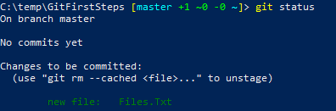
What’s going on in my repo?
A repository (or repo) is what you call a folder that git is tracking.
To see the state of a repo, use ‘git status’
Here’s what our status looks like right now:

Slide 9
Wait…we’re on a branch?
In git, you are always on a branch.
The “main” branch is called master.
We’ll talk more about branches later.

Slide 10

How do we save the file(s) we have staged?
Saving the state of all of the staged files is called a commit.
To commit, use the git commit command
You need to include a comment to tell what you committed.
It looks like this:
git commit –m ‘initial copy of files’

Slide 11
Wait a minute…what’s that stuff in your prompt?
A PowerShell module called posh-git
Install-module posh-git (as administrator)
Install-module posh-git –Scope CurrentUser
Then, add “import-module posh-git” to one of your profile scripts.
Adds a “git status” indicator in the prompt (shows branch and status)
Also adds tab-completion for common git commands (including branch names)

Slide 12
Add some more content and another commit
Dir | out-file Files.Txt –Append
Git add Files.Txt
Git commit –m ‘Some more content’
Now, let’s run a tool called “gitk” that is part of the git toolkit

Slide 13
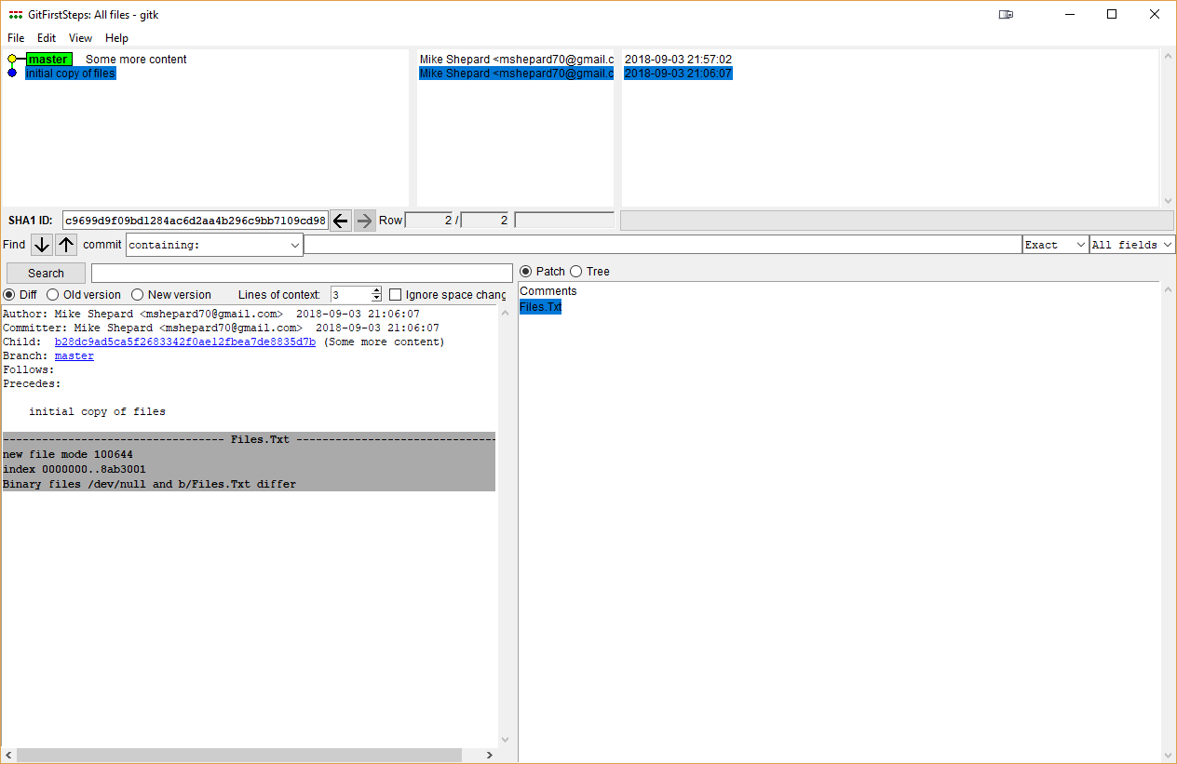
Gitk
Shows tree of commits
(and branches)
And more info (which I
haven’t figured out)

Slide 14
Let’s work in a branch!
A branch is a path or line of development.
Development (changes) on a branch are separate from changes on other branches
To create a branch, use the git branch command
git branch FirstBranch
(look at it in gitk)
At this point, master and FirstBranch are the same
We created the branch, but we haven’t switched to it.
Use the git checkout command to switch to a branch
git checkout FirstBranch
You can create and checkout at the same time using
git checkout –b AnotherBranch (but let’s stay on FirstBranch)

Slide 15
Committing on a branch
Get-Service | out-file Services.Txt
git add –A #remember, this adds anything that has changed)
git commit –m ‘added services’
(look at it in gitk)
Notice that FirstBranch is “ahead” of master.

Slide 16
Merging changes back to master
Once we’ve decided our branch is good, we can “merge” the changes back to the master branch
We need to switch back to master
git checkout master
git merge FirstBranch
This merge will succeed automatically (because the changes were simple, and master hadn’t changed).
If the branch and master both had changes to the same file since their branching point, it would be a “merge conflict”.
Not going to talk about fixing these (we can if you really want to, though).

Slide 17
Now we’ve merged the branch, what do we do?
I would delete the branch.
git branch –d FirstBranch

Slide 18
What about github?
Good point.
This has all been about working with changes locally.
The good thing is that you will make your changes locally even when you’re using github.
Instead of using “git init” to create an empty repo, you use the “git clone” command to copy a repo from a URL.
For instance, git clone https://github.com/MikeShepard/GitPresentation

Slide 19
The “GitPresentation” Repo
To create this repo, I uploaded the files that we’ve created so far.
In Github, I can see the history of the repo as well as look at the files at any state.
(demo)
(btw, GitHub is free for public repos. If you want a private repo, you can pay $7/month for unlimited private repos)

Slide 20
Working with the local copy
If we look at the local copy (clone), we can see all of the same things.
(gitk/git-gui)
Let’s create a branch
Git checkout –b SecondBranch
Get-process | out-file Processes.Txt
Git add –A
Git commit –m ‘added processes’

Slide 21
What if I forgot to checkout the branch and made some changes in master?
This is something that happens to me all the time.
Simple to fix.
First, stage your changes
Then, use the git stash command to store them somewhere safe!
Git stash # include –u to include untracked files (created but not ever committed)
Now, you can use git status to look at the repo…it should be “clean”
Git checkout <branch>
Git stash pop
The changes you accidentally made in master will now be in the branch

Slide 22
Now that we have a local commit on a branch, how do we get that up to GitHub?
First, to be clear, we could stay on master and use git push to push the changes up to master.
That is considered “bad form”…
Since everyone working on this repo is sharing, everyone should work on a branch (or multiple branches)
This allows you to push your code up without merging it with other people’s code (for long-running branches, for instance)
To push a branch up to github, there are 2 options
1. If you created the branch locally, git push –u origin <BranchName>
2. If the branch already existed in the repo, git push

Slide 23
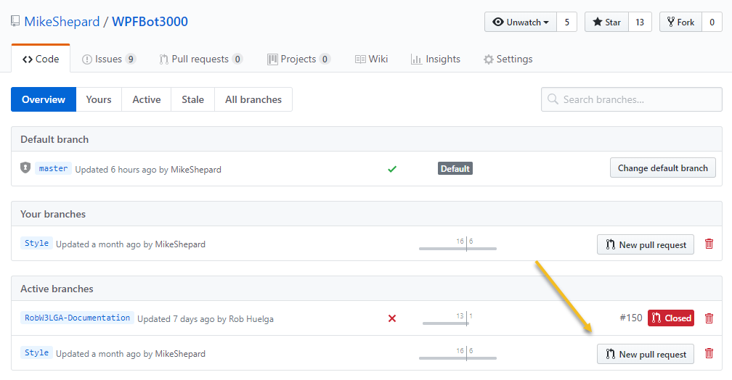
Ok…the changes are on github, but how do they get into master
This is the magical “pull request”.
To create a pull request, you need to have pushed a branch to github
Then, you can click on the
Branch and select
“New pull request”

Slide 24
Pull Request
The name might seem backwards (since you’re wanting to push your changes)
Think of it from the repo’s standpoint.
You’re requesting that the repo pull the changes in this branch into master.
We’ll work through this as a project…

Slide 25
Sideline – My git process
I use github to house my code
Git clone <url> #makes a local copy of a repo
Git checkout –b <branchname> #sets me up developing on a local branch
Git add –A #stages all changed files for a commit
Git commit –m ‘<commit message>’ # commits all staged changes
Git push –u origin <branchname> #pushes all committed changes to remote branch
------perform pull request on github…no command-line built in for that----
Git checkout master #switches me back to local master branch
Git pull # pull changes down from Github
Git branch –d <branchname> #deletes my local copy of the branch
Git checkout –b <newbranch> #starts the process over
Use git stash / git stash pop when I need to clean up changes on wrong branch

